Slide 1
The Highway Transportation System
Notes:
HTS are part of the National transportation system. Every public road that we drive on is part of the HTS.

Slide 2
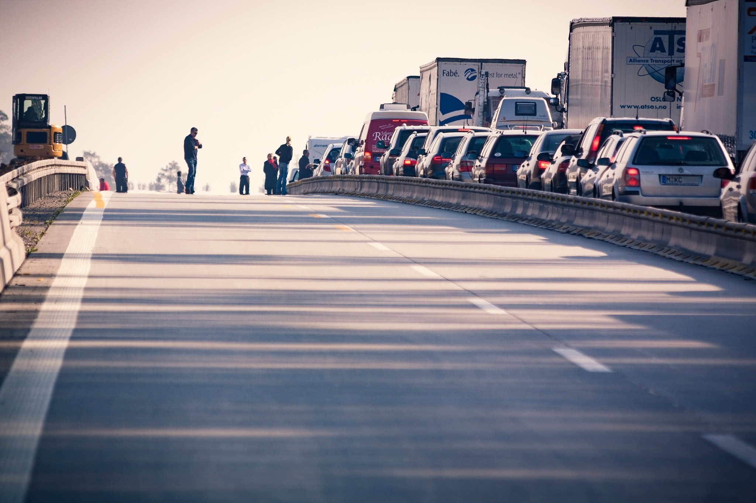
Purpose of the Highway Transportation System (HTS)
Safe and efficient movement of people and goods from one place to another
Notes:
The purpose of the HTS is to move people and goods safely and efficiently from one place to another.

Slide 3
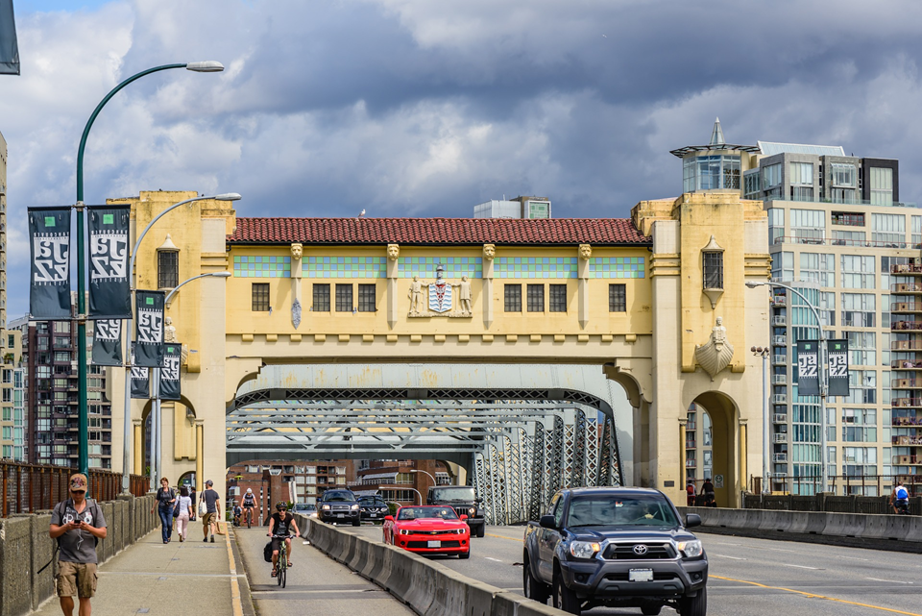
3 parts to the HTS
- People
- Vehicles
- Roadways

Slide 4
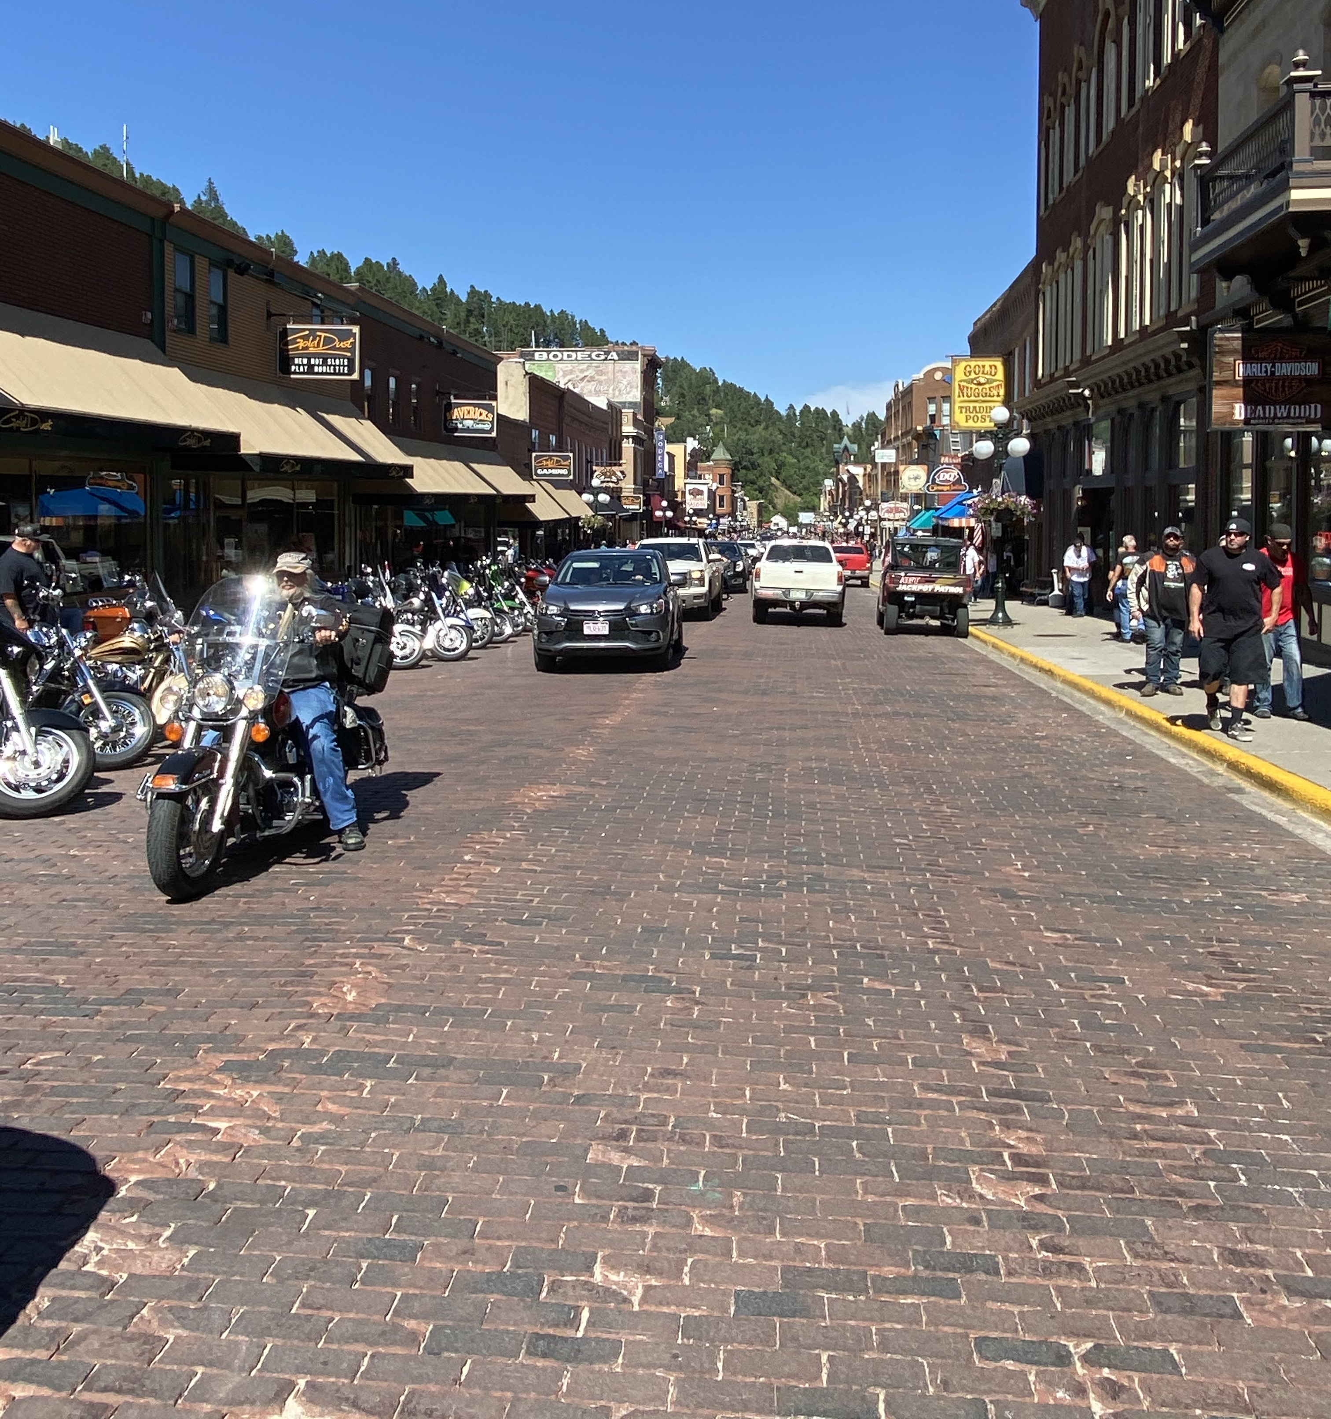
1. People
People use the HTS
by walking, driving,
or riding
Some of these fit into the
category of Vulnerable
Roadway Users

Slide 5
Vulnerable Roadway Users
A Vulnerable Roadway User is anyone who is on or alongside the roadway without the protective covering of an automobile.
Notes:
Oregon’s Vulnerable Roadway User* Law is not a stand-alone law. It is an enhanced penalty that can be levied when a driver violates Oregon’s Careless Driving law and in doing so causes physical injury to, or the death of, a vulnerable roadway user. V.U.E stands for Vulnerable Users are Everywhere, Oregon’s Info Campaign

Slide 6
Vulnerable Roadway Users
Pedestrians
Highway Workers
Animal Riders
Farm Tractors
Skateboarders
Roller Skaters
In-Line Skaters
Scooter Riders
Bicycle Riders
Moped Riders
Motorcyclists
Wheelchair Users

Slide 7
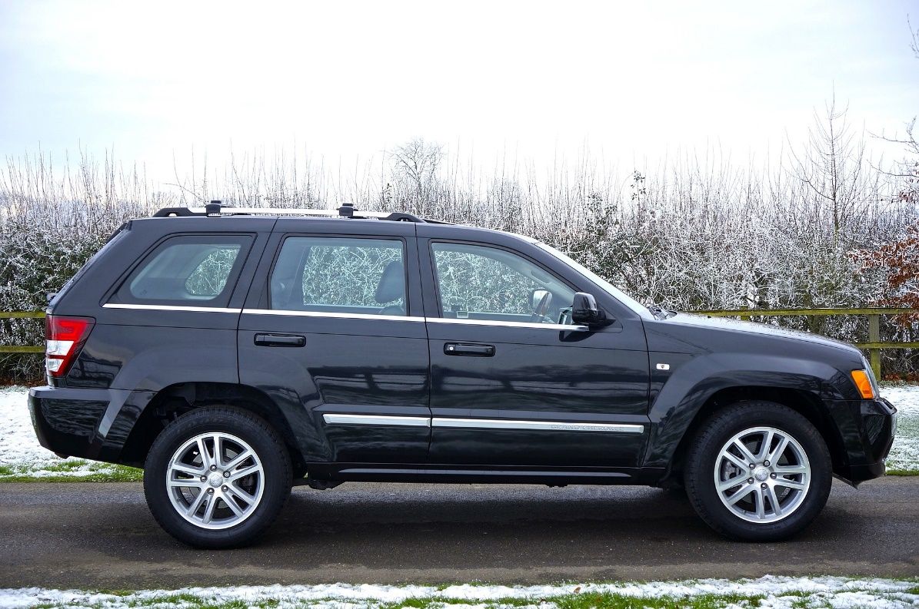
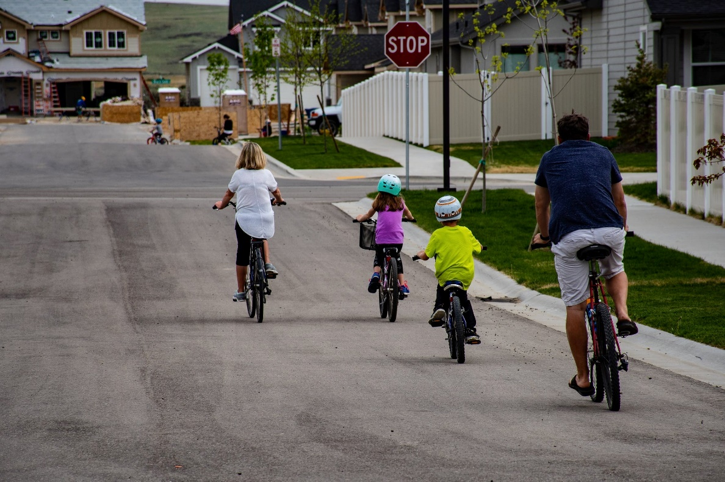
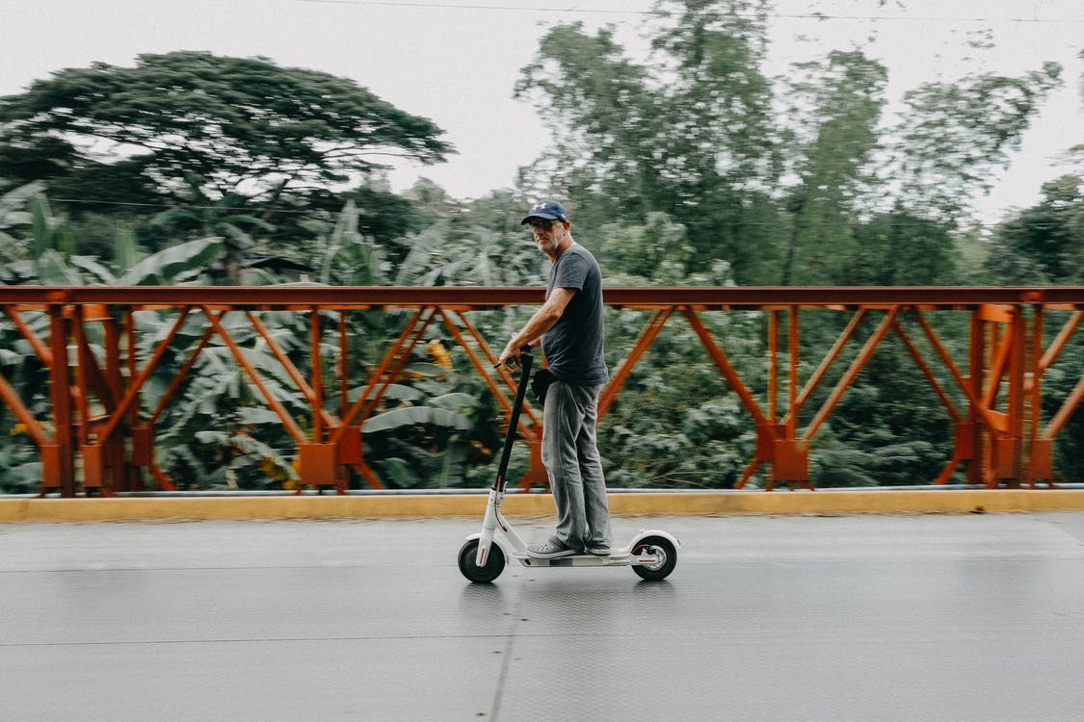
2. Vehicles
A vehicle is any device that is propelled by any means upon a public highway
Notes:
Vehicle
A “vehicle” is defined as any device in, upon or by which any person or property is or may be transported or drawn upon a public highway and includes vehicles that are propelled or powered by any means. (ORS 801.590)
Vehicles vary from mopeds to tractor-trailer rigs. Also, could be horses, manual scooters, and skateboards.

Slide 8
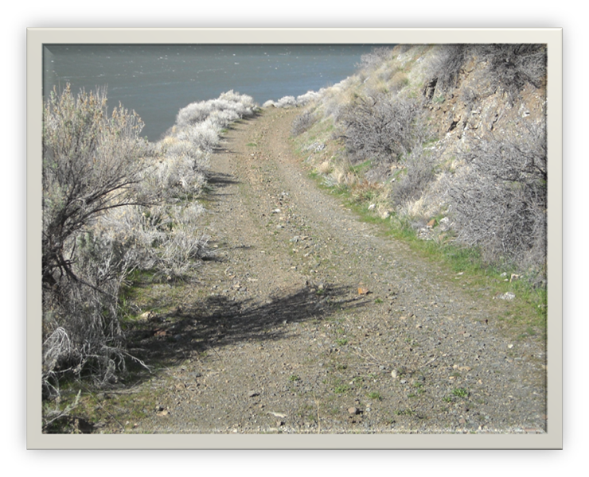
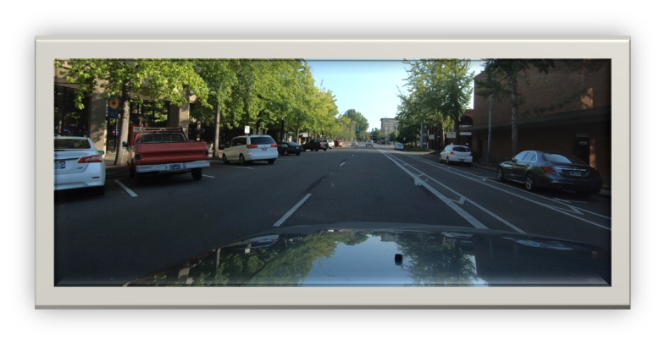
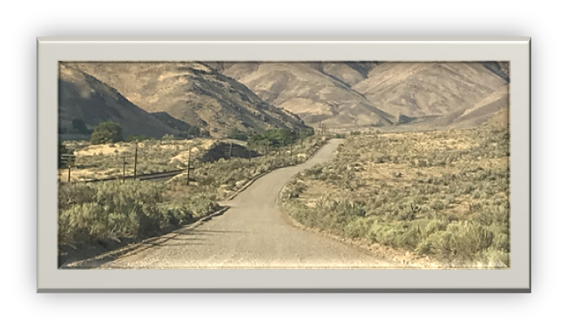
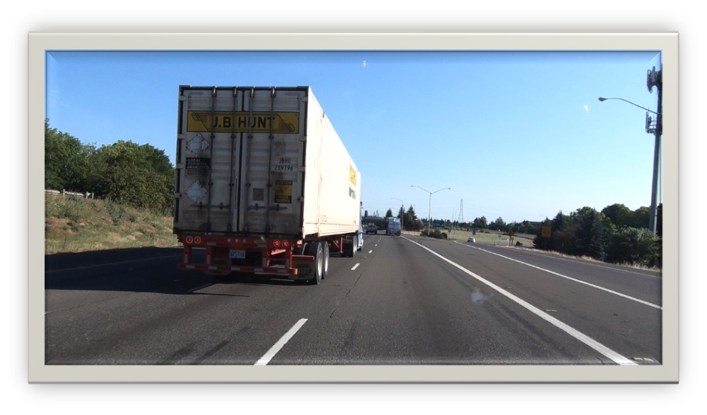
3. Roadways
The places designated for vehicle travel
Notes:
Roadways vary from dirt lanes to complex multilane highways

Slide 9
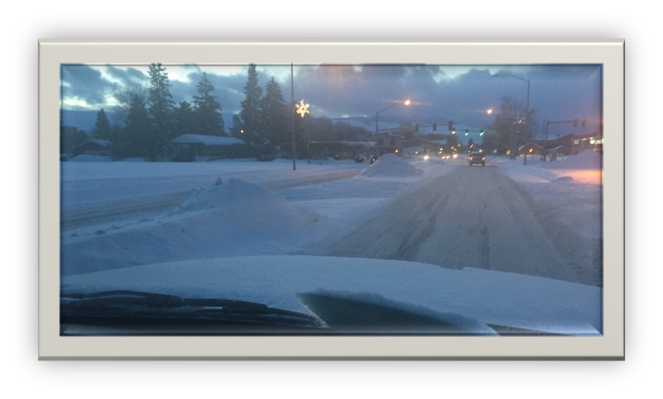
The environment is the surrounding area and neighborhoods we drive in
Environments have many components:
Roadway
Weather
Pedestrians
Other Vehicles
Vision restrictions
Path restrictions

Slide 10
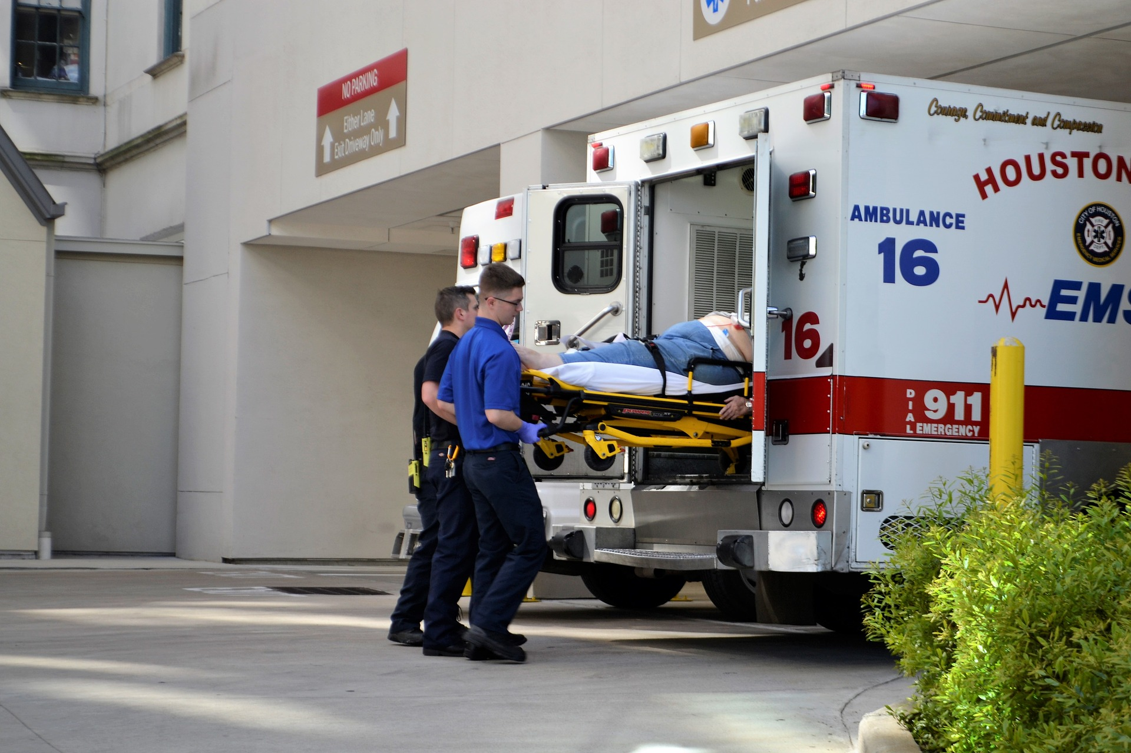
HTS Failures
Most often caused by driver error and/or high-risk driver behaviors
Person, vehicle or road failures cause serious problems:
Congestion
Collisions
Monetary loss
Injury
Notes:
Construction, weather, infrastructure, etc. are other reasons for breakdowns

Slide 11
Top US Driving Errors
94% Human Error
2% Environment
2% Vehicle
2% Unknown
Source: National Highway Traffic Safety Administration, 2016
Notes:
Errors that cause crashes

Slide 12
Contributing Factors to Risk
Driver:
Attitude
Knowledge
Skills
Attitude and emotions play a key role
Notes:
Driving is a privilege (not a right) and can be lost. Strive to keep this privilege.

Slide 13
Contributing Factors to Risk
Vehicle:
Condition
Model and year
Driver assist technology
Notes:
What are the risks from vehicles?
Condition-tires, headlights, windshield, brakes, wipers etc…..
Model and year- old or new, 4-wheel drive, abs brakes etc…
Driver assist technology- lane departure warning, blind spot check, rear/forward collision warning/assist, adaptive cruise control, drowsy driver, etc… Technology becomes a risk when you are dependent on the technology and not using the technology the way it was intended, which is to enhance our driving.

Slide 14
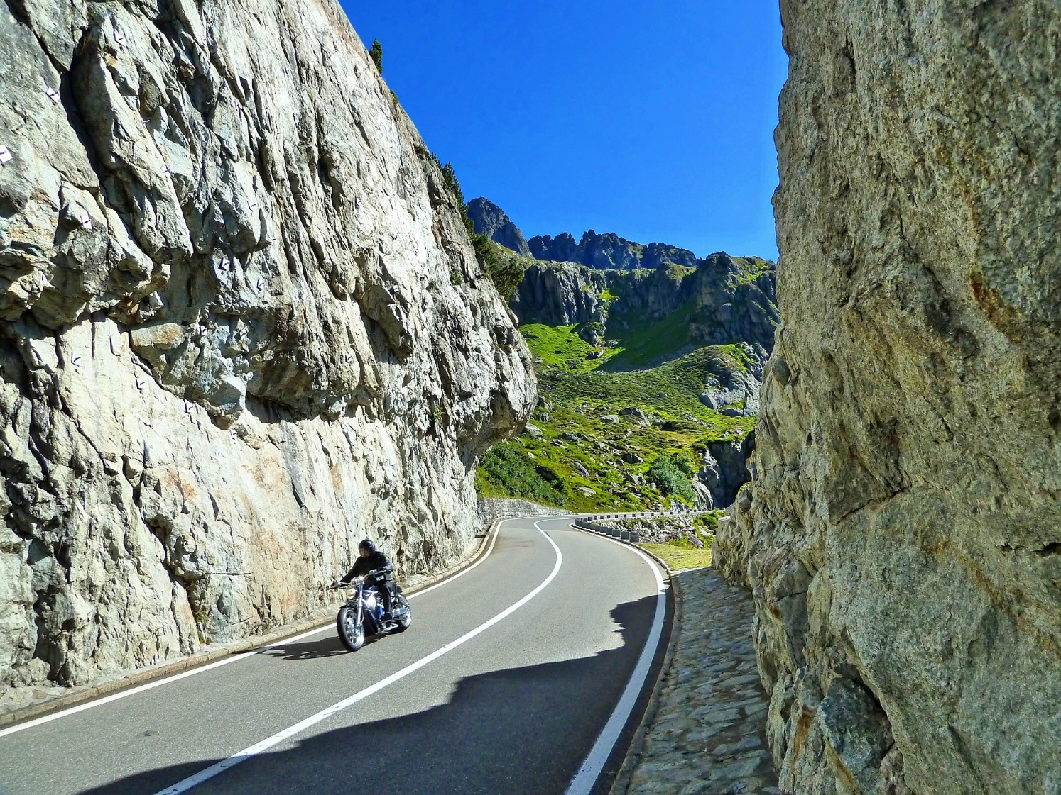
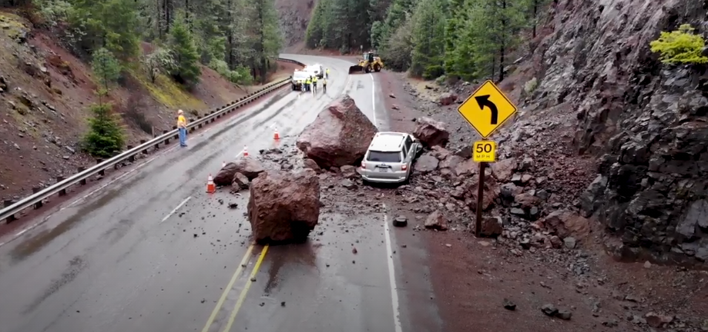
Contributing Factors to Risk
Environment:
Roadways
Weather conditions
Pedestrians
Other Vehicles
Vision Restrictions
Path Restrictions
Notes:
Roadway
Weather conditions
Pedestrians
Other vehicles
Vision restrictions
Path restrictions

Slide 15
Tools
In order to develop RISK MANAGEMENT driving habits:
Positive attitude
Knowledge base
Decision making skills
Repetition of correct performance
Notes:
Developing risk management driving habits requires knowing how and when to perform a maneuver, possessing the correct attitude and repeating the action correctly every time.
Habit formation is crucial for low-risk driving. Habits must be formed so the driver can perform correctly, automatically and timely. The habits must be formed consciously so they can be developed into unconscious automatic responses.

