Slide 1
Safety Belt Information and the Law

Slide 2
Safety Belts
For drivers and front seat passengers, safety belts
Reduce the risk of death by 45%
Reduce the risk of serious injury by 50%
Prevent drivers and passengers from being ejected during a crash
NHTSA/NSC
Notes:
Do you wear your safety belt? How about everyone else you ride with? Check out these shocking but true facts about how a safety belt can really save your life. 1. Even a Crash at 25 MPH Can Hurt without a safety belt. It’s comparable to falling out a second story window. 2. Yes, a Crash Can Do Serious Damage Especially to your soft tissues like your brain, spinal cord, and internal organs. Safety belts hold your strongest parts of your body in place, your sternum and hips. 3. You’re Not Any Safer in the Back Whether you’re in the front or the back, you can still fly through the windshield or collide with someone else if you don’t have a seat belt on. 4. Even If You’re Buckled Up You Can Still Get Hurt...By Someone Else in the Car Who’s Not Yes, things go flying in a crash, including other people. This can cause serious or fatal damage to others in the car...so it’s important that everyone in the car buckles up.
Video- https://www.youtube.com/watch?v=llgLw7oEAFc

Slide 3
Safety Belts
For other occupant seating positions, including 3rd row safety belts
Reduce the risk of death by 44% (passenger cars)
Reduce the risk of death by 73% (light trucks and vans)
People not wearing a safety belt are 30 times more likely to be ejected from a vehicle during a crash.
GHSA-Spotlight on Highway Safety 2019
Notes:
Governors Highway Safety Association www.ghsa.org @GHSAHQ

Slide 4
Safety belts work if you use them
The purpose of a safety belt is to limit the occupant's motion in the event of a crash.
BODY MOVEMENT IN CRASH - ACTIVITY
Video
Notes:
Balance Discovery Activity: Let’s test that out!
Ask students to demonstrate what it feels like to be in a car with a driver who:
slams on the brake
takes off too fast
makes a turn or a lane change too fast or too sharp
Make the point that failing to control the balance of a vehicle is a culturally common high-risk behavior. Managing vehicle balance is at the core of low-risk driving skills and can prevent many problems.

Slide 5
© Copyright 2000, Ellis Clinic, PC, www.EllisClinic.com Used by Permission

Slide 6
Oregon Safety Belt Statute
Oregon law requires:
All motor vehicle operators and passengers be properly secured with a safety belt or safety harness, unless all safety-belt equipped seating positions are occupied by other persons.
Notes:
ORS 811.210-811.215 Vehicle owners are required to maintain belt systems in working order.

Slide 7
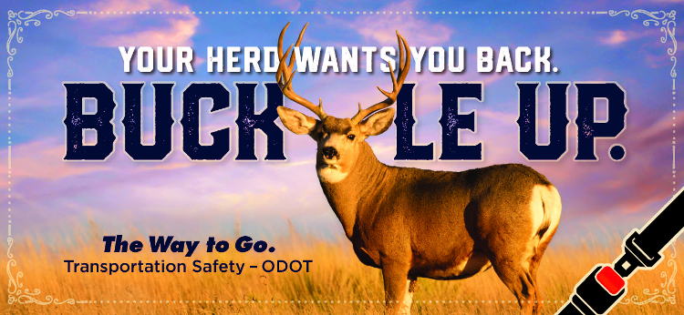
No Safety Belt? Who is Issued the Citation?
16+ years old – Issued the citation
Under 16 years old – Driver issued the citation
Transportation Safety – ODOT

Slide 8
Fines and Penalties
Adult Safety Belt Law is a Primary Offense
Class D Violation
Fees start at $115
Notes:
ORS 811.210-811.215

Slide 9
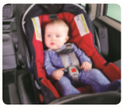
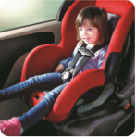
Child Safety Seat Law
​Child passengers must be restrained in child safety seats until they weigh forty pounds or reach the upper weight limit for the car seat in use.
Infants must ride rear-facing until they reach two years of age unless the child turned age one prior to May 26, 2017
Rear facing seats must be placed in the back seat
Check your owner's manual for specific placement information for your vehicle
Transportation Safety – ODOT
Notes:
Rear Seating for Children There is no Oregon law specifically prohibiting children from riding in the front seat of passenger vehicles. However, a rear-facing infant seat cannot be placed in a front seating position that is equipped with an airbag because this would violate Oregon's requirement for "proper use" of a child safety seat. There is a national "best practice recommendation" calling for rear seating through age twelve.

Slide 10
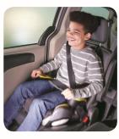
Booster Seat Law
Children over forty pounds or who have reached the upper weight limit for their forward-facing car seat must use a child seat with harness or a booster to 4'9" tall or age eight and the adult belt fits correctly.
Check your owner’s manual for specific placement information for your vehicle
Transportation Safety – ODOT
Notes:
Safety belts are designed to fit adults – not children. In a crash, a child can slip out of an adult safety belt and can even be injured by a poorly fitting safety belt. Kids who aren’t buckled up at all face even greater danger. Securing your child in the right type of safety seat or booster seat dramatically reduces their risk of injury in a crash

Slide 11
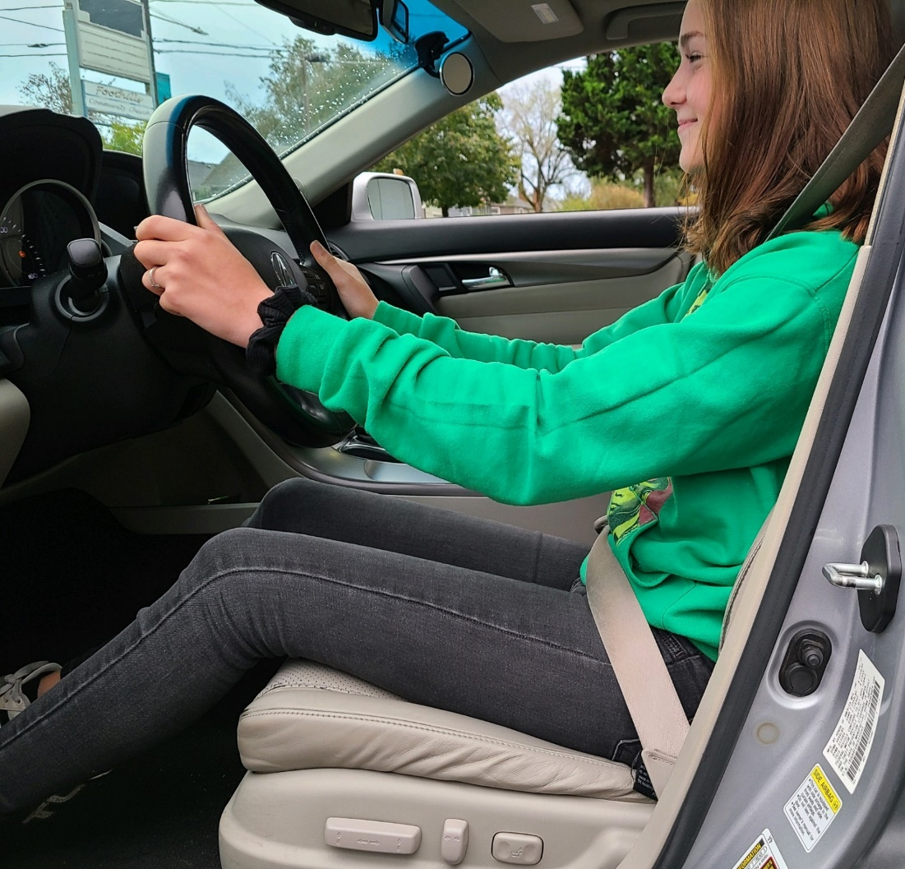
Safety Belt Positioning
The belt should fit snug across your body
The lower lap part of the safety belt should be placed low and across the hip bones (not across the abdomen)
NHTSA

Slide 12
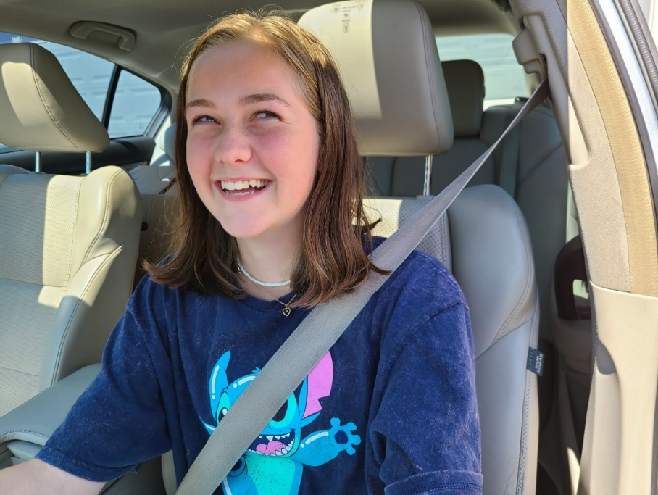
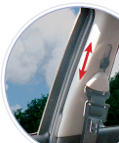
Safety Belt Positioning
Place the shoulder belt across the middle of your chest and away from your neck
Never place the shoulder belt behind your back or under your arm
Use the belt positioner to adjust your shoulder belt so it doesn’t rub across the neck or face
NHTSA/ODOT
Notes:
The lap belt and shoulder belt are secured across the pelvis and rib cage, which are better able to withstand crash forces than other parts of your body.
Place the shoulder belt across the middle of your chest and away from your neck.
The lap belt rests across your hips, not your stomach.
NEVER put the shoulder belt behind your back or under an arm.

