Slide 1
Reading Gauges
tachometer,
speedometer,
odometer

Slide 2
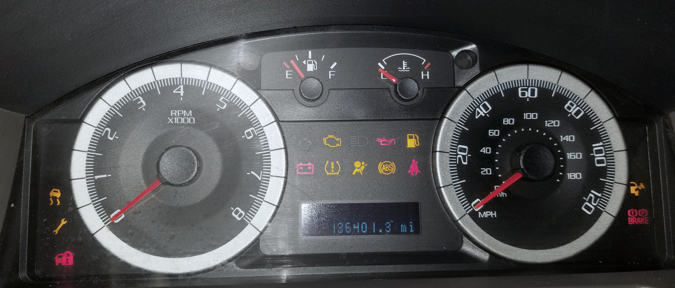
tachometer
speedometer
odometer
Notes:
!/3 of a second glances

Slide 3
Time to Read Your Speed
You’ll have 6 examples

Slide 4
Each speedometer
will appear for only one second

Slide 5
Then you’ll have
5-seconds
to write the speed
on your paper

Slide 6
Ready?

Slide 7
Here’s the
first one

Slide 8
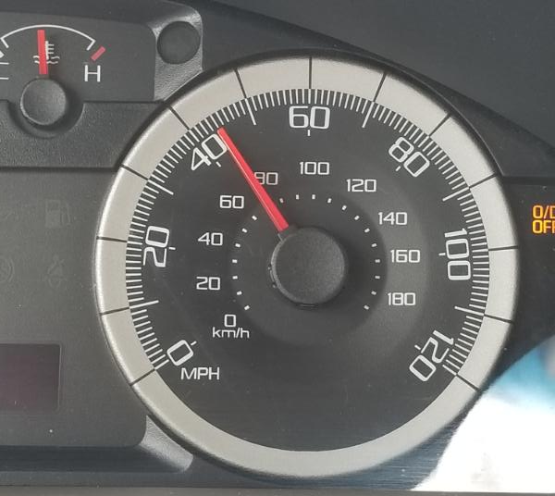
Notes:
44

Slide 9
Try another

Slide 10
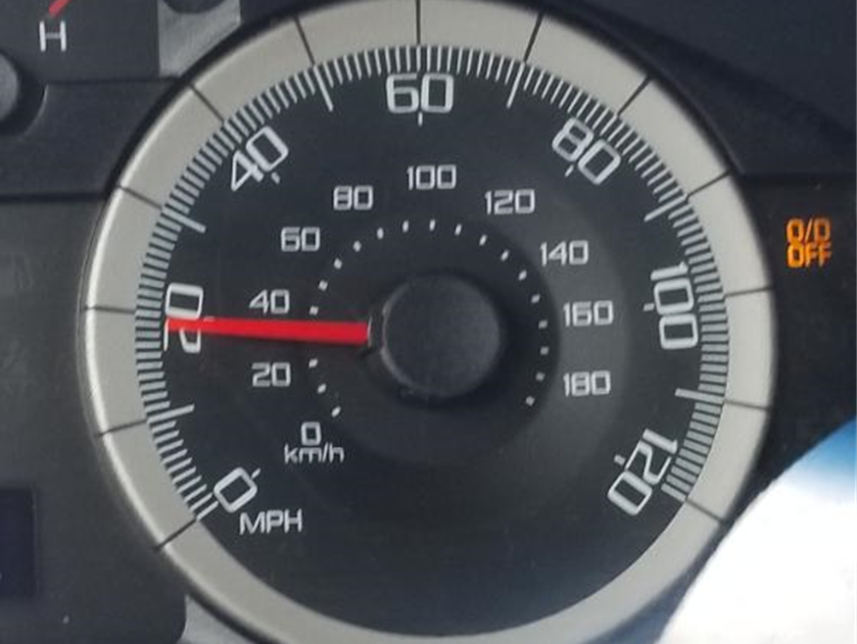
Notes:
20

Slide 11
Here’s another

Slide 12
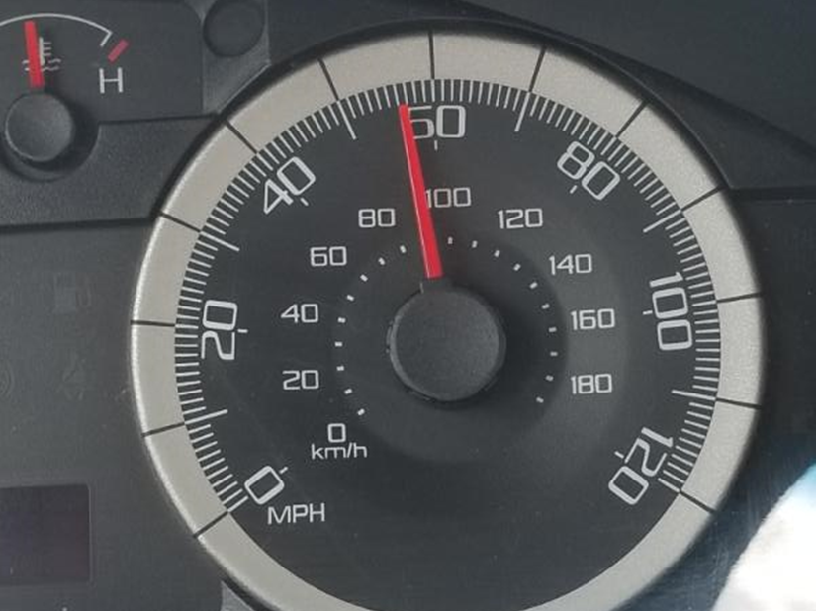
Notes:
46

Slide 13
Try this one

Slide 14
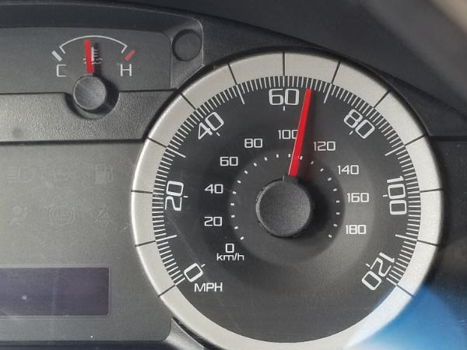
Notes:
66

Slide 15
Try another

Slide 16
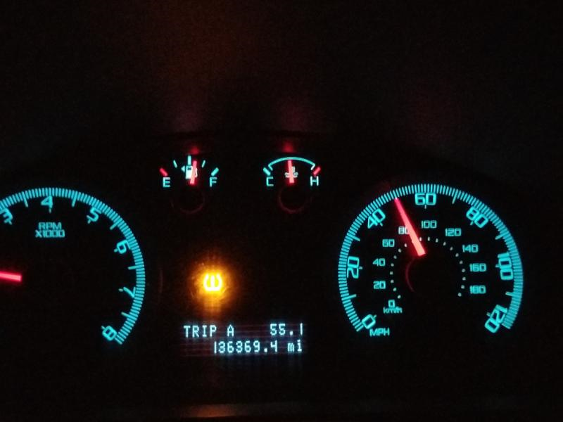
Notes:
50

Slide 17
One more

Slide 18
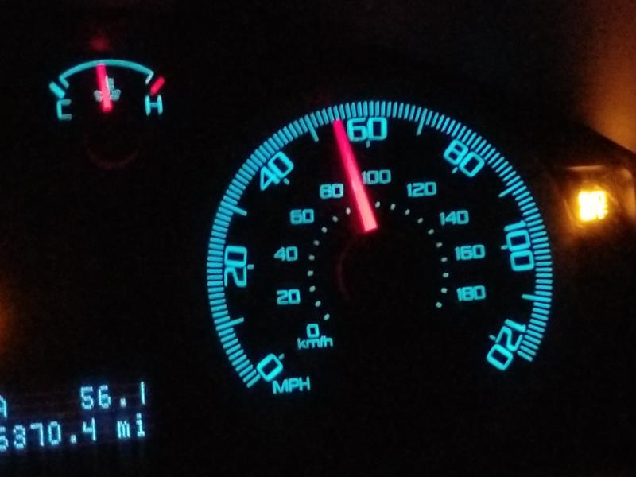
Notes:
55

