Slide 1
Steering Techniques

Slide 2
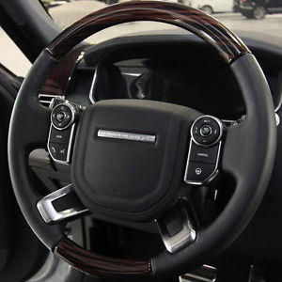
Ha
Smooth steering starts with the correct hand position
9
3
8
4

Slide 3
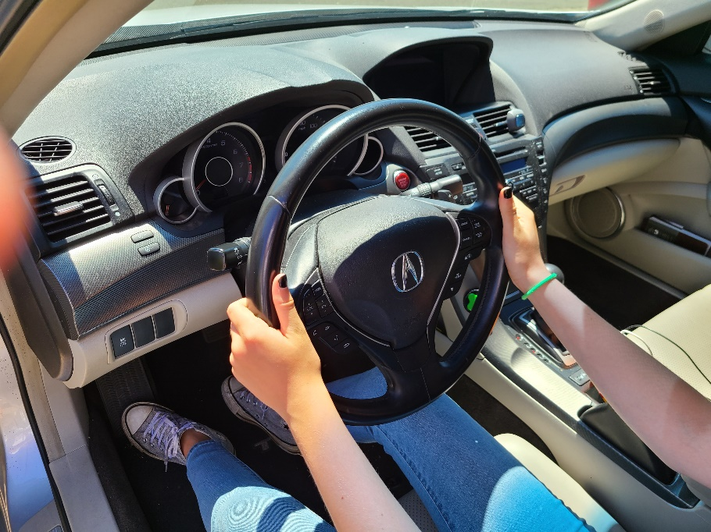
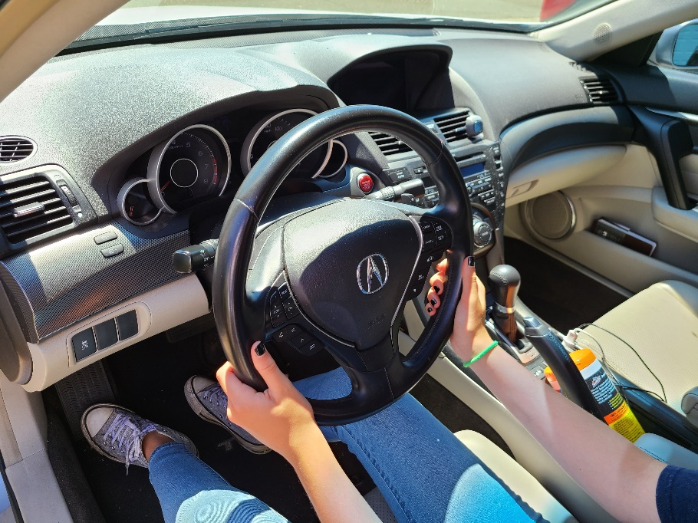
9 & 3 OR 8 & 4 knuckles out, thumbs up
Hand Position Options

Slide 4
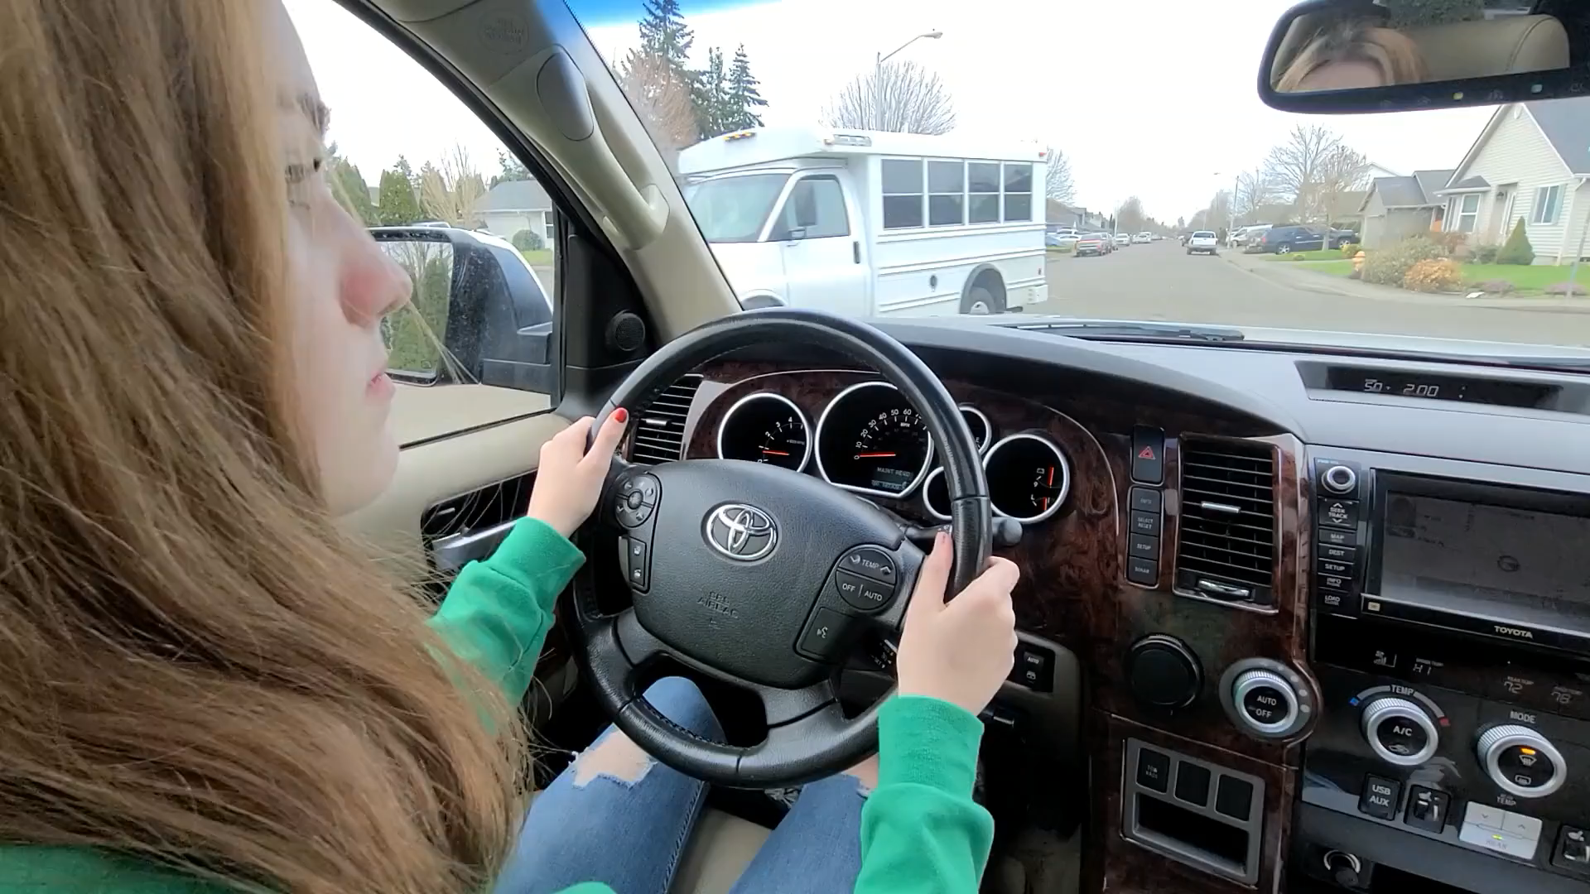
Steering Techniques
Push-Pull steering is used for most turns and curves.
Push-Pull Video

Slide 5
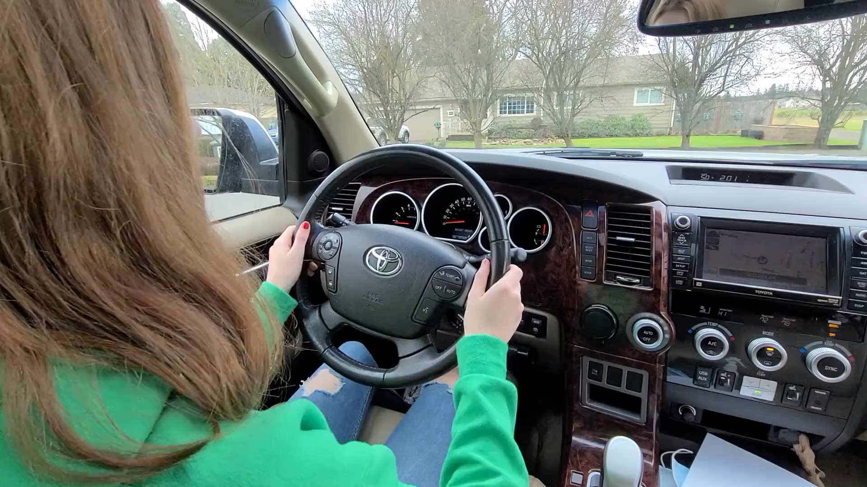
Steering Techniques
Hand over Hand steering is used for slow, sharp turns and parking
Hand over Hand Video

Slide 6
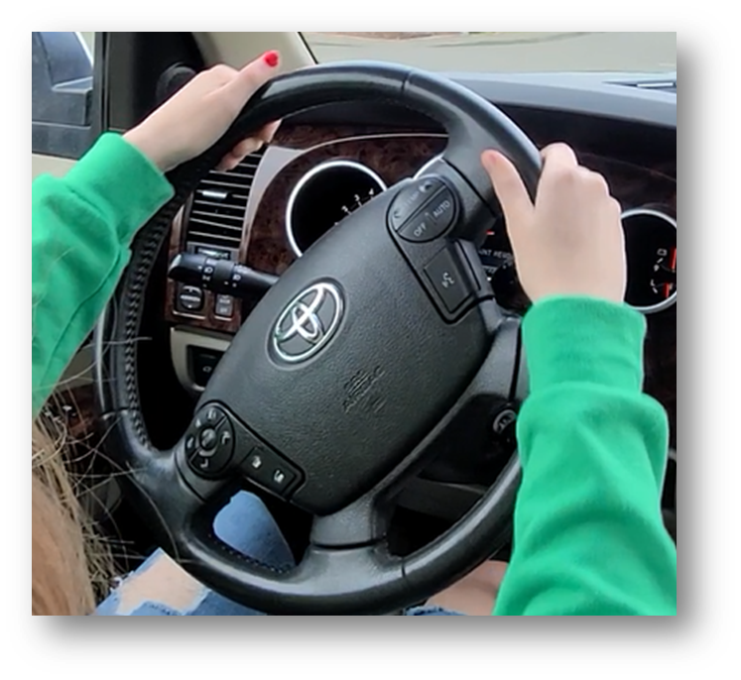
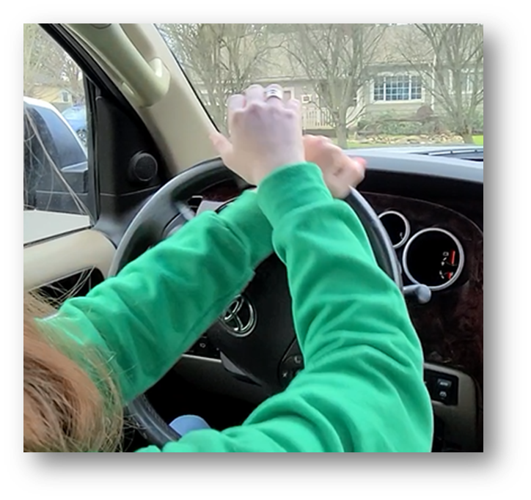
Let’s practice!
Notes:
Rehearsal Activity-

