Slide 1
Search and Identify
Before entering any space, you must know if it is available.
Correct searching patterns allow you to gather information prior to occupying a space.

Slide 2
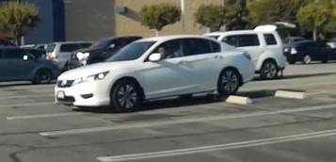
Gather all the information available before putting your car in motion
Turn your head and look before moving.
Ensure that your path is clear.

Slide 3
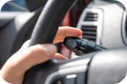
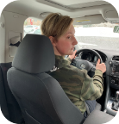
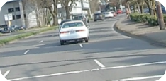
MSMOG-Blind Spot check process
Mirror
Signal
Mirror
Over the Shoulder
Go
Perform before turning left, right or moving laterally. Search back to target after each mirror check.
Notes:
Explain MSMOG procedure.

Slide 4
Searching Pattern while Moving- 45° Search
Notes:
Left, Front, Right (LFR)

Slide 5
45° Search
Video Link

Slide 6
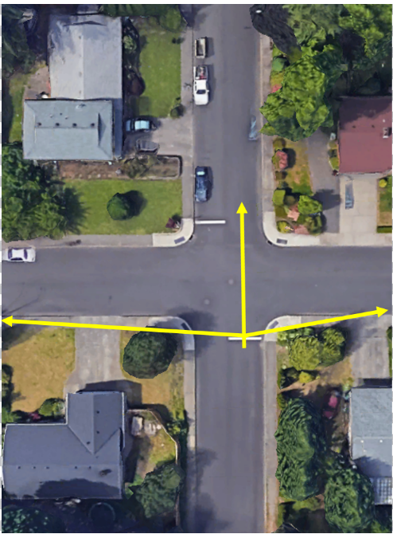
Searching Pattern while Stopped- 90° Search
Notes:
LFR

Slide 7
90° Search
Video Link

Slide 8
Searching Patterns
90° search from a stopped position
45° search from a moving position

Slide 9
45° search and 90° search
Video Link

