Slide 1
Searching While Approaching Intersections

Slide 2
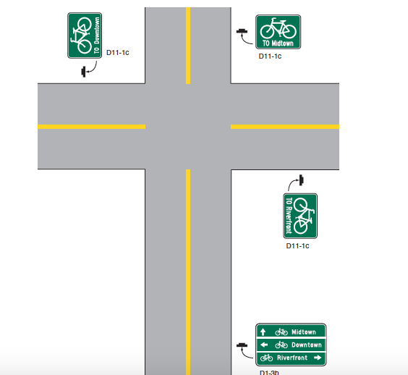
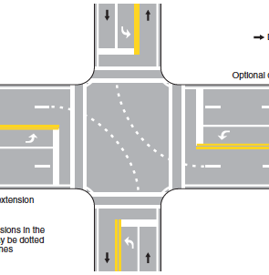
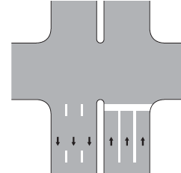
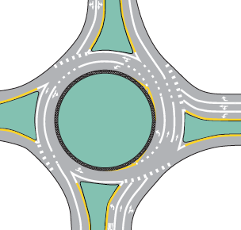








What is an Intersection?
Where 2 or more roads come together
Can be any shape or size
Can be controlled or uncontrolled

Slide 3
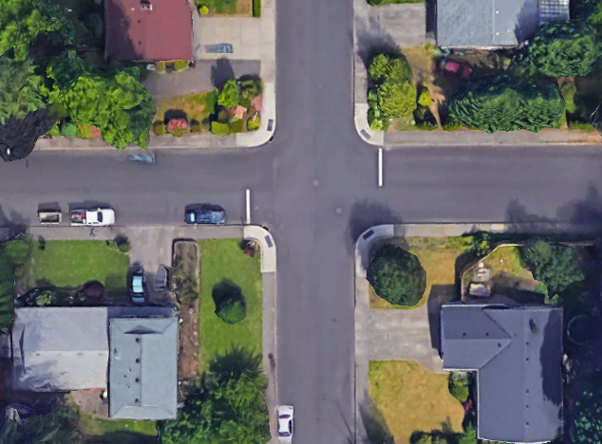


Searching Pattern while Moving-
45° Search
Notes:
Reminder from 3.2- Search and Identify

Slide 4
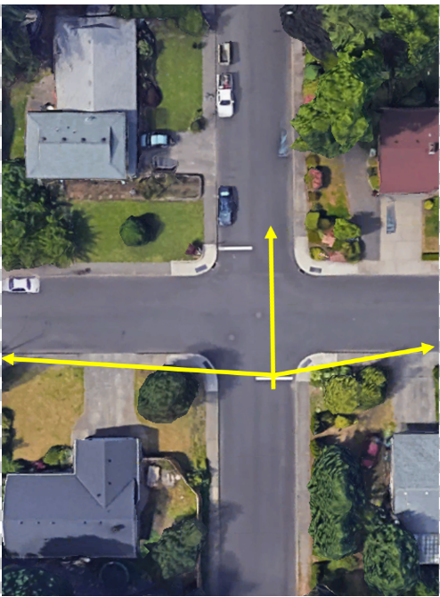

Searching Pattern while Stopped-
90° Search
Notes:
LFR

