Slide 1
Lane Positions
Lane Position Activity:
Identify what lane position is shown and what speed control option should be used

Slide 2

Notes:
1-decelerate

Slide 3
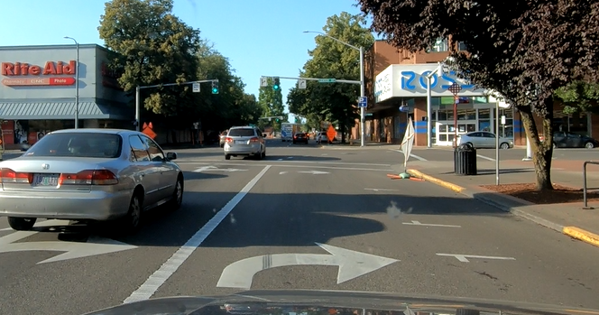
Notes:
1-apply brake

Slide 4
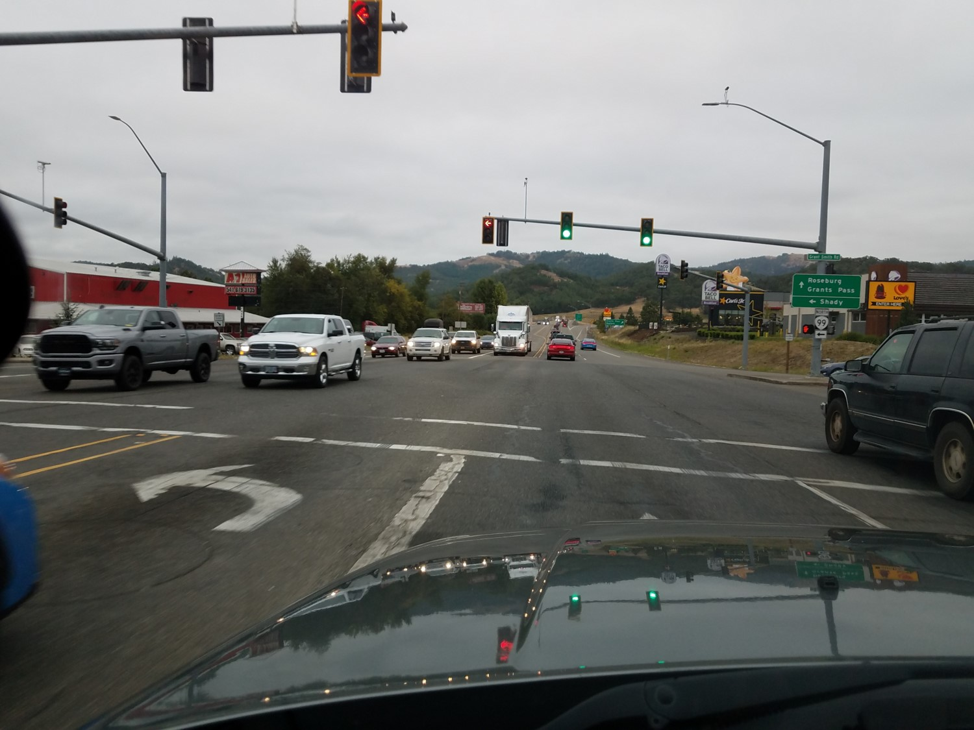
Notes:
1-cover brake

Slide 5
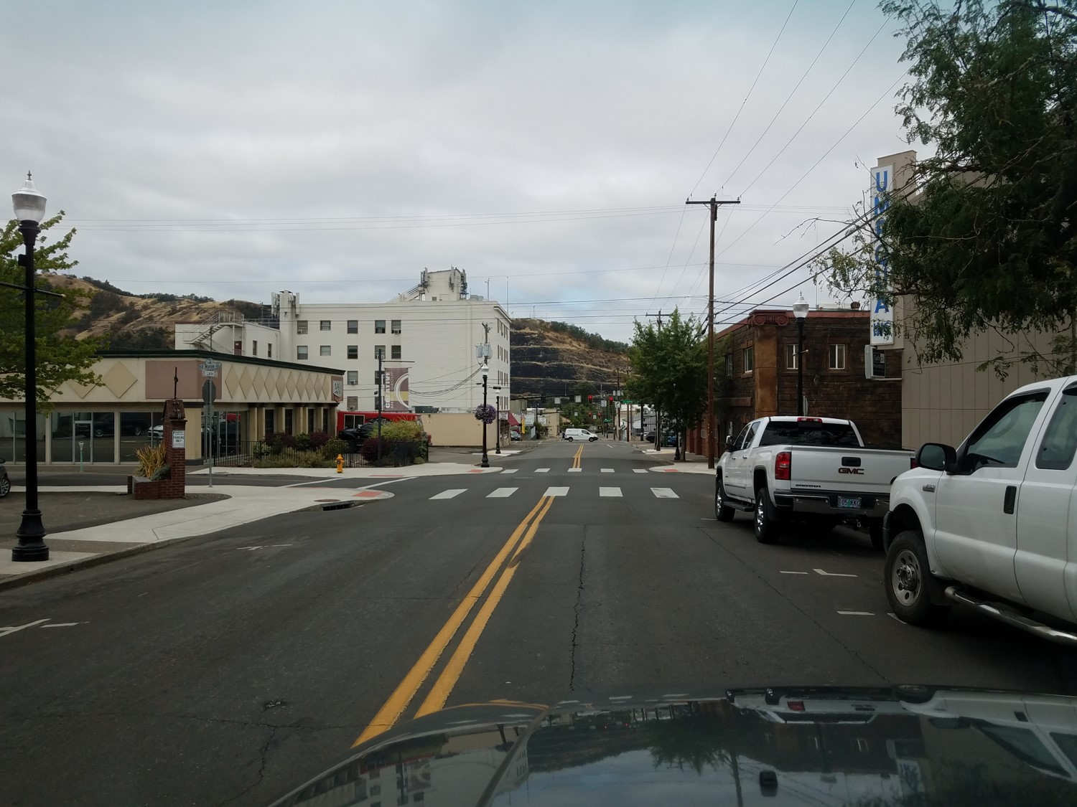
Notes:
2-cover or apply brake

Slide 6
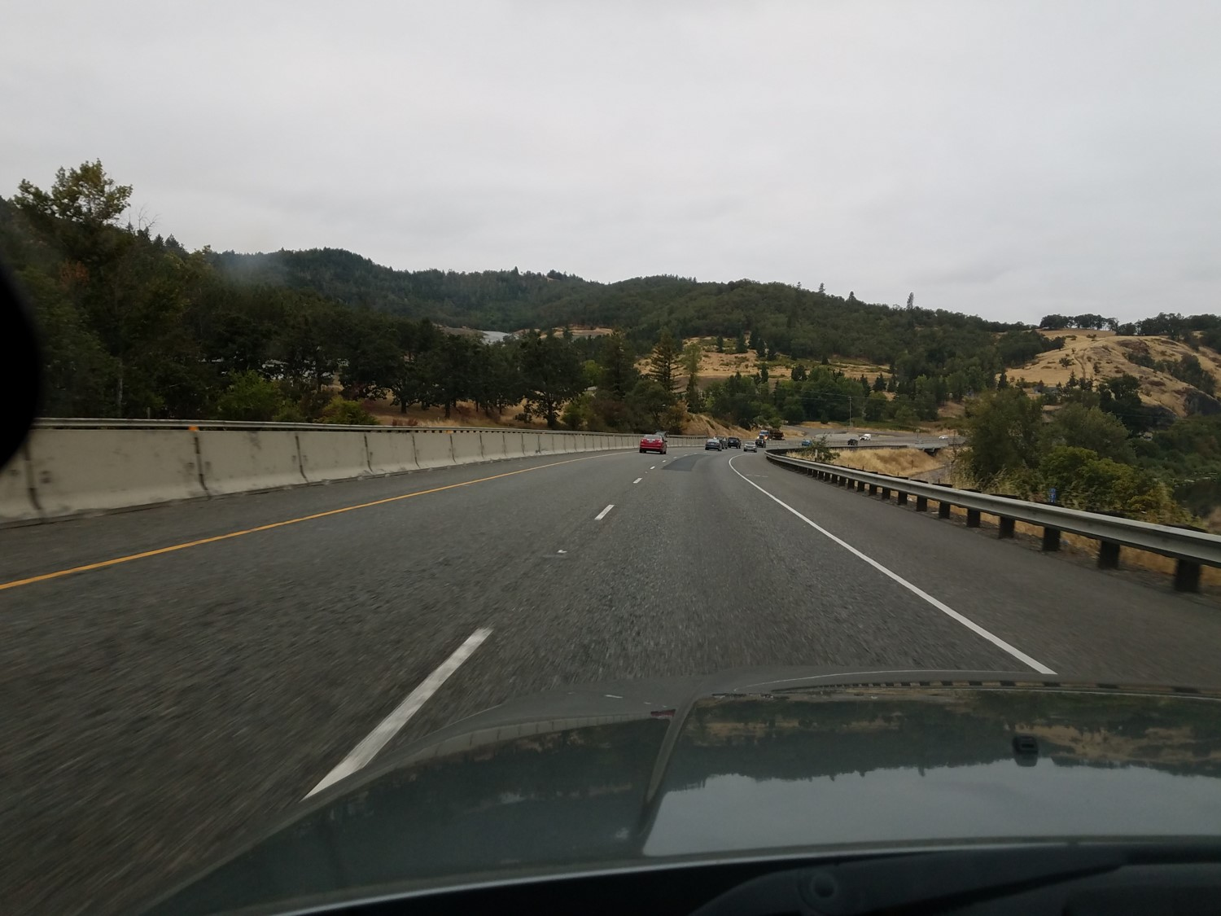
Notes:
1-maintain speed

Slide 7
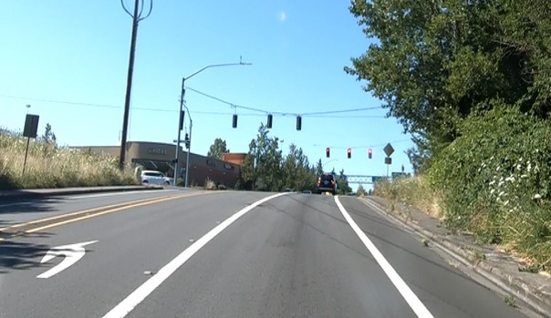
Notes:
1-decelerate (note incline will affect speed, may have to increase pressure on accelerator)

Slide 8
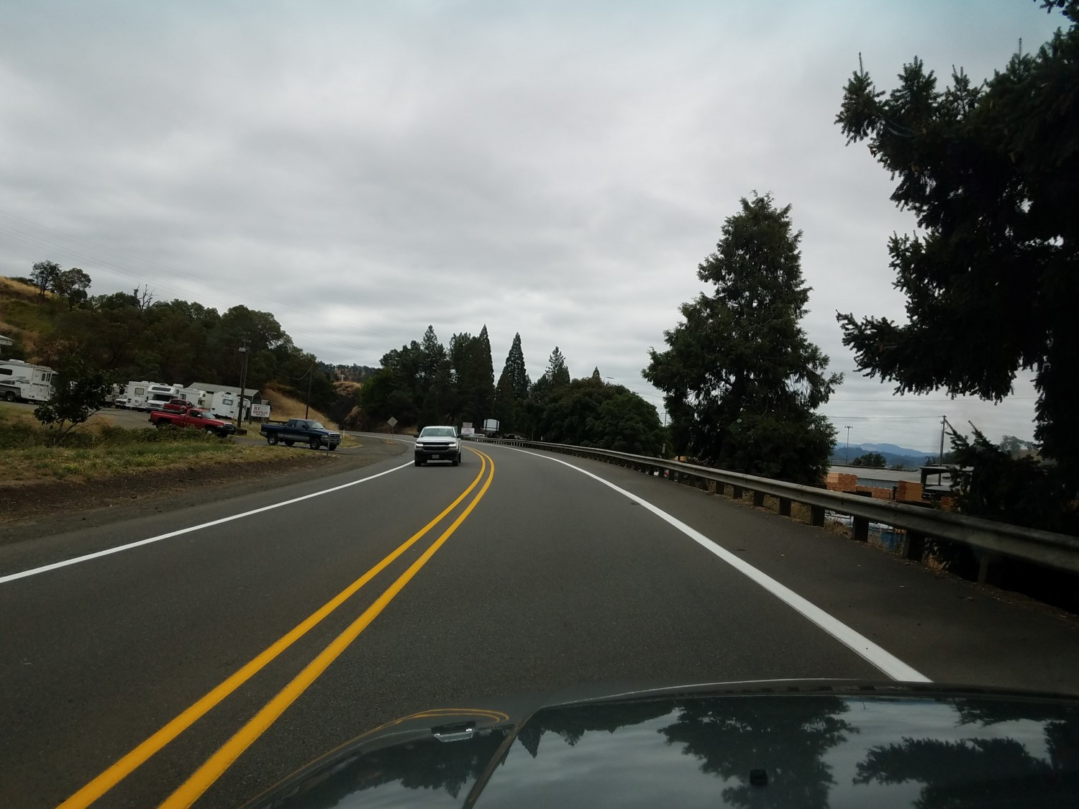
Notes:
3-decelerate

Slide 9
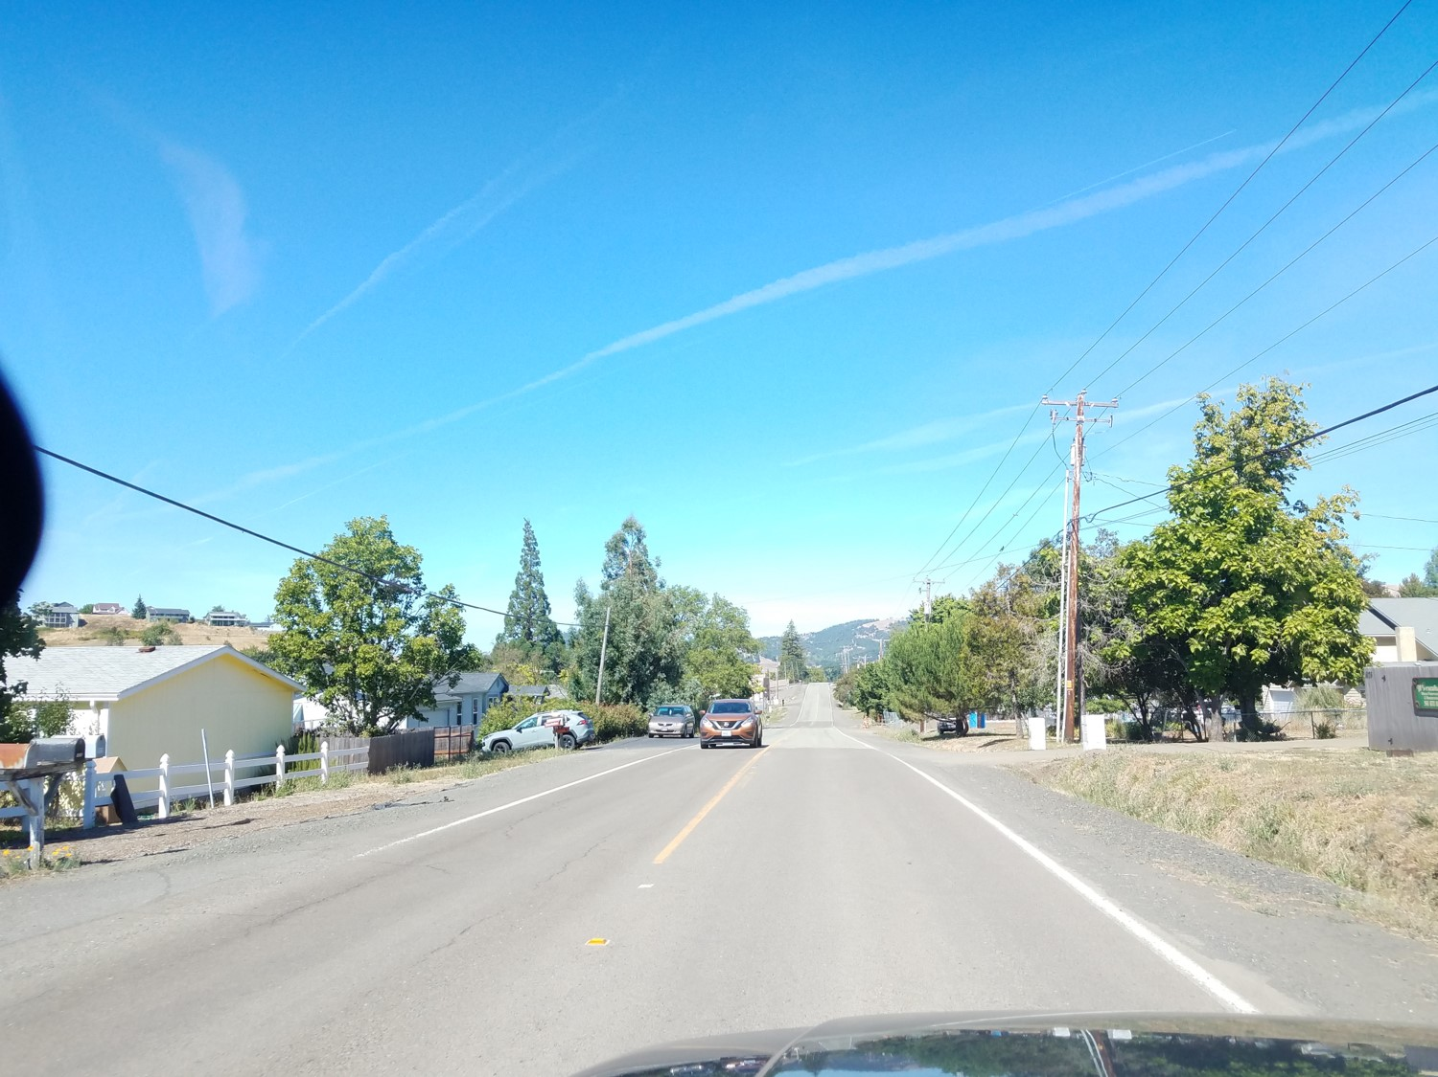
Notes:
3-maintain speed

Slide 10
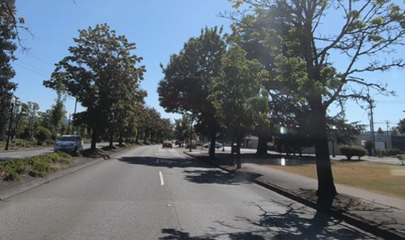
Notes:
4-maintain speed (changing lanes)

Slide 11
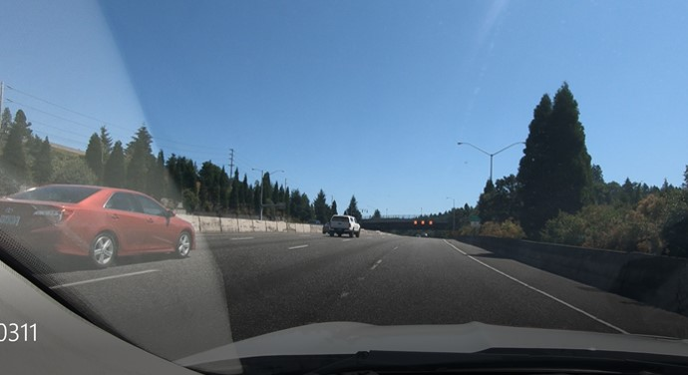
Notes:
1-maintain speed

Slide 12
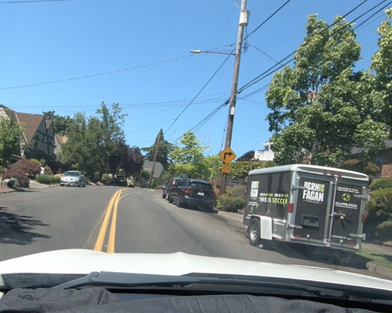
Notes:
2-apply brake move back into 1 before curve

Slide 13
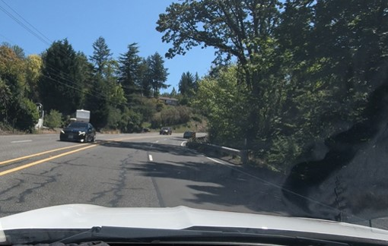
Notes:
5-maintain speed (changing lanes)

Slide 14
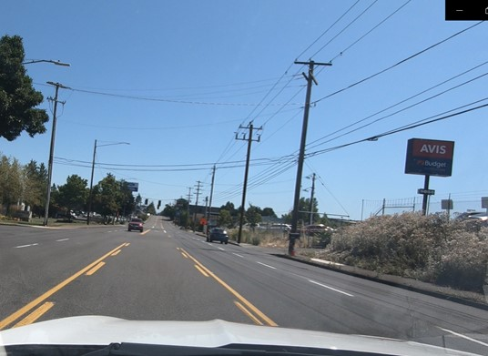
Notes:
1-apply brake

Slide 15
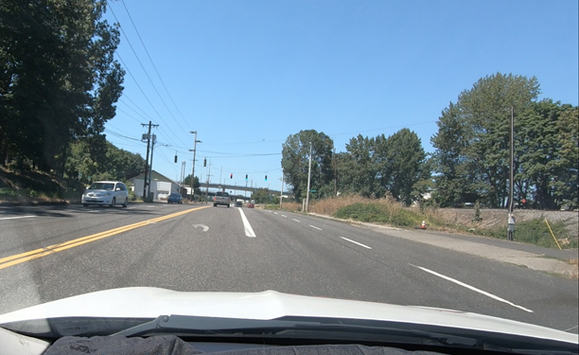
Notes:
4-maintain speed (entering turn lane)

Slide 16
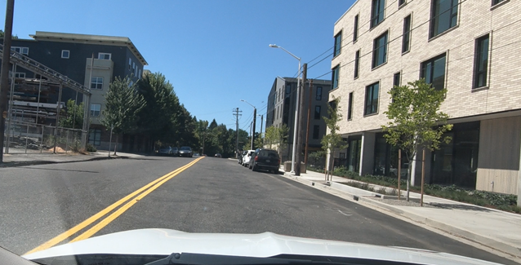
Notes:
1-maintain speed

Slide 17
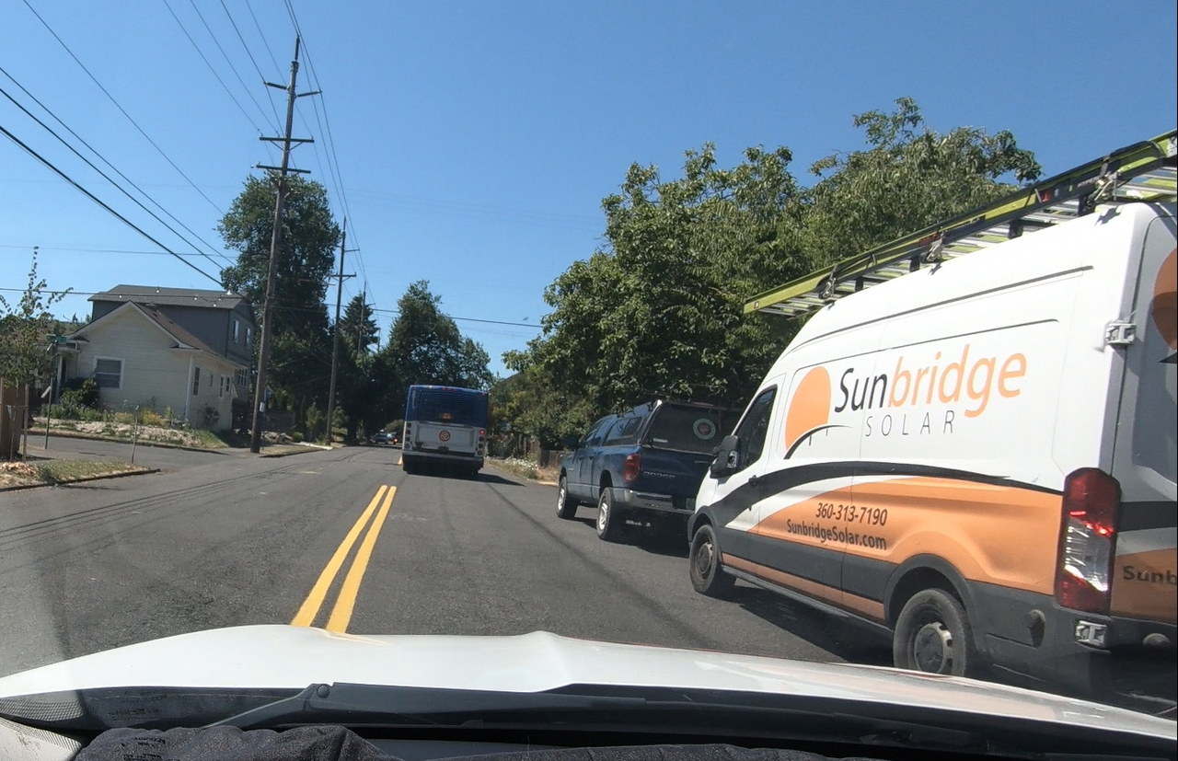
Notes:
2-cover brake

Slide 18
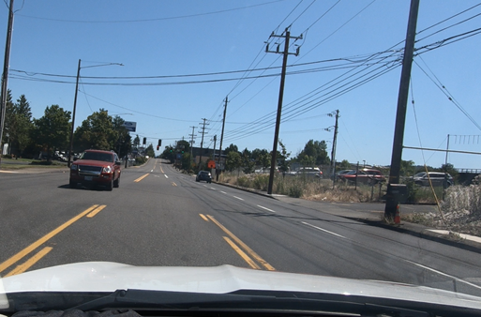
Notes:
1-apply brake

Slide 19
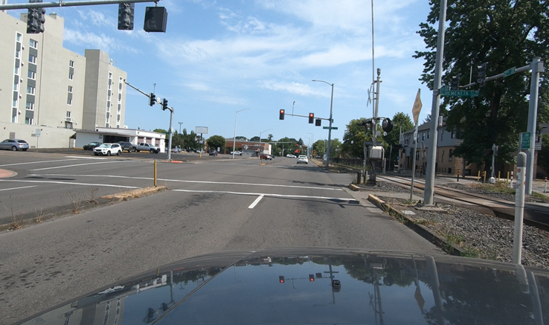
Notes:
1-apply brake

Slide 20
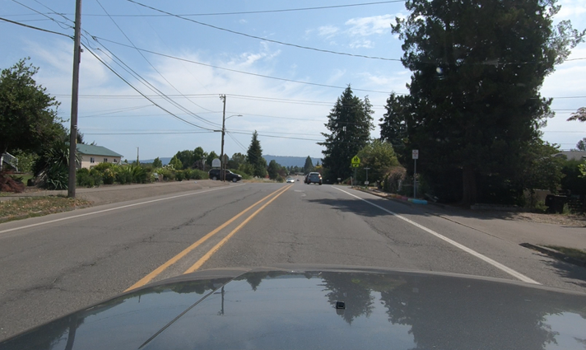
Notes:
1-decelerate or cover brake

Slide 21
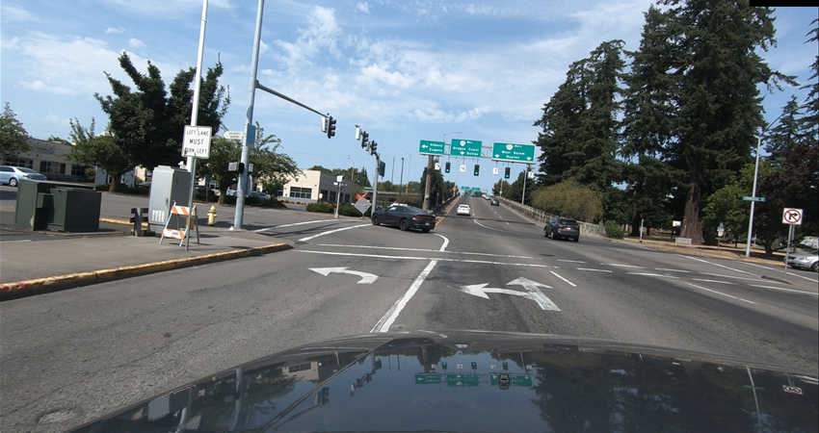
Notes:
2-apply brake

Slide 22
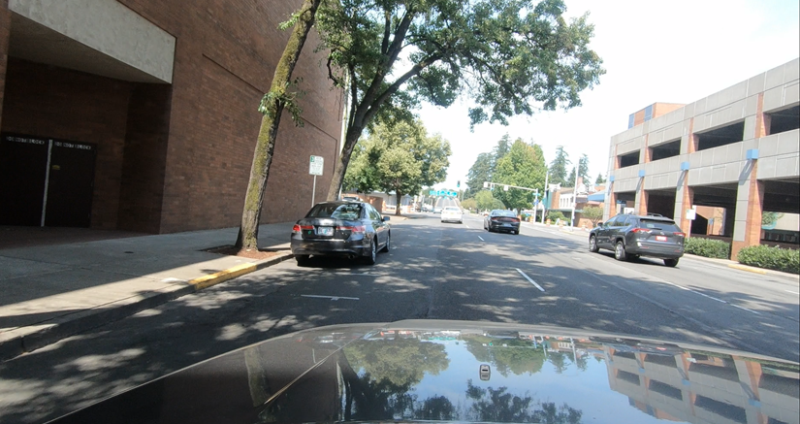
Notes:
3 - Maintain

Slide 23
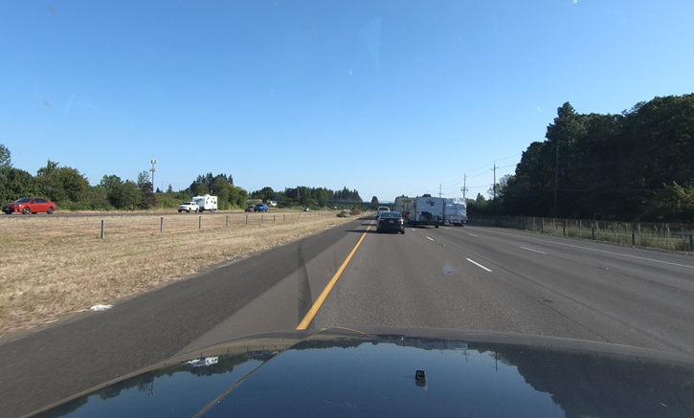
Notes:
2 - Maintain

Slide 24
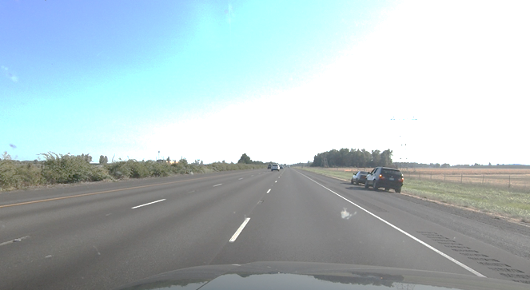
Notes:
2 – Reduce speed

Slide 25
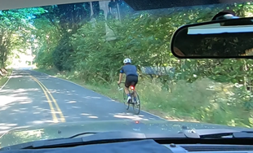
Notes:
2 - Decelerate

