Slide 1
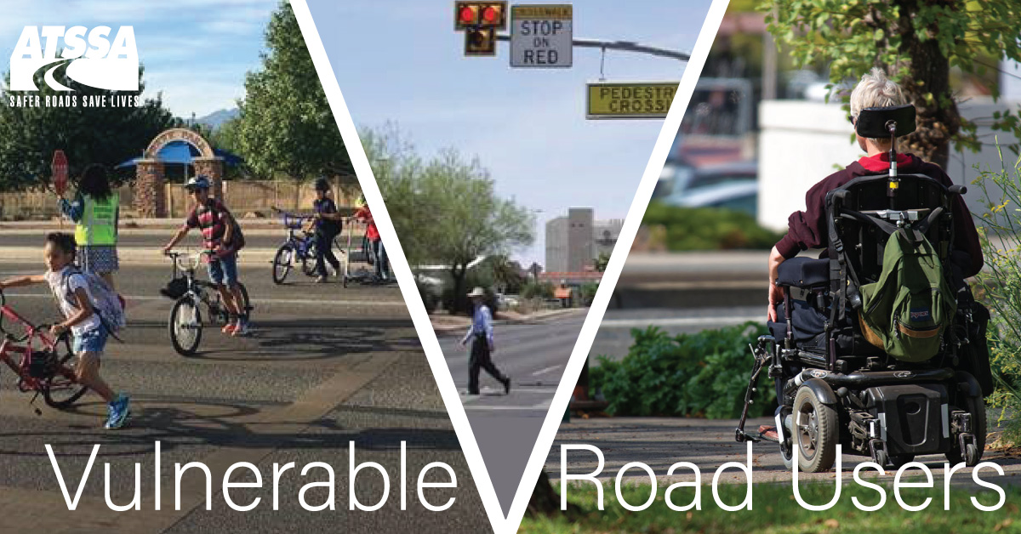
Complex Interactions
Notes:
"Materials reproduced (and/or reprinted) with the permission of the American Traffic Safety Services Association (ATSSA)
801.608 “Vulnerable user of a public way.” “Vulnerable user of a public way” means a pedestrian, a highway worker, a person riding an animal or a person operating, or riding on, any of the following on a public way, crosswalk or shoulder of the highway: (1) A farm tractor or implement of husbandry; (2) A skateboard; (3) Roller skates; (4) In-line skates; (5) A scooter; (6) A bicycle; (7) A moped; or (8) A motorcycle.
Implement of husbandry means a farm tractor, a vehicle designed to be drawn or pulled by a farm tractor or animal, a vehicle that directly harvests farm products, or a vehicle that directly applies fertilizer, spray, or seeds to a farm field. Implement of husbandry does not include a motor vehicle licensed for use on the public roads or highways of this state

Slide 2
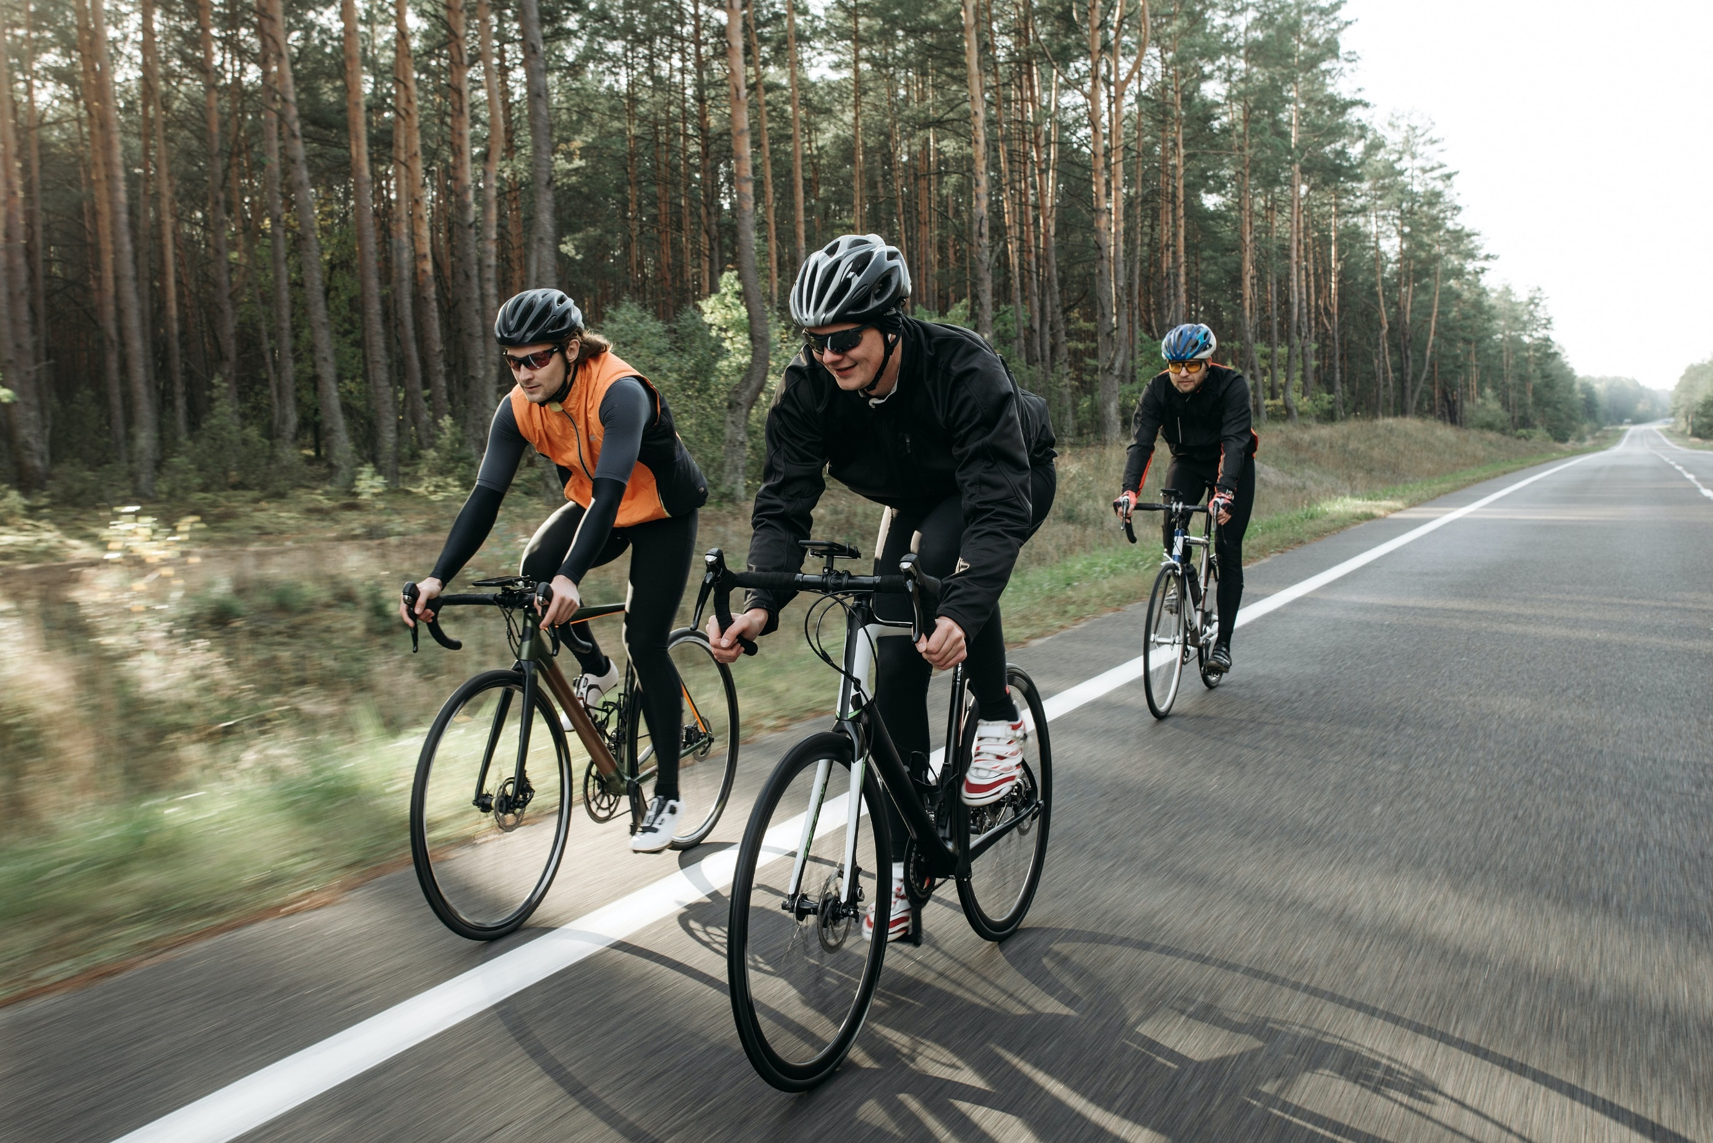
Notes:
Cyclists

Slide 3
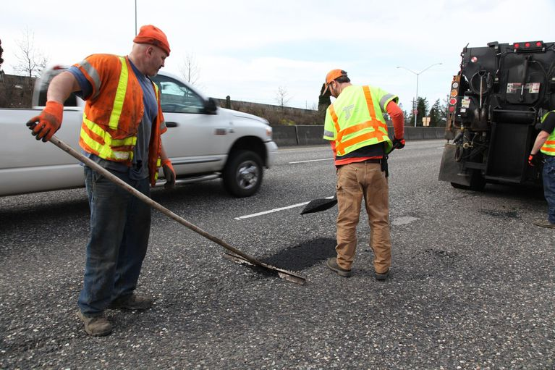
Notes:
Work Zones

Slide 4
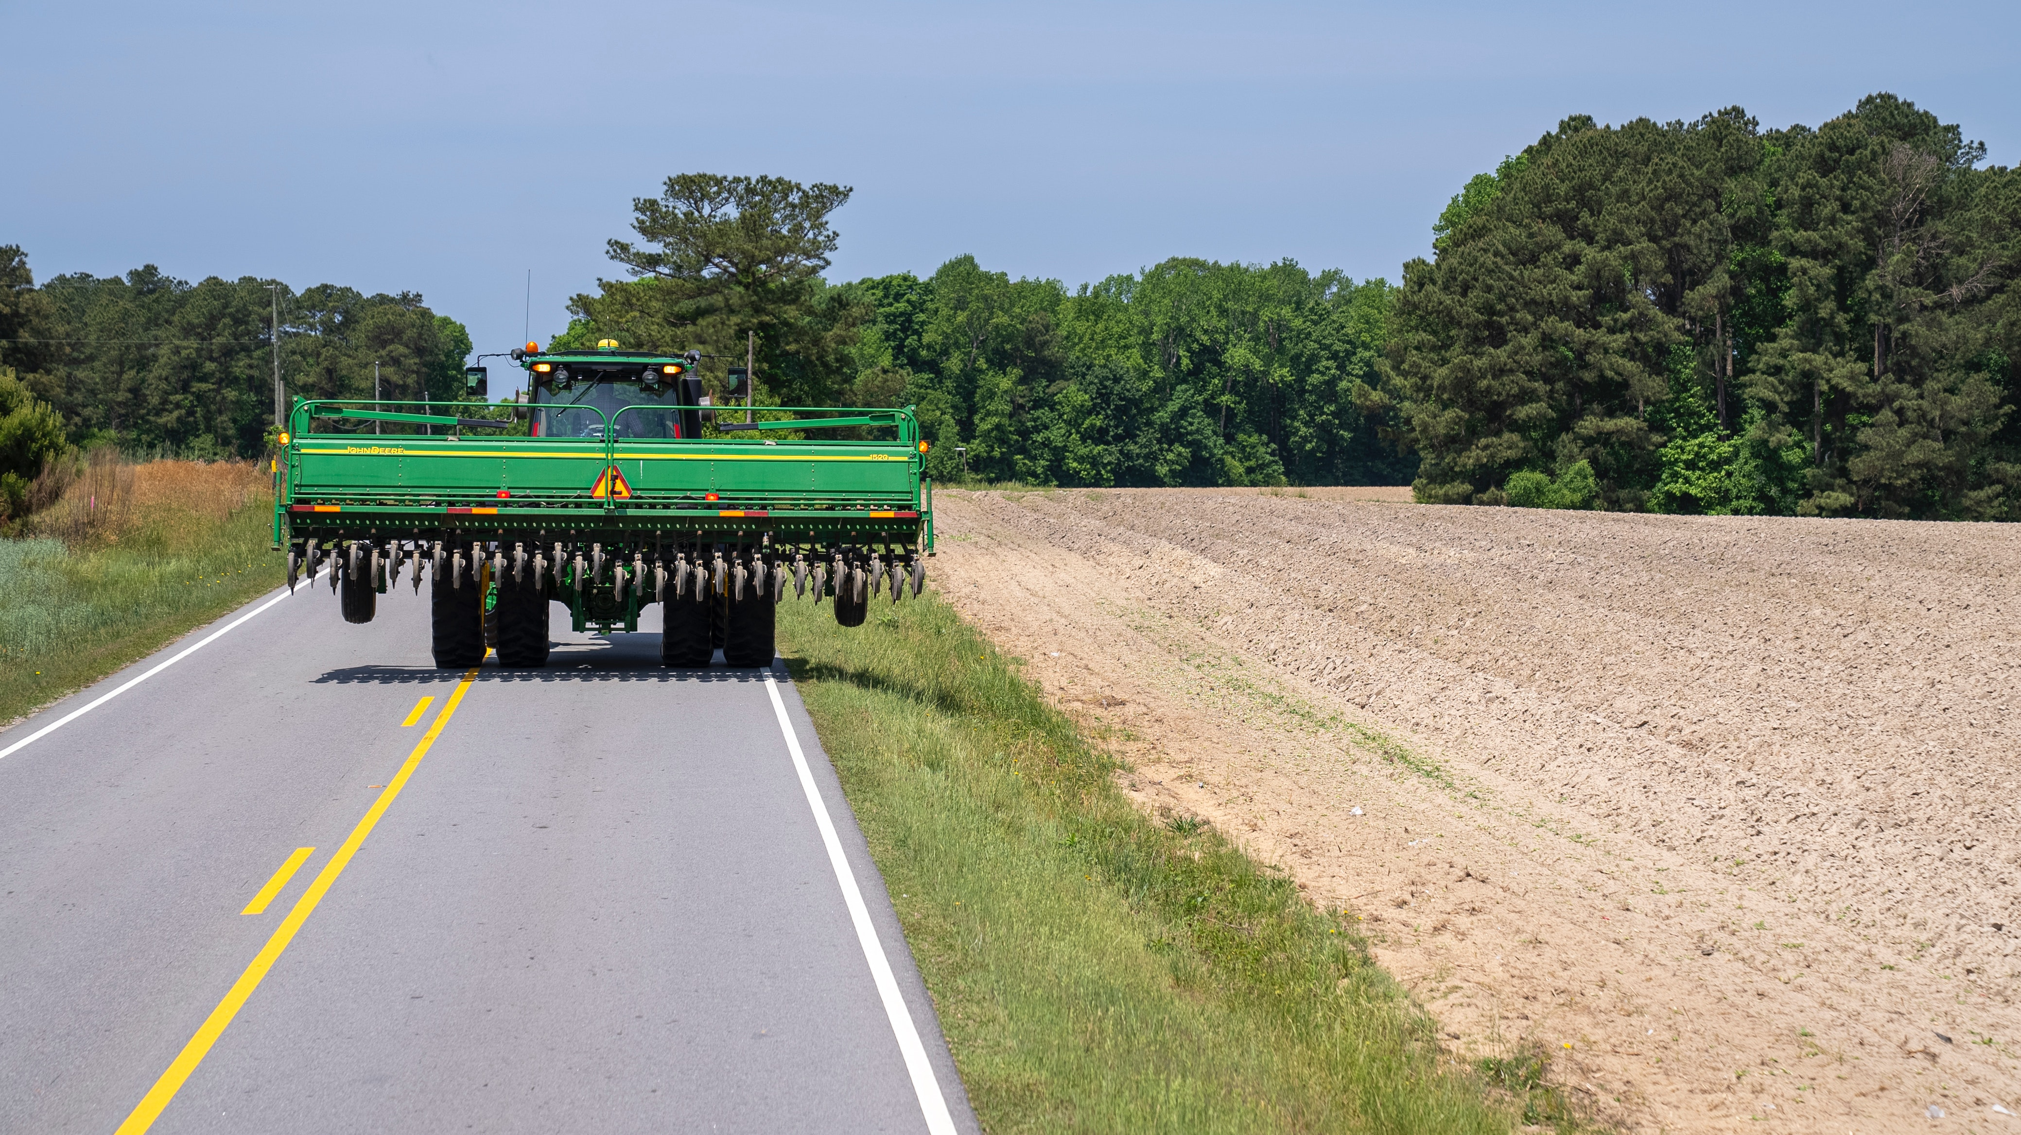
Notes:
Tractors

Slide 5
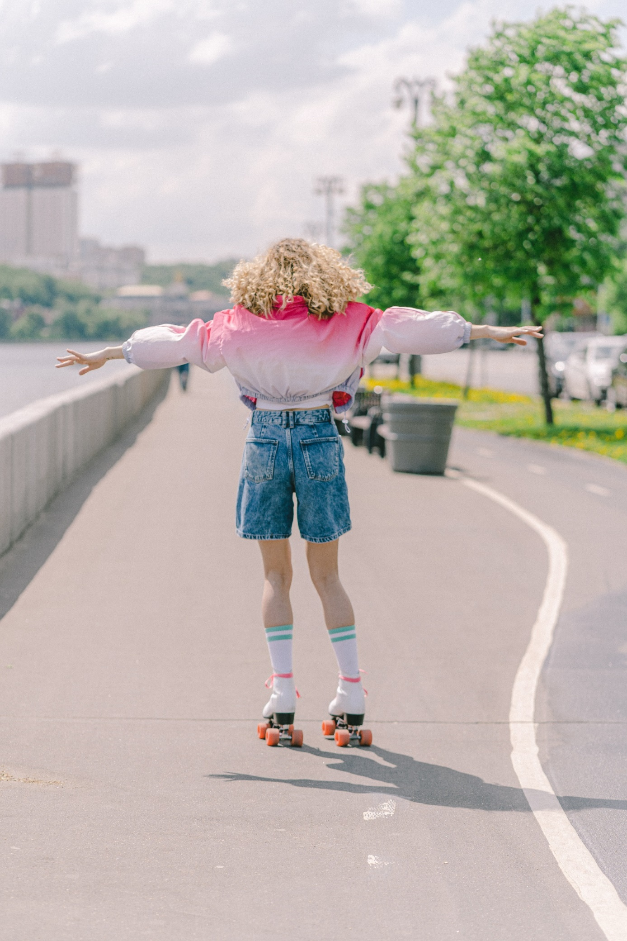
Notes:
Rollerbladers

Slide 6
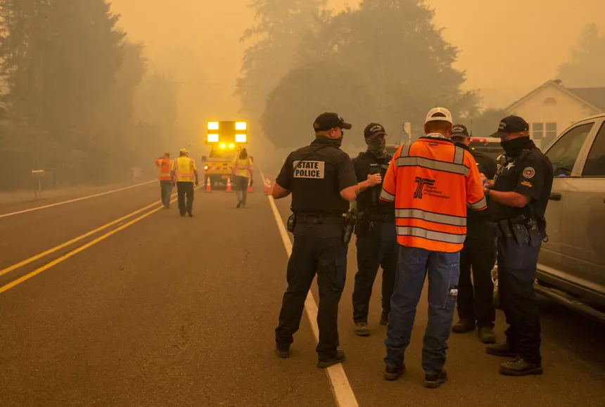
Notes:
Emergency Vehicles

Slide 7
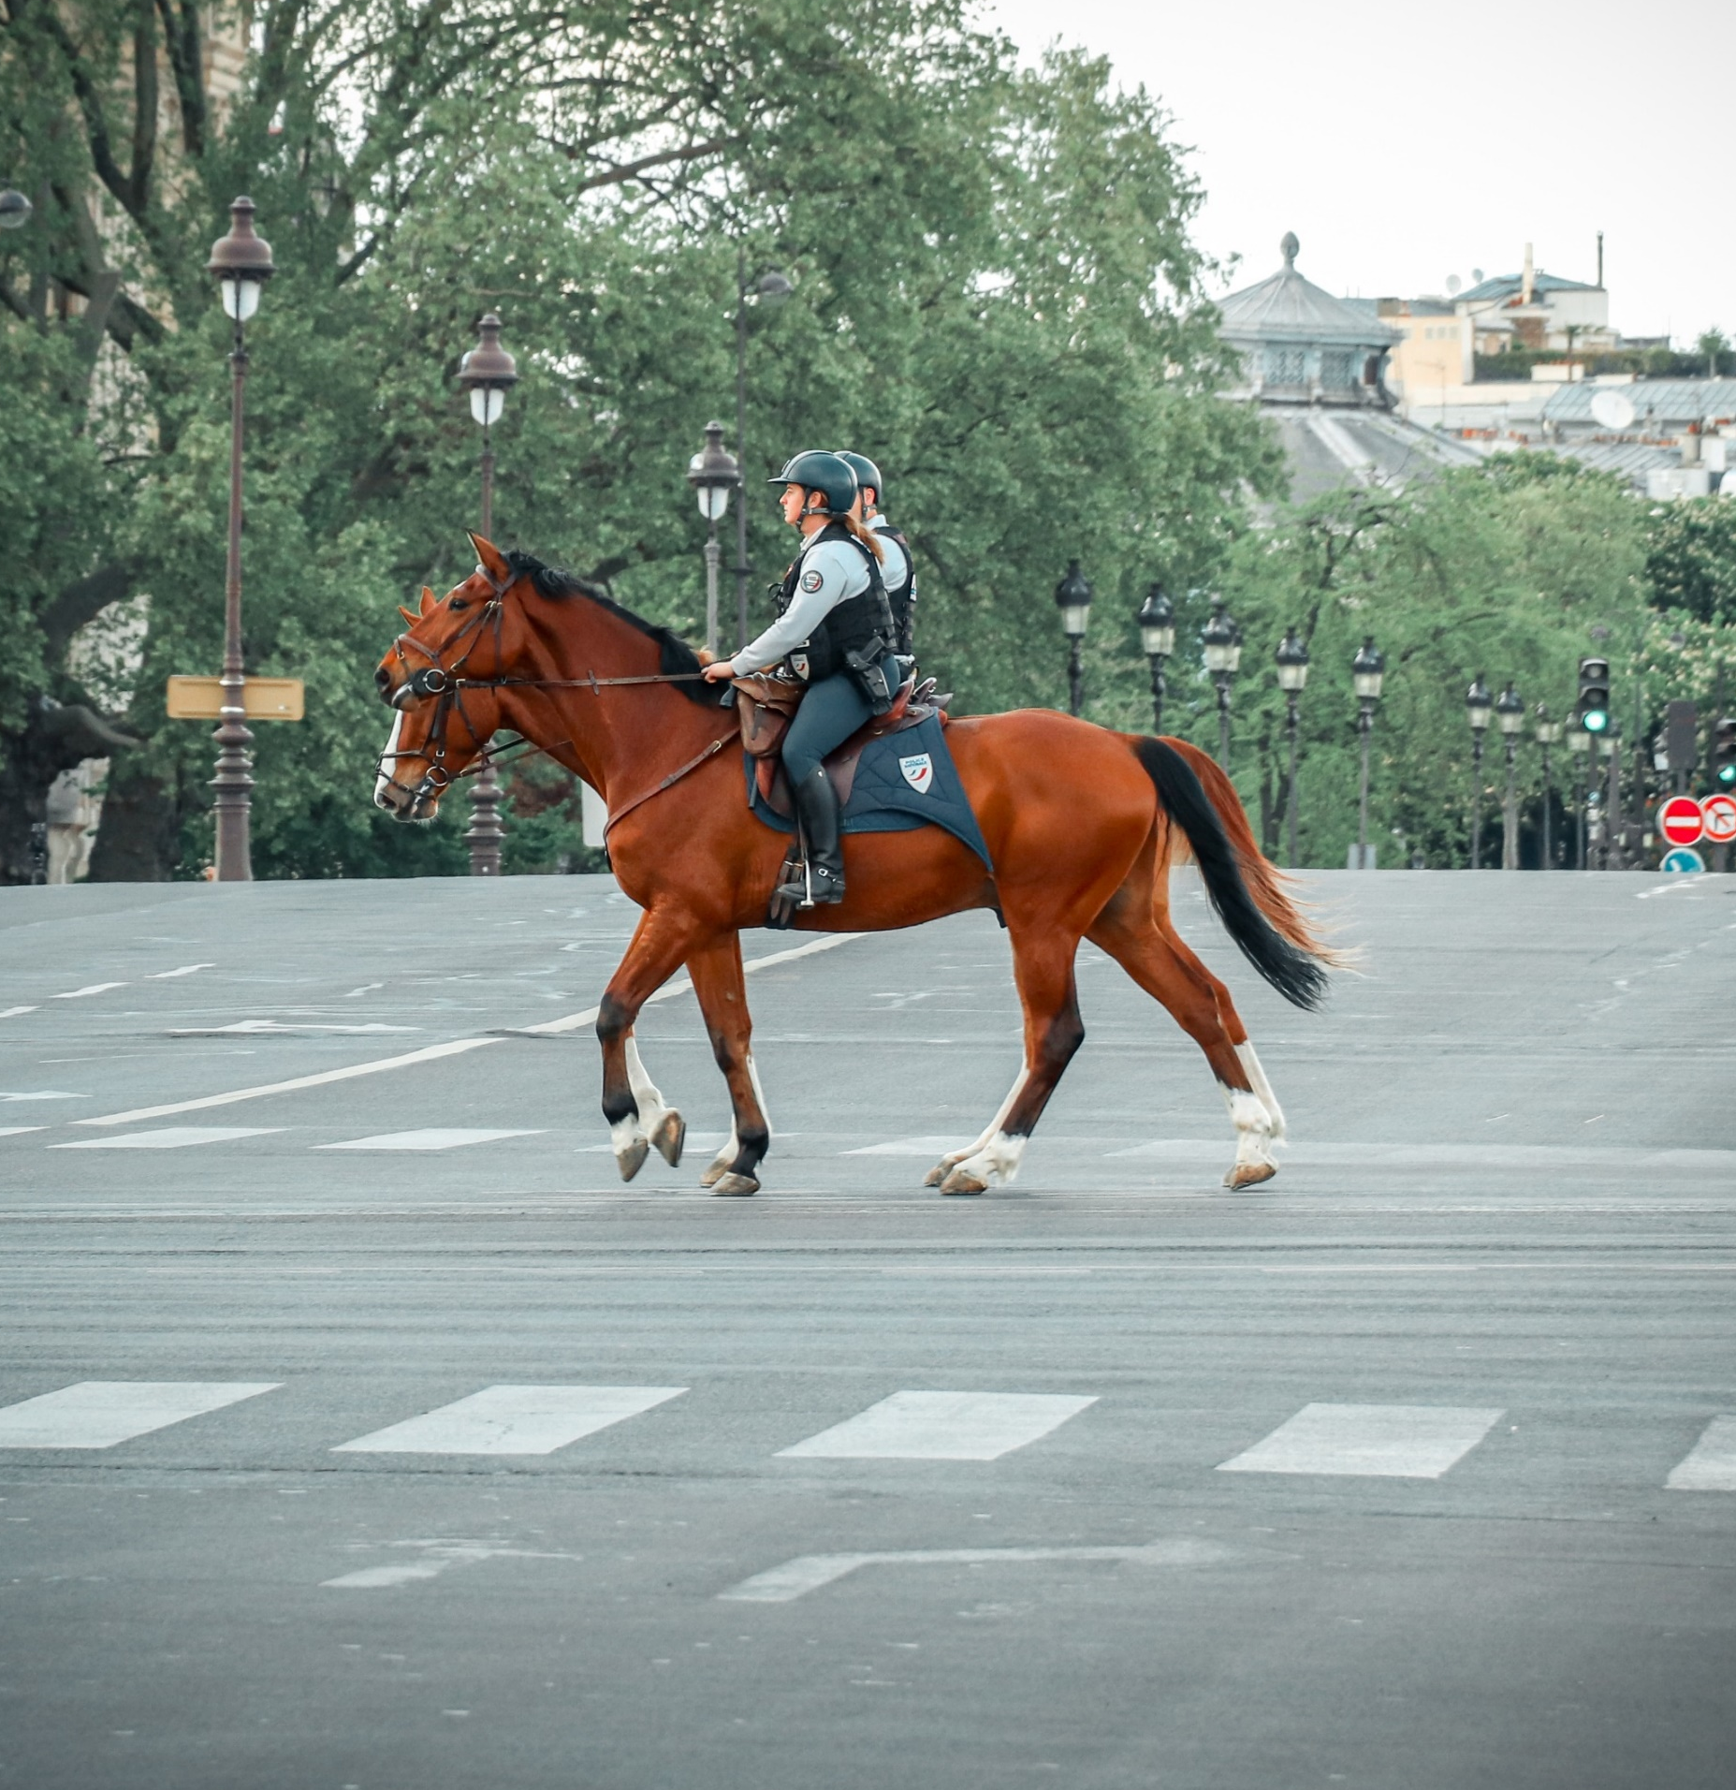
Notes:
Horses

Slide 8
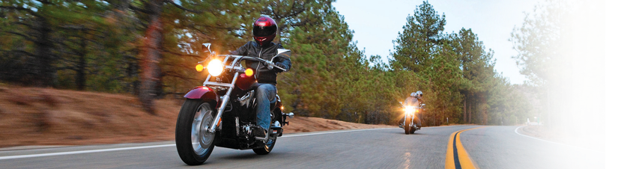
Notes:
Motorcycles

Slide 9
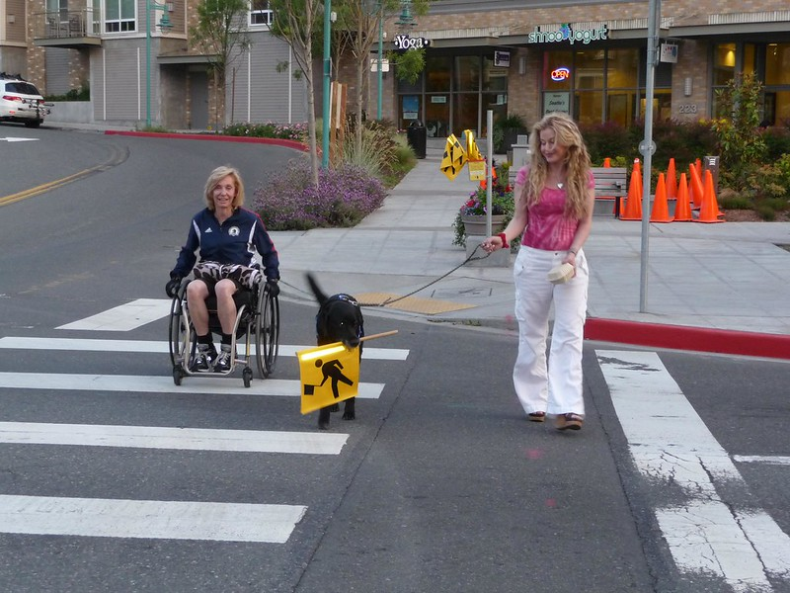
Notes:
Pedestrians

Slide 10
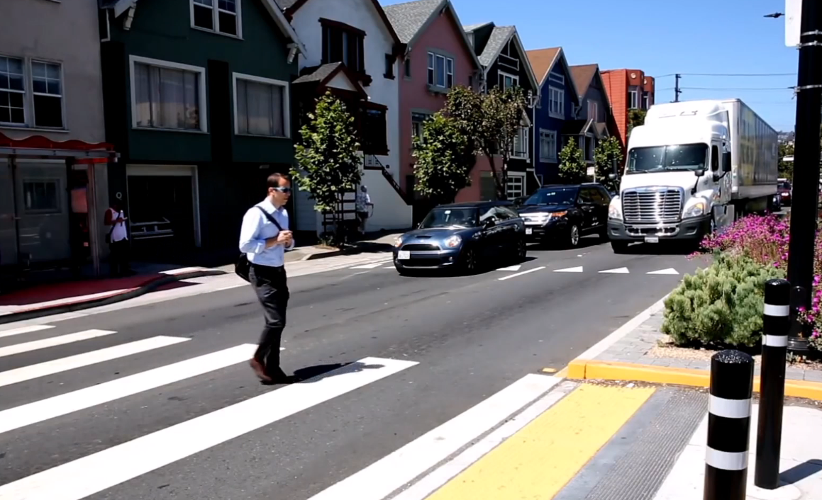
Notes:
Pedestrians

Slide 11
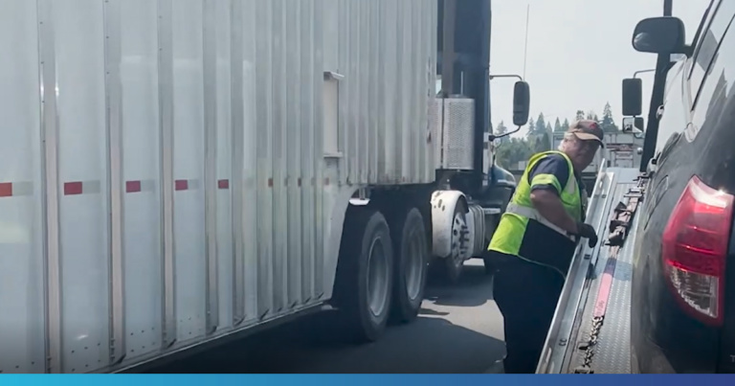
Notes:
Trucks

Slide 12
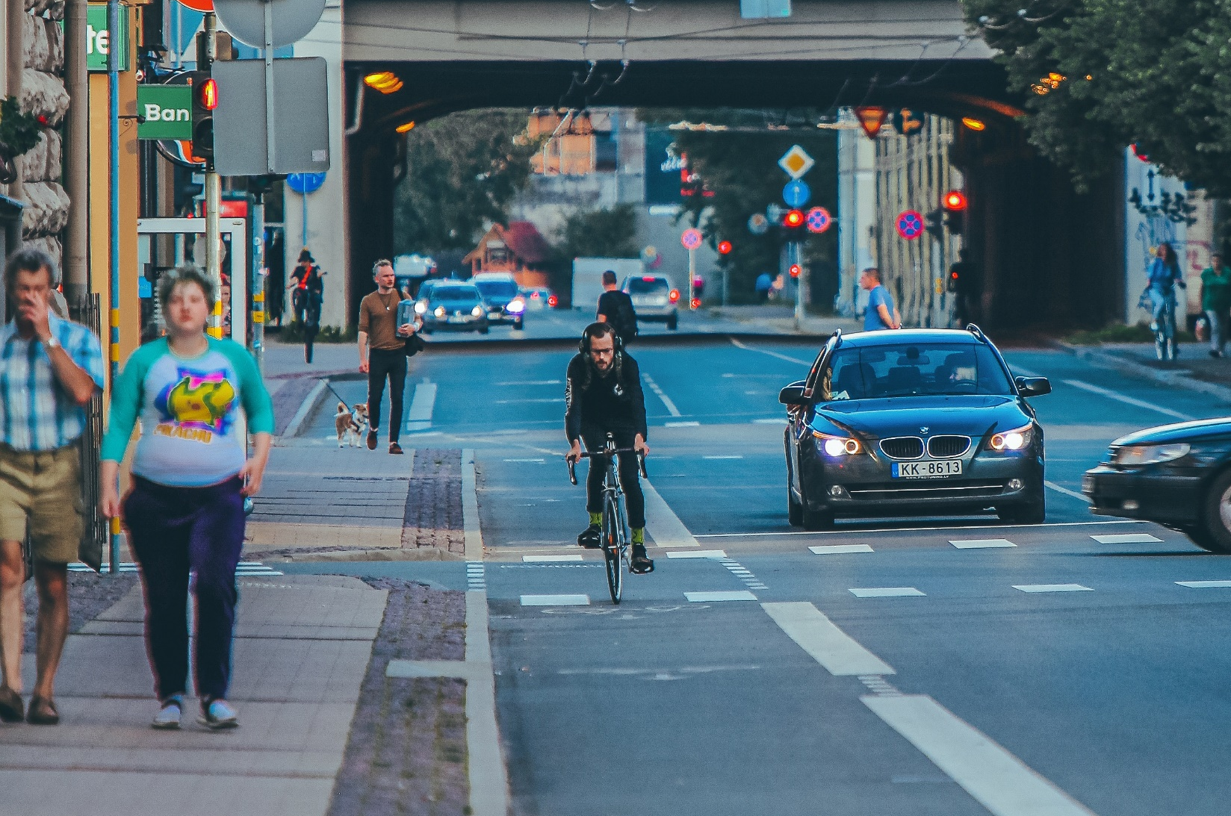
Notes:
Pedestrians/Cyclists

Slide 13
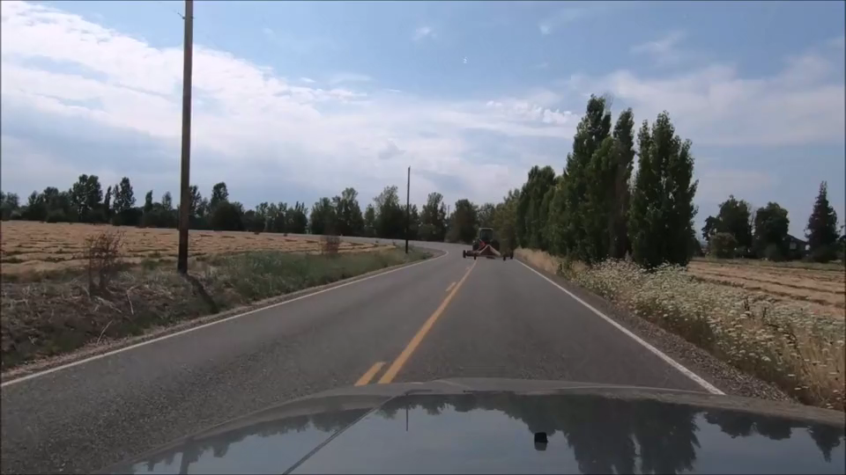
Space Management and Communication
Video Link

