Slide 1
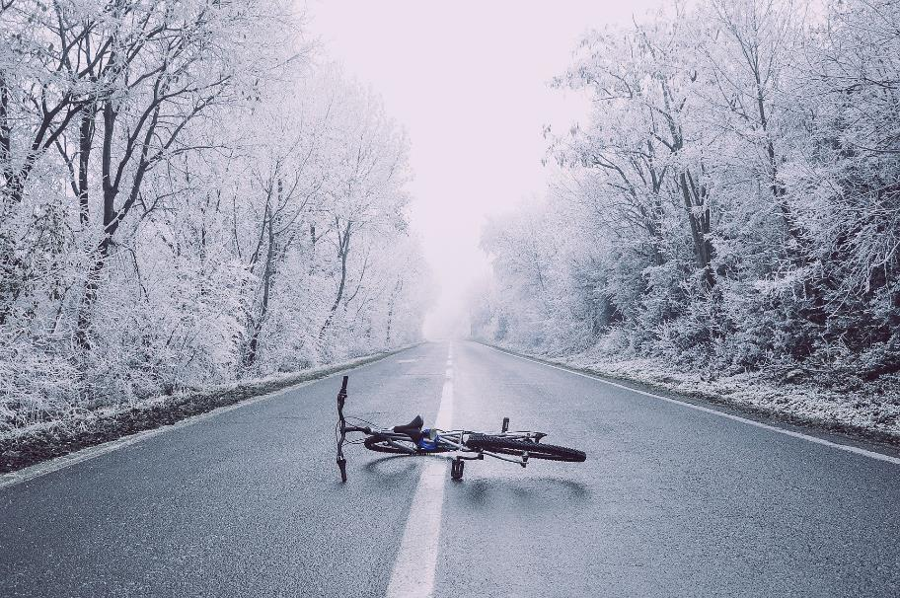
Cyclists

Slide 2
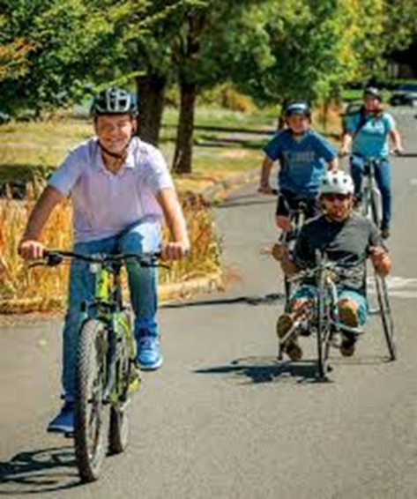
Bicycles on the roadway are vehicles with the same rights and responsibilities as motorized vehicles
Notes:
ORS 801.150 “Bicycle” means a vehicle that:(1)
Is designed to be operated on the ground on wheels;(2)
Has a seat or saddle for use of the rider;(3)
Is designed to travel with not more than three wheels in contact with the ground;(4)
Is propelled exclusively by human power; and(5)
Has every wheel more than 14 inches in diameter or two tandem wheels either of which is more than 14 inches in diameter. [1983 c.338 §22]

Slide 3
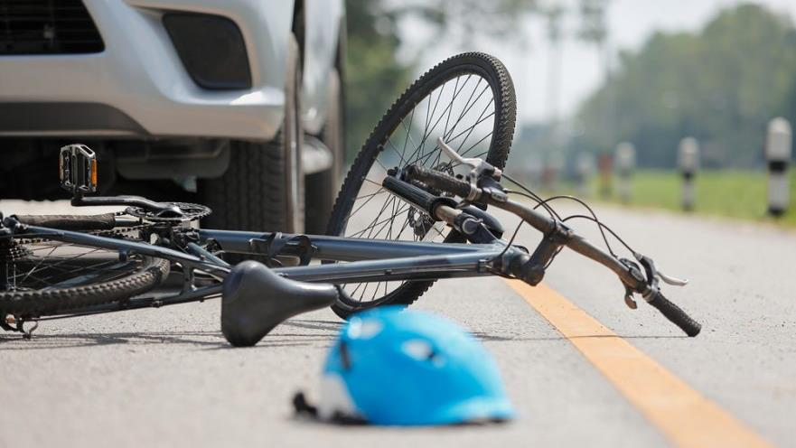
846 BICYCLISTS KILLED IN TRAFFIC CRASHES in 2019
Notes:
https://www.nhtsa.gov/road-safety/bicycle-safety
Cyclist deaths occurred most often between 6 p.m. and 9 p.m.
Most often in urban areas (78%) compared to rural areas (22%)
Deaths were 6 times higher for males than females
One in four fatal bike crashes in 2019 involved a bicyclist who had been drinking alcohol.

Slide 4
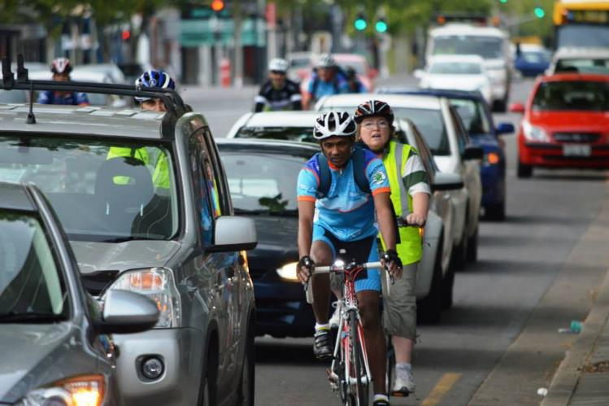
Why are they at risk?
- No protective shell
Hard to see
  Small and easily hidden
- Drivers do not always search for them, or see them when they search

Slide 5
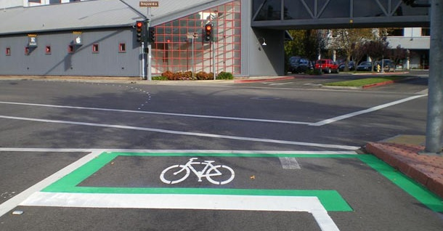
Pavement Markings and Bike Use

Slide 6
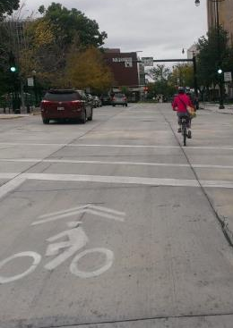
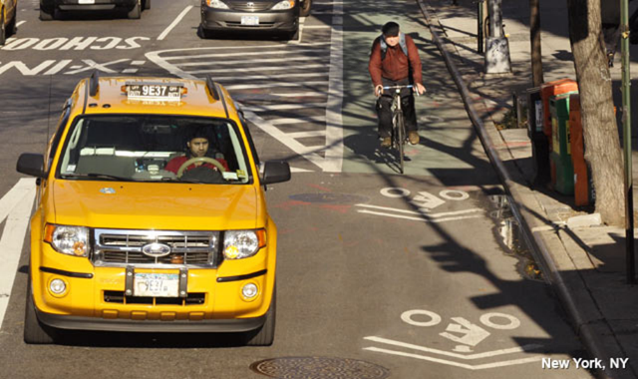
Can be faded
Can be confusing
Notes:
Photo Credit: National Association of City Transportation Officials
https://nacto.org/

Slide 7
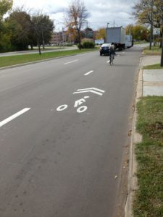
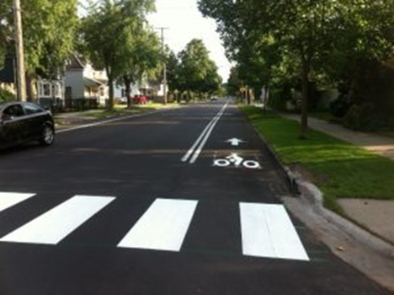
Bike Use Only

Slide 8
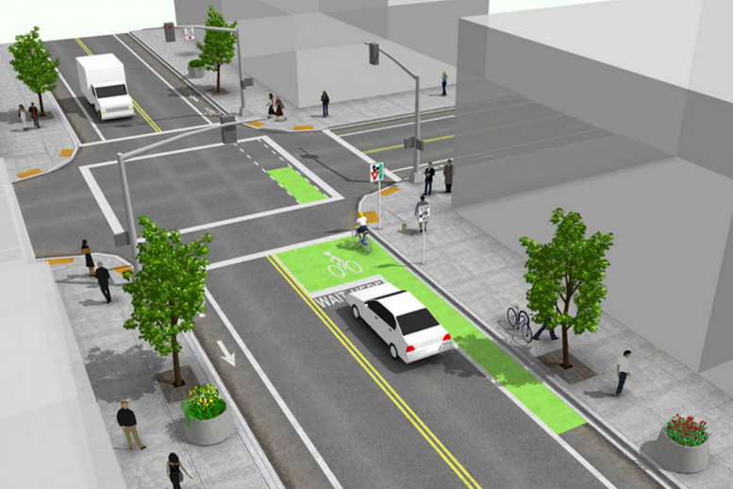
Bike Box
Notes:
The bike box helps prevent collisions between motorists and bicycles at intersections. It is typically a painted box on the road with a white bicycle symbol inside. Bicycle lanes approaching and leaving the box may also be painted.
Photo Credit: National Association of City Transportation Officials
https://nacto.org/

Slide 9
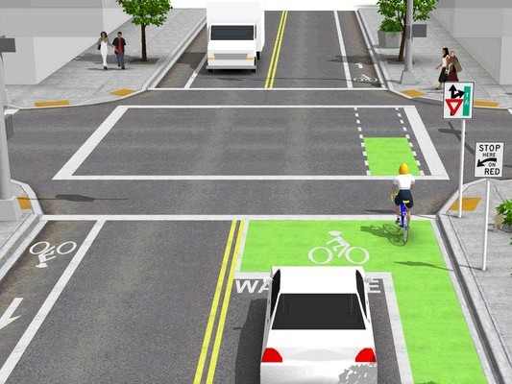
Bike Box
Notes:
Photo Credit: National Association of City Transportation Officials
https://nacto.org/

Slide 10
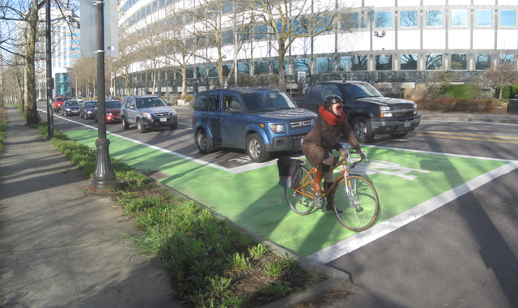
Notes:
Photo Credit: National Association of City Transportation Officials
https://nacto.org/

Slide 11
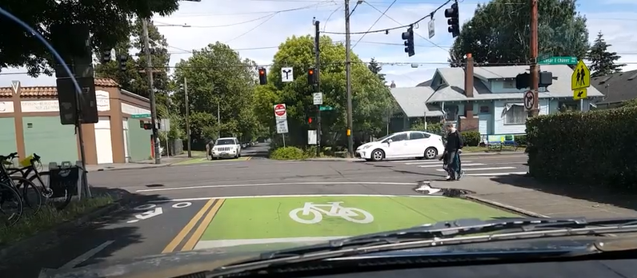

Slide 12
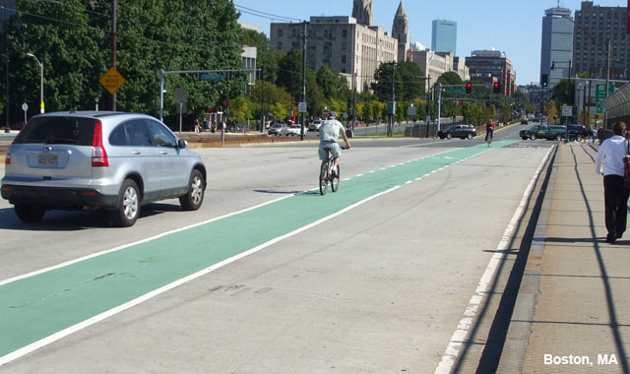
Bike Lanes
Notes:
Photo Credit: National Association of City Transportation Officials
https://nacto.org/

Slide 13
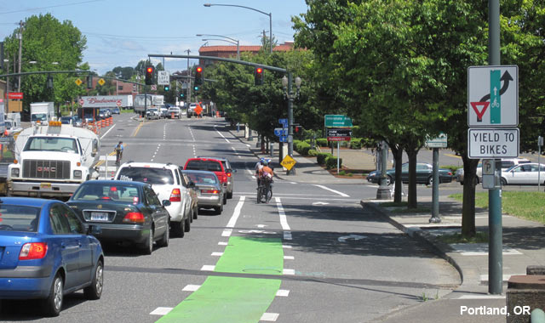
Notes:
Photo Credit: National Association of City Transportation Officials
https://nacto.org/

Slide 14
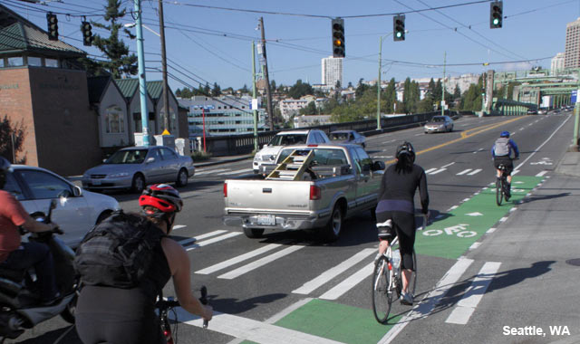
Notes:
Photo Credit: National Association of City Transportation Officials
https://nacto.org/

Slide 15
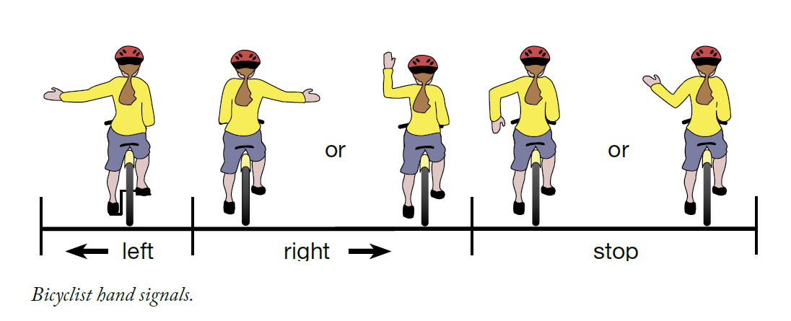
Hand Signals

Slide 16

Safe Passing Law
Video Link

Slide 17
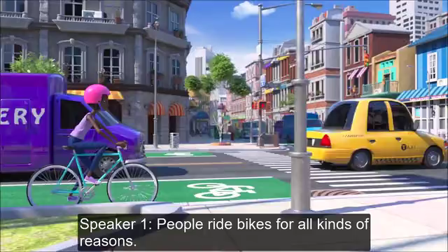
Stop as Yield
Video Link
Notes:
Oregon Stop as Yield Law (AKA “Idaho Stop”) Senate Bill 998, passed in June 2019, allows people riding bicycles in Oregon to treat stop signs and flashing red signals as yield signs beginning January 1, 2020 (ORS 811.260 and ORS 811.265 ORS 814.414, ORS 814.416). ODOT has developed educational materials for this legal change. Please access digital materials below. To order free printed brochures and rack cards to help educate the public on the Stop as Yield Law

