Slide 1
Buses
Video Link

Slide 2
When do I stop?

Slide 3
Undivided Road- no median

Slide 4
Undivided Road- no median

Slide 5
Undivided Road- no median

Slide 6
Multiple lanes
Both directions must stop

Slide 7
Median (paved, unpaved or a barrier)
Traffic on the same side as the bus must stop

Slide 8
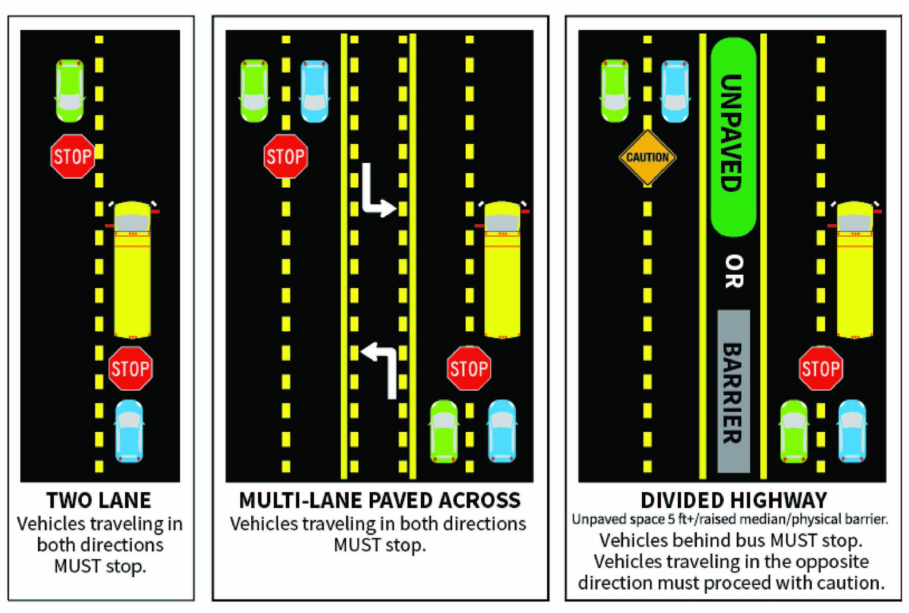
Median (paved, unpaved or a barrier)
Notes:
Worker transport buses may have stop light systems like school buses, The same responses are required
Photo credit: https://www.13abc.com/content/news/When-should-you-stop-for-a-school-bus-in-Michigan-559239141.html

Slide 9
City Buses
Notes:
Public transit buses often pull to a curb to load or unload passengers. To help protect these buses and their passengers when they re-enter a traffic lane, drivers of other vehicles approaching from the rear must yield when a bus driver signals to re-enter a traffic lane and there is an electric sign flashing “yield” on the back of the bus

Slide 10
When the turn signal and/or yield sign is activated, yield to the bus
Video Link
Notes:
Video Courtesy of Vancouver DashCam: https://www.youtube.com/watch?v=28qjXqQAtNc

