Slide 1
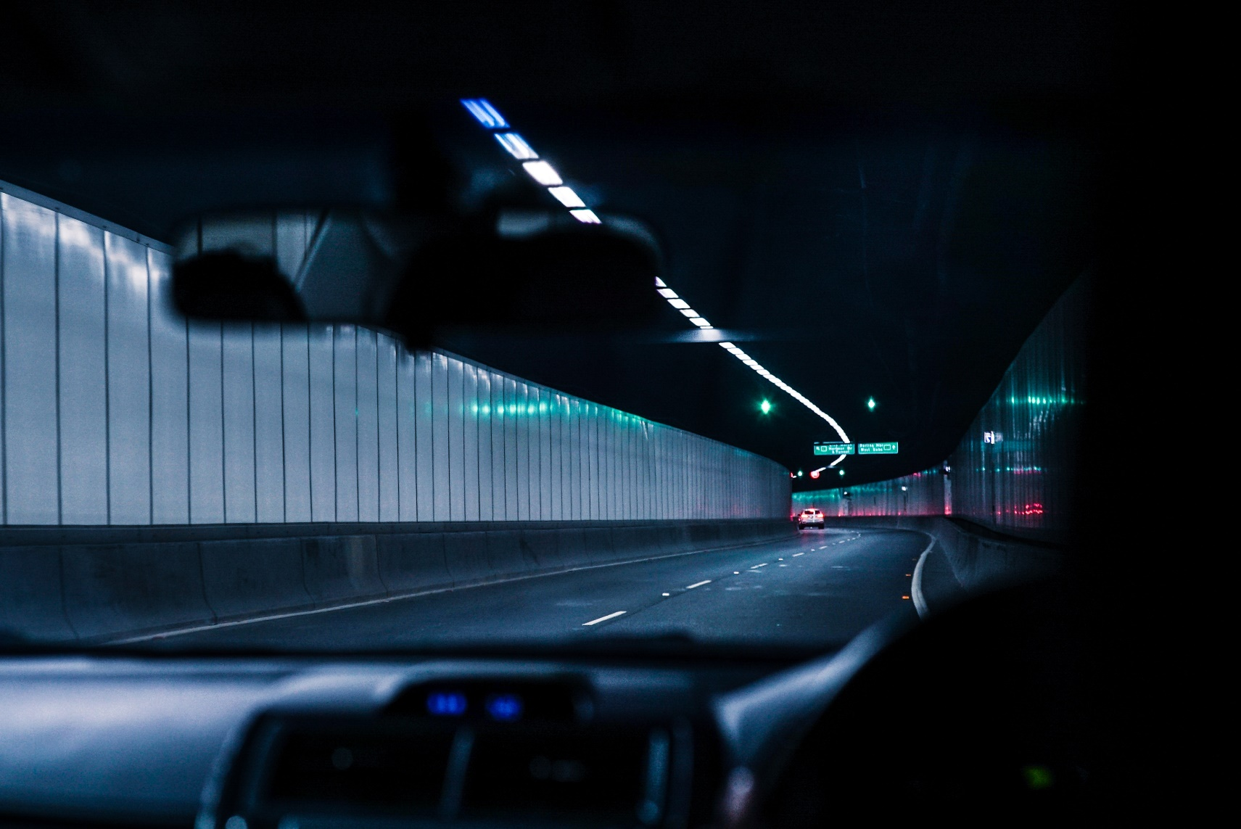
Driving at Night

Slide 2
Vehicle Readiness and Risk Reduction
Clean windows and lights
Turn internal lighting down
Correct high beam use

Slide 3
Adaptive Headlights
Adaptive Headlights Video Link

