Slide 1
Parent/Student Orientation
Welcome to Driver Education

Slide 2
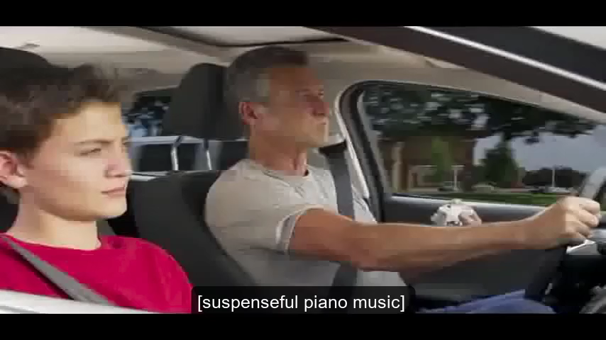
Partners in Learning
Video

Slide 3
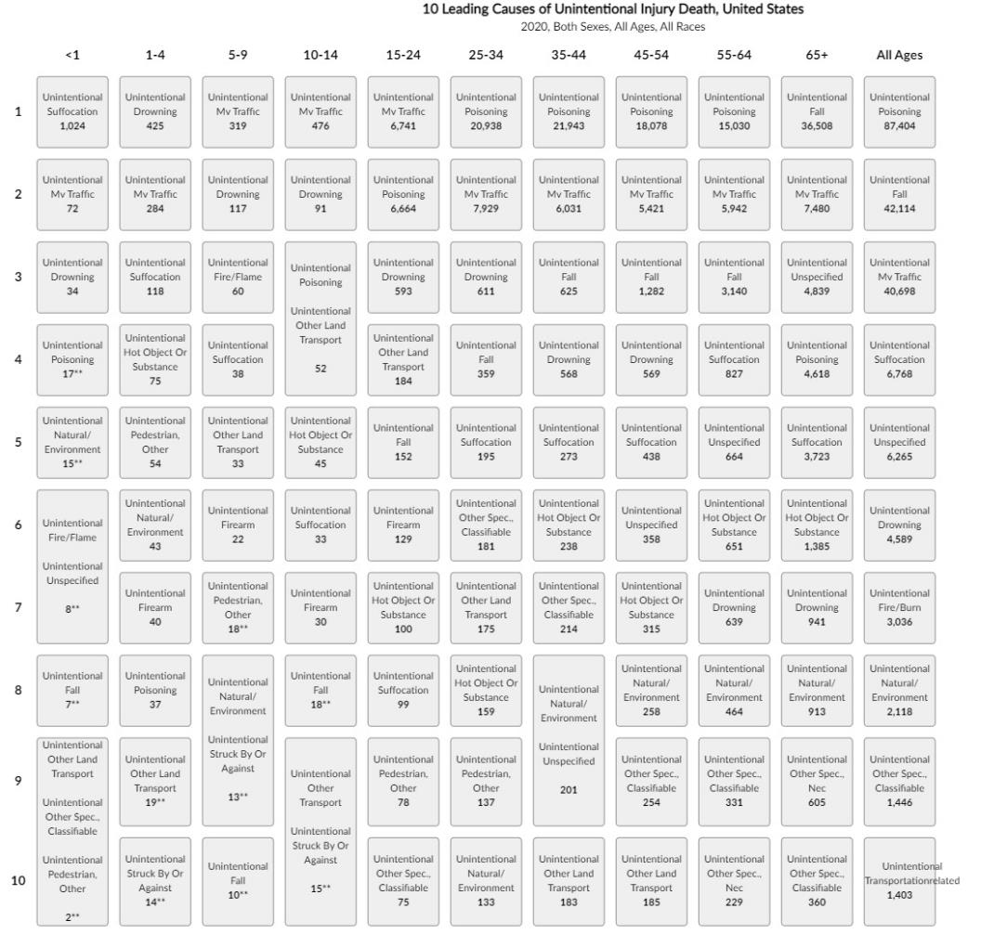

Top 10 Leading Causes of Unintended Deaths by Age Group -United States - 2020
Notes:
Source: https://wisqars.cdc.gov/data/lcd/home
Instructor can also show DMV Quick Facts: https://www.oregon.gov/odot/Data/Documents/QuickFacts_2020.pdf

Slide 4
You Set the Standards…
Talk about them
Model them
Enforce them
No exceptions
No excuses
Formal or Informal Vehicle-Use Contract

Slide 5
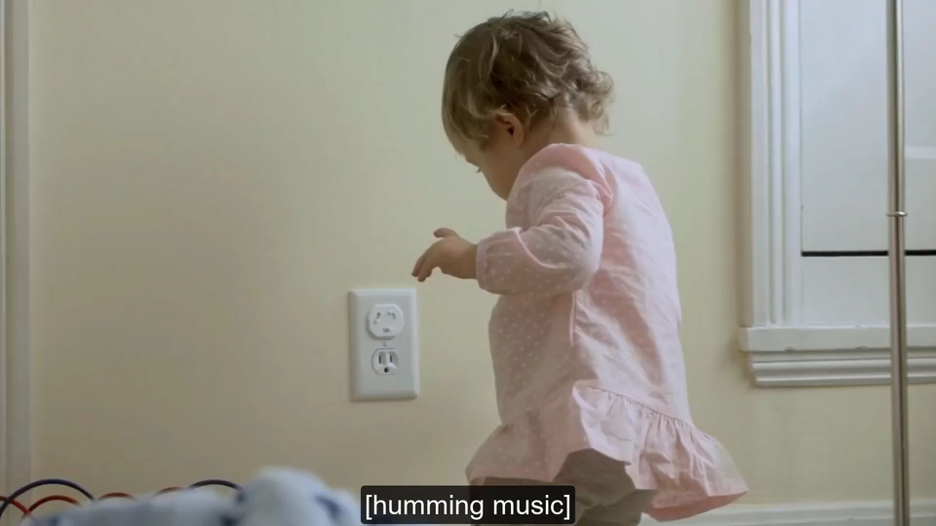
Set the Standards
Video

Slide 6
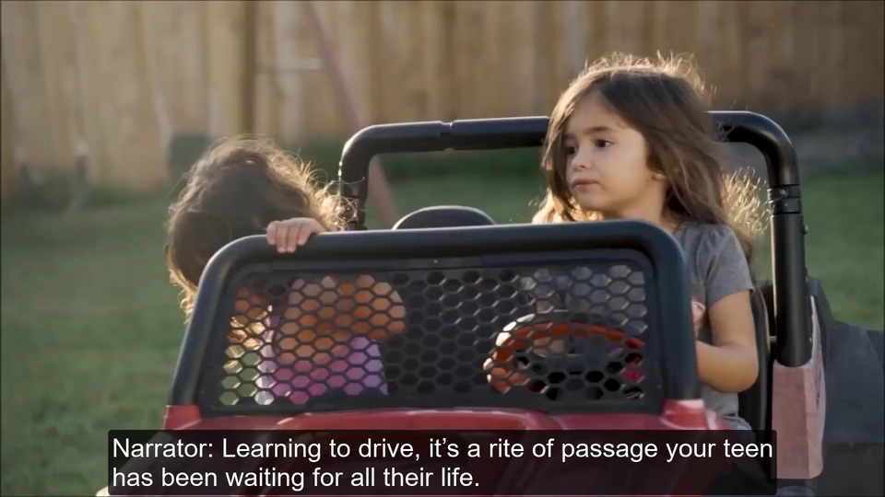
ODOT Approved DE Courses
It’s the Way to Go!
Video

Slide 7

Your Main Resource
Pre-assigned homework
so, you’ll be ready
to learn and practice
in class every day.
Complete your homework
before class.

Slide 8
Other Resources
Driver Manual
New Rules and Laws
Parent Guide to Teen Driving
Driving Logs
GDL Laws
Notes:
http://drowsydriving.org/resources/us-graduated-driver-licensing-laws-by-state/ (Link page to website or if no internet, use DMV Manual)

Slide 9
Requirements
Class In Car
Attend all 30 hours of classroom
Complete all assignments
(turn in by due date)
Participate in class activities
Be on time for all classes
No cell phones/iPods
Score 80% on exams and overall class assignment totals
Attend all 12 hours of in car instruction
Be on time for all drives
NO cell phones
Document and turn in a minimum of 5 hours supervised home practice (more time is always recommended)
Be well rested
Failure to complete class and in car hours will result in an additional fee

Slide 10
Did you know?
1. Mirror Settings
2. Steering Control
3. Vehicle Placement
And More

Slide 11
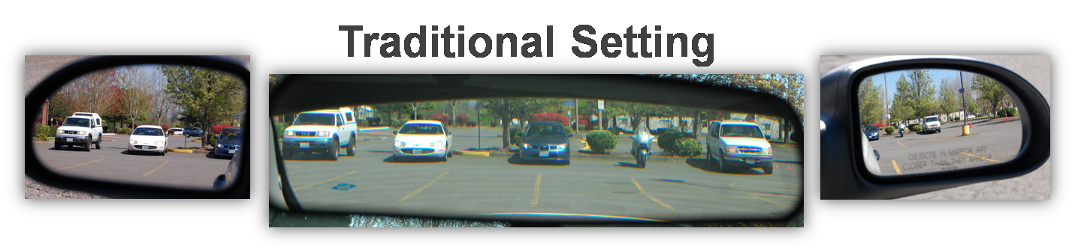
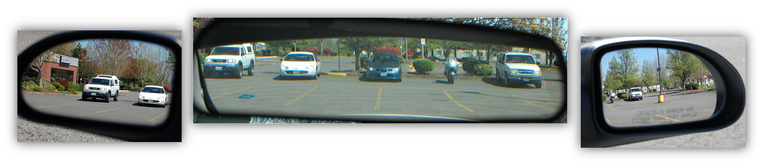
Mirror Settings- widens your view to the rear, which reduces the size of your blind spots.
Modified Setting

Slide 12
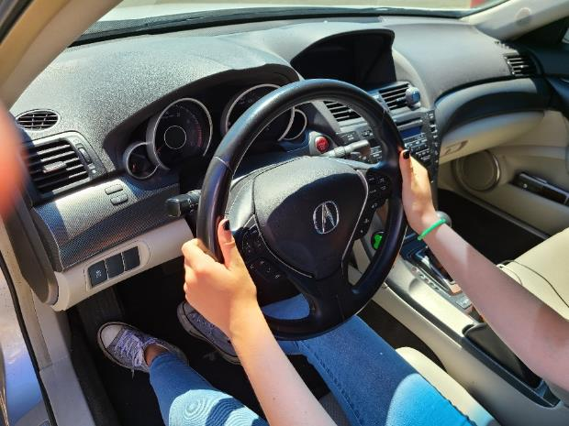
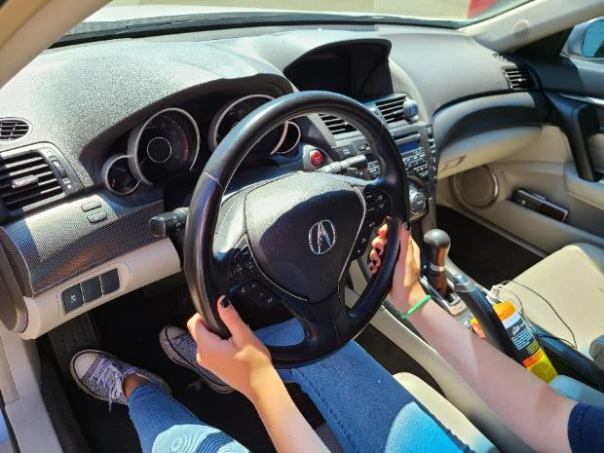
9 & 3 OR 8 & 4 knuckles out, thumbs up
Hand Positions

Slide 13
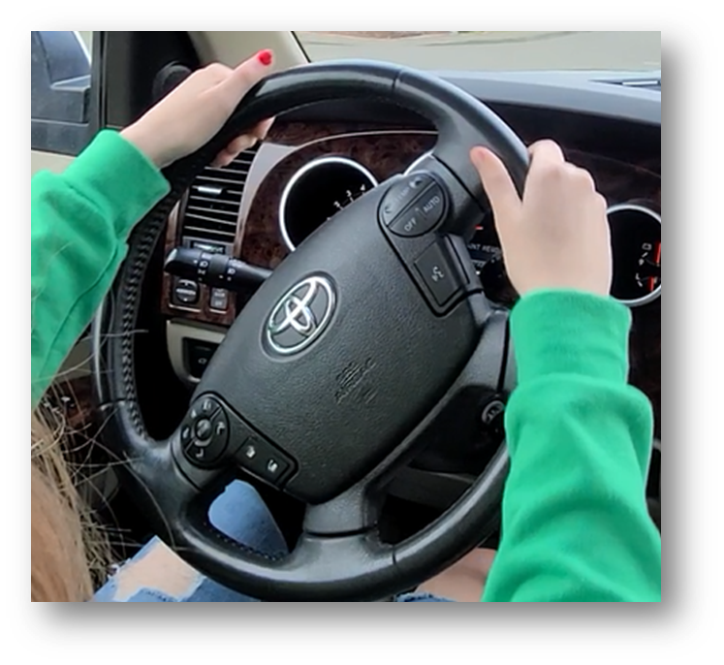
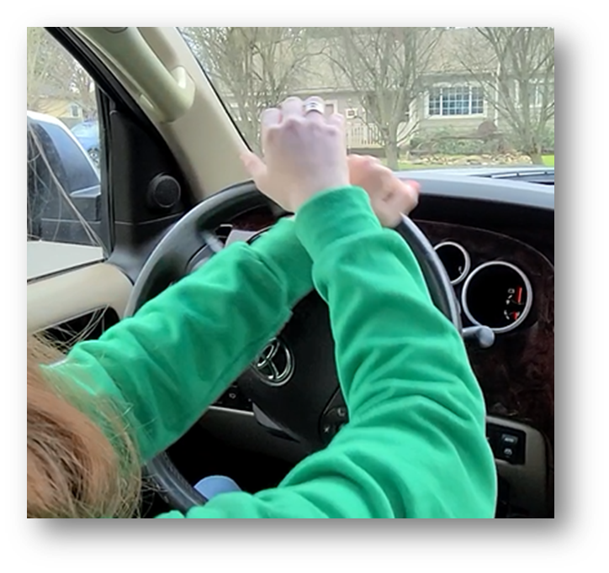
Steering
Push-Pull or Hand over Hand

Slide 14
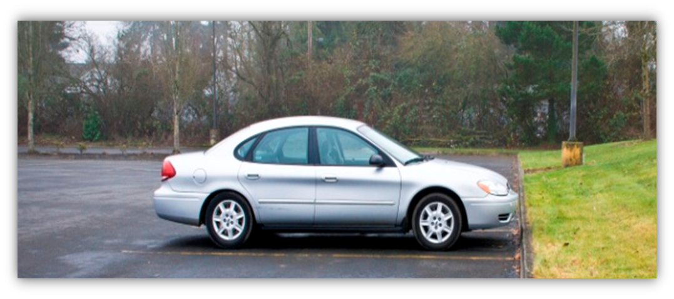
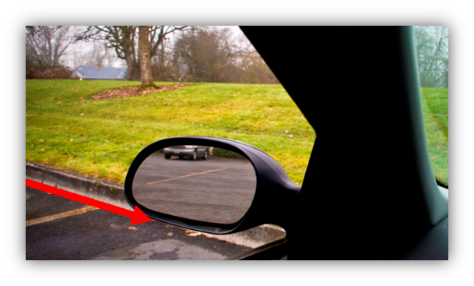
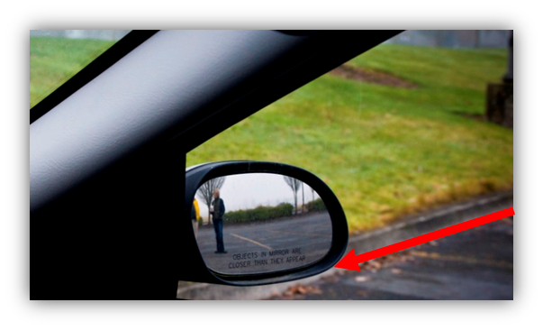
Front Position Reference Point
Front bumper is 3-6 inches away from bottom of curb
Driver’s View Reference Points:
Outside Rear-view Mirrors or Corner Posts
Passenger’s View Reference Points:
Outside Rear-view Mirrors or Corner Posts

Slide 15
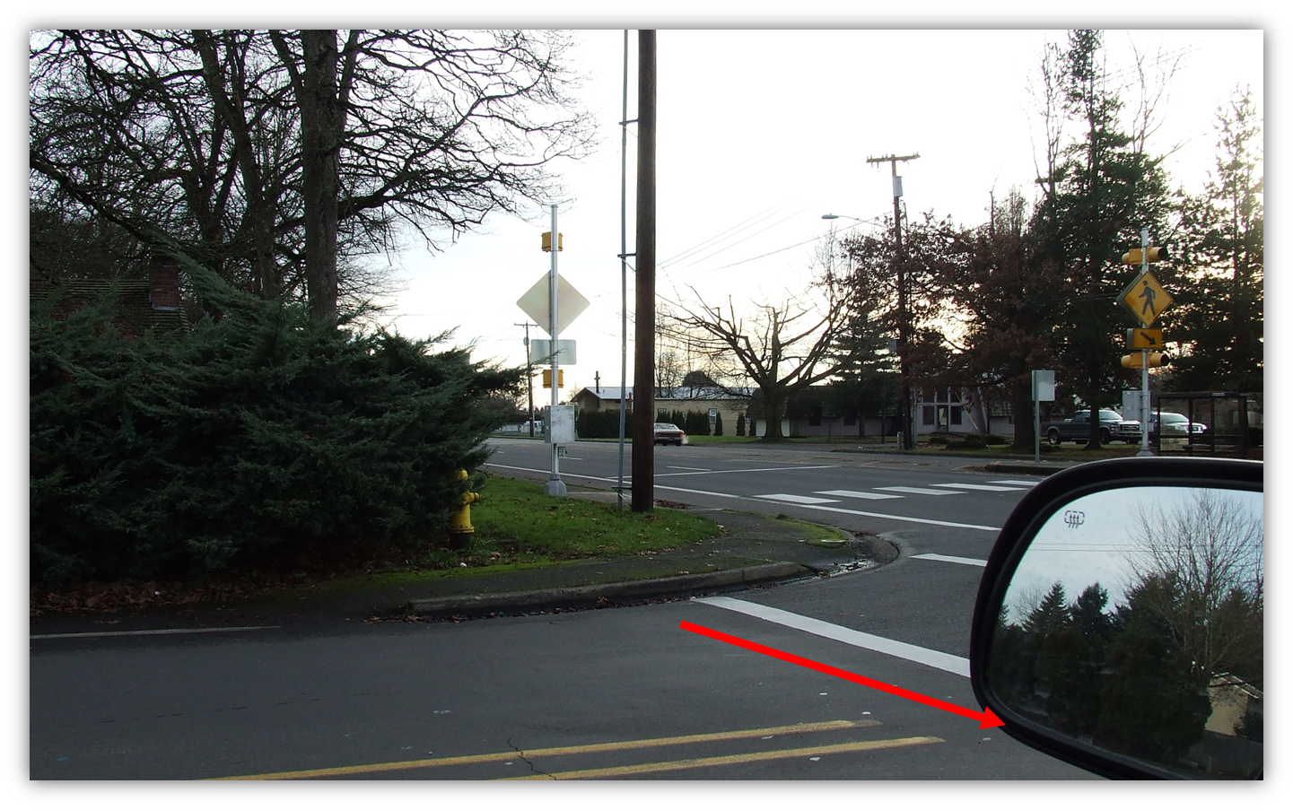
Use Reference Point for Legal Stops
Before stop line or
crosswalk - painted or implied
Front Limit: Bottom of passenger or driver side mirror just before crosswalk

Slide 16
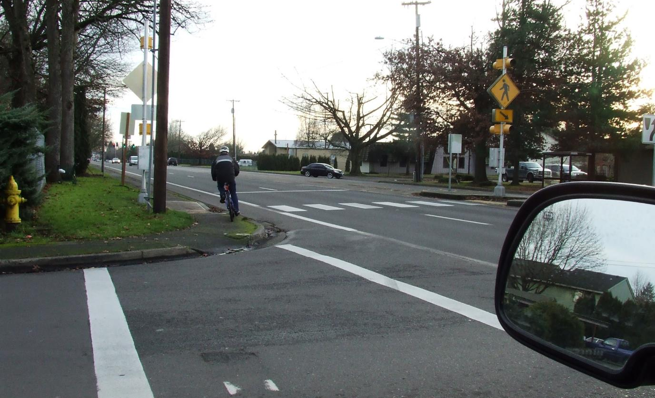
And Safety Stops
To get the best view
The front bumper is aligned with this part of the crosswalk.

Slide 17
Thank you!

