Slide 1
Precision Turns

Slide 2
Right Turns

Slide 3


Crossing Traffic
Right Turn
Side Position
With a bike lane
Lane Position 3
Notes:
Search all lanes and sidewalks

Slide 4
Crossing Traffic
Right Turn
Side Position
Without a bike lane
Side Position 3: 3 feet from curb
Notes:
Search all lanes and sidewalks

Slide 5
Crossing Traffic
Forward position
Turn your head and look towards the target. Turn the wheel when it appears that your mirror lines up with the curb.
Notes:
Turn head before steering input

Slide 6
Transition point – Right Turn
When the inside rearview mirror (transition point) aligns with the target, start to straighten the wheel and pivot from the brake to the accelerator.
Notes:
Moving turn-for a stopped turn you are already on the accelerator

Slide 7
Crossing Traffic
After the turn
Check the front and rear

Slide 8
Left Turns

Slide 9
Crossing Traffic
Left Turn
Side Position
Without oncoming traffic-
Lane Position 2
Notes:
Search all lanes and sidewalks

Slide 10

Crossing Traffic
Left Turn
Side Position
With oncoming traffic-
Lane Position 1
Notes:
Search all lanes and sidewalks

Slide 11
Crossing Traffic
Forward Position
See the target without
looking across the curb
Notes:
Search all lanes and sidewalks

Slide 12
Crossing Traffic
Transition point – Left Turn
When the left corner post (transition point) aligns with the target, start to straighten the wheel and pivot from the brake to the accelerator.
Notes:
Moving turn-for a stopped turn you are already on the accelerator

Slide 13
Crossing Traffic
After the turn
Check the front and rear
Notes:
Search all lanes and sidewalks

Slide 14

Crossing Traffic-
Which Lane?
Two-way to Two-way
Continuing forward
Turning right
Notes:
Have students identify correct lane

Slide 15

Crossing Traffic
Which Lane?
Two-way to Two-way
Continuing forward
Turning right
Notes:
Have students identify correct lane

Slide 16
Crossing Traffic
Which Lane?
Two-way to Two-way
Turning left
Notes:
Have students identify correct lane

Slide 17
Crossing Traffic
Which Lane?
Two-way to Two-way
Turning left
Notes:
Have students identify correct lane

Slide 18
Crossing Traffic
Which Lane?
One-way to Two-way
Turning left
Notes:
Have students identify correct lane

Slide 19
Crossing Traffic
Which Lane?
Two-way to One-way
Turning left
Notes:
Have students identify correct lane

Slide 20
Crossing Traffic
Which Lane?
Two-way to One-way
Turning left
Notes:
Have students identify correct lane

Slide 21
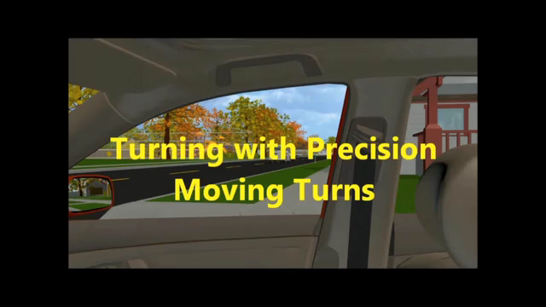
Turning with Precision- Moving Turns
Video Link

Slide 22

Turning with Precision- Stopped Turns
Video Link

