Slide 1
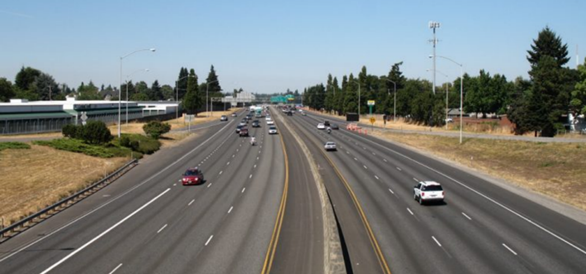
Limited Access Highway (Freeway)
Notes:
All roads open to public use are highways’
The roads that have limited access are called freeways

Slide 2
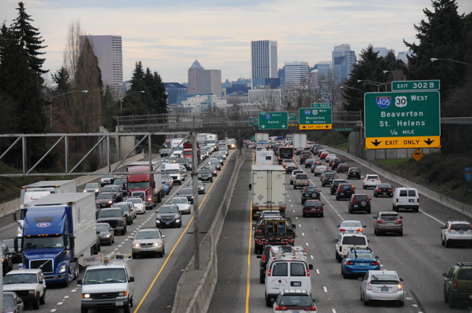
Freeways
- High speed (up to 70 mph)
- Usually divided by some type of barrier
- Multiple lanes
- Only for motorized vehicles
- Wide shoulders provide escape paths
- Signs help drivers plan well ahead

Slide 3



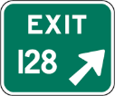
Guide Signs
North & South Roadways-Odd Numbered
East & West Roadways-Even Numbered
Mile markers start at 1 at southern and westerly borders
Exit numbers coincide with mile markers

Slide 4
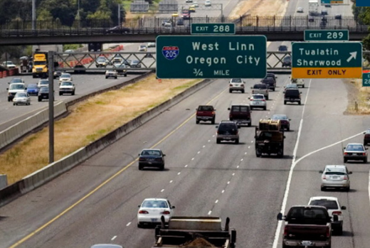
Different from city driving
  - No intersections
  - No cross traffic or railroads
  - No stopping or parking
  - No pedestrians
  - Limited access

Slide 5
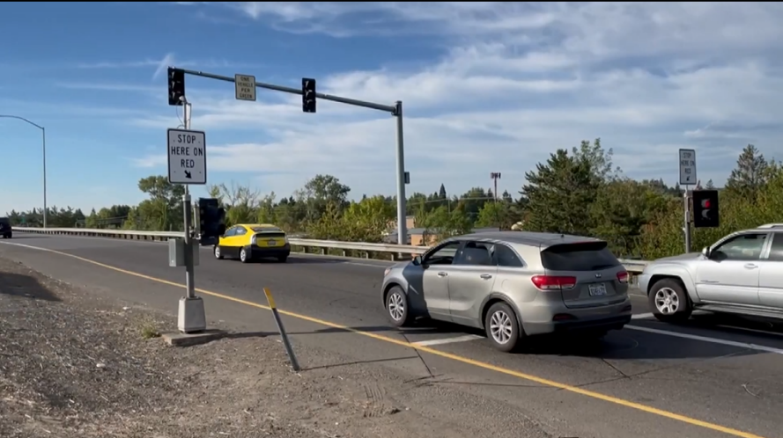
Entrance Ramps with Lights
Notes:
1 car per green

Slide 6
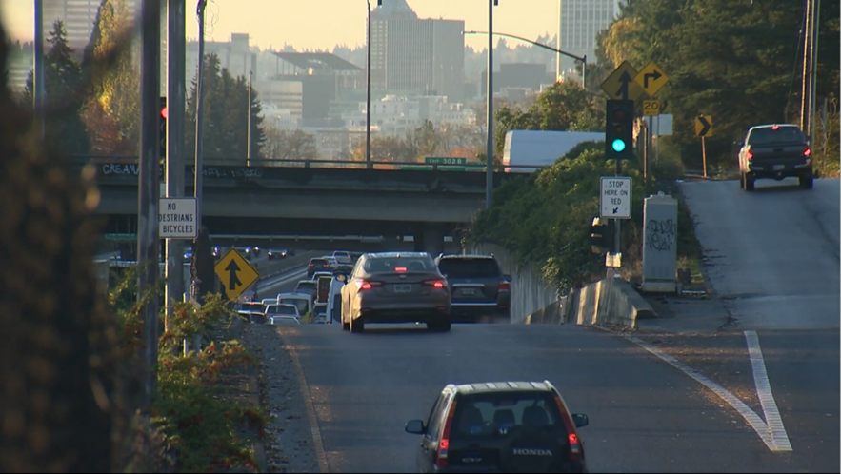
Entrance Ramps with Lights

Slide 7
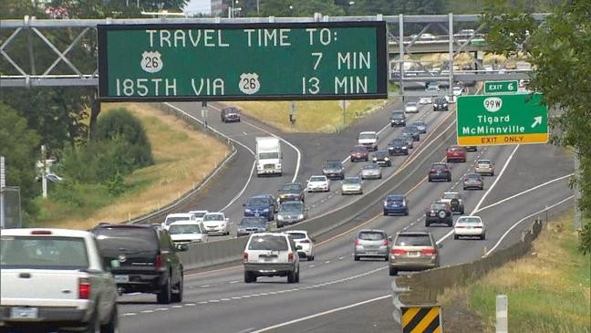
Signs Give Us Information
Notes:
Travel time
Lane use
Closures
Delays

Slide 8
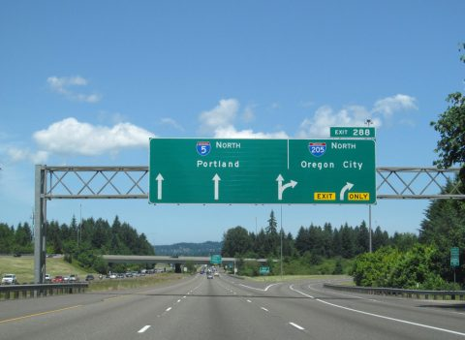
Signs Help Us Prepare
Notes:
Be in the correct lane early

Slide 9







Entering
- - - - - - - - - - - - - - - - - - - - - - - - - - - - - - - - - - - - - - - - - - - - - - - - - - - -
- - - - - - - - - - - - - - - - - - - - - - - - - - - - - - - - - - - - - - - - - - - - - - - - - - - - -
Merge Area
Acceleration Area
Entry Ramp

Slide 10


Acceleration/Deceleration Lane
- - - - - - - - - - - - - - - - - - - - - - - - - - - - - - - - - - - - - - - - - - - - - - - - - - - -
- - - - - - - - - - - - - - - - - - - - - - - - - - - - - - - - - - - - - - - - - - - - - - - - - - - -
-------------------------------------------------------------------------------------------------
Weave Lane

Slide 11
Entering the Freeway- Video Link
Notes:
This is from R2 so make sure you point out the use of “Zone” rather than the terms “Space” or “Area” we are using in R3

Slide 12

Lane Use
- - - - - - - - - - - - - - - - - - - - - - - - - - - - - - - - - - - - - - - - - - - - - - - - - - - -
- - - - - - - - - - - - - - - - - - - - - - - - - - - - - - - - - - - - - - - - - - - - - - - - - - - -
-------------------------------------------------------------------------------------------------
Left Lane: HOV and Passing
Center Lane: Through Traffic
Right Lane: Enter, Exit and Slower Moving Traffic
Notes:
High Occupancy Vehicle (HOV)

Slide 13
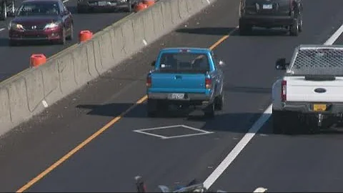
Pavement Markings

Slide 14
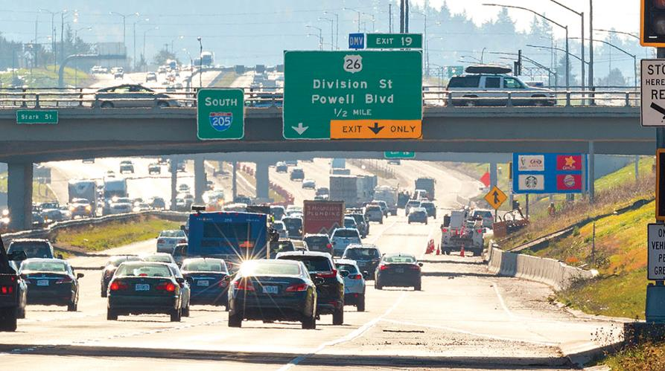
Exiting
Notes:
Plan ahead
Be in the correct lane
Maintain speed

Slide 15
- - - - - - - - - - - - - - - - - - - - - - - - - - - - - - - - - - - - - - - - - - - - - - - - - - - -
- - - - - - - - - - - - - - - - - - - - - - - - - - - - - - - - - - - - - - - - - - - - - - - - - - - -
Exiting

Slide 16
Exiting the Freeway- Video Link

