Slide 1
Following Distance

Slide 2
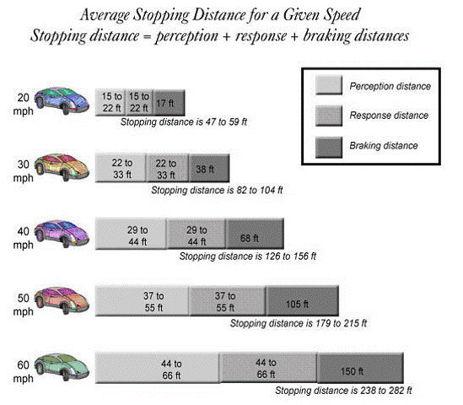
Following Distance
Remember your vehicle needs enough space to stop safely if needed.
The chart shows an average for a passenger vehicle in ideal conditions.
Photo: Florida Safety Council
Notes:
Inform students that we will discuss in later chapters other instances to increase following distance and what else increases our stopping distance.
Photo: Florida Safety Council- http://bdi.floridasafety.org/topics/english/module6english.html

Slide 3
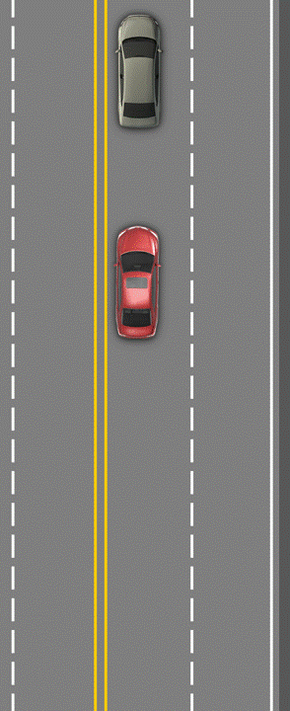
You’re the driver of the red car
1 second following
time

Slide 4
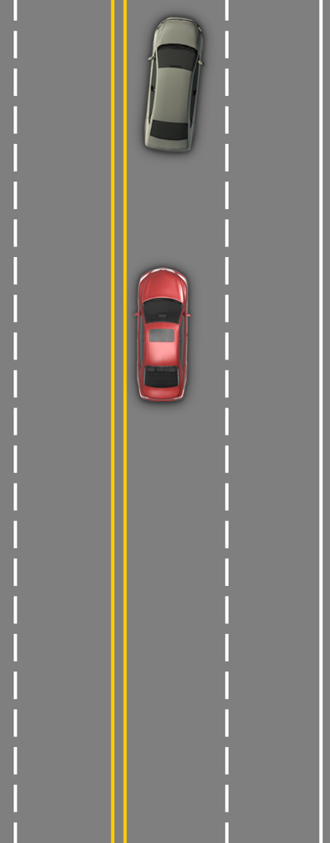
You’re the driver of the red car.
1 second following
time
What actions would you
take to avoid a crash?
Link to Video
Notes:
Conducting the Activity:
Hand out simulated steering wheels.
The activity begins by asking learners: What actions would you take to avoid a crash? Listen to their answers and be prepared to observe their feet and hands during the video clip that follows. Some will brake and steer right, others will steer left into the path of oncoming traffic, some will just hit the brake, and some will freeze and take no actions. There may be a few learners who actually come off the pedals and steer for open space; they will not however, take three steering actions. Each action will result in failure to control the emergency.
Make this point: in an emergency your habits take over.
Explain what actions are needed to make a successful emergency lane change, then allow them to practice those actions several times with each following time interval.
As you near the end of the presentation, expect some learners will conclude that braking is a better alternative action to take than evasive steering. Give them positive feedback and continue through the last slides.

Slide 5
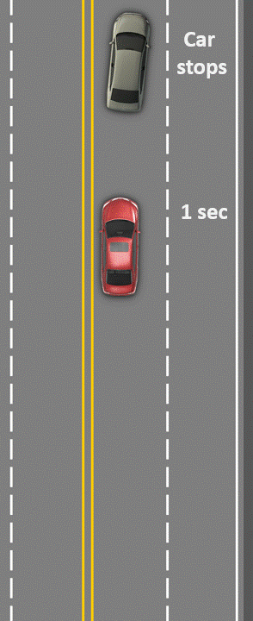
A braking action won’t stop your car in time.
Hard braking plus a hard steering actions creates an out of balance condition that can cause a skid and loss of control.

Slide 6
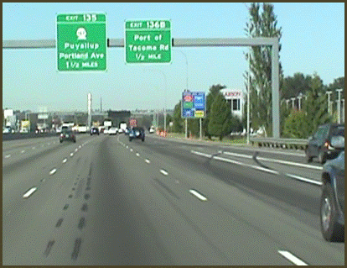
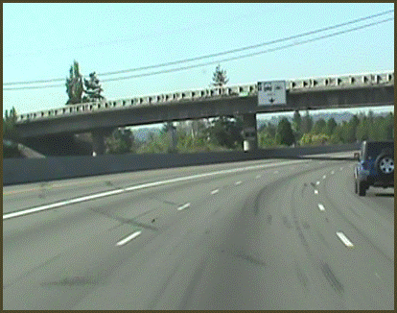
To prevent a collision and make an evasive action successfully you MUST be able to:
Target an open space
Separate hard braking from hard steering
Take three steering actions without hesitations

Slide 7
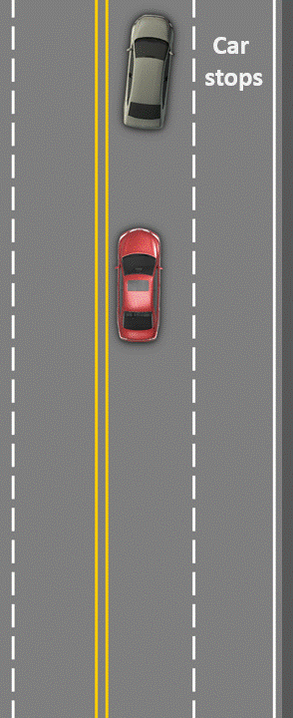
You’re the driver of the red car.
1 second following
time

Slide 8
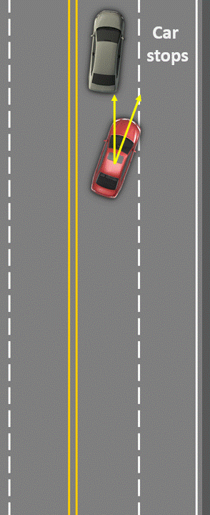
Target open space, off the pedals
& three steering inputs:
1 second following
time
Steer
Right
Steer
Left
Steer
Right
all in 1 second!
You won’t prevent a collision with only one second of time,
no matter how much you practice!

Slide 9
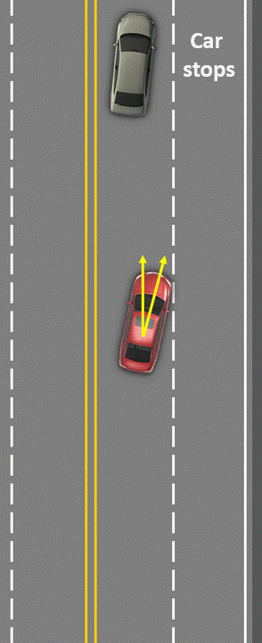
Target open space, off the pedals
& these three steering inputs:
2 seconds following
time
Steer
Right
Steer
Left
Steer
Right
all in 2 seconds!
You might be able to prevent a collision
with two seconds of time.

Slide 10
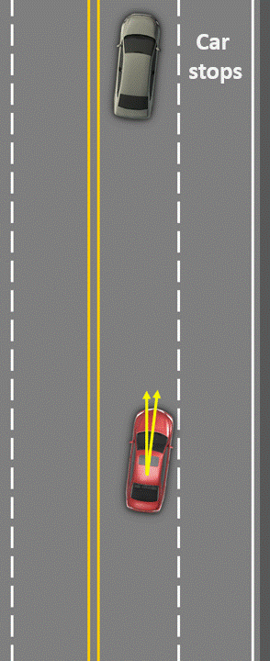
Target open space, off the pedals
& these three steering inputs:
3 seconds following
time
Steer
Right
Steer
Left
Steer
Right
all in 3 seconds!
Could you prevent a collision
in three seconds?

Slide 11
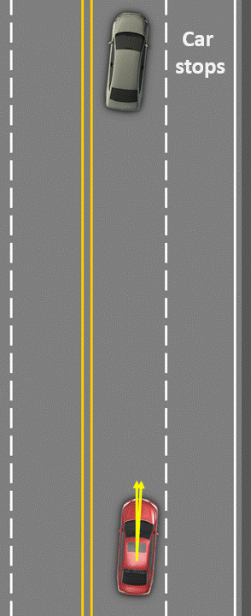
Target open space, off the pedals
& only these three steering inputs:
4 seconds following
time
Steer
Right
Steer
Left
Steer
Right
all in 4 seconds!
Could you prevent a collision
in four seconds?
Notes:
Conducting the Activity:
Hand out simulated steering wheels.
The activity begins by asking learners: What actions would you take to avoid a crash? Listen to their answers and be prepared to observe their feet and hands during the video clip that follows. Some will brake and steer right, others will steer left into the path of oncoming traffic, some will just hit the brake, and some will freeze and take no actions. There may be a few learners who actually come off the pedals and steer for open space; they will not however, take three steering actions. Each action will result in failure to control the emergency.
Make this point: in an emergency your habits take over.
Explain what actions are needed to make a successful emergency lane change, then allow them to practice those actions several times with each following time interval.
As you near the end of the presentation, expect some learners will conclude that braking is a better alternative action to take than evasive steering. Give them positive feedback and continue through the last slides.

Slide 12
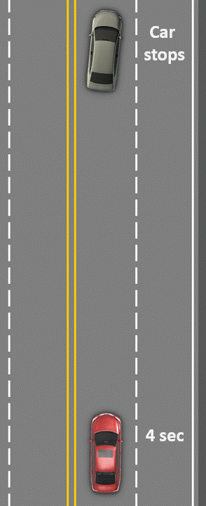
At this distance, a low-risk braking action is a better option!
Link to video

Slide 13
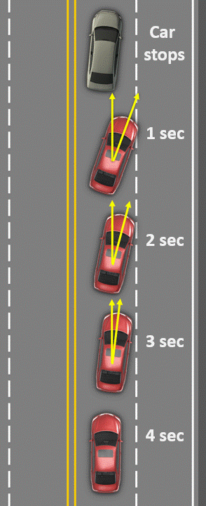
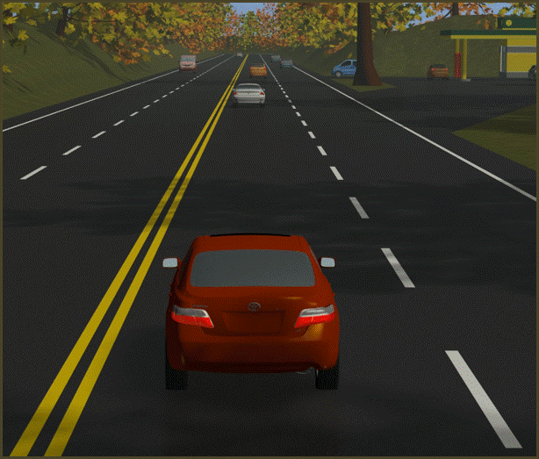
Create Control or Give it Away?

Slide 14
Following too close
Blocks your view to the target area
Prevents you from gathering information.
Only allows time to respond
Increases the chance of becoming involved in a crash
Video link

Slide 15
Judging Following Distance
How many seconds should we have between us and a vehicle in the front?
4 seconds
How many seconds should we have between us and a large truck or motorcycle in the front?
6 seconds
How do we count seconds?
one thousand one, one thousand two, one thousand three, one thousand four

Slide 16
Video link

Slide 17
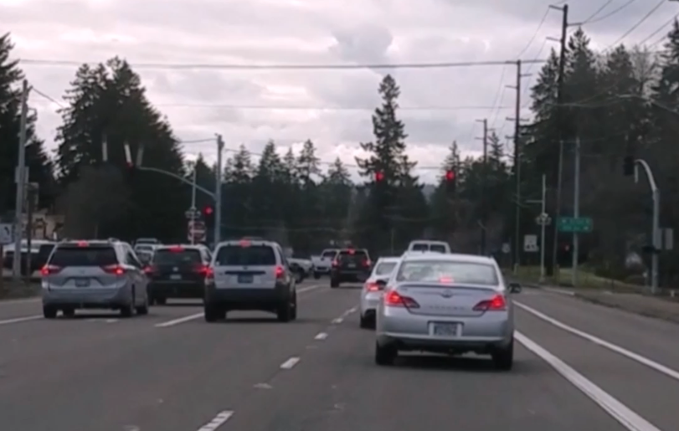
Following Distance
In the video, determine if the following distance:
Increasing
Decreasing
Staying the same
Video link

Slide 18
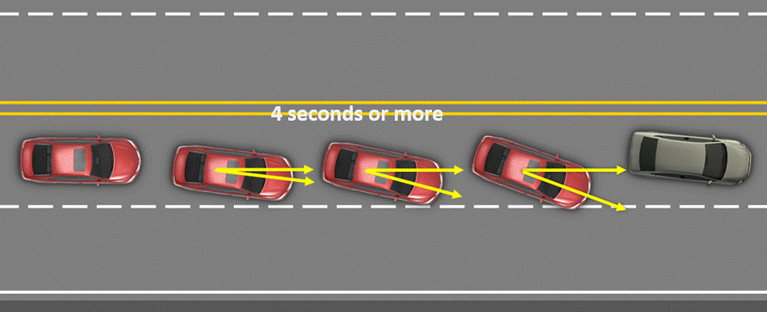
Maintain space for control

Slide 19
When I Say Stop Activity
Notes:
Activity Directions listed in IM- Same activity as R2

