Slide 1
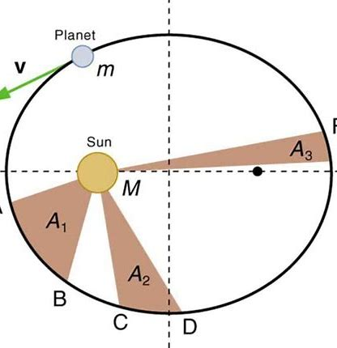
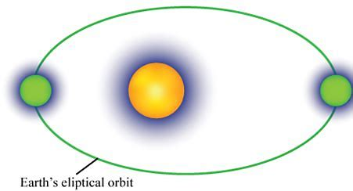
2 Body Equation of Motion
2 Body Equation of Motion (EOM)
Solution

Slide 2
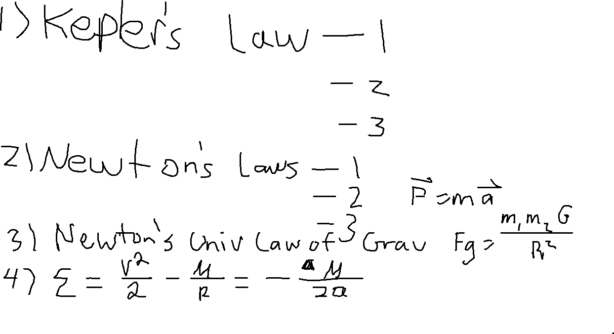

Slide 3
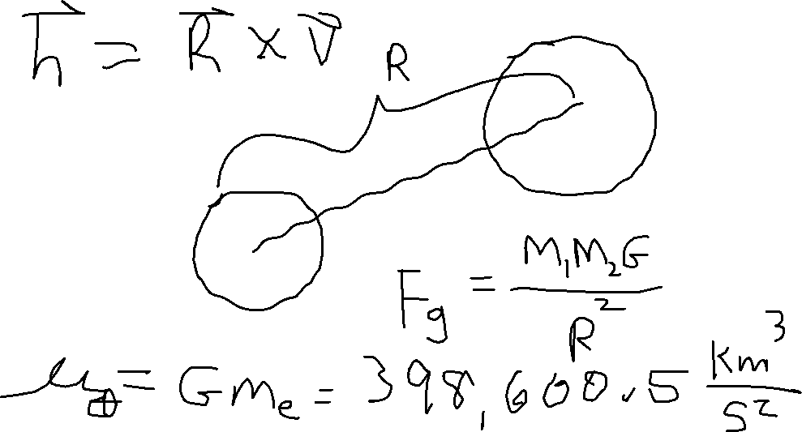

Slide 4
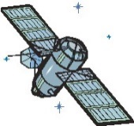
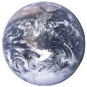
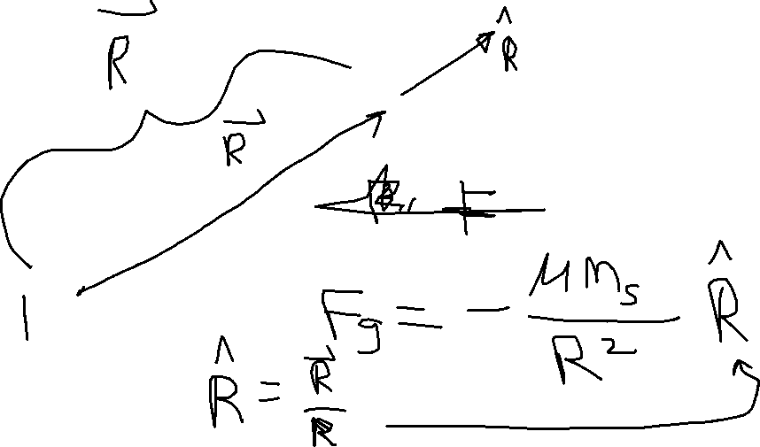
2 BODY EQUATION OF MOTION (EOM)
$${\overset{⃑}{F}}_{g}$$

Slide 5
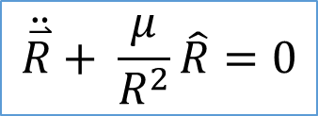
2 BODY EQUATION OF MOTION (EOM)
$$\hat{R}$$
Derivation not shown here
$$\ddot{\overset{⃑}{R}}+ \frac{μ}{R^{2}}\hat{R}=0$$
$${\overset{⃑}{F}}_{g}$$
$\overset{⃑}{R}$ = position vector
$\dot{\overset{⃑}{R}}= \overset{⃑}{V}$ = velocity vector
$\ddot{\overset{⃑}{R}}= \overset{⃑}{a}$ = acceleration vector
$\hat{R}=$ unit vector in $\overset{⃑}{R}$ direction
μ = G$m_{e}$
Alternate form:
$$\ddot{\overset{⃑}{R}}+ \frac{μ}{R^{3}}\overset{⃑}{R}=0$$

Slide 6
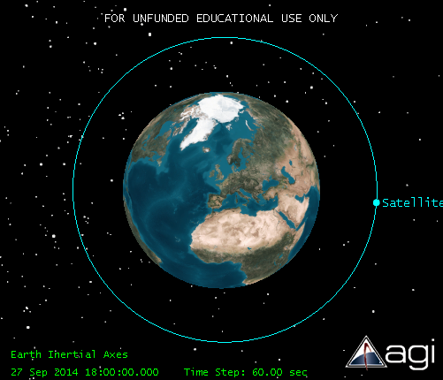
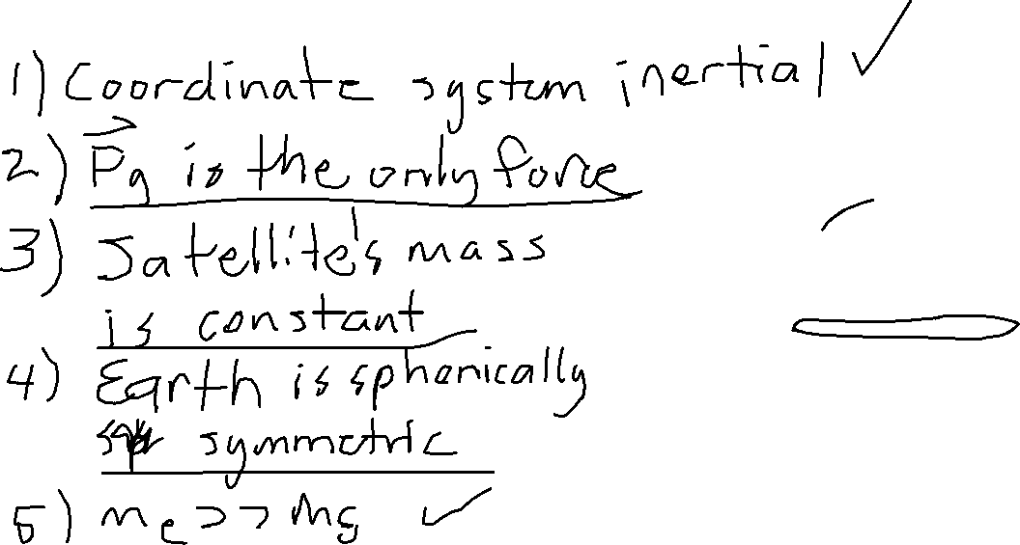
ASSUMPTIONS
$${\overset{⃑}{F}}_{g}$$

Slide 7
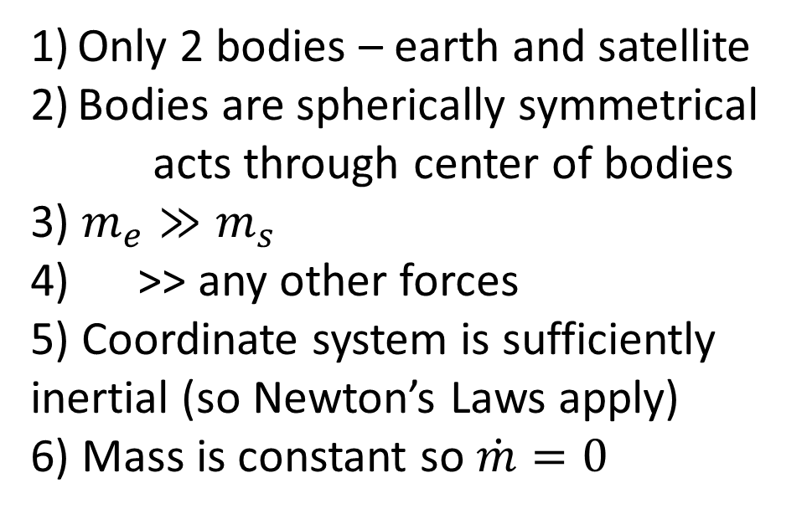
ASSUMPTIONS
Only 2 bodies – earth and satellite
Bodies are spherically symmetrical
acts through center of bodies
3) $m_{e}≫m_{s}$
>> any other forces
5) Coordinate system is sufficiently inertial (so Newton’s Laws apply)
6) Mass is constant so $\dot{m}=0$
$${\overset{⃑}{F}}_{g}$$
$${\overset{⃑}{F}}_{g}$$
$${\overset{⃑}{F}}_{g}$$

Slide 8

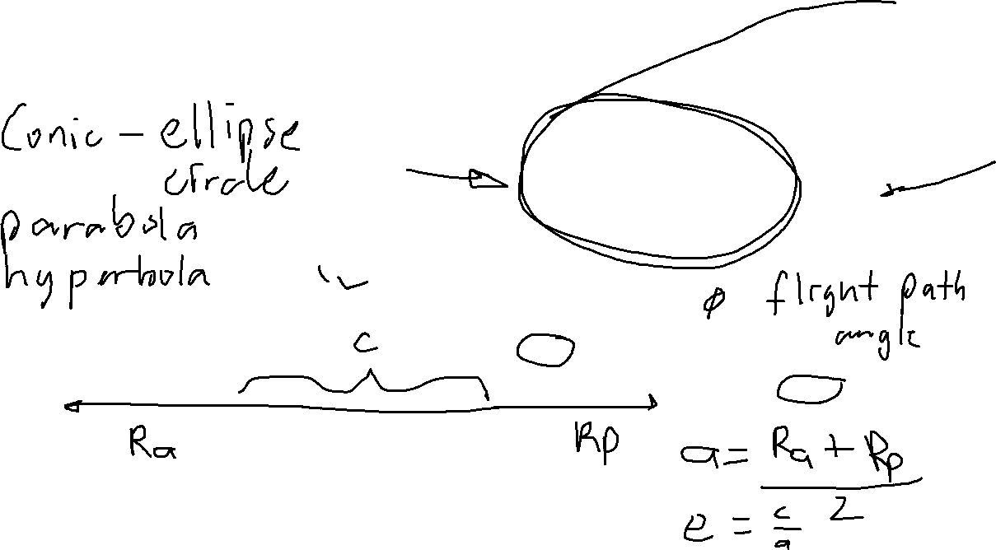
SOLUTION TO 2 BODY EOM
$$R= \frac{a(1−e^{2})}{1+ecos\text{ν} }$$
$$\overset{⃑}{V}$$
φ
$$\overset{⃑}{R}$$
ν
apogee
$$\overset{⃑}{e}$$
$$°$$
perigee
F’
F
2a

Slide 9
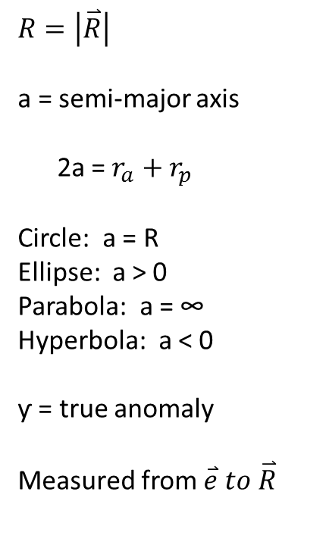
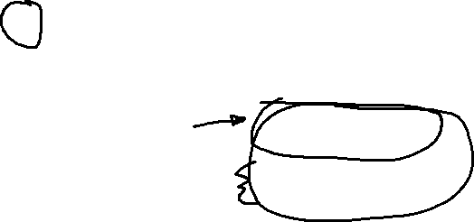
SOLUTION TO 2 BODY EOM
$$\overset{⃑}{V}$$
φ
$$R=\left|\overset{⃑}{R}\right|$$
a = semi-major axis
2a = $r_{a}+r_{p}$
Circle: a = R
Ellipse: a > 0
Parabola: a = ∞
Hyperbola: a < 0
ƴ = true anomaly
Measured from $\overset{⃑}{e} to \overset{⃑}{R}$
$$\overset{⃑}{R}$$
apogee
$$\overset{⃑}{e}$$
$$°$$
perigee
F’
F
2a
$$r_{a}$$
$$r_{p}$$
c

Slide 10
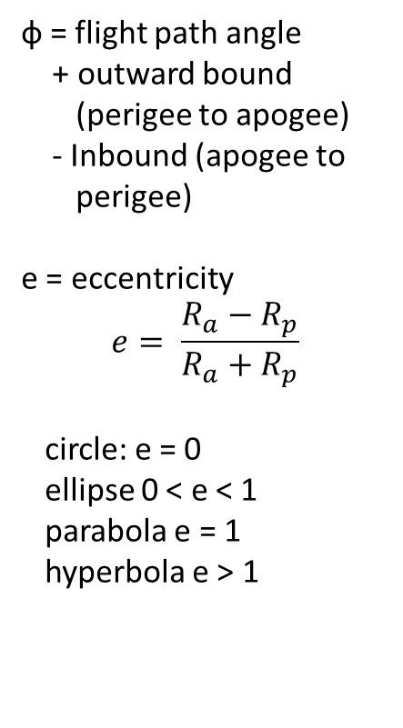
SOLUTION TO 2 BODY EOM
$$\overset{⃑}{V}$$
φ
ф = flight path angle
+ outward bound
(perigee to apogee)
- Inbound (apogee to
perigee)
e = eccentricity
$$e= \frac{R_{a}−R_{p}}{R_{a}+R_{p}}$$
circle: e = 0
ellipse 0 < e < 1
parabola e = 1
hyperbola e > 1
$$\overset{⃑}{R}$$
ν
apogee
$$\overset{⃑}{e}$$
$$°$$
perigee
F’
F
2a
$$r_{a}$$
$$r_{p}$$
c

Slide 11
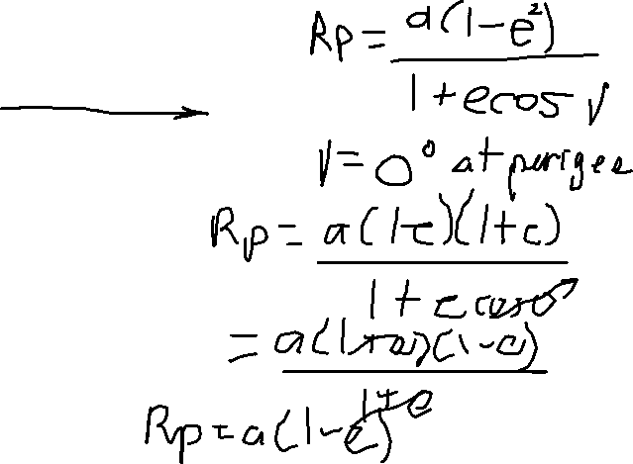
SOLUTION TO 2 BODY EOM
$$\overset{⃑}{V}$$
y
φ
ф = flight path angle
$$\overset{⃑}{R}$$
ν
apogee
x
$$°$$
perigee
F’
F
2a
$$r_{a}$$
$$r_{p}$$

Slide 12

SOLUTION TO 2 BODY EOM
$$\overset{⃑}{V}$$
φ
c = distance between foci
= $r_{a} − r_{p}=ae$
$$r_{p}=a−c=a−ae$$
$$r_{p}=a\left(1−e\right)$$
$r_{p}=a+c=a+ae$
$r_{a}=a(1+e)$
$$\overset{⃑}{R}$$
ν
apogee
$$\overset{⃑}{e}$$
$$°$$
perigee
F’
F
2a
$$r_{a}$$
$$r_{p}$$
c

Slide 13
