Slide 1
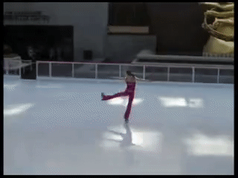
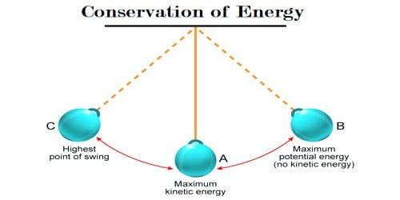
CONSERVATION LAWS SPECIFIC ANGULAR MOMENTUM SPECIFIC MECHANICAL ENERGY

Slide 2
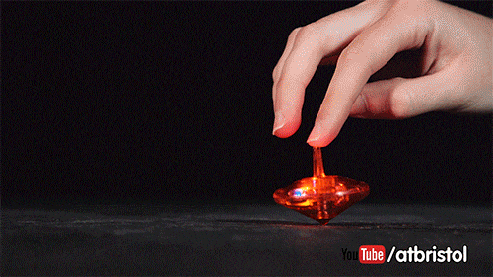
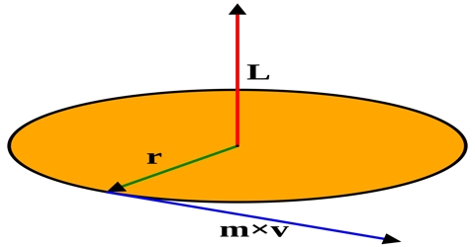
CONSERVATION OF MOMENTUM
$$\overset{⃑}{p}=m\overset{⃑}{V}$$
Moment of momentum (angular momentum)
$\overset{⃑}{H}= \overset{⃑}{R} ×\overset{⃑}{p}$
= $\overset{⃑}{R} ×m\overset{⃑}{V}$
H
R

Slide 3
Energy Considerations
Conservation of Momentum
$\overset{⃑}{H}= \overset{⃑}{R} ×m\overset{⃑}{V}$ = constant
$\overset{⃑}{H}$ is angular momentum
Define $\overset{⃑}{h }≡ \frac{\overset{⃑}{H}}{m}= \overset{⃑}{R}× \overset{⃑}{V}$
$\overset{⃑}{h}$ is specific angular momentum

Slide 4
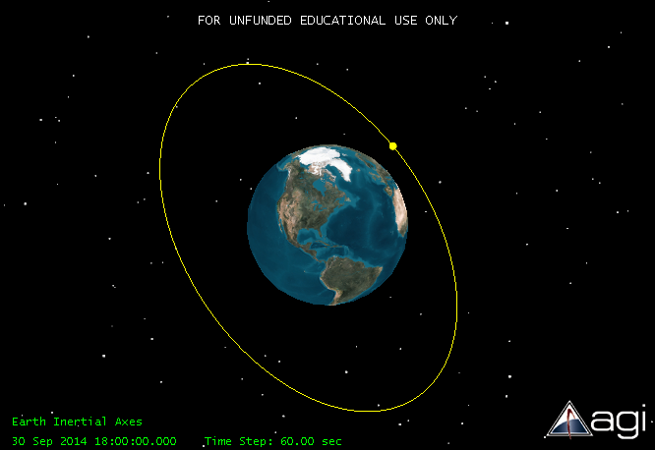
Energy Considerations
$$\overset{⃑}{h}$$
Relevance: orbit plane is constant!

Slide 5
Energy Considerations
KE lowest
PE highest
Conservation of Mechanical Energy
E = KE + PE
E = energy
KE = kinetic energy
PE = potential energy
specific mechanical energy
$$ε≡ \frac{E}{m}$$
KE highest
PE lowest

Slide 6
SPECIFIC POTENTIAL ENERGY
$$F_{grav }= \frac{μm}{R^{2}}=mg$$
$$g=\frac{μ}{R^{2}}$$
Since this is acting downward and we are measuring R from the center of the earth, which is our datum point, outward:
$$g = −\frac{μ}{R^{2}}$$
So
$$mgh= −\frac{mμR}{R^{2}}$$
And dividing by mass and simplifying yields the specific potential energy term,
$$PE= −\frac{μ}{R}$$

Slide 7
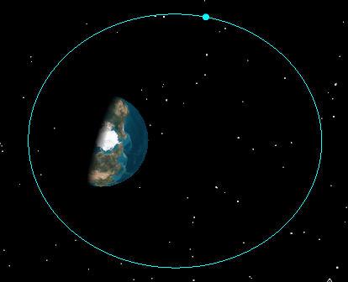
Specific Mechanical Energy
Conservation of Mechanical Energy
E = KE + PE
Define $ε≡ \frac{E}{m}= \frac{V^{2}}{2}−\frac{μ}{R}= \frac{−μ}{2a}$
KE PE constant!
KE highest
PE lowest
KE lowest
PE highest
$ε =$ specific mechanical energy
Relevance: orbit size is fixed!

Slide 8
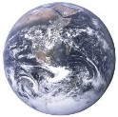
Energy Considerations
PE is defined differently than we’re used to seeing
It is defined negative inside the Earth’s sphere of influence (SOI) and equal to zero at the very edge of the SOI
ε = 0
PE = 0
ε > 0
PE = 0
ε < 0
PE < 0
Earth’s SOI ~ 1,000,000 km
(not to scale)

Slide 9
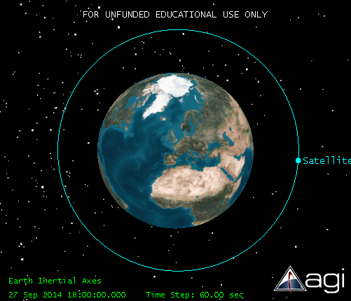
EXAMPLE
For a circular geo orbit with a=42,000 km
$$ε=−\frac{μ}{2a}=−\frac{398600.5 \frac{{km}^{3}}{s^{2}}}{2∗42,000 km}=−4.6 \frac{{km}^{2}}{s^{2}}$$
For a circular orbit with a=10,000 km
$$ε=−\frac{μ}{2a}=−\frac{398600.5 \frac{{km}^{3}}{s^{2}}}{2∗10,000 km}=−19.93 \frac{{km}^{2}}{s^{2}}$$

Slide 10
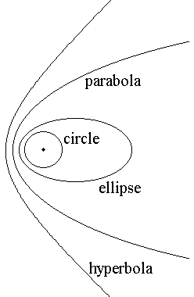
EXAMPLE
ε = 0
$$ε=−19.93 \frac{{km}^{2}}{s^{2}}$$
Negative? Yes!
ε < 0
ε < 0
ε > 0

