Slide 1
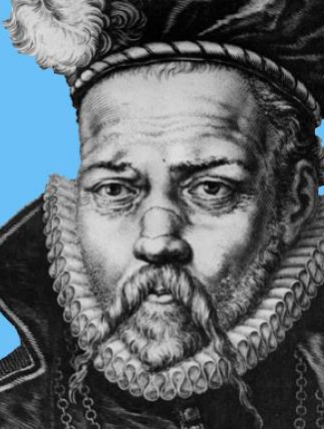
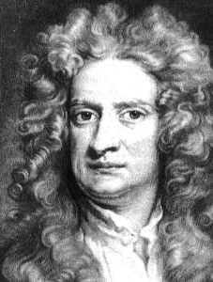
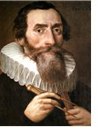
Chapter 1
- Newton and Kepler’s Laws
- Constants of Motion
- 2 Body Equation of Motion

Slide 2
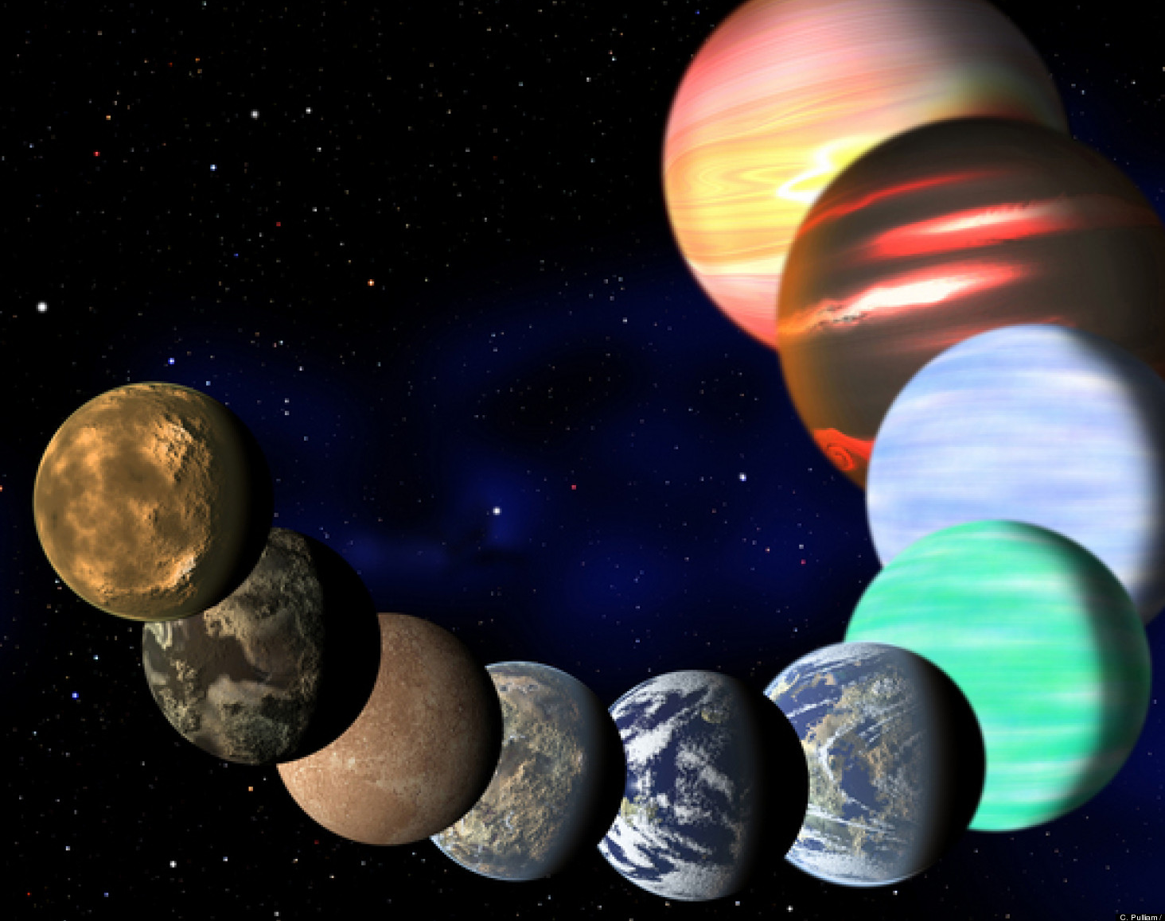
CHAPTER OBJECTIVES
Objectives for this chapter are:
Explain how early space explorers contributed to our understanding of orbits
Understand Newton’s 3 basic laws of motion and how they apply to orbits
Explain and use Newton’s Universal Law of Gravitation
Use the two constants of orbital motion – specific mechanical energy and specific angular momentum, the explain basic properties of orbits
Combine these laws to develop the two body equation of motion

Slide 3
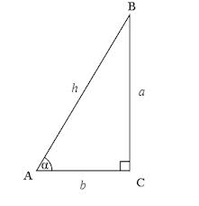
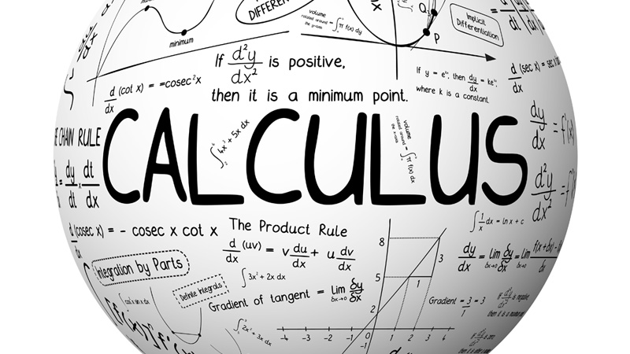
See Math Review video for some basics of vector mathematics, trigonometry and calculus.
$$\overset{⃑}{B}$$
$$\overset{⃑}{A}$$
$$\overset{⃑}{A}+ \overset{⃑}{B}$$

Slide 4
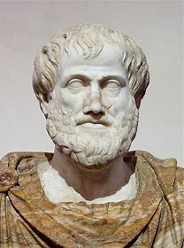
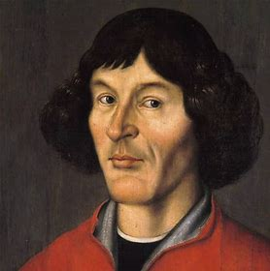
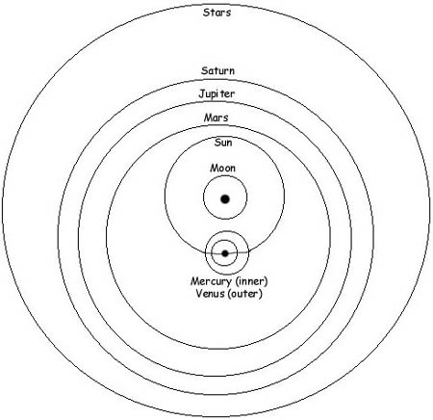
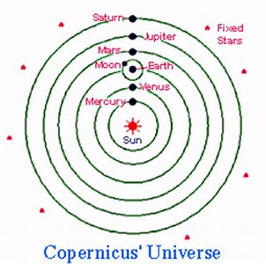
ARISTOTLE
COPERNICUS
EARLY ASTRONOMERS

Slide 5
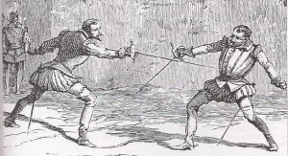
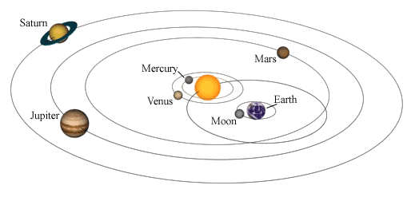
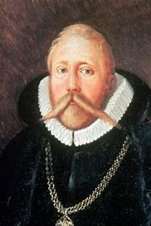
TYCHO BRAHE
Observational astronomy

Slide 6
WHAT IS AN ARCMINUTE?

Slide 7
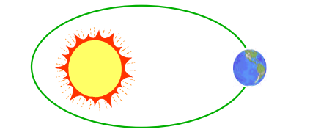
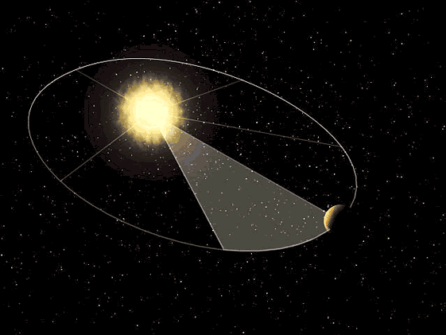
JOHANNES KEPLER
The orbits of planets are ellipses with the sun at one focus.
2. The line joining a planet to the sun sweeps out equal areas in equal times.
3. The square of an orbit’s period is proportional to the cube of the average distance between the planet and the sun.
$P=2π\sqrt{\frac{a^{3}}{μ}}$
periapsis
apoapsis
2a
P = period
a = semi-major axis
μ = gravitational constant

Slide 8
ISAAC NEWTON
1st Law: A body continues in its state of rest, or uniform motion, unless compelled to change that state by force impressed upon it.
Relevance:
1) There must be a force on satellites – gravity
2) Momentum is conserved – orbits are constant (orientation and size)

Slide 9
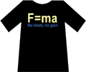
Isaac Newton
2nd Law: The time rate of change of an object’s momentum is equal to the applied force.
$$\sum{\overset{⃑}{F }= \frac{d\overset{⃑}{p}}{dt} }$$
Where:
$$\sum{=sum}$$
$$\overset{⃑}{ } denotes vector$$
$$\overset{⃑}{F}=force$$
$$\overset{⃑}{p}=m \overset{⃑}{V}=momentum$$
$$\overset{⃑}{V}=velocity$$
But wait! Isn’t this law just F=ma?
NO!
Only under certain conditions.

Slide 10
Newton’s 2nd Law (cont)
Let’s apply the product rule:
$$\overset{⃑}{F}=\frac{∆\overset{⃑}{p}}{∆t}=\frac{∆m\overset{⃑}{V }}{∆t}= \frac{∆m}{∆t}\overset{⃑}{V}+m\frac{∆\overset{⃑}{V}}{dt}$$
If mass is not changing, this term goes to zero
$\frac{∆\overset{⃑}{V}}{∆t}= \overset{⃑}{a}$

Slide 11
Newton’s 2nd Law (cont)
So:
$$\overset{⃑}{F}=m\overset{⃑}{a}$$
Only if mass doesn’t change!
Relevance:
We will use this law to derive the two body equation of motion that describes orbital motion
In rockets, $\frac{∆m}{∆t}\overset{⃑}{V}≠0$ → this is the thrust term!

Slide 12
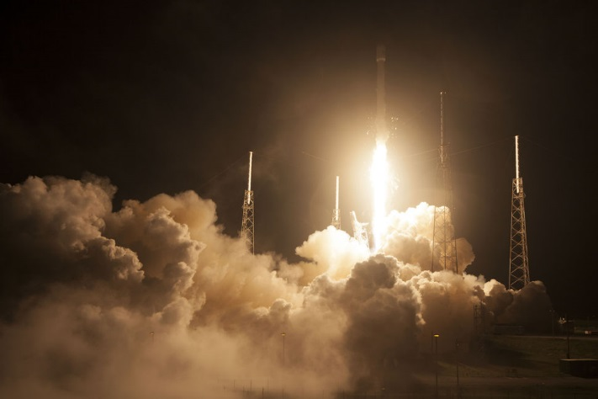
Newton’s 3rd Law
For every action there is an equal and opposite reaction.
Relevance: Rockets!

Slide 13
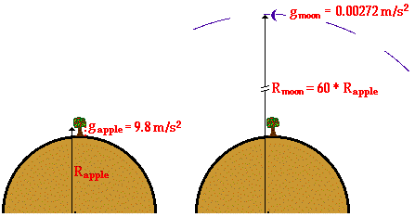
Newton’s Universal Law of Gravitation
$$\frac{g_{moon}}{g_{apple}} = \frac{0.00272 \frac{m}{s^{2}}}{9.8\frac{m}{s^{2}}}= \frac{1}{3600}$$

Slide 14
Newton’s Universal Law of Gravitation
$$F_{g}= \frac{Gm_{1}m_{2}}{R^{2}}$$
$$Where:$$
$$F_{g}=force due to gravity$$
$$G=universal gravitational constant=6.67x{10}^{−11} \frac{N m^{2}}{{kg}^{2}}$$
$$m_{1} \&{ m}_{2} =masses$$
$$R=distance between the two objects$$

Slide 15
Newton’s Universal Law of Gravitation
But we are going to define a new constant:
$$μ=G m_{e }=398600.5 \frac{{km}^{3}}{s^{2}}$$
Where:
$$m_{e}=mass of the earth$$
$$m_{s}=mass of the satellite$$
$$μ=Earth^{′}s gravitational constant$$
So
$$F_{g}= \frac{μm_{s}}{R^{2}}$$

Slide 16
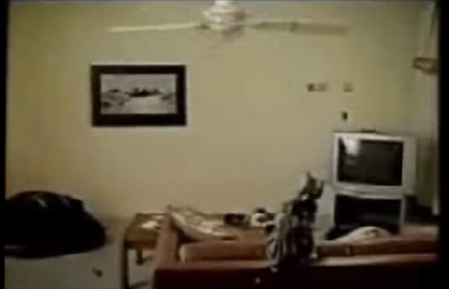
Energy Considerations
Conservation of Momentum
$\overset{⃑}{H}= \overset{⃑}{R} ×m\overset{⃑}{V}$ = constant
$\overset{⃑}{H}$ is angular momentum
Define $\overset{⃑}{h }≡ \frac{\overset{⃑}{H}}{m}= \overset{⃑}{R}× \overset{⃑}{V}$
$\overset{⃑}{h}$ is specific angular momentum

Slide 17
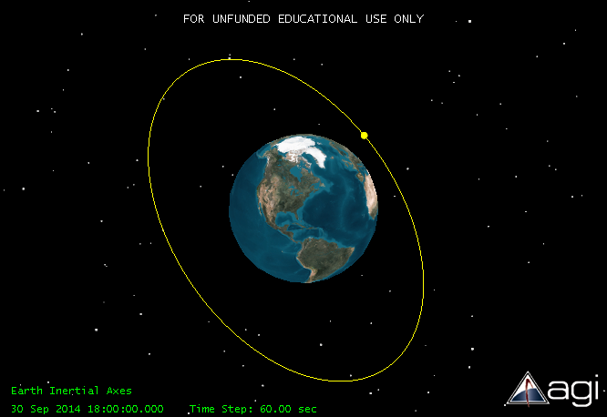
Energy Considerations
Conservation of Momentum
$$\overset{⃑}{h}$$
Relevance: orbit plane is constant!

Slide 18
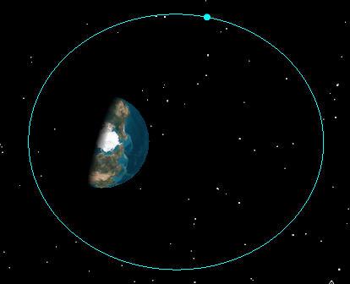
Energy Considerations
Conservation of Mechanical Energy
E = KE + PE
E = energy
KE = kinetic energy
PE = potential energy
Define $ε≡ \frac{E}{m}= \frac{V^{2}}{2}−\frac{μ}{R}= \frac{−μ}{2a}$
KE highest
PE lowest
KE lowest
PE highest
KE PE constant!
$ε =$ specific mechanical energy
Relevance: orbit size is fixed!

Slide 19
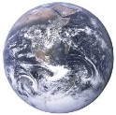
Energy Considerations
PE is defined differently than we’re used to seeing
It is defined negative inside the Earth’s sphere of influence (SOI) and equal to zero at the very edge of the SOI
ε = 0
PE = 0
ε > 0
PE = 0
ε < 0
PE < 0
Earth’s SOI ~ 1,000,000 km
(not to scale)

Slide 20
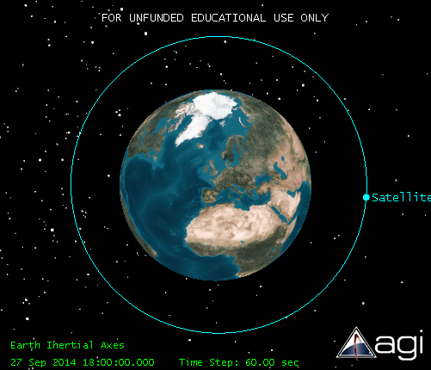
EXAMPLE
For a circular orbit with a=10,000 km
$$ε=−\frac{μ}{2a}=−\frac{398600.5 \frac{{km}^{3}}{s^{2}}}{2∗10,000 km}=−19.93 \frac{{km}^{2}}{s^{2}}$$

Slide 21
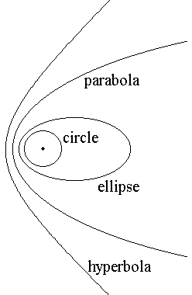
EXAMPLE
ε = 0
$$ε=−19.93 \frac{{km}^{2}}{s^{2}}$$
Negative? Yes!
ε < 0
ε < 0
ε > 0

Slide 22
GEOCENTRIC EQUATORIAL COORDINATE SYSTEM $$\hat{I}\hat{J}\hat{K}$$
1st day of Spring, 21 March
Origin: Center of Earth
Fundamental Plane ($\hat{I} \hat{J}$):
Earth’s equator
$\hat{I}:$ vernal equinox
$\hat{J}$: 90° East
$\hat{K}$: through North Pole (right hand rule)
Doesn’t rotate with Earth
$$\hat{I} , Υ$$
$$\hat{J}$$

Slide 23
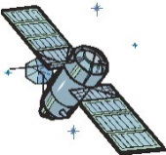
2 BODY EQUATION OF MOTION (EOM)
·
·
·
Derivation not shown here
$$\ddot{\overset{⃑}{R}}+ \frac{μ}{R^{2}}\hat{R}=0$$
$${\overset{⃑}{F}}_{g}$$
$\overset{⃑}{R}$ = position vector
$\dot{\overset{⃑}{R}}= \overset{⃑}{V}$ = velocity vector
$\ddot{\overset{⃑}{R}}= \overset{⃑}{a}$ = acceleration vector
$\hat{R}=$ unit vector in $\overset{⃑}{R}$ direction
μ = G$m_{e}$
Alternate form:
$$\ddot{\overset{⃑}{R}}+ \frac{μ}{R^{3}}\overset{⃑}{R}=0$$

Slide 24
ASSUMPTIONS
Only 2 bodies – earth and satellite
Bodies are spherically symmetrical
acts through center of bodies
3) $m_{e}≫m_{s}$
>> any other forces
5) Coordinate system is sufficiently inertial (so Newton’s Laws apply)
6) Mass is constant so $\dot{m}=0$
$${\overset{⃑}{F}}_{g}$$
$${\overset{⃑}{F}}_{g}$$
$${\overset{⃑}{F}}_{g}$$

Slide 25
SOLUTION TO 2 BODY EOM
$$R= \frac{a(1−e^{2})}{1+ecosγ}$$
$$\overset{⃑}{V}$$
φ
$$\overset{⃑}{R}$$
ƴ
apogee
$$\overset{⃑}{e}$$
$$°$$
perigee
F’
F
2a

Slide 26
SOLUTION TO 2 BODY EOM
$$\overset{⃑}{V}$$
φ
$$R=\left|\overset{⃑}{R}\right|$$
a = semi-major axis
2a = $r_{a}+r_{p}$
Circle: a = R
Ellipse: a > 0
Parabola: a = ∞
Hyperbola: a < 0
ƴ = true anomaly
Measured from $\overset{⃑}{e} to \overset{⃑}{R}$
$$\overset{⃑}{R}$$
ƴ
apogee
$$\overset{⃑}{e}$$
$$°$$
perigee
F’
F
2a
$$r_{a}$$
$$r_{p}$$
c

Slide 27
SOLUTION TO 2 BODY EOM
$$\overset{⃑}{V}$$
φ
ф = flight path angle
+ outward bound
(perigee to apogee)
- Inbound (apogee to
perigee)
e = eccentricity
= $\frac{c}{a}= \frac{r_{a}−r_{p}}{r_{a}+r_{p}}$
circle: e = 0
ellipse 0 < e < 1
parabola e = 1
hyperbola e > 1
$$\overset{⃑}{R}$$
ƴ
apogee
$$\overset{⃑}{e}$$
$$°$$
perigee
F’
F
2a
$$r_{a}$$
$$r_{p}$$
c

Slide 28
SOLUTION TO 2 BODY EOM
$$\overset{⃑}{V}$$
φ
c = distance between foci
= $r_{a} − r_{p}=ae$
$$r_{p}=a−c=a−ae$$
$$r_{p}=a\left(1−e\right)$$
$r_{p}=a+c=a+ae$
$r_{a}=a(1+e)$
$$\overset{⃑}{R}$$
ƴ
apogee
$$\overset{⃑}{e}$$
$$°$$
perigee
F’
F
2a
$$r_{a}$$
$$r_{p}$$
c

Slide 29
NEXT TIME
Solving the Two body Equation of Motion
ρ
El
$$\overset{⃑}{R}$$
$${\overset{⃑}{R}}_{site}$$

Slide 30
Quiz
1. Who determined that the orbits of planets travelled in ellipses with the sun at one focus?
a. Copernicus
b. Galileo
c. Brahe
d. Kepler
e. Newton

Slide 31
Quiz
2. What important assumption do we make when we write Newton’s 2nd Law as $\overset{⃑}{F}=m\overset{⃑}{a}$
a. Time is constant
b. Velocity is constant
c. Force is constant
d. Mass is constant
e. Acceleration is constant

Slide 32
Quiz
3. What is the specific mechanical energy in $\frac{{km}^{2}}{s^{2}}$for a geostationary satellite with 35786 km altitude?
a. 4.73
b. 5.57
c. -19.9
d. -5.57
e. -4.73

Slide 33
Quiz
4) Which of the following is NOT an assumption made in developing the 2-body equation of motion:
a. Only 3 bodies – earth, satellite, and the moon
b. Bodies are spherically symmetrical
c. Mass of the satellite is less than mass of the earth
d. Mass is constant
e. System is sufficiently inertial

Slide 34
Quiz
What is the radius to perigee of a satellite in an orbit with a semi-major axis of 10,000 km and an eccentricity of .25
a. 2500 km
b. 10,000 km
c. 8,000 km
d. 10,000 km
e. 7500 km

Slide 35
REFERENCES
Arfbog: Safe Food from Farm to Fork. (5 May 2014). Image slide 13.
ClipArtbest.com. Image slide 14.
Control Booth. (31 Dec 2012). “Cyc Color Wash using Fresnels.” Image slide 17.
Everyone Wants to Be an Ambassador to France. (2014). Image Slide 4.
Ghosh, Anurag. (24 Nov 2011). Bright Hub: The Hub for Bright Minds. “Nothing But the Facts about Johannes Kepler.” Image slide 1.
The Intuitor Store. (2001). F=ma, No Brain No Grain T-shirt.
Mancini, Mark. (9 May 2013). Mental_floss. “Tycho Brahe: The Astronomer with the Drunken Moose.” Image slide 1.
Natural Historian. (3 Aug 2012). “Isaac Newton on the Mosaic Account of Creation.” Image slide 1.
OpenStax College. (18 Aug 2014). “Satellite’s and Kepler’s Law: An Argument for Simplicity. Image slide 5.
Seligman, Courtney. (2014). Online Astronomy eText: Orbital Motions. “Tycho Brahe’s Astronomical Accomplishments.” Image slide 4.
Sellers, Jerry Jon. (2005). Understanding Space: An Introduction to Astronautics, 3rd edition. McGraw-Hill. Image slide 2.
SpaceX. (7 Aug 2014). Asiasat8 Outside Wide Front 1 2
University of Nebraska-Lincoln. (2014). Planetary Orbits Lab. Simulation slide 5.
Wyzant Resources. (2014). “Conic Sections.” Image slide 3.
YouTube (2006). Cat Runs off Bed into Wall – Funny. Hyperlink slide 6.
YouTube (2006). Big Gun Recoil -- Test Firing Middle East Version.

