Slide 1
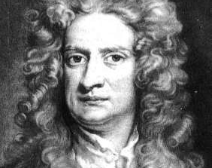
Newton’s 3 Laws and Universal Law of Gravitation

Slide 2
ISAAC NEWTON
1st Law: A body continues in its state of rest, or uniform motion, unless compelled to change that state by forces impressed upon it.
Relevance:
1) There must be a force on satellites – gravity
2) Momentum is conserved – orbits are constant (orientation and size)

Slide 3
MOMENTUM
Momentum is the amount of resistance an object in motion has to changes in its speed or direction of motion.
Linear momentum is defined as mass times velocity and often represented by the variable $\overset{⃑}{p}$. In equation form, this becomes:
$$\overset{⃑}{p}=m\overset{⃑}{V}$$
Where:
$\overset{⃑}{p}=$ linear momentum vector $\left(\frac{kg m}{s^{2}}\right)$
m = mass (kg)
$\overset{⃑}{V}$ = velocity vector $\left(\frac{m}{s}\right)$
Why you need to wear a seatbelt (especially if you are a giraffe)

Slide 4
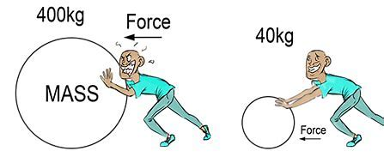
Isaac Newton
2nd Law: The time rate of change of an object’s momentum is equal to the applied force.
$$\sum{\overset{⃑}{F }= \frac{d\overset{⃑}{p}}{dt} }$$
Where:
$$\sum{=sum}$$
$$\overset{⃑}{ } denotes vector$$
$$\overset{⃑}{F}=force$$
$$\overset{⃑}{p}=m \overset{⃑}{V}=momentum$$
$$\overset{⃑}{V}=velocity$$
But wait! Isn’t this law just F=ma?
NO!
Only under certain conditions.

Slide 5

Newton’s 2nd Law (cont)
Let’s apply the product rule:
$$\sum{\overset{⃑}{F}}=\frac{d\overset{⃑}{p}}{dt}=\frac{d(m\overset{⃑}{V })}{dt}= \frac{dm}{dt}\overset{⃑}{V}+m\frac{d\overset{⃑}{V}}{dt}$$
If mass is not changing, this term goes to zero
$\frac{d\overset{⃑}{V}}{dt}= \overset{⃑}{a}$

Slide 6
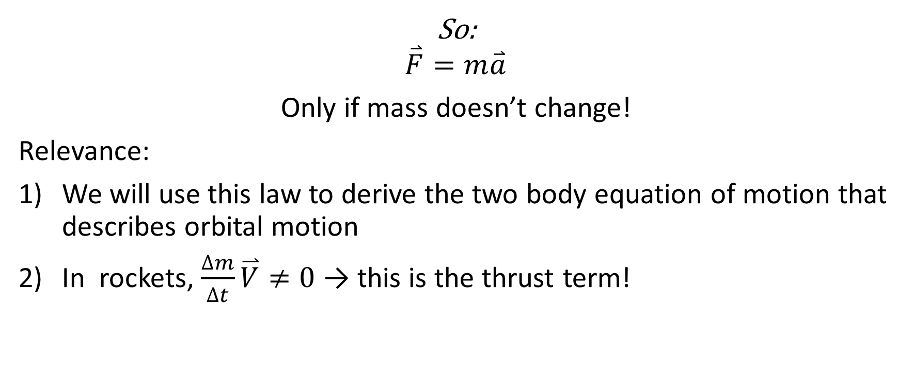
Newton’s 2nd Law (cont)
So:
$$\overset{⃑}{F}=m\overset{⃑}{a}$$
Only if mass doesn’t change!
Relevance:
We will use this law to derive the two body equation of motion that describes orbital motion
In rockets, $\frac{∆m}{∆t}\overset{⃑}{V}≠0$ → this is the thrust term!

Slide 7
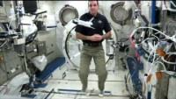
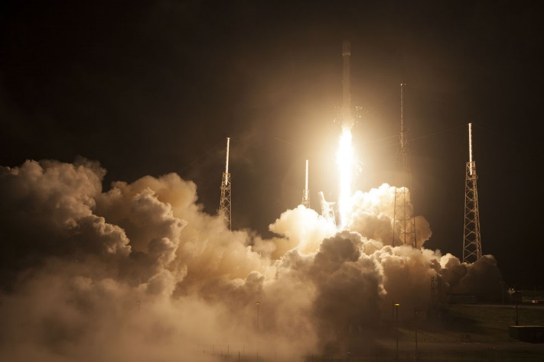
Newton’s 3rd Law
For every action there is an equal and opposite reaction.
Relevance: Rockets!

Slide 8
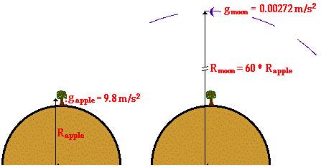
Newton’s Universal Law of Gravitation
$$\frac{g_{moon}}{g_{apple}} = \frac{0.00272 \frac{m}{s^{2}}}{9.8\frac{m}{s^{2}}}= \frac{1}{3600}$$

Slide 9
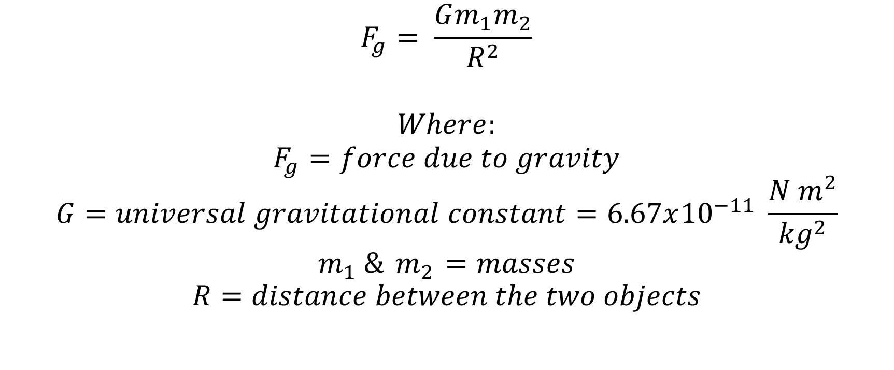
Newton’s Universal Law of Gravitation
$$F_{g}= \frac{Gm_{1}m_{2}}{R^{2}}$$
$$Where:$$
$$F_{g}=force due to gravity$$
$$G=universal gravitational constant=6.67x{10}^{−11} \frac{N m^{2}}{{kg}^{2}}$$
$$m_{1} \&{ m}_{2} =masses$$
$$R=distance between the two objects$$

Slide 10
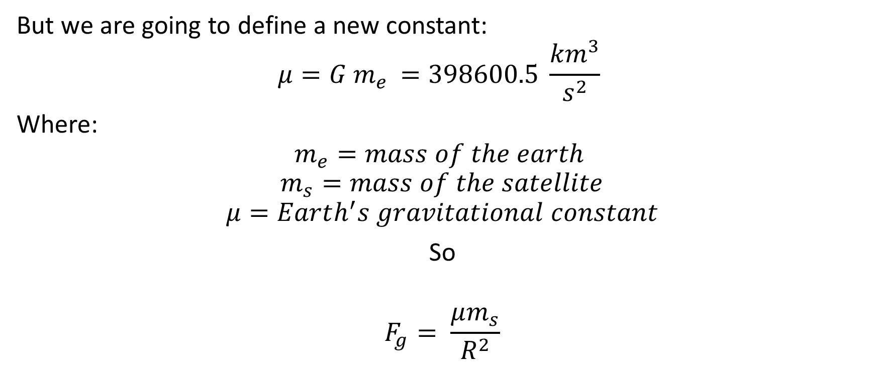
Newton’s Universal Law of Gravitation
But we are going to define a new constant:
$$μ=G m_{e }=398600.5 \frac{{km}^{3}}{s^{2}}$$
Where:
$$m_{e}=mass of the earth$$
$$m_{s}=mass of the satellite$$
$$μ=Earth^{′}s gravitational constant$$
So
$$F_{g}= \frac{μm_{s}}{R^{2}}$$

