Slide 1
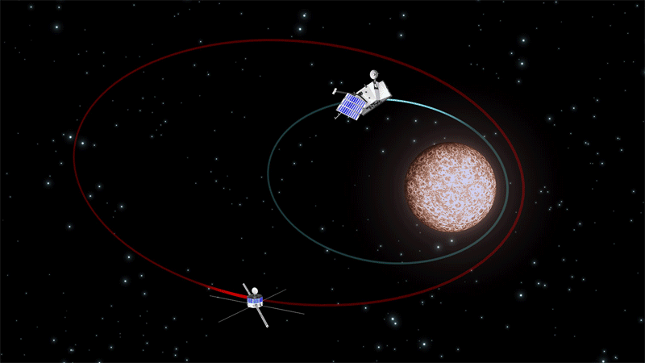
Fundamentals of ASTRODYNAMICS
Lynnane George
lgeorge2@uccs.edu
ESA, image by C.Carreau

Slide 2
Lynnane George
lgeorge2@uccs.edu
PhD Ga. Tech Mechanical Engineering
20 years Air Force mostly Space Systems
24 years teaching
https://mae.uccs.edu/people/lynnane-george.php
Linked in: Lynnane George | LinkedIn

Slide 3
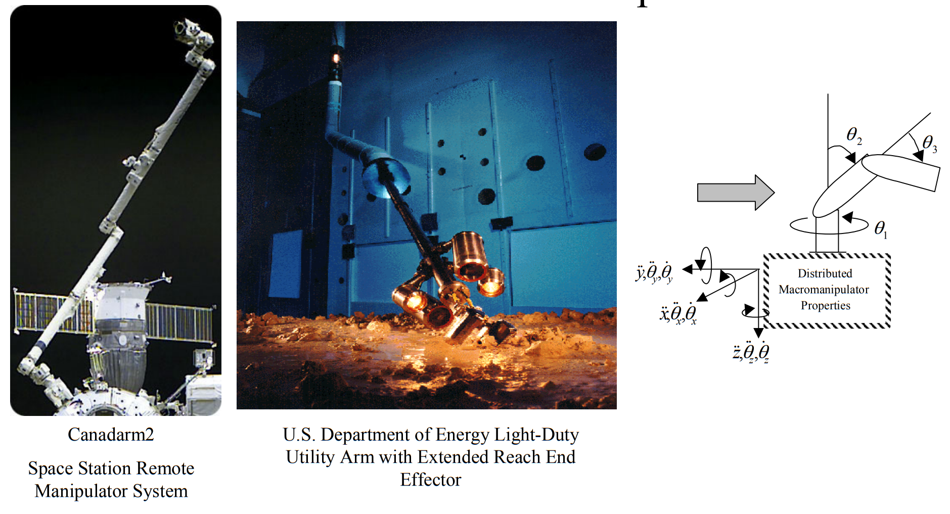
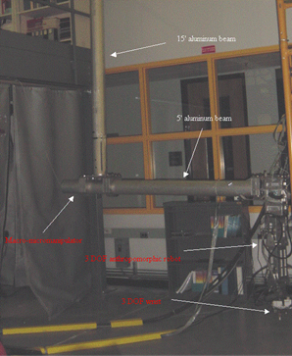
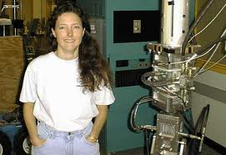
Active Vibration Control of a Flexible Base Robot

Slide 4
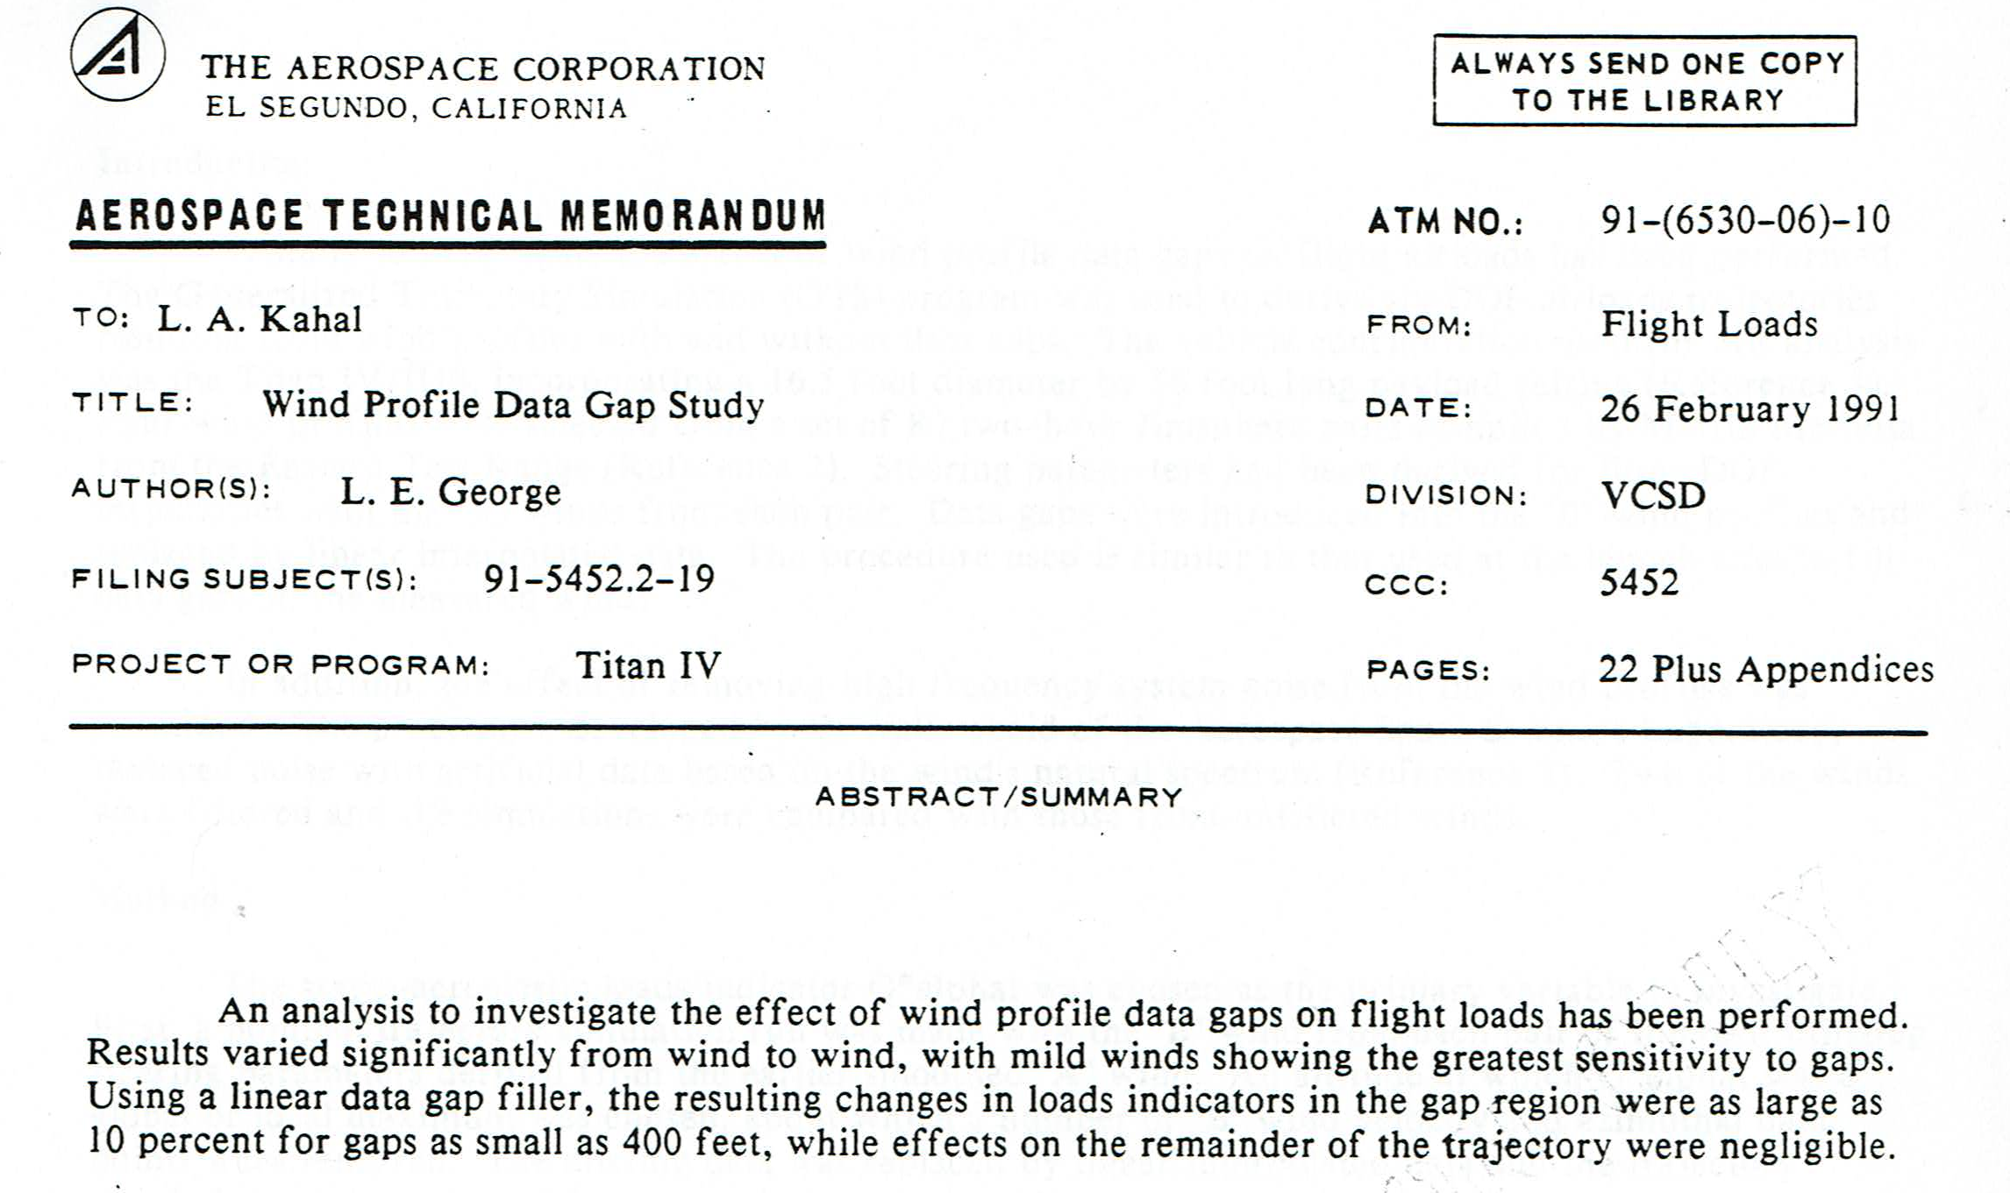
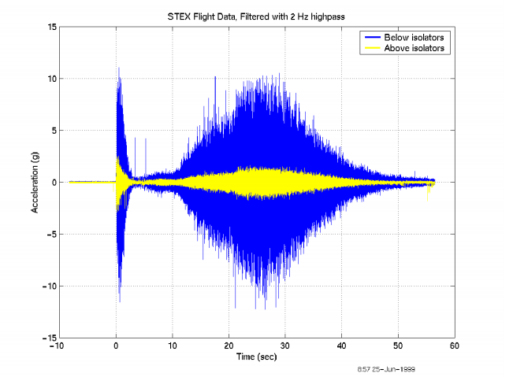
THE AEROSPACE CORPORATION

Slide 5
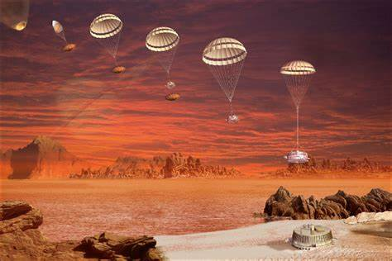
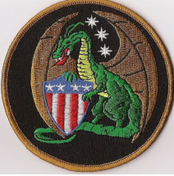
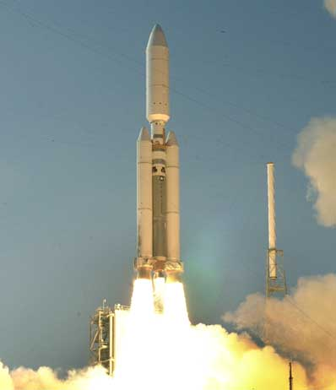
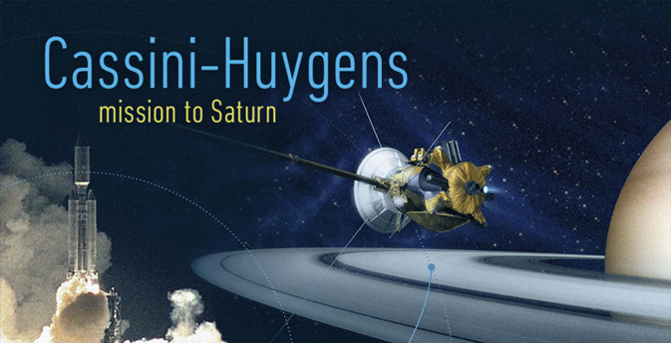
TITAN IV SYSTEM PROGRAM OFFICE
LOS ANGELES AIR FORCE BASE

Slide 6
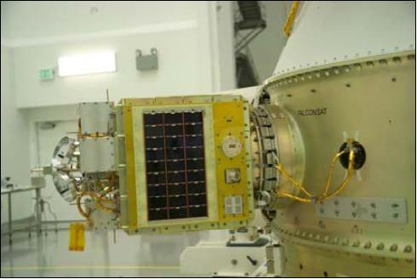
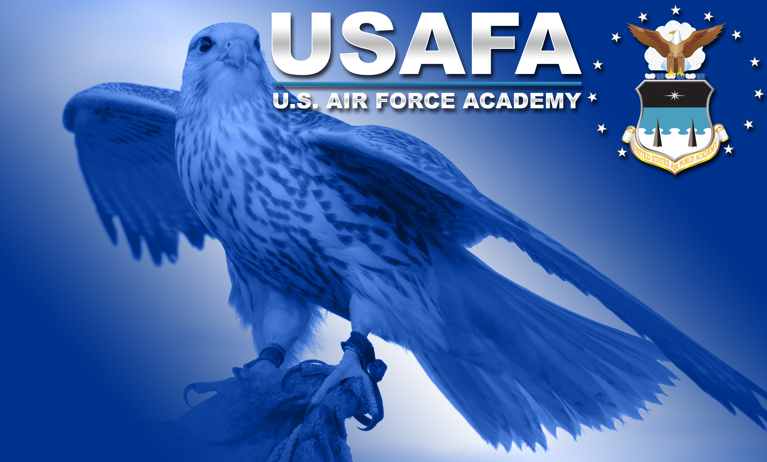
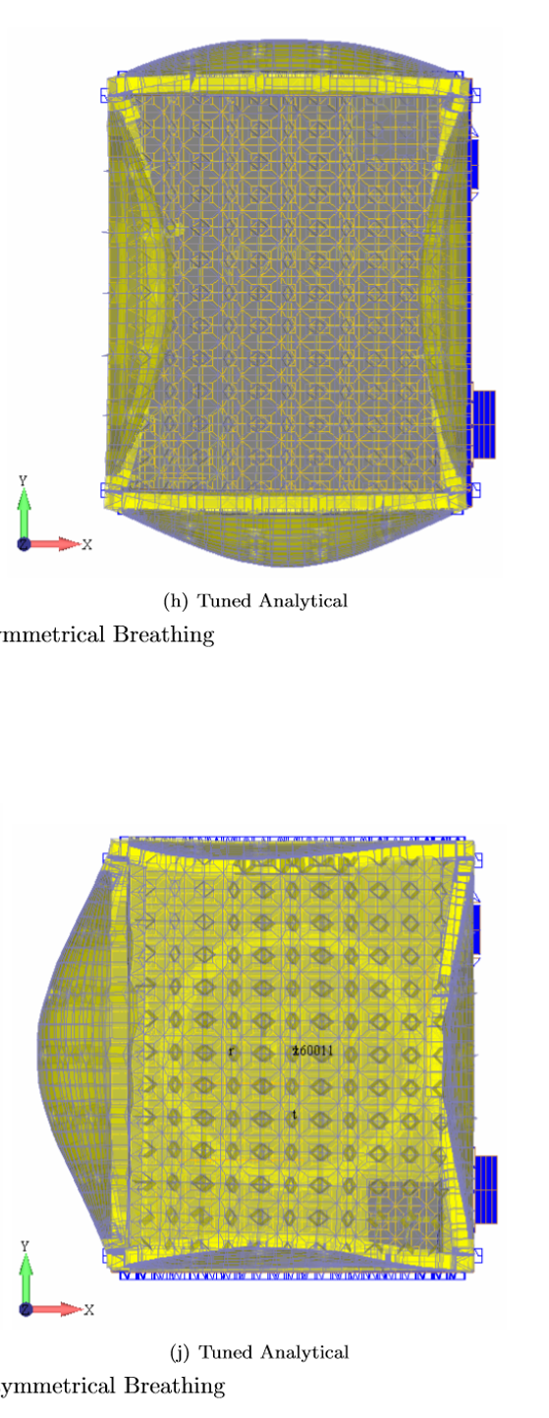
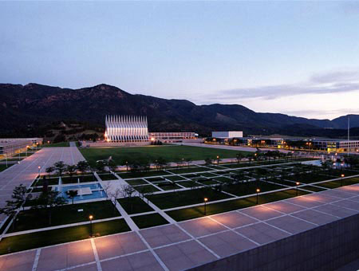
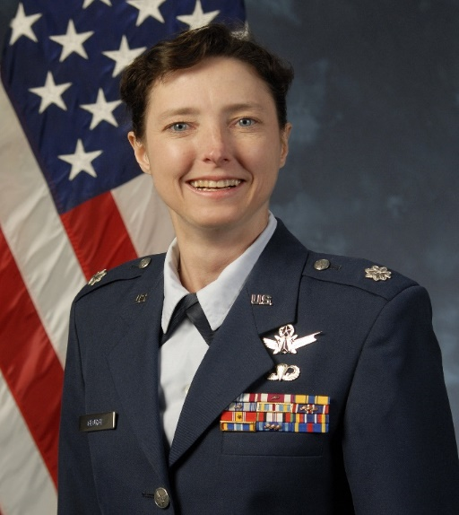
Symmetrical Breathing
Asymmetrical Breathing

Slide 7
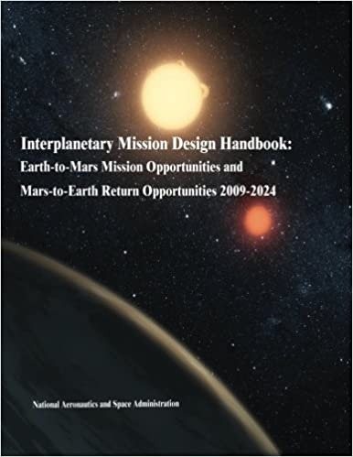
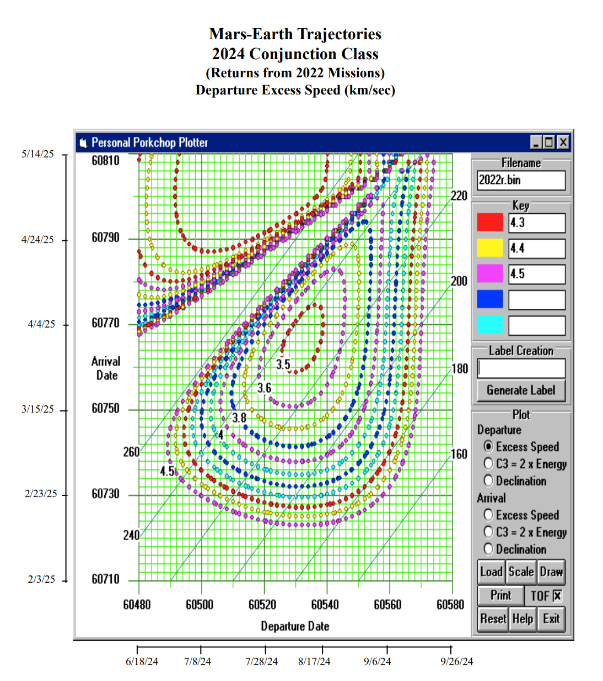
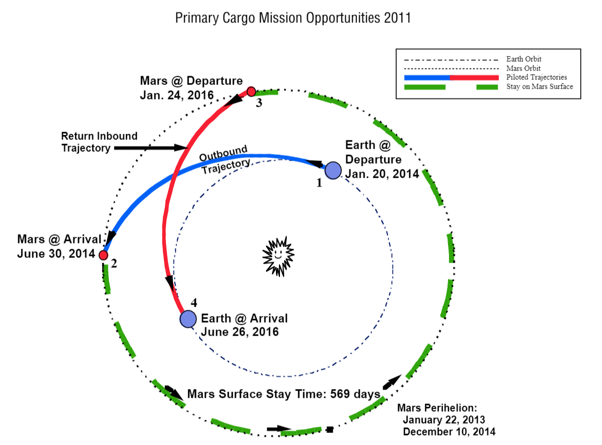
INTERPLANETARY TRAJECTORIES FOR A PILOTED MARS MISSION

Slide 8
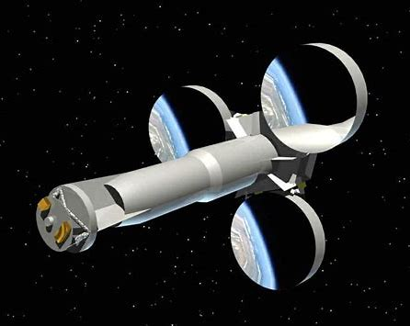
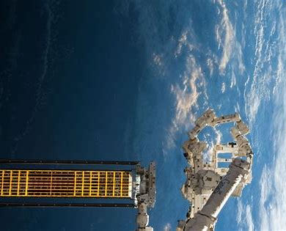
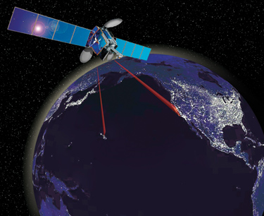
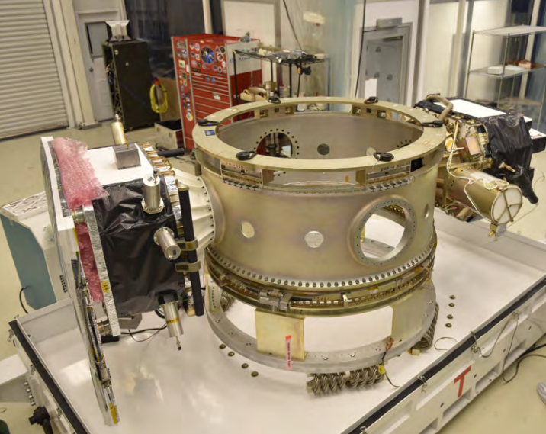
SPACE VEHICLES
KIRTLAND AFB

Slide 9
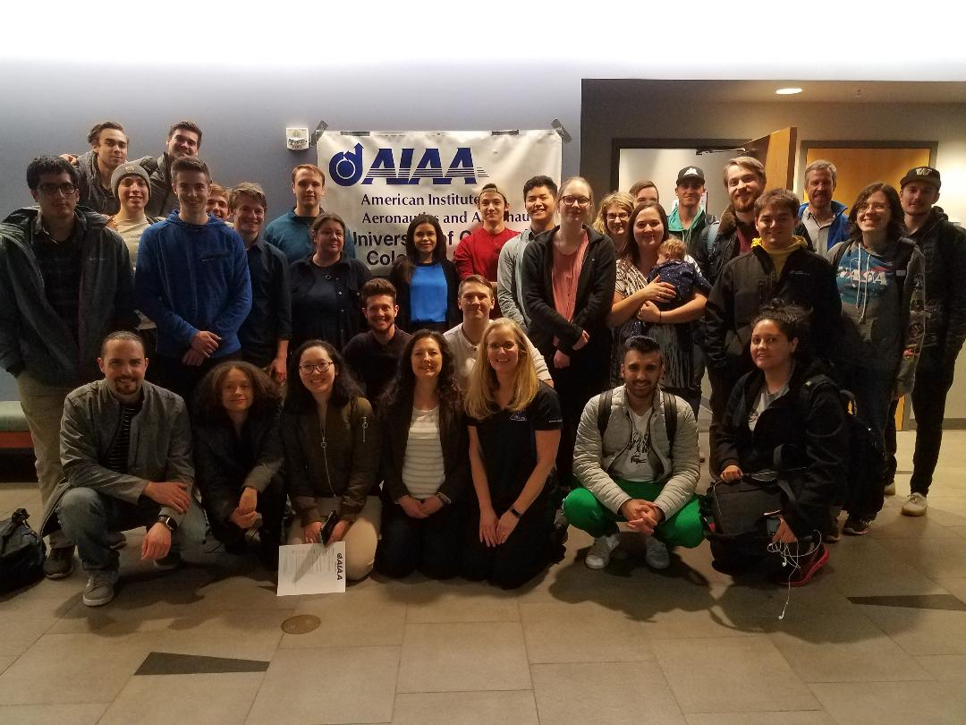
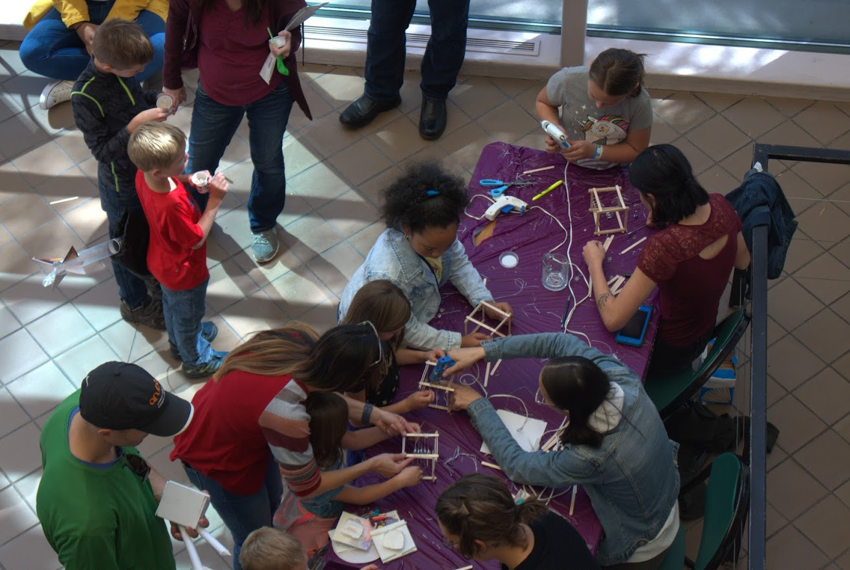
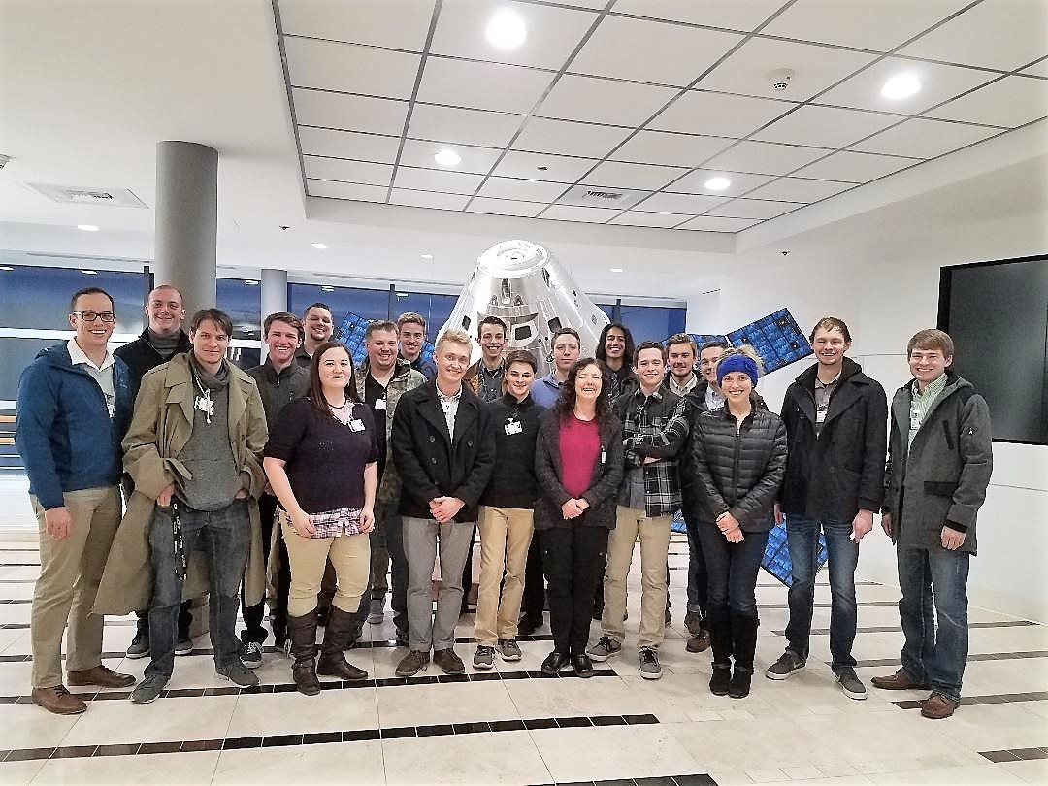

Slide 10
REFERENCES
Doupe, C., Swenson, E., George, L, and Black, J. Finite Element Model Tuning with 3D Mode Shapes from FalconSAT-5. (2009, May). 50th AIAA/ASME/ASCE/AHS/ASC Structures, Structural Dynamics and Materials Conference.
Dunbar, B. (2012, October 15). A Long and Winding Road: Cassini Celebrates 15 Years. https://www.nasa.gov/mission_pages/cassini/whycassini/cassini20121015.html
George, Lynnane E. (2002). Active Vibration Control of a Flexible Base Manipulator. Doctoral dissertation, Georgia Institute of Technology.
George, L. E., & Kos, L. D. (1998). Interplanetary mission design handbook: Earth-to-Mars mission opportunities and Mars-to-Earth return opportunities 2009-2024. Huntsville, Ala.: National Aeronautics and Space Administration, Marshall Space Flight Center.
George, L.E. (1991). Wind Profile Data Gap Study. (ATM NO: 91-(6530-06)-10. The Aerospace Corporation.
Herbert, K. (2020). Falconsat-3. https://directory.eoportal.org/web/eoportal/satellite-missions/f/falconsat-3
Pike, J. (n.d.). Space. https://www.globalsecurity.org/space/library/news/1999/n19991220_992265.htm
Progressive Management. (2014). NASA Space Technology Report: Pogo in Rockets and Launch Vehicles.
Staff, S. (2012, October 12). Saturn's Moon Titan Has Soft and Crusty Surface, Probe Landing Reveals. https://www.space.com/18033-saturn-moon-titan-surface-huygens-landing.html
USAF, Kirtland AFB. Air Force Research Laboratory’s Roll-Out Solar Array (ROSA) (af.mil)
Wilke, P., Johnson, C., Grosserode, P., & Scuilli, D. (2000, March). Whole-Spacecraft Vibration Isolation for Broadband Attenuation. https://apps.dtic.mil/dtic/tr/fulltext/u2/a451903.pdf

Slide 11
VIDEOS
Approaching Titan a Billion Times Closer. (2015, January 14). Retrieved December 24, 2020, from https://youtu.be/TMxL3ZhO8A8
ROSA: Roll Out Solar Array Is Deployed On The International Space Station. (2017, June 19). Retrieved December 25, 2020, from https://youtu.be/jlDS7jdCooA

