Slide 1
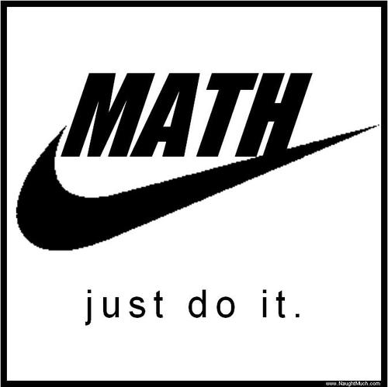
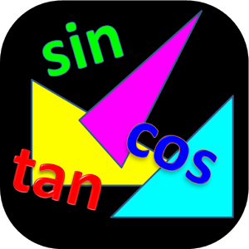
MATH REVIEW

Slide 2
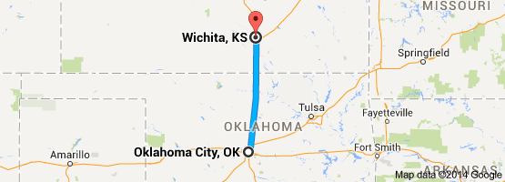
VECTOR NOTATION
A scalar is a quantity that has magnitude only
A vector is a quantity that has magnitude and direction
Example: You drive from Oklahoma City to Wichita
You drove 261 km (scalar)
You drove 261 km North (vector)

Slide 3
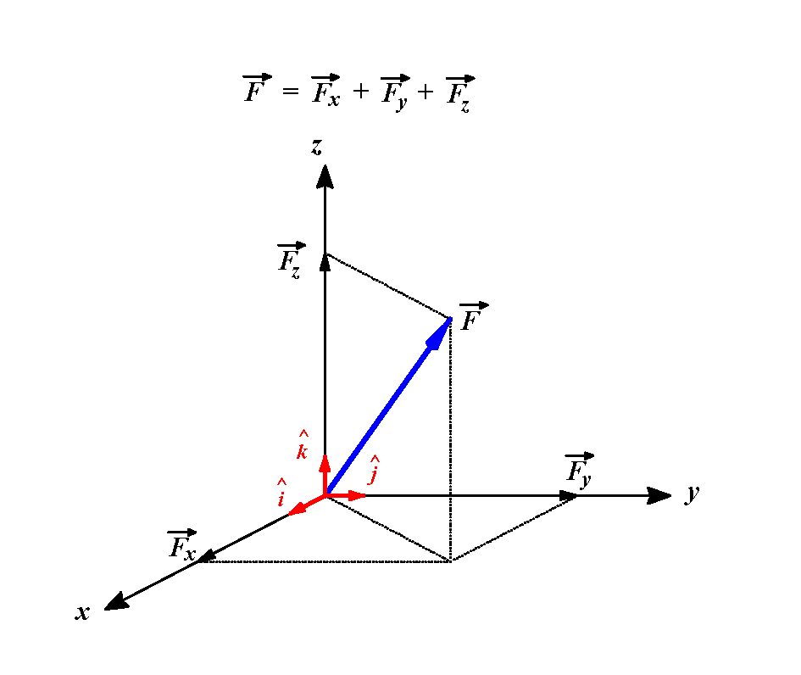
VECTOR NOTATION
A unit vector is a vector having a magnitude of one (determines direction only)
Vectors can be resolved into components
$\overset{⃑}{F}= F_{x}\hat{I}+ F_{y}\hat{J}+ F_{k}\hat{K}$

Slide 4
VECTOR OPERATIONS
The magnitude of a vector is the scalar part of a vector
If $\overset{⃑}{R}= R_{I}\hat{I}+ R_{J}\hat{J}+ R_{K}\hat{K}$
$\left|\overset{⃑}{R}\right|=R= \sqrt{R_{I}^{2}+ R_{J}^{2}+ R_{K}^{2}}$
Example: $\overset{⃑}{R}=7\hat{I}+2\hat{J}−1\hat{K}$
$$R= \sqrt{{\left(7\right)}^{2}+{\left(2\right)}^{2}+{\left(−1\right)}^{2}}$$
$= \sqrt{49+4+1}$
$= \sqrt{55}$
$≈$7.416

Slide 5
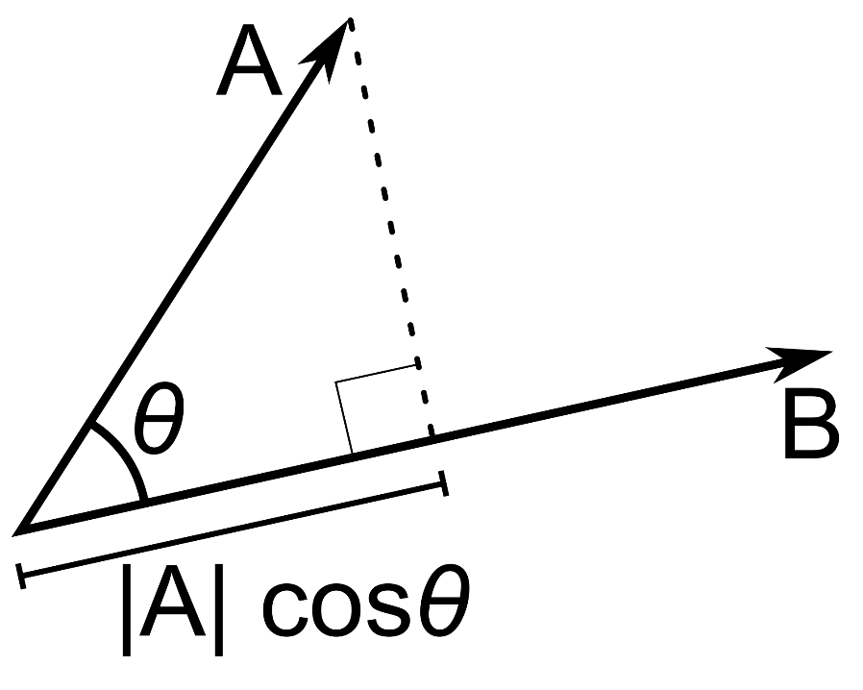
DOT PRODUCTS
$$\overset{⃑}{e}= \frac{1}{μ} \left[\left(V^{2}−\frac{μ}{R}\right)\overset{⃑}{R}+\left(\overset{⃑}{R } ∙ \overset{⃑}{V}\right) \overset{⃑}{V}\right]$$
This form of the eccentricity vector has a dot product
A dot product of two vectors $\overset{⃑}{A} and \overset{⃑}{B}$ multiplies the amount of $\overset{⃑}{A}$ that is in the direction of $\overset{⃑}{B}$by the magnitude of $\overset{⃑}{B}.$
$$\overset{⃑}{A } ∙ \overset{⃑}{B}=ABcosθ$$

Slide 6
DOT PRODUCTS
The dot product can also be calculated by:
$\overset{⃑}{A}∙ \overset{⃑}{B}= A_{I}B_{I}$ + $A_{J}B_{J}+ A_{K}B_{K}$
Example: $\overset{⃑}{A}=7\hat{I}+2\hat{J}−1\hat{K}$
$$\overset{⃑}{B}=0\hat{I}+6\hat{J}+20\hat{K}$$
$\overset{⃑}{A}∙ \overset{⃑}{B}=$ (7)(0) + (2)(6) + (-1)(20) = -8
Why did the two vectors start an internet-based company?
Because they thought they had a good dot product!

Slide 7
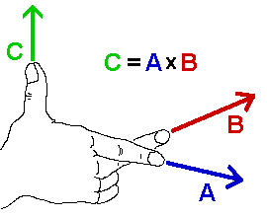
CROSS PRODUCTS (VECTOR PRODUCT)
The cross product of two vectors in three dimensions is a vector at right angles to both the original vectors.
You can use the right-hand rule to find the direction of the third vector

Slide 8
CROSS PRODUCTS (VECTOR PRODUCT)
Mathematically, you solve the determinant:
$\left|\begin{matrix}\hat{I} & \hat{J} & \hat{K} \\ A_{I} & A_{J} & A_{K} \\ B_{I} & B_{J} & B_{K}\end{matrix}\right|$ so $\overset{⃑}{A} ×\overset{⃑}{B}=\left[\left(A_{J}\right)\left(B_{K}\right)\right]−(B_{J})(A_{K})]\hat{I}$
$$−[\left(A_{I}\right)\left(B_{K}\right)−(B_{I})(A_{K})]\hat{J}$$
$$+[\left(A_{I}\right)\left(B_{J}\right)−(B_{I})(A_{J})]\hat{K}$$
What do you get when you cross a mosquito with a mountain climber?
Nothing! The mountain climber is a scalar.

Slide 9
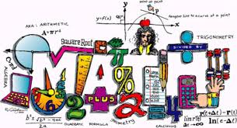
CROSS PRODUCTS (VECTOR PRODUCT)
An easier way to remember this is a method my 7th grade teacher taught
$\begin{matrix}\hat{I} & \hat{J} & \hat{K} \\ A_{I} & A_{J} & A_{K} \\ B_{I} & B_{J} & B_{K}\end{matrix} \begin{matrix}\hat{I} & \hat{J} \\ A_{I} & A_{J} \\ B_{I} & B_{J}\end{matrix}$
Read down diagonally, then subtract reading back up
-
-
-
$\overset{⃑}{A} × \overset{⃑}{B}$ =
$$A_{J}B_{K}\hat{I}$$
$$+ A_{K}B_{I}\hat{J}$$
$$+A_{I}B_{J}\hat{K}$$
$$−B_{I}A_{J}\hat{K}$$
$$−B_{J}A_{K}\hat{I}$$
$$−B_{K}A_{I}\hat{J}$$

Slide 10
CROSS PRODUCT EXAMPLE
Example: $\overset{⃑}{A}=7\hat{I}+2\hat{J}−1\hat{K}$
$$\overset{⃑}{B}=0\hat{I}+6\hat{J}+20\hat{K}$$
$$\begin{matrix}\hat{I} & \hat{J} & \hat{K} \\ 7 & 2 & −1 \\ 0 & 6 & 20\end{matrix} \begin{matrix}\hat{I} & \hat{J} \\ 7 & 2 \\ 0 & 6\end{matrix}$$
$$\overset{⃑}{A} × \overset{⃑}{B}=$$
$$\overset{⃑}{A} × \overset{⃑}{B}=46\hat{I}−140\hat{J}+42\hat{K}$$
VECTOR!
-
-
-
$$(2)(20)\hat{I}$$
+$(−1)(0)\hat{J}$
$$+ (7)(6)\hat{K}$$
$$−(0)(2)\hat{K}$$
$$−(6)(−1)\hat{I}$$
$$−(20)(7)\hat{J}$$
$$\overset{⃑}{A}× \overset{⃑}{B}=(40 −\left(−6)\right)\hat{I}+\left(0−140\right)\hat{J}+(\left(42\right)−0)\hat{K}$$

Slide 11
ANGLES AND QUADRANT CHECKS
A lot of what we do in Astro requires determining the angle between two vectors.
We mainly do this with dot products, which results in an inverse cosine.
Thinking back to trigonometry, are there any potential issues with using inverse trig functions?
$$\overset{⃑}{A } ∙ \overset{⃑}{B}=ABcosθ$$
$$θ =\cos^{−1}\left(\frac{\overset{⃑}{A } ∙ \overset{⃑}{B}}{AB}\right)$$

Slide 12
ANGLES AND QUADRANT CHECKS
YES, THERE ARE! Let’s consider an example.
I do all of my dot product math and I get a number on the inside of the inverse cosine of 0.5.
I plug that into my calculator and get an angle of 60°.
$$θ =\cos^{−1}\left(\frac{\overset{⃑}{A } ∙ \overset{⃑}{B}}{AB}\right)$$
$$θ =\cos^{−1}\left(0.5\right)$$
$$θ =60° (?)$$

Slide 13
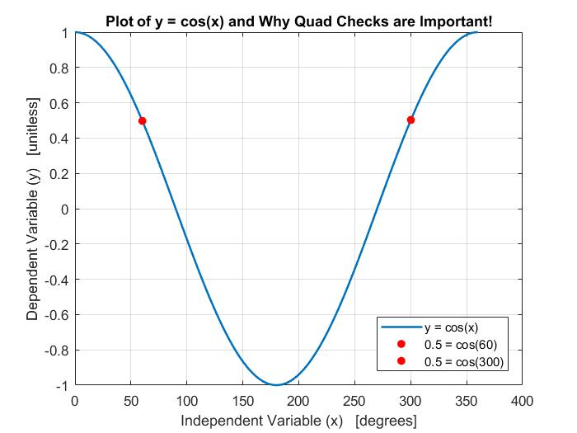
ANGLES AND QUADRANT CHECKS
So, my angle is 60°, right?
Well, maybe. cos(60°) = 0.5, but is there any other angle that gives cos(θ) = 0.5?
There is! Cosine is periodic, so cos(300°) ALSO equals 0.5.

Slide 14
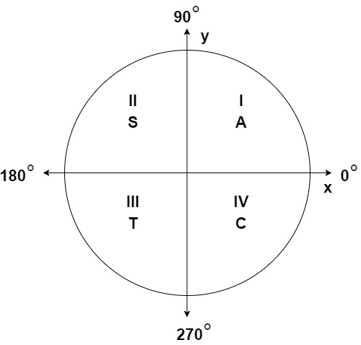
ANGLES AND QUADRANT CHECKS
Well, this is an issue. Mathematically, we get two answers, but physically, only one of them is correct.
Our spacecraft is only at one of those angles, so how do we figure out the right one?
By using the unit circle! We can use our vectors to determine which quadrant of the unit circle we’re in, and then use that to determine the correct angle. We’ll cover this more when we start talking about the COEs.

