Slide 1
What is Risk?
Driver Statistics
Notes:
Chance of injury, damage, or loss. In driving, risk is the possibility of having a conflict that results in a crash.

Slide 2





Crimes 2019
Crashes 2017
1
murder occurs every
32.1 minutes
1
fatality every
14 minutes
1
violent crime every
26.3 seconds
5
people injured every
60 seconds
1
burglary every
28.3 seconds
1
Pedestrian fatality
every 88 minutes
1 alcohol-impaired fatality every 48 minutes.
Data Sources: Crime – Federal Bureau of Investigation’s 2019 Crime Clock Statistics
NHTSA Traffic Safety Facts, “Highlights of 2017 Motor Vehicle Crashes”
Notes:
NHTSA’s National Center for Statistics and Analysis

Slide 3
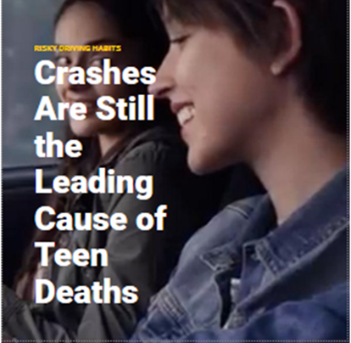
What is Risk?
Notes:
Leading cause of unintentional deaths
Chance of injury, damage, or loss. In driving, risk is the possibility of having a conflict that results in a crash.

Slide 4
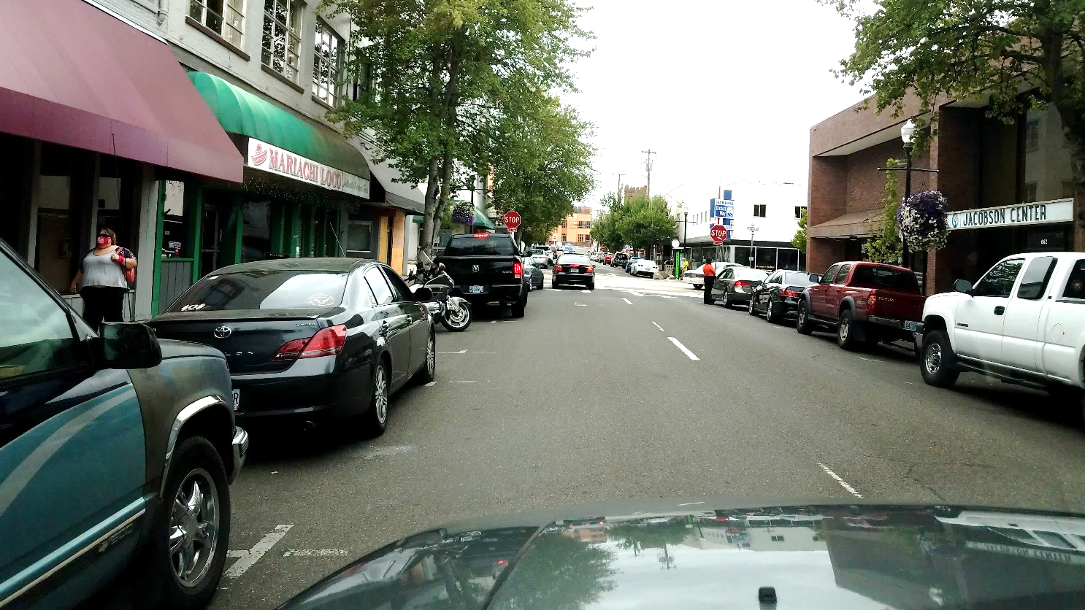
Driving behavior is based on risk awareness
Many drivers do not understand the risks involved when driving
Awareness is crucial in managing risks successfully
Visibility, space and time are the driver's best tools
Notes:
Risk is always present and continually changes depending on the situation, which is known as situational awareness. Situational awareness is defined as the perception of environmental elements and events with respect to time or space, the comprehension of their meaning, and the projection of their future status.
This will be covered more within SIM.

Slide 5
National Statistics 2020: 15-20 years old
Deaths
1,885 Drivers (8.5% of all drivers)
219 Motorcycle Riders
Crashes
Decreased by 20% from 2019 to 2020
However, fatal crashes increased by 14%
Gender
Females- 21.54% involved in fatal crashes
Males- 56.59% involved in fatal crashes
Alcohol
82% of fatal crashes had .08 BAC or higher
NHTSA 2020
Notes:
NHTSA 202
There were 1,885 young drivers killed in motor vehicle crashes.
8.5 percent of all drivers involved in fatal crashes in 2017 were 15 to 20 years old.
Young drivers accounted for 5.1 percent of the total number of licensed drivers in the United States
The rate of drivers involved in fatal crashes per 100,000 licensed drivers for young female drivers was 21.54 in 2020.
For young male drivers in 2020, the involvement rate was 56.59, more than twice that of young female drivers.
During 2020, there were 219 motorcycle riders 15 to 20 years old killed in crashes.
Of the young drivers killed with known restraint use, 52 percent were unrestrained at the time of the crashes in 2020.
Twenty-nine percent of young drivers 15 to 20 years old who were killed in crashes in 20120 had blood alcohol concentrations (BACs) of .01 g/dL or higher; 82 percent of those young drivers also had BACs of .08 g/dL or higher.

Slide 6
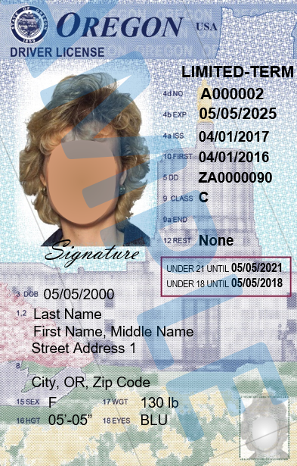
Licensed Drivers in the USA
2020
Total Licensed drivers: 228.2 Million Drivers
Total of Licensed Drivers aged 15 to 20 years old: 11.6 Million
(5.1% of total number of drivers)
NHTSA 2020
Notes:
There were 228.2 million licensed drivers in the United States in 2020. Young drivers accounted for 5.1 percent (11.6 million) of the total in 2020.

Slide 7
2020 National Crash Data
Police reported crashes
5,250,837
Crashes resulting in a fatality
35,766
38,824
People killed in motor vehicle traffic
crashes
Vehicles that were driven by 15- to 20-year-old drivers involved in fatality crashes.
5,037
Data Sources: NHTSA Traffic Safety Facts, 2020
Notes:
In 2017, there were an estimated 5,250,837 police-reported traffic crashes,
Of those crashes there were 35,766 that resulted in fatalities
38,824 people were killed and an estimated 2,282000 people were injured.
Of the 35,766 crashes 14% (5,037) were 15-to-20- year old drivers

Slide 8
2020 Oregon Motor Vehicle Traffic Crashes
Total Crashes: 38,141
Injury crashes: 19,343
Fatal Crashes: 460
Persons injured: 27,998
Persons killed: 507
Drivers Aged 15-20 (Fatal & Injury Crashes) *3,464
Most common collision type for fatal crashes: Motor Vehicle in Transport (36%)
13% of fatal and injury* crashes involved a driver aged 15 to 20
Data Sources: 2020 Oregon Motor Vehicle Traffic Crashes Quick Facts
Notes:
2020 Oregon Motor Vehicle Traffic Crashes
Quick Facts https://www.oregon.gov/odot/Data/Documents/QuickFacts_2020.pdf

Slide 9
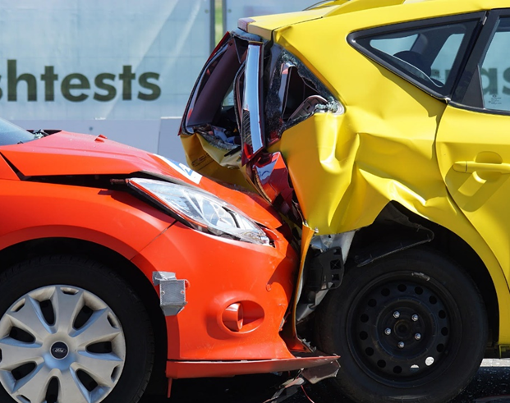
Top 10 Driver Errors
1. Failed to avoid stopped or parked vehicle ahead
2. Failed to yield right-of-way
3. Ran off road
4. Driving too fast for conditions (not exceeding posted speed)
5. Inattention
Data Sources: 2020 Oregon Motor Vehicle Traffic Crashes Quick Facts
Notes:
2020 Oregon Motor Vehicle Traffic Crashes
Quick Facts

Slide 10
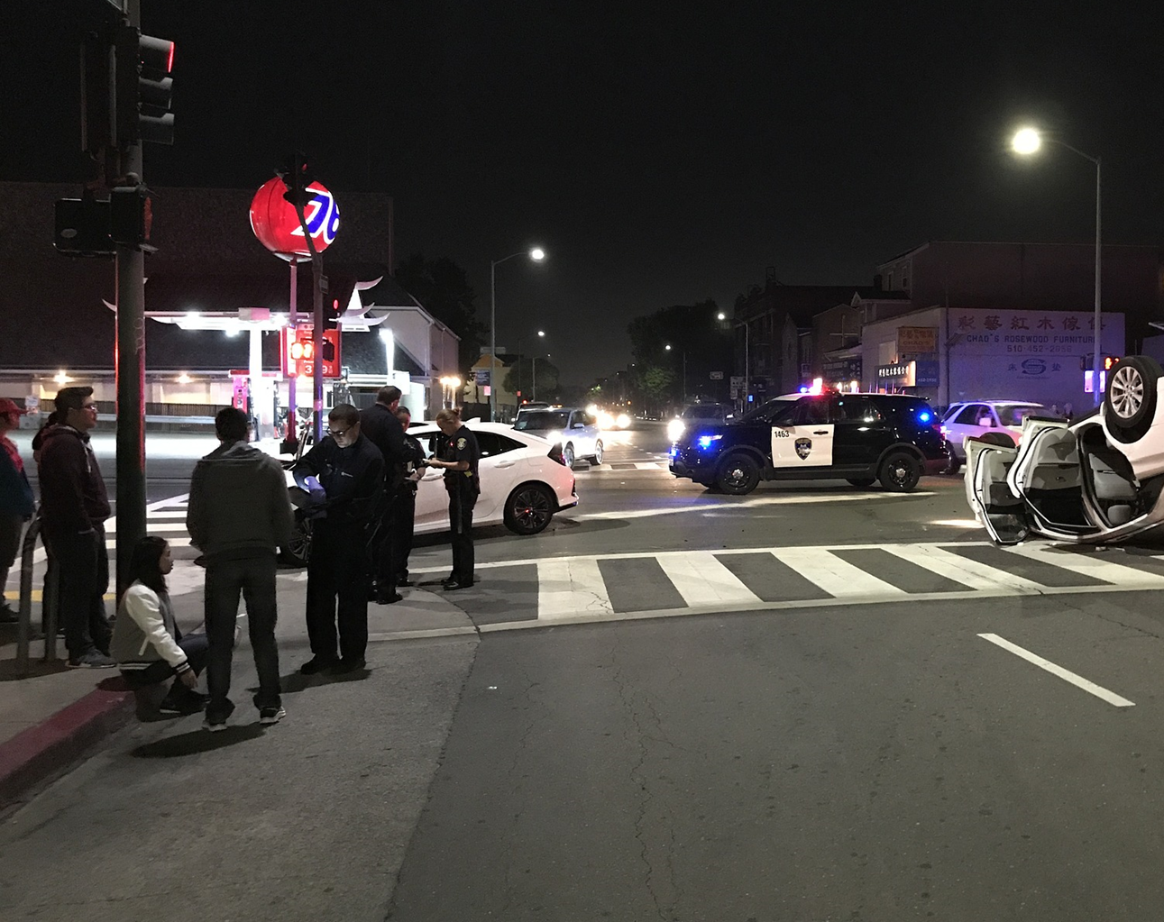
6. Failed to maintain lane
Top 10 Driver Errors
7. Left turn in front of on-coming traffic
8. Disregarded traffic
signal
9. Following too closely
10. Failed to Negotiate a Curve
Data Sources: 2020 Oregon Motor Vehicle Traffic Crashes Quick Facts
Notes:
2020 Oregon Motor Vehicle Traffic Crashes
Quick Facts

