Slide 1
Mirror Adjustments

Slide 2
Setting Your Mirrors
Correct Seat Position
No Raising of the Body
No Closing an Eye
No Squinting

Slide 3
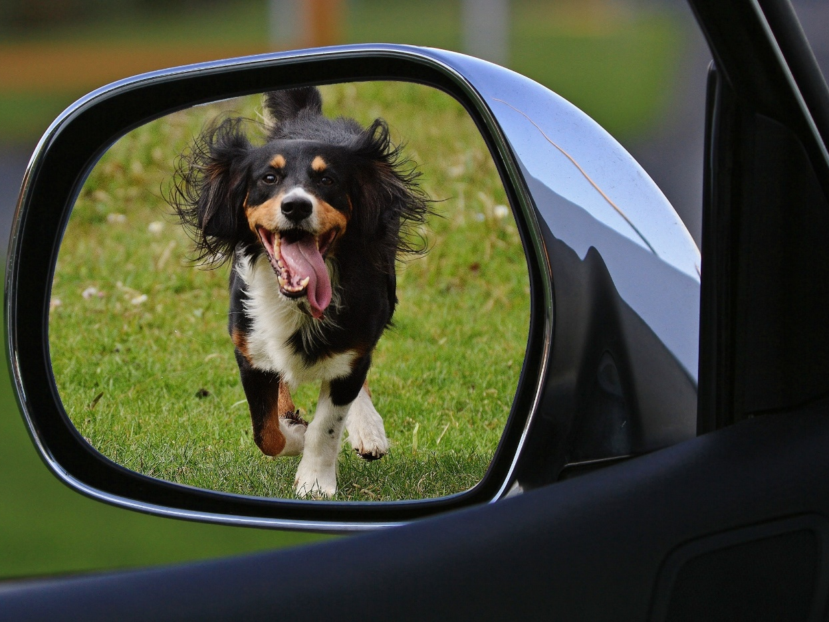
Properly adjusted mirrors provide valuable information
Notes:
Properly adjusted mirrors do not eliminate blind spots. They do reduce the size of the blind spot and allow us to look into the blind spot with minimal movement of our body, which gives us better steering control

Slide 4
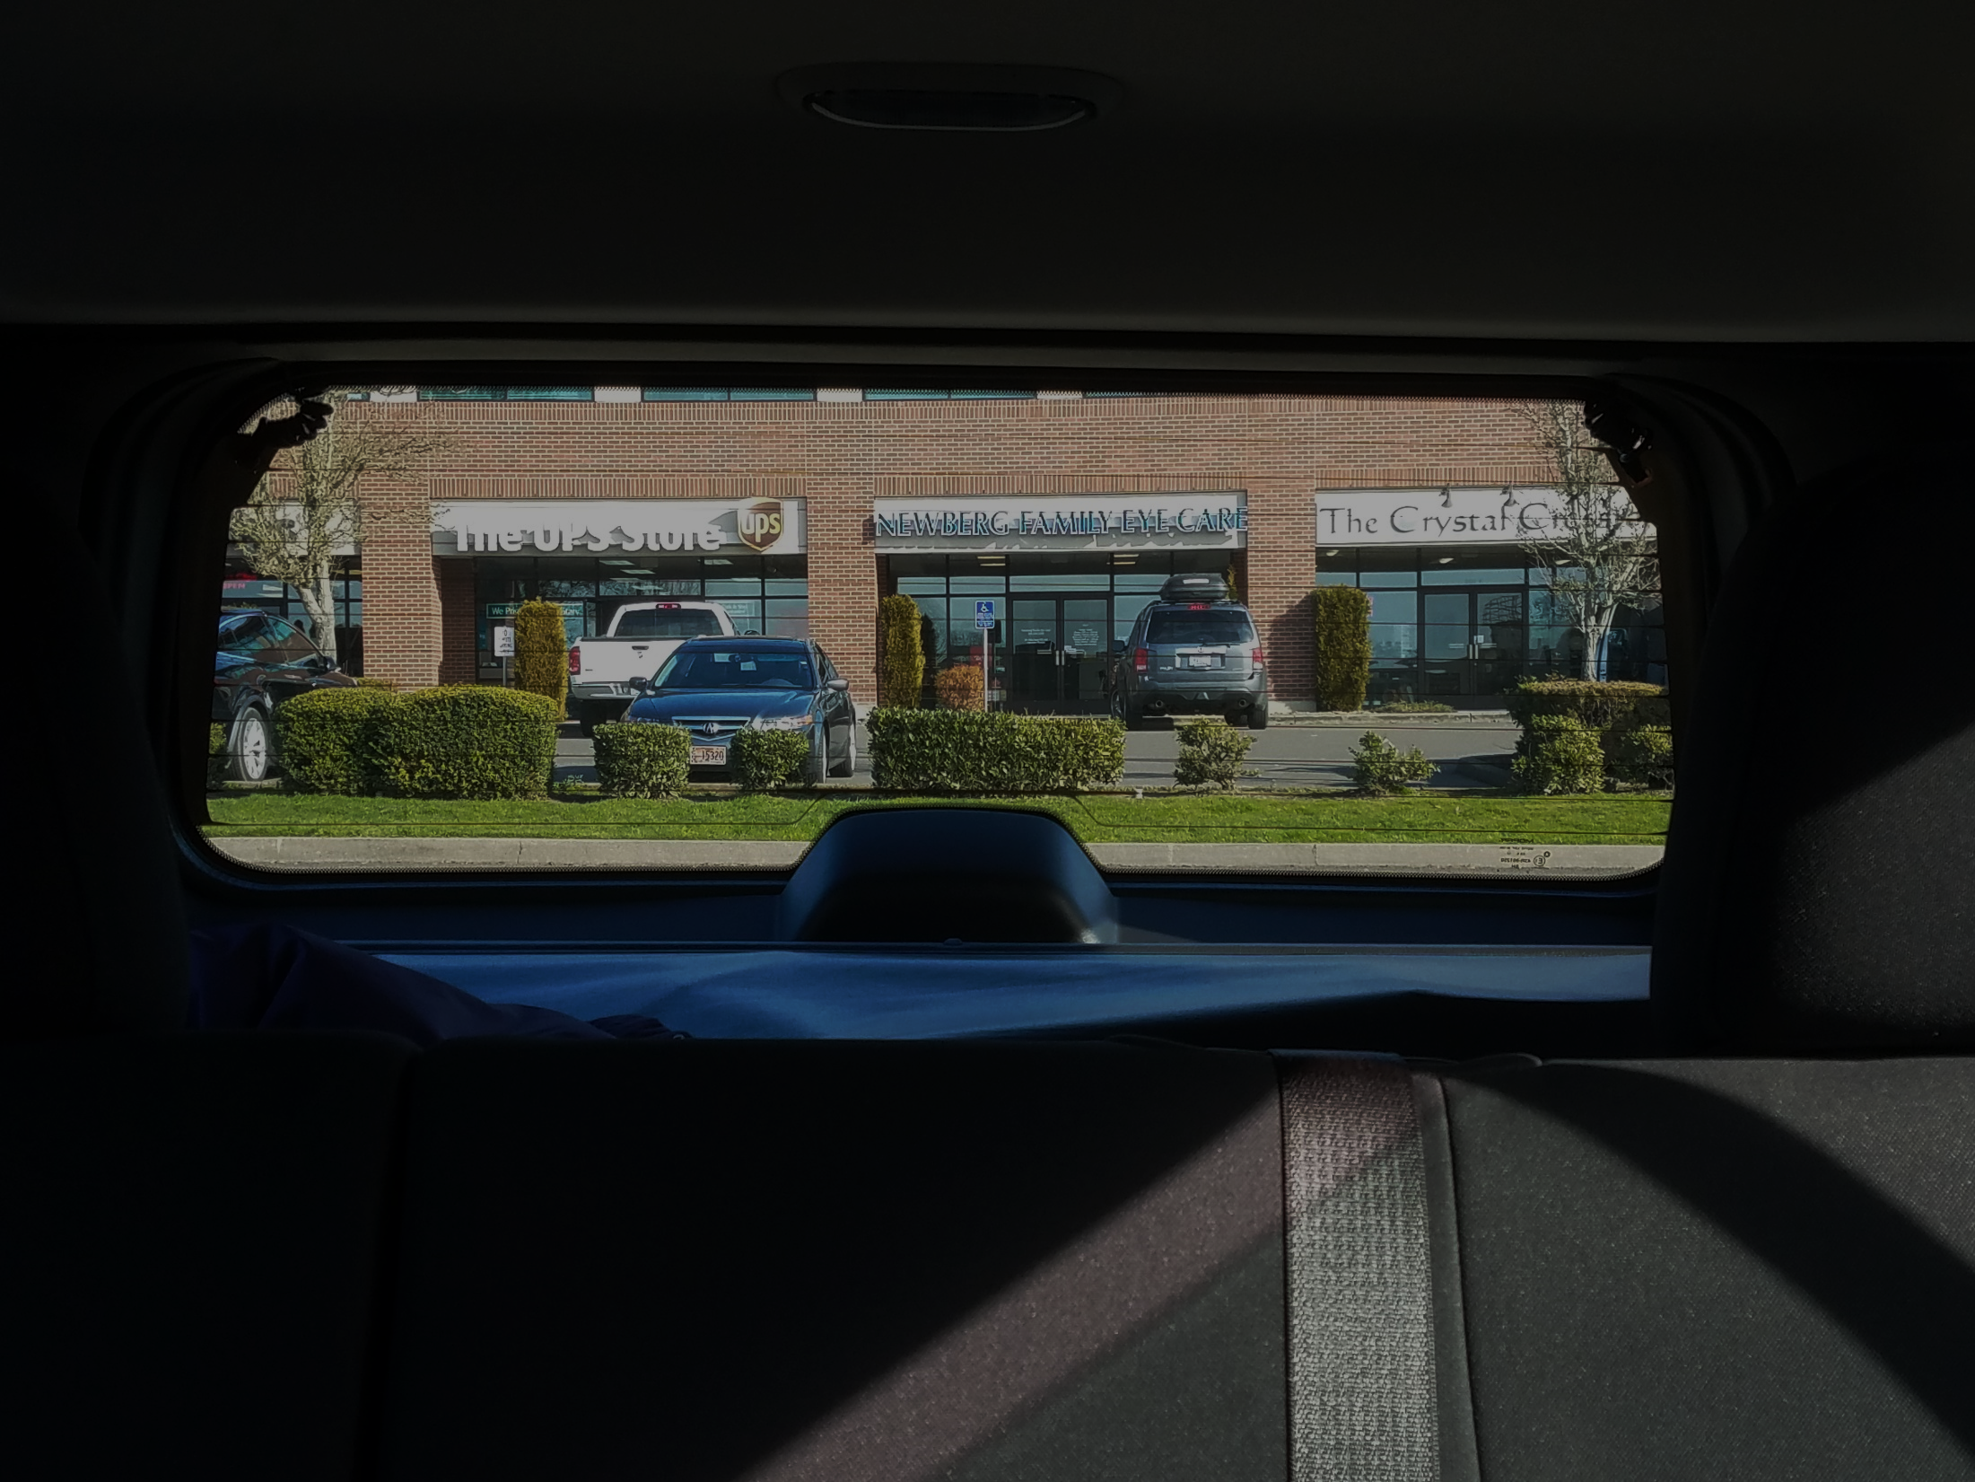
Inside Rearview Mirror
This mirror allows you to see out the rear window.
Notes:
Emphasize to Students: No leaning, No raising of body, No closing an eye, No squinting

Slide 5
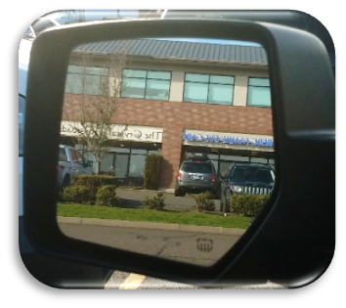
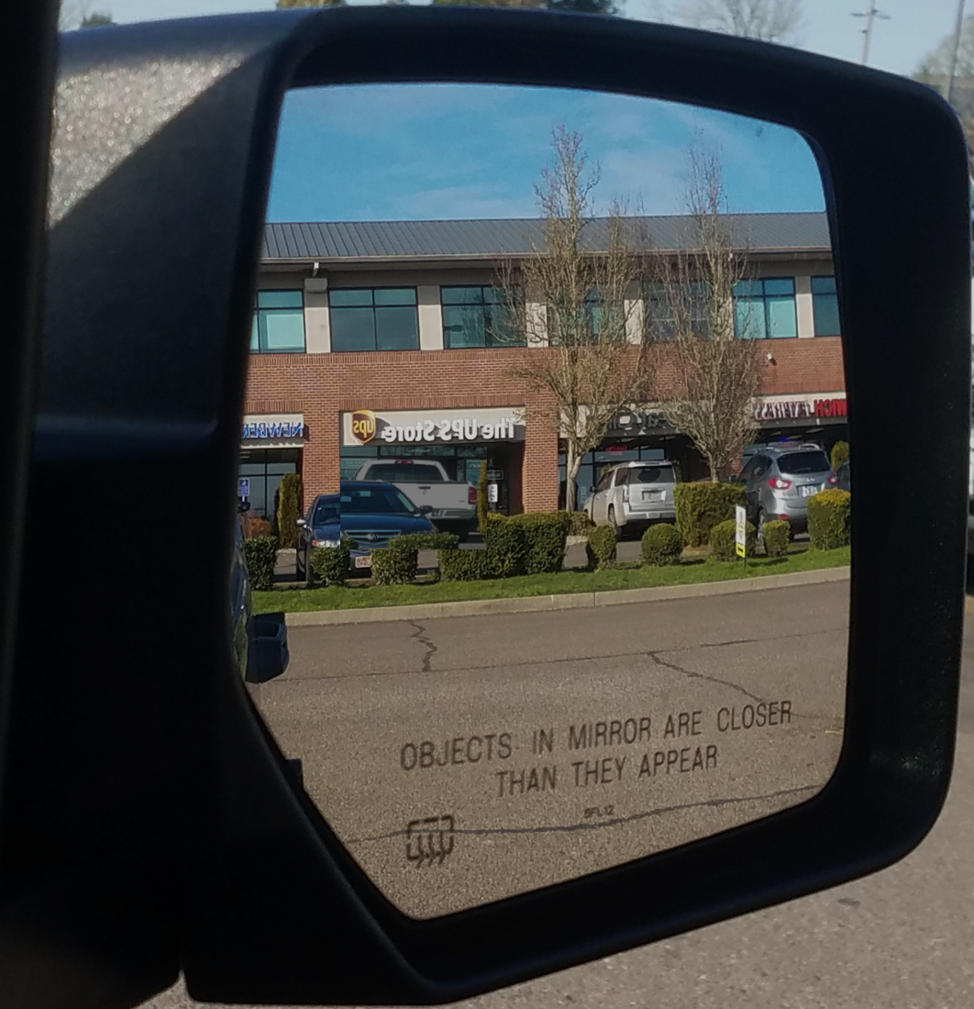
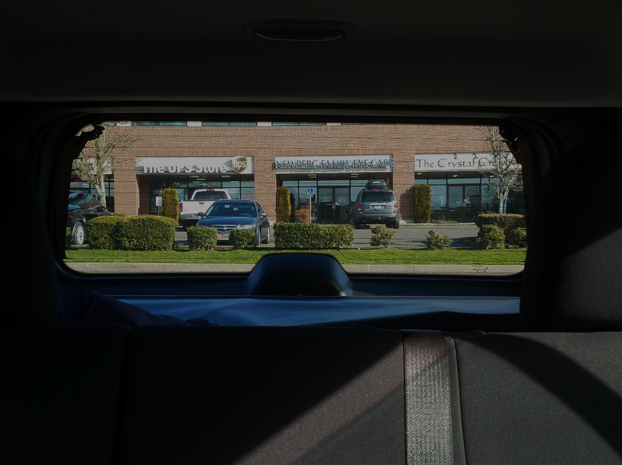
Outside Rearview Mirrors
The outside rearview mirrors allow you to see to the sides and rear of your vehicle.
Notes:
The outside rearview are an extension of the inside rearview mirror.

Slide 6
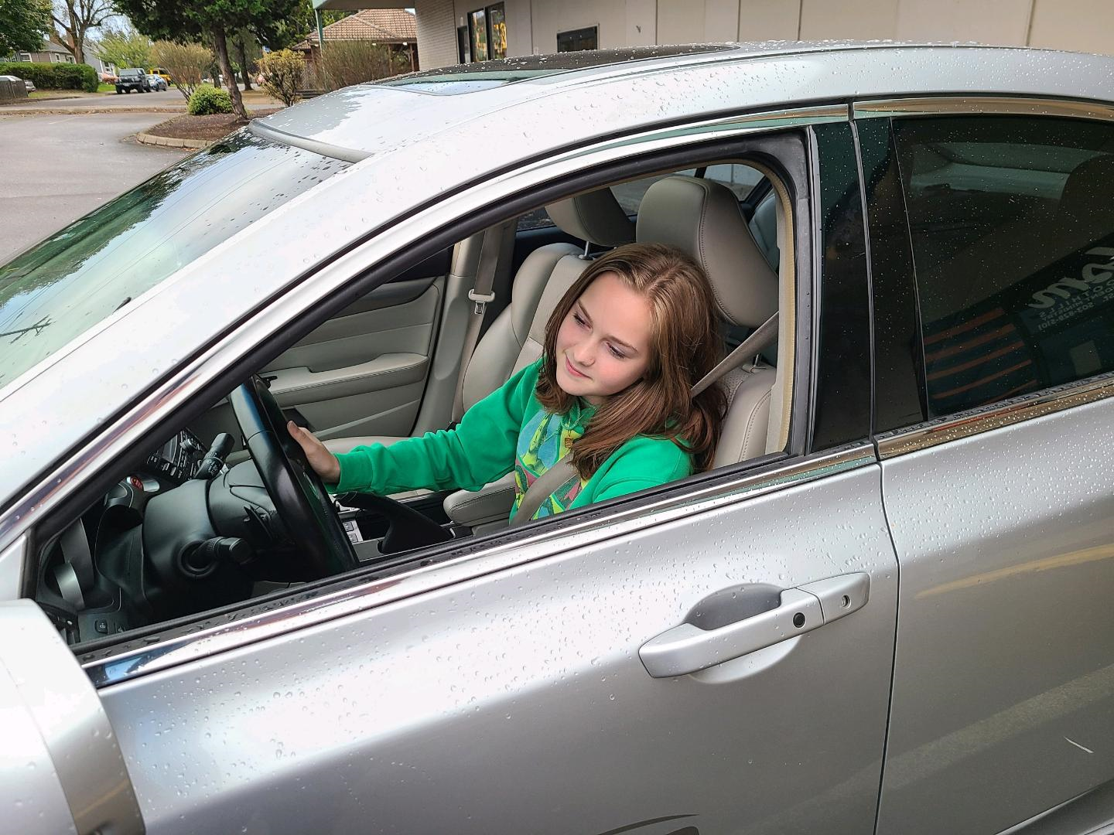
Driver Side Rearview Mirror
To adjust this mirror, tilt your head slightly to the left and adjust the mirror to see a sliver of your vehicle. After adjustment, the vehicle will not be visible in the mirror.

Slide 7
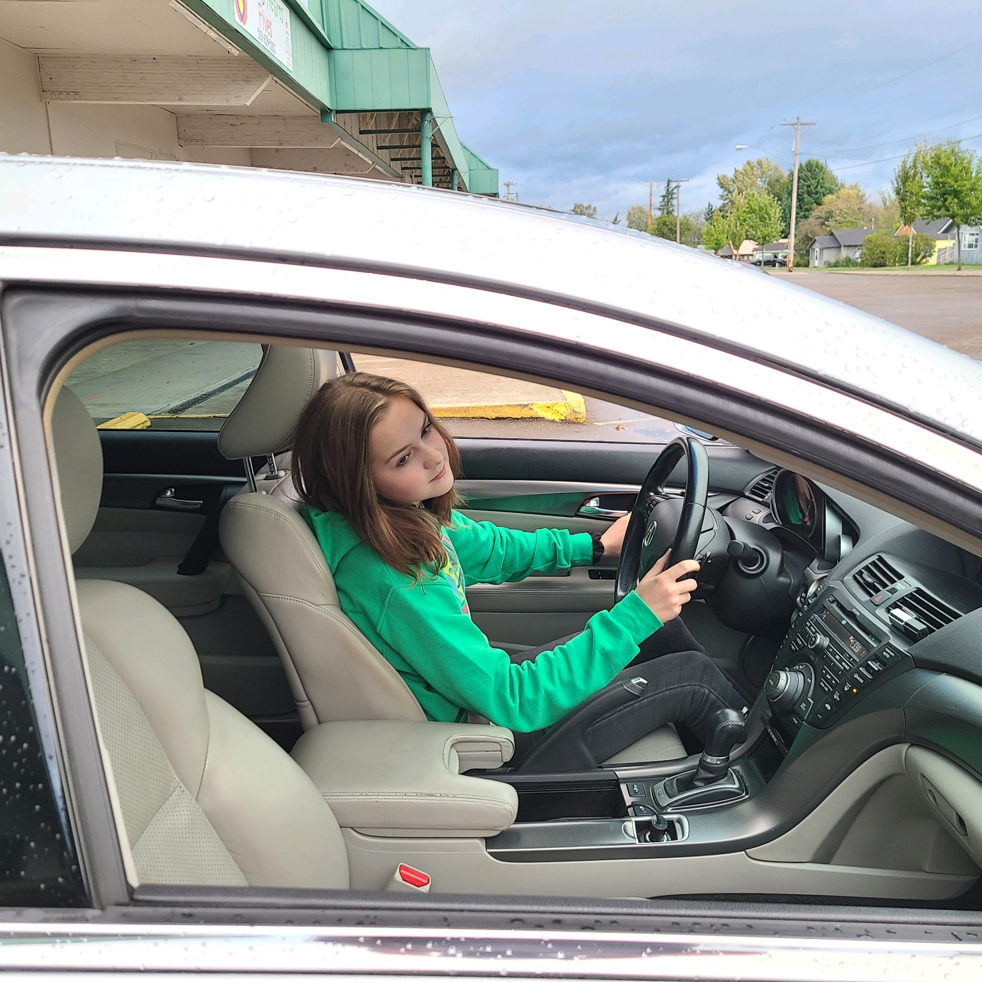
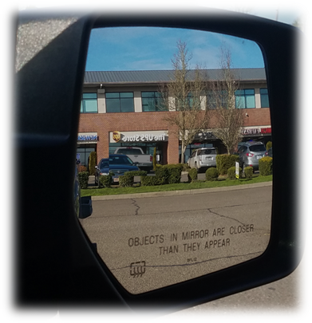
Passenger Side Rearview Mirror
Tilt your head slightly to the right and adjust the mirror to see a sliver of your vehicle. After adjustment, the vehicle will not be visible in the mirror.

Slide 8
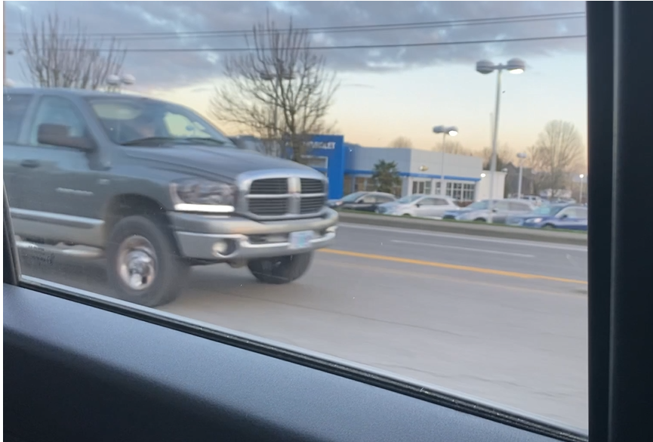
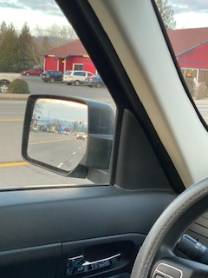

Mirrors do not allow you to see all the areas around your car. The areas you cannot see are called “blind spots”
Look over your shoulder to know if the blind spot is occupied or not!
Left mirror check

Slide 9
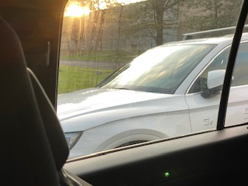
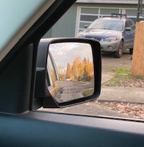
There are blind spots on both sides.
Chin to shoulder to check.
Right blind spot
Right mirror check
Notes:
Door posts or roof pillars can block your view of the blind spot and prevent you from gathering information about the condition of the roadway next to your car. Look around door posts and pillars.

Slide 10
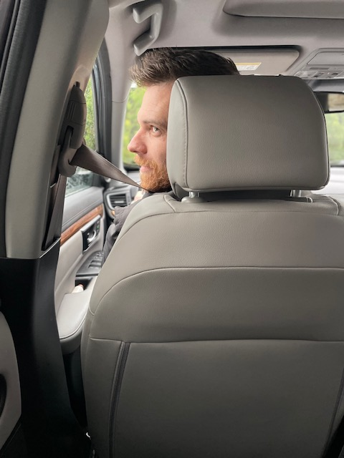

Chin to shoulder blind spot check
Left blind spot
Right blind spot
Notes:
Activity- Have students demonstrate blind spot check

