Slide 1
Instruments, Gauges and Symbols

Slide 2
Each will appear for 1.0 second…

Slide 3
You will then have ten (10) seconds to write down its meaning on your paper.

Slide 4
Ready?

Slide 5
Here Comes
# 1…

Slide 6
1

Slide 7
Here Comes
# 2…

Slide 8
2

Slide 9
Here Comes
# 3…

Slide 10
3

Slide 11
Here Comes
# 4…

Slide 12
4

Slide 13
Here Comes
# 5…

Slide 14
5

Slide 15
Here Comes
# 6…

Slide 16
6

Slide 17
Here Comes
# 7…

Slide 18
7

Slide 19
Here Comes
# 8…

Slide 20
8

Slide 21
Here Comes
# 9…

Slide 22
9

Slide 23
Here Comes
# 10…

Slide 24
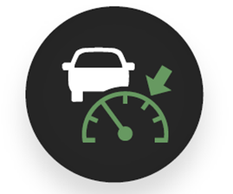
10

Slide 25
Here Comes
#11…

Slide 26
11

Slide 27
Here Comes
#12…

Slide 28
12

Slide 29
Here Comes
#13…

Slide 30
13

Slide 31
Here Comes
#14…

Slide 32
14

Slide 33
Here Comes
#15…

Slide 34
15

Slide 35
Here Comes
#16…

Slide 36
16

Slide 37
Here Comes
#17…

Slide 38
17

Slide 39
Here Comes
#18…

Slide 40
18

Slide 41
Here Comes
#19…

Slide 42
19

Slide 43
Here Comes
#20…

Slide 44
20

Slide 45
Here Comes
#21…

Slide 46
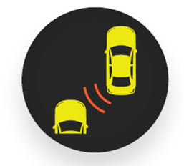
21

Slide 47
Here Comes
#22…

Slide 48
22

Slide 49
Here Comes
#23…

Slide 50
23

Slide 51
Here Comes
#24…

Slide 52
24

Slide 53
Here Comes
#25…

Slide 54
25

Slide 55
Here Comes
#26…

Slide 56
26

Slide 57
Here Comes
#27…

Slide 58
27

Slide 59
Here Comes
#28…

Slide 60
28

Slide 61
Here Comes
#29…

Slide 62
29

Slide 63
Here Comes
#30…

Slide 64
30

Slide 65
That is all of the Instruments, Gauges and Symbols…

Slide 66
ANSWERS….

Slide 67
1.
5.
9.
13.
Lane keep assist
Lane departure warning
Temperature warning
Safety belt warning
2.
6.
10.
14.
Forward collision warning
Brake system warning
Adaptive cruise control
Brake assist
3.
7.
11.
15.
Defrost
Electronic stability control
Daytime running lights
Drowsiness alert
4.
8.
12.
16.
Push button start
Traction control
Windshield washer fluid
Bicycle detection
Notes:
Red – potential serious problem or safety issue- should be taken to a mechanic as soon as possible
Green /Blue - information
Yellow or Orange – needs to be serviced or repaired soon (usually an advisory- important information)

Slide 68
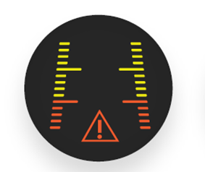
17. 21. 25. 29.
18. 22. 26. 30.
19. 23. 27.
20. 24. 28.
Back-up camera
Blind spot warning
Parking sensors
Hazard lights
Check engine
Anti-lock brakes
Fuel cap warning
Oil pressure warning
Rear cross traffic alert
Battery
Fog lights
Rear defroster
Engine temperature warning
High beam indicator

