Slide 1
Lane Position Selection

Slide 2
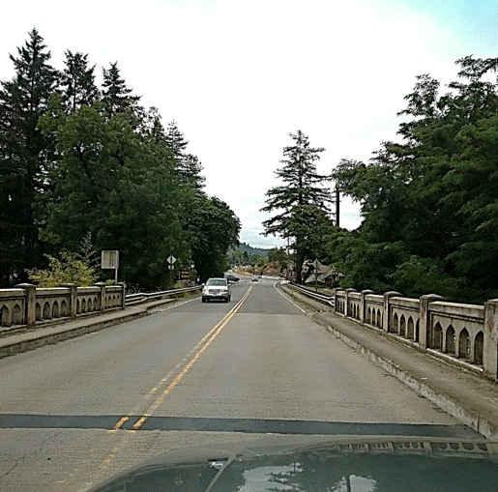
Lane Positions
Lane positions help you accurately position your vehicle within your lane and on the roadway.
They help you position your vehicle for turns and manage space to reduce risk.

Slide 3
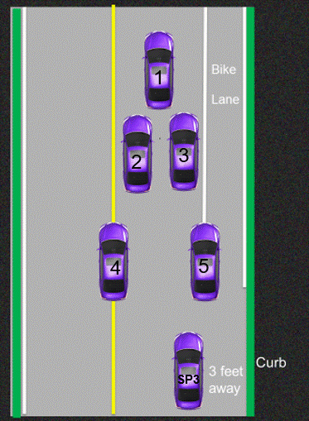
There are 5 lane positions (LP) and 2 side positions (SP)
Notes:
Introductory slide. Use next slide to discuss lane positions
SP 3 and SP 6 are our two side positions. SP 6 is used for parking and will be introduced later

Slide 4
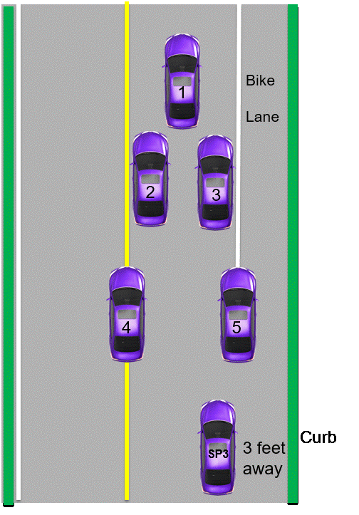
Notes:
Elaborate on lane positions

Slide 5
Lane Position Scenarios
For each scenario, answer the following questions:
- What is your lane position?
- Why use that lane position?

Slide 6
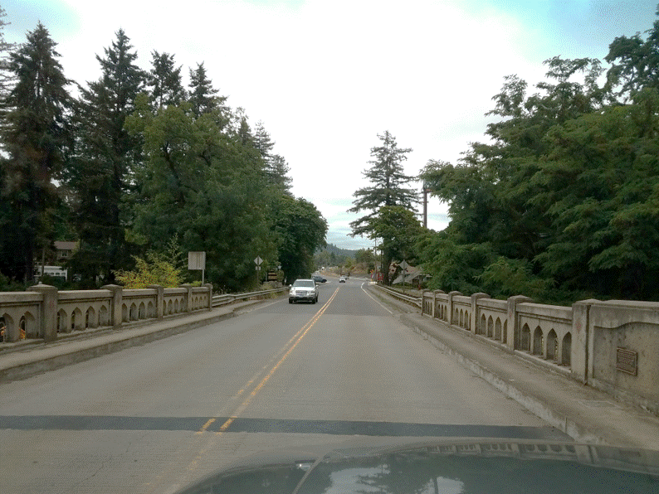
Notes:
Lane position 1- path restriction on left and right

Slide 7
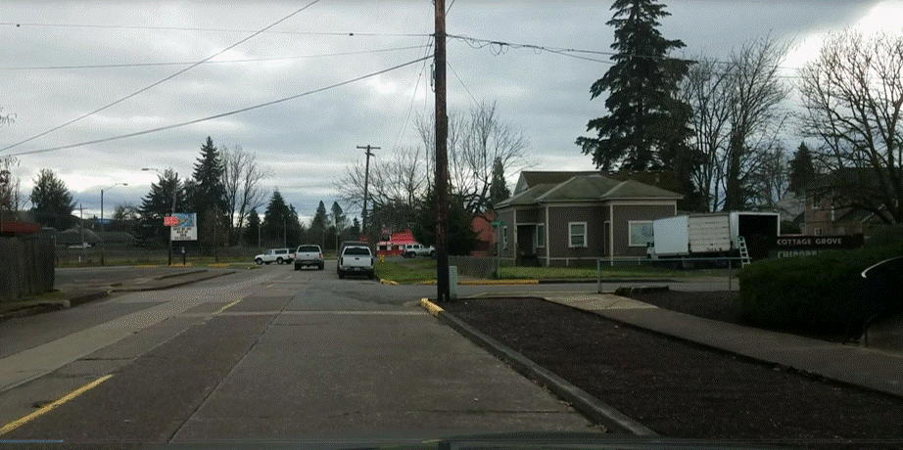
Notes:
Side Position 3-Turning right

Slide 8
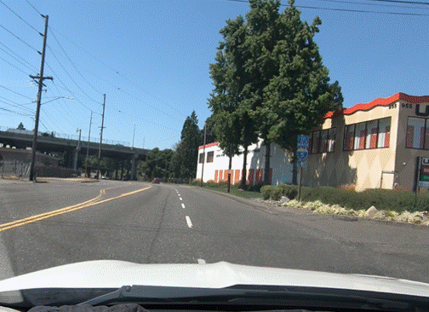
Changing lanes to the left
Notes:
Lane position 4 - lane change left

Slide 9
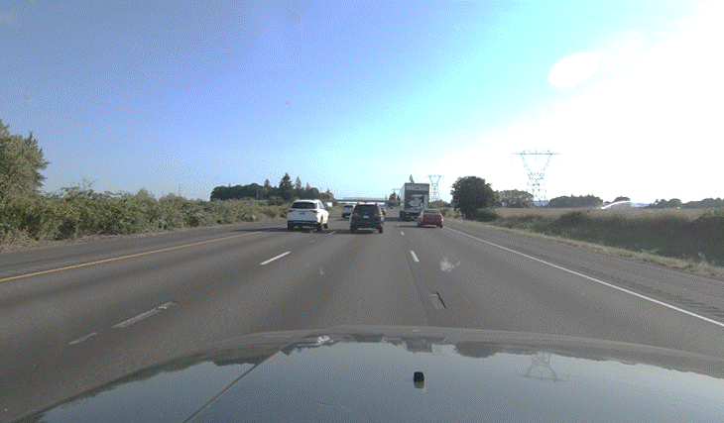
Changing lanes to the right
Notes:
Lane position 5 - lane change right

Slide 10
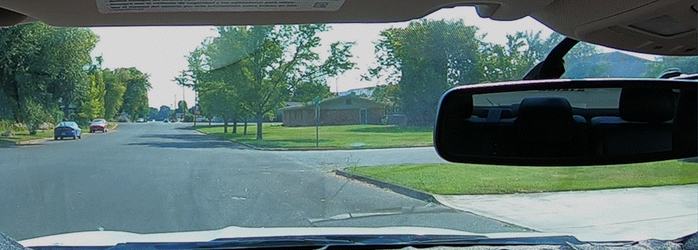
Notes:
Side position 3-turning right with no bike lane present

Slide 11
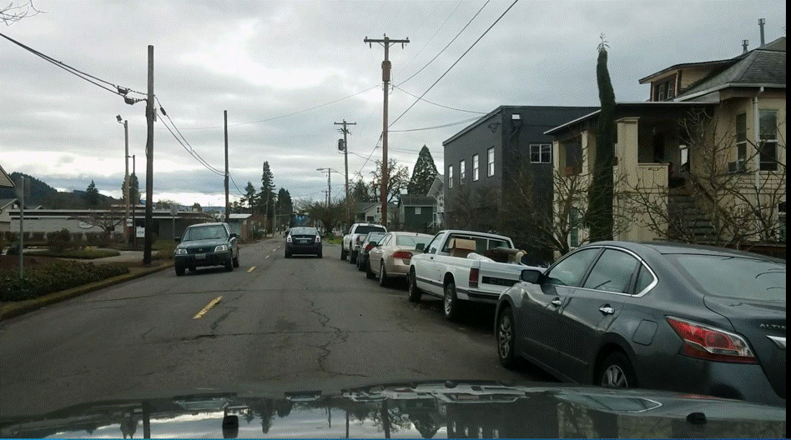
Notes:
Lane position 1-oncoming traffic and parked cars

Slide 12
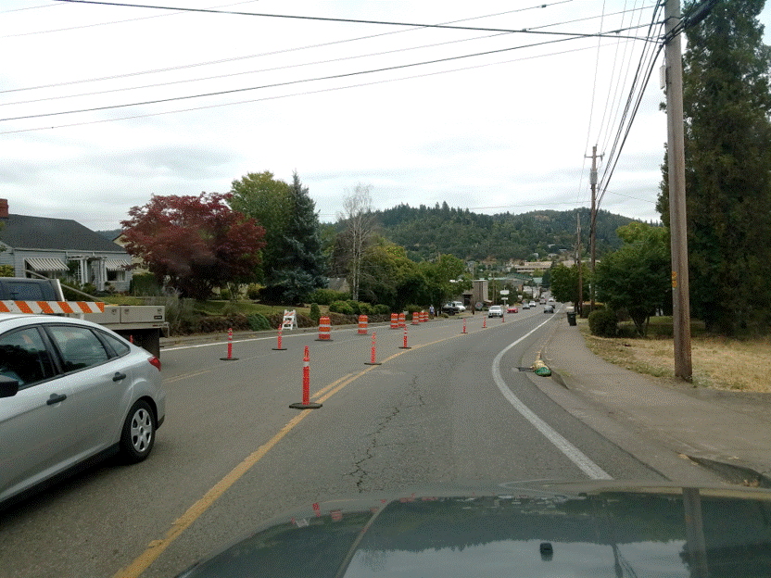
Notes:
Lane position 3 – closed left

Slide 13
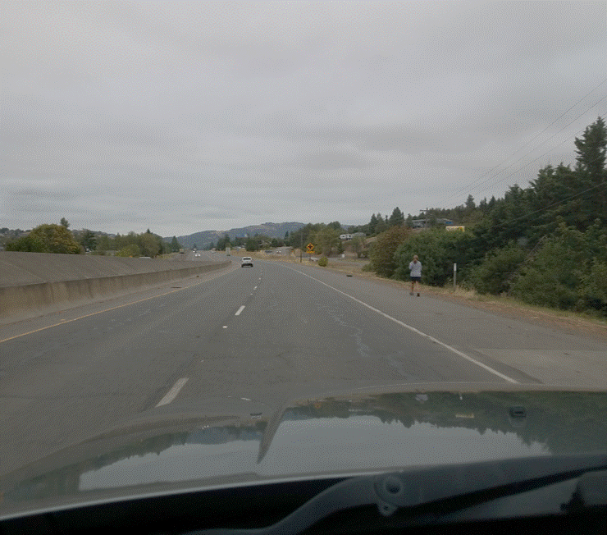
Notes:
Lane position 2-pedestrian

Slide 14
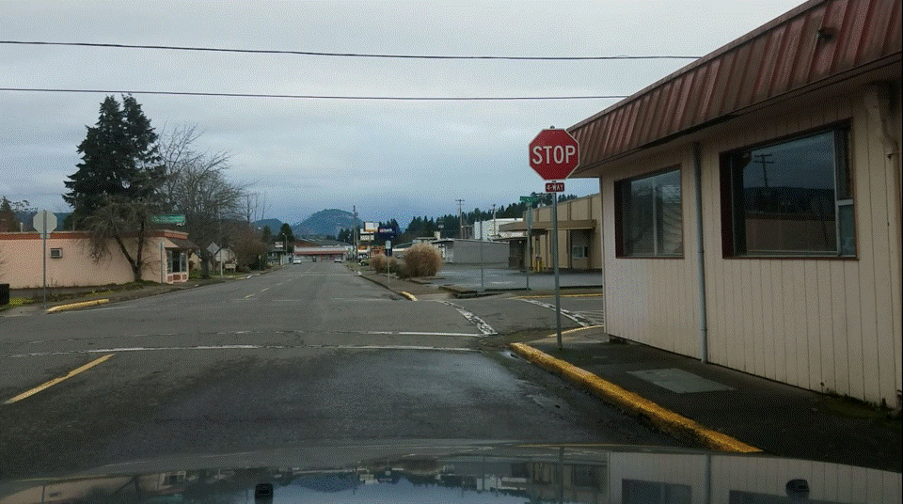
Notes:
Side position 3- turning right/no bike lane

Slide 15
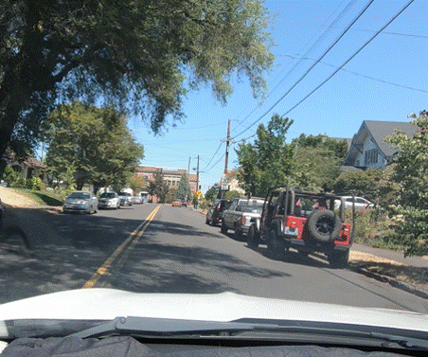
Notes:
Lane position 2-parked cars on the right

Slide 16
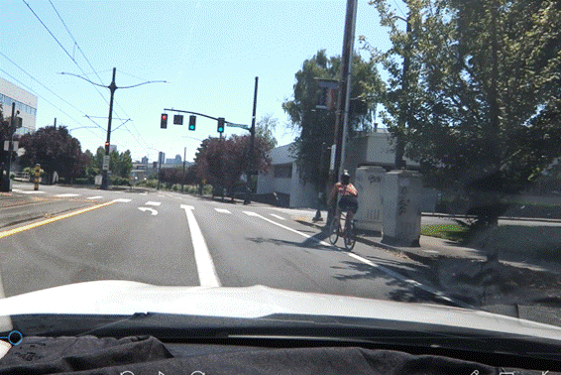
Notes:
Lane position 4-entering turn lane

Slide 17
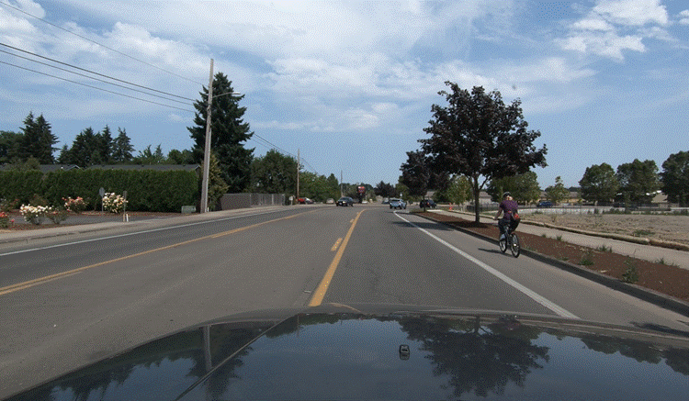
Notes:
Lane position 2-cyclist on the right

Slide 18
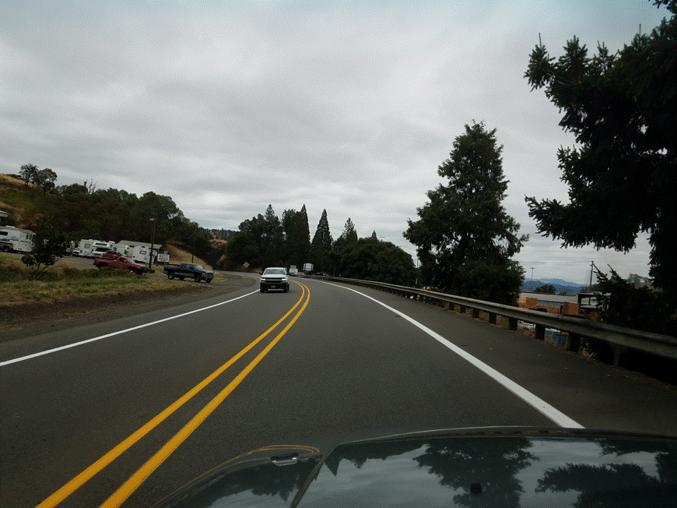
Notes:
Lane position 3-oncoming traffic and curve

Slide 19
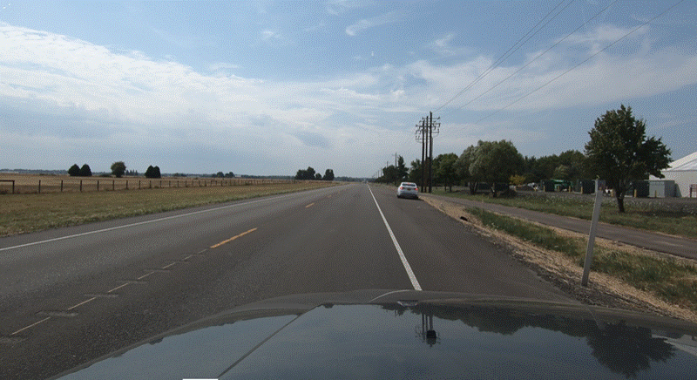
Notes:
Lane position 5-exiting the travel lane

Slide 20
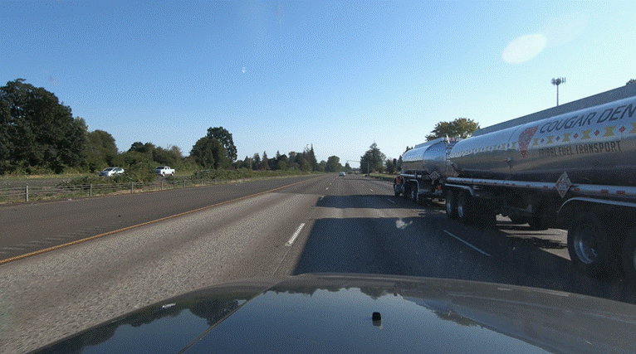
Notes:
Lane position 2-truck on right-vision restriction

