Slide 1
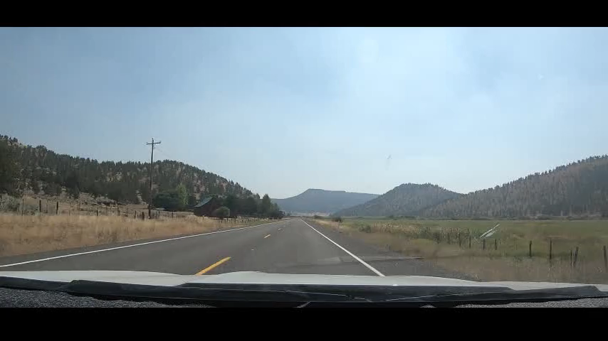
Communication
Timely and correct or late and confusing
Video link

Slide 2

Communication
Turn Signals
Brake Lights
Lane Positions
Horn
Reverse Lights
Headlights
Hand Signals
Speed
Hazard Lights

Slide 3
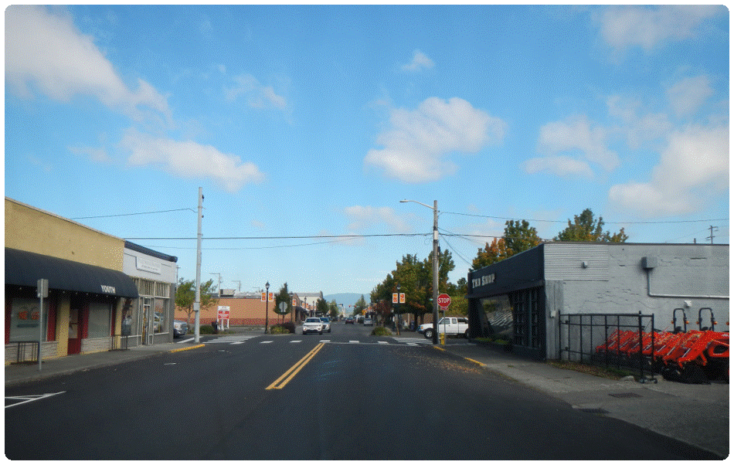
You plan to turn left at the intersection.
What communication options will you use?
Brake lights
Signal 5 seconds ahead
LP – 1
Notes:
Click for answers

Slide 4
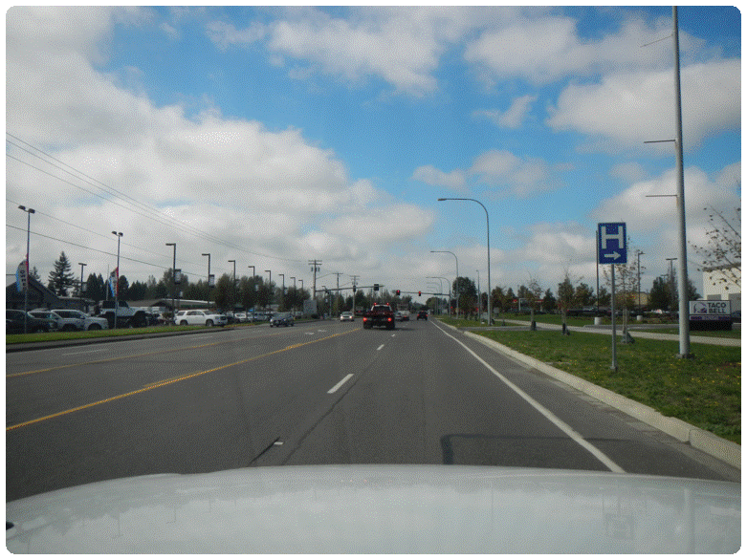
You plan to turn right at the intersection.
What communication options will you use?
Brake lights
Signal 5 seconds ahead
LP – 3

Slide 5
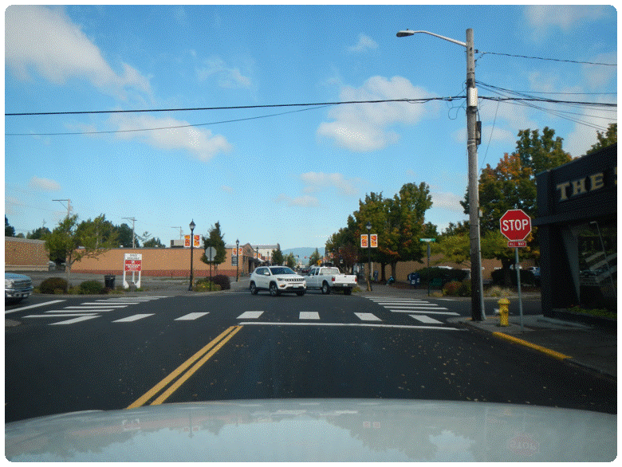
You plan to turn right at the intersection.
What communication options will you use?
Brake lights
Signal 5 seconds ahead
SP – 3

Slide 6
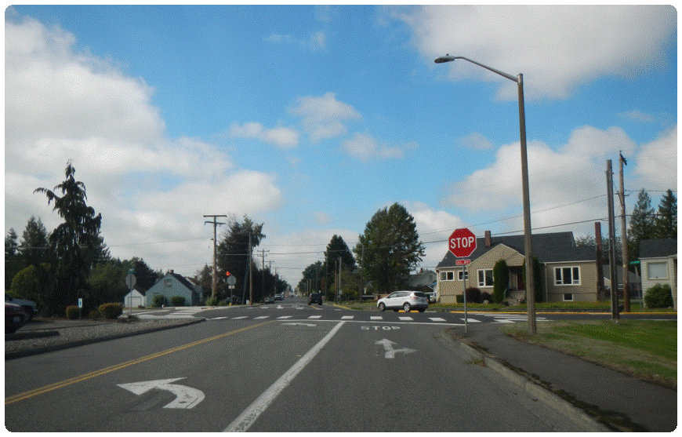
You plan to continue forward at the intersection.
What communication options will you use?
Brake lights
LP – 1

Slide 7
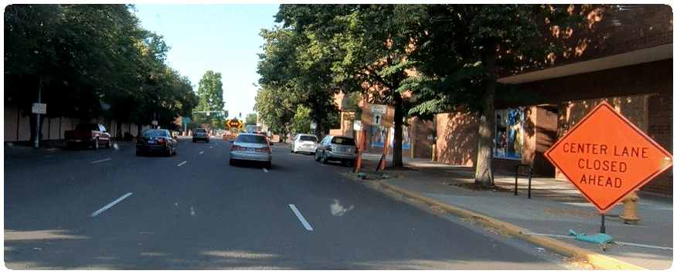
How will you communicate your intention to move to the right lane?
Right signal
LP – 3
Maintain speed

Slide 8
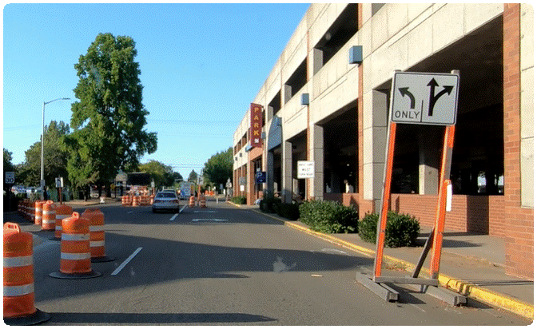
How will you communicate your intention to move to the left lane?
Left signal
LP – 2
Maintain speed

Slide 9
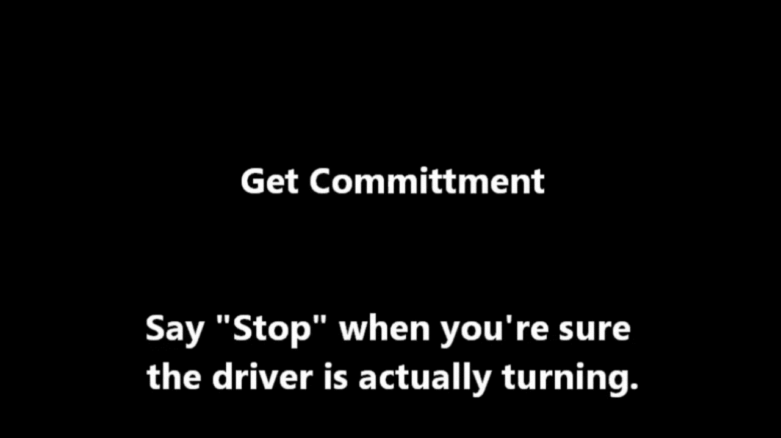
Get Commitment
Click to play or hover mouse over screen to use play button

Slide 10
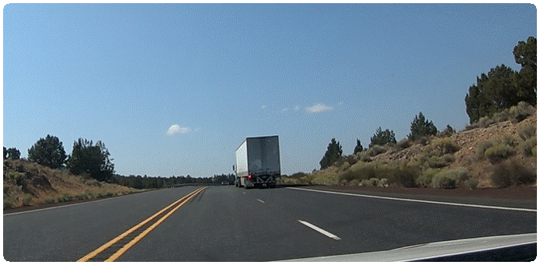
What is the truck communicating?
Changing lanes to the left

Slide 11
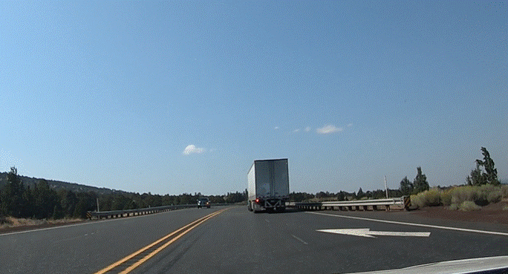
How could you communicate your cooperation?
Stay back. Create a gap for the truck to move into.

Slide 12
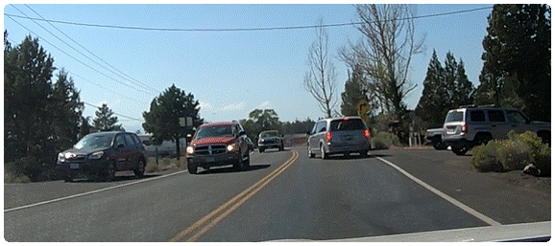
What is the van communicating?
Something happening in the lane ahead.
How should you respond?
Brake lights
LP3

Slide 13
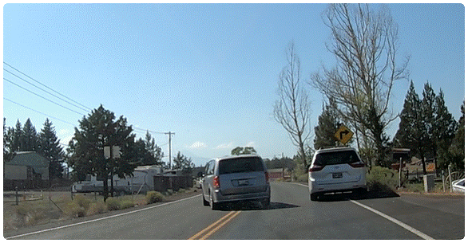

Slide 14
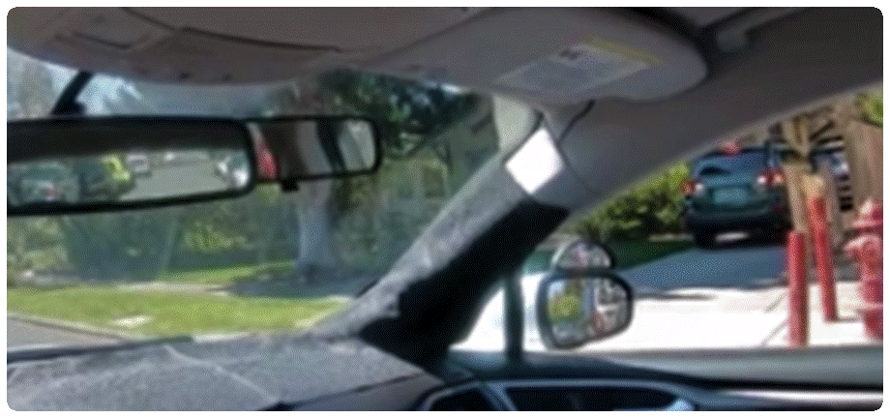
What is the vehicle in the driveway communicating?
Backing out

Slide 15
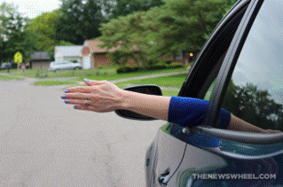
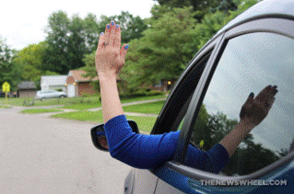
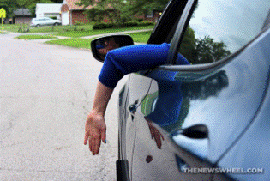
Hand Signals
Left turn
Right turn
Slow or Stop
Notes:
To be used during daylight hours only
Photo: https://thenewswheel.com/a-simple-guide-to-using-hand-signals-while-driving-photos/

Slide 16
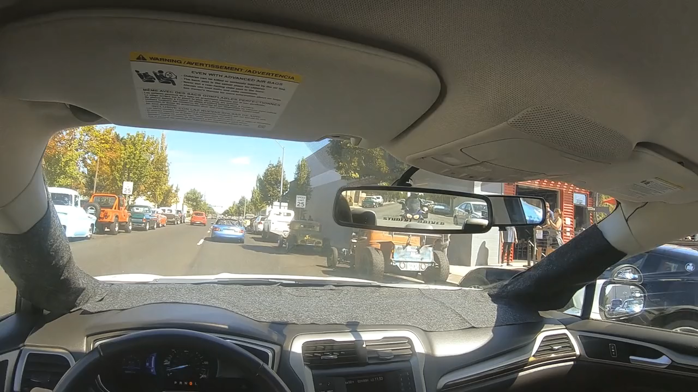
How does this vehicle communicate?
What other communications did you see?
Link to video
Notes:
Brake lights, lane position, reverse lights, turn signals, speed

Slide 17
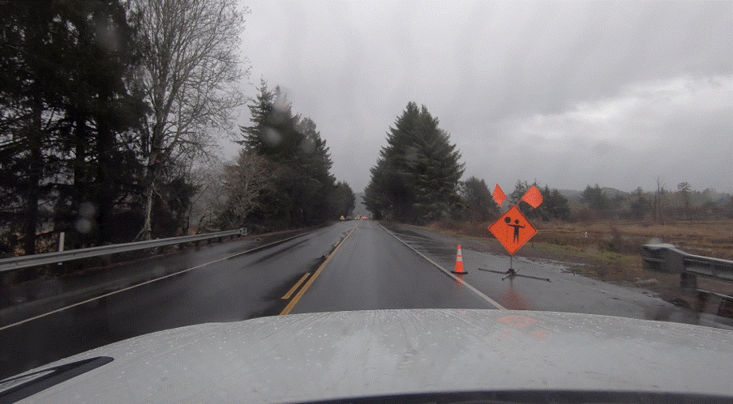
What is the sign telling you?
What communication should you send to the vehicles to the rear?
What’s the situation?
Notes:
Flagger ahead

Slide 18
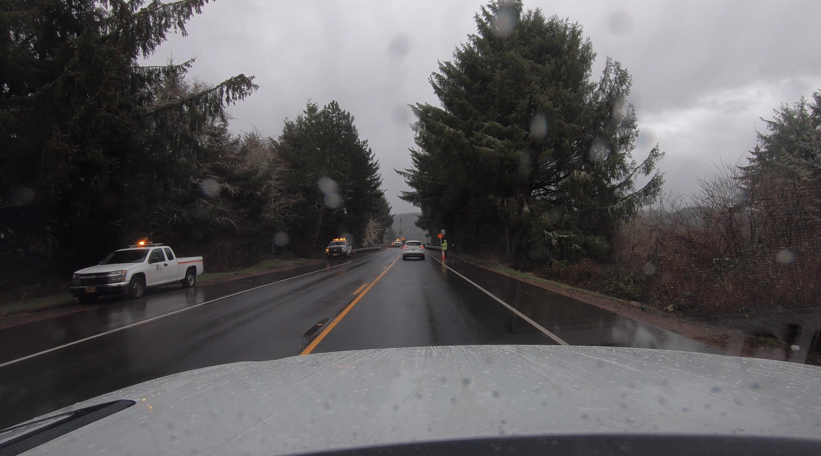
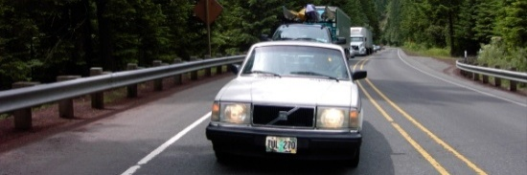
How do you communicate the situation?
Brake early

Slide 19
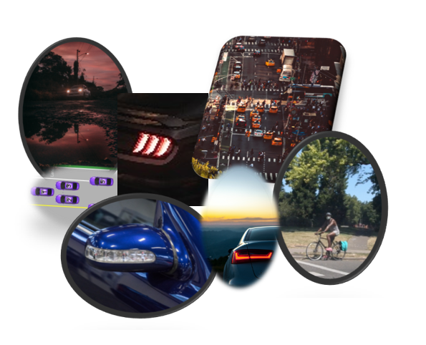
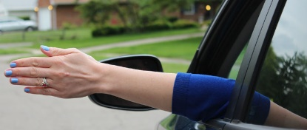
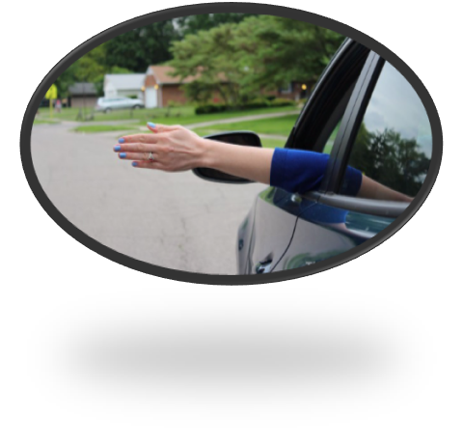
COMMUNICATION OPTIONS
Notes:
Ask students what communication options we have

