Slide 1
Road Signs Recognition

Slide 2
Each sign will appear for 0.3 seconds…

Slide 3
You will then have ten (10) seconds to write down its meaning on your paper.

Slide 4
Ready?

Slide 5
Here Comes
Sign # 1…

Slide 6
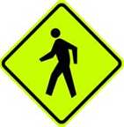
1

Slide 7
Here Comes
Sign # 2…

Slide 8
2

Slide 9
Here Comes
Sign # 3…

Slide 10
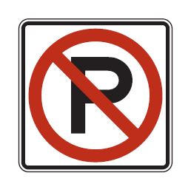
3

Slide 11
Here Comes
Sign # 4…

Slide 12
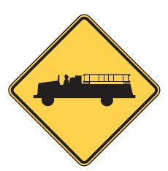
4

Slide 13
Here Comes
Sign # 5…

Slide 14
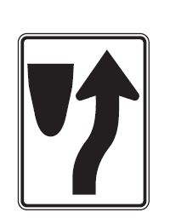
5

Slide 15
Here Comes
Sign # 6…

Slide 16
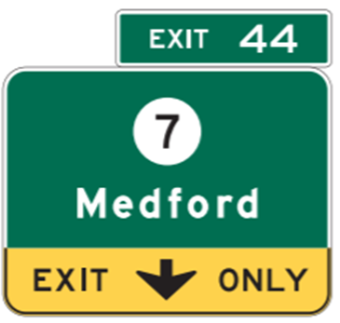
6

Slide 17
Here Comes
Sign #7 …

Slide 18
7

Slide 19
Here Comes
Sign # 8…

Slide 20
8

Slide 21
Here Comes
Sign # 9…

Slide 22
9

Slide 23
Here Comes
Sign #10…

Slide 24
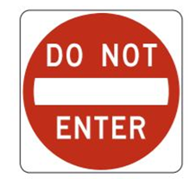
10

Slide 25
Here Comes
Sign #11…

Slide 26
11

Slide 27
Here Comes
Sign #12…

Slide 28
12

Slide 29
Here Comes
Sign #13…

Slide 30
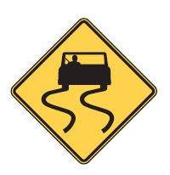
13

Slide 31
Here Comes
Sign #14…

Slide 32
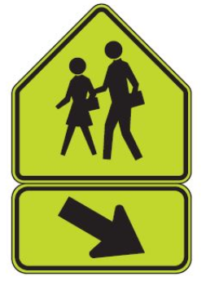
14

Slide 33
Here Comes
Sign #15…

Slide 34
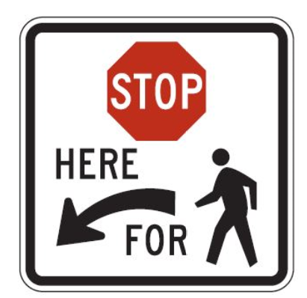
15

Slide 35
Here Comes
Sign #16…

Slide 36
16

Slide 37
Here Comes
Sign #17…

Slide 38
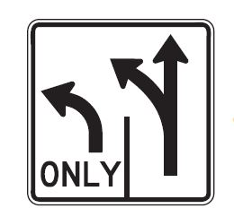
17

Slide 39
Here Comes
Sign #18…

Slide 40
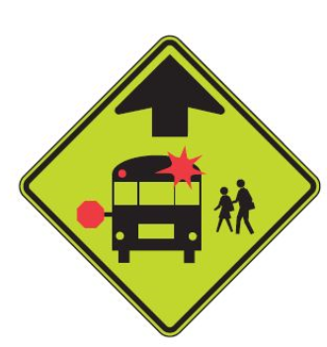
18

Slide 41
Here Comes
Sign #19…

Slide 42
19

Slide 43
Here Comes
Sign #20…

Slide 44
20

Slide 45
Here Comes
Sign #21…

Slide 46
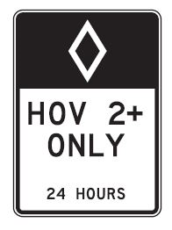
21

Slide 47
Here Comes
Sign #22…

Slide 48
22

Slide 49
Here Comes
Sign #23…

Slide 50
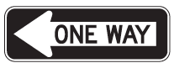
23

Slide 51
Here Comes
Sign #24…

Slide 52
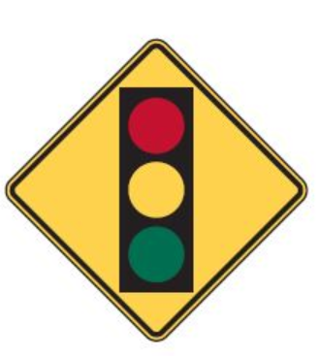
24

Slide 53
Here Comes
Sign #25…

Slide 54
25

Slide 55
ANSWERS….

Slide 56
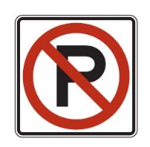
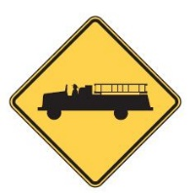
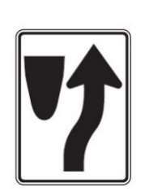
ANSWERS….
Crosswalk
Stop Sign
No Parking
Fire Station Ahead
Divided Highway

Slide 57
ANSWERS…
6. Exit Only
Advance Warning Railroad Crossing
T Intersection
Traffic Merging from Right
Do Not Enter

Slide 58
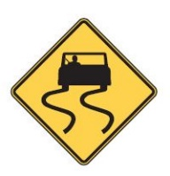
ANSWERS…
11. Roundabout
12. Object Marker (within or adjacent to lane)
Slippery Roadway
School Crossing

Slide 59
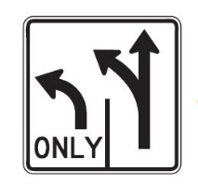
ANSWERS…
15. Stop for Pedestrians
16. Lane Merge Left
17. Lane Usage
School Bus Stop Ahead
No Left or U Turns

Slide 60
ANSWERS…
20. Adverse Camber Curve Warning
Carpool lane
Flagger Ahead
23. One Way Street
24. Intersection Ahead
25. Bike Lane

