Slide 1
Traffic Signs, Signals and Pavement Markings

Slide 2
3 Categories of Traffic Signs:
Regulate traffic, movement, or parking
Warn of potential dangers or road conditions
Guide and provide information
Notes:
Traffic signs are utilized as a method of regulating, warning and guiding drivers. They help to regulate the flow of traffic among vehicles, pedestrians, motorcycles, bicycles and others who travel the streets, highways and other roadways. Signs have specific colors and shapes to aid in prompt recognition by drivers.

Slide 3
Traffic Signs have specific shapes and colors to aid in prompt driver recognition
Octagon/Red
Trapezoid/Brown
Stop
Guide
Diamond/Orange
Circle/Yellow
Warning
RR Xing Advance Warning
Diamond/Yellow
Pentagon/Yellow
(pointed up)
Warning
School Advance Warning

Slide 4
Traffic Signs have specific shapes and colors to aid in prompt driver recognition
Rectangle/Green
Rectangle/Orange
Guide
Warning
Rectangle/Blue
Rectangle/Yellow
Guide
Warning
Rectangle/Brown
Rectangle/White
Guide
Regulatory

Slide 5
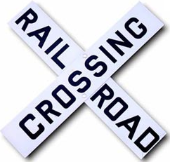
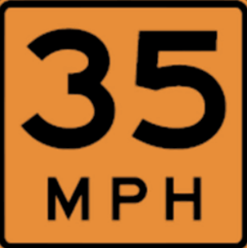
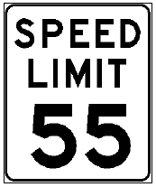
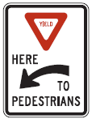
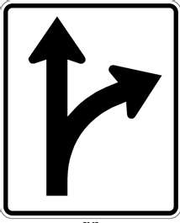
Regulatory
Notes:
Regulatory traffic signs are white with black or red letters instructing road users what they must or must not do under certain conditions.
Regulatory signs indicate and reinforce traffic laws and regulations which apply either permanently or at specified times or places.

Slide 6
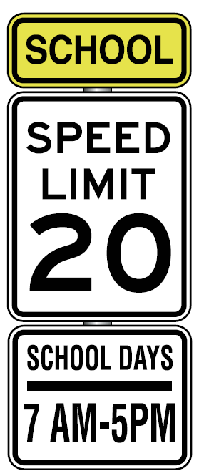
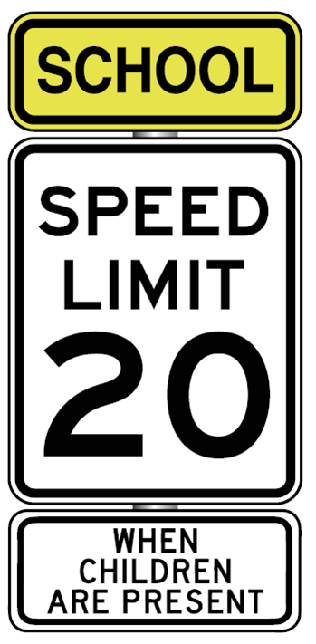
Regulatory
Notes:
School zones can be posted with varying signs.

Slide 7
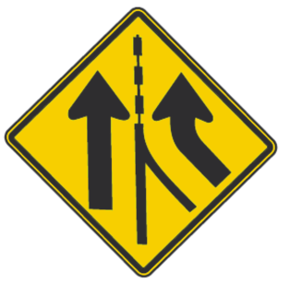
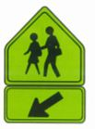
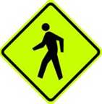
Warning
Notes:
Warning signs are used to alert highway, street or road users to unexpected or dangerous conditions ahead that might call for a reduction of speed, situations that might not be readily apparent, or an action in the interest of safety and efficient traffic operations such as a curve, detour, sideroad, etc. They usually have a yellow or orange background with black symbols or letters on a diamond-shaped or rectangular sign. Yellow pennant-shaped signs caution motorists where passing is unsafe. Round yellow warning signs alert motorists that there's a railroad crossing ahead.

Slide 8
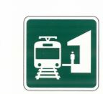
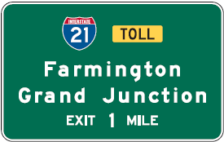
Guide
Light Rail
Notes:
Guide signs provide directional and mileage information to specific destinations. They can be rectangular or have other shapes. Route signs mark federal interstates, state highways, and county or municipal roadways.

Slide 9
Regulatory, Warning, or Guide?
Red?
Green?
Regulatory
Guide
Blue?
Yellow?
Guide
Warning
Optic Yellow?
White?
Warning
Regulatory
Orange?
Brown?
Warning
Guide

Slide 10
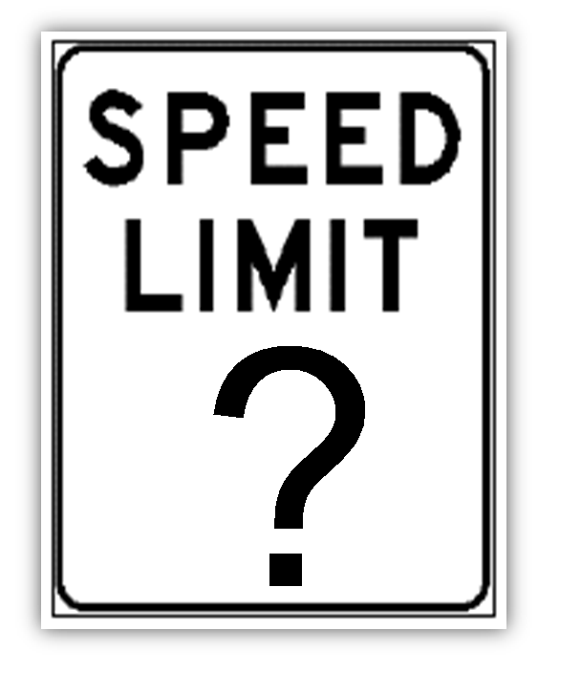
Unless otherwise posted…
Narrow Residential (18 feet)?
15 mph
Residential Street?
25 mph
Business District?
20 mph
Alley?
15 mph
Notes:
All roadways in Oregon have specific speed limits. Speed limits do not authorize speeds higher than those required for compliance with the basic speed rule.

Slide 11
Unless otherwise posted…
Public Parks?
25 mph
Highways?
55 mph
Freeway?
65 mph
(Varies by location)
Notes:
55 mph – all other roads and highways not meeting other definitions.
Can be lower or up to 70 max in Oregon

Slide 12
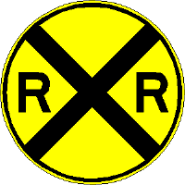
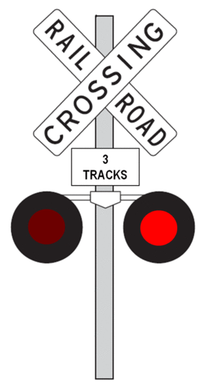
Railroad Crossing Warnings
RR sign or RR painted on the pavement are advanced warning signs.
Crossbucks are regulatory signs.
Flashing red lights are regulatory

Slide 13
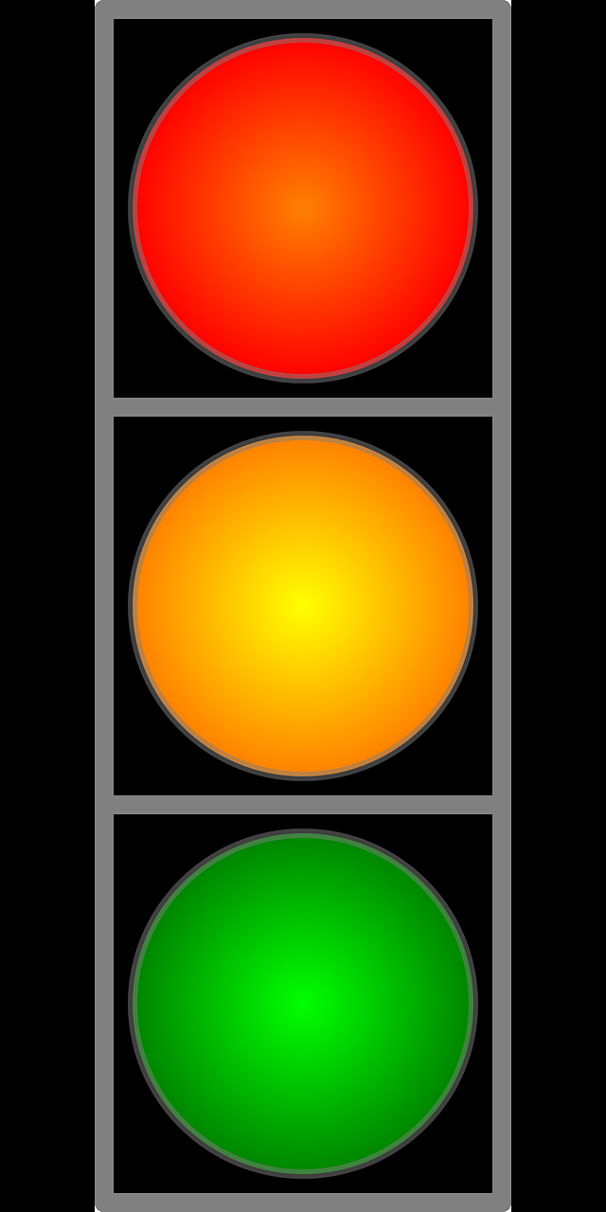
Traffic signals
Regulate traffic and movement
Warn of potential dangers
(red light to follow, pedestrian crossing etc….)
Notes:
Traffic signals control the flow of traffic in one way or another. Increase safety, manage traffic and travel times, and provide direction for drivers.

Slide 14
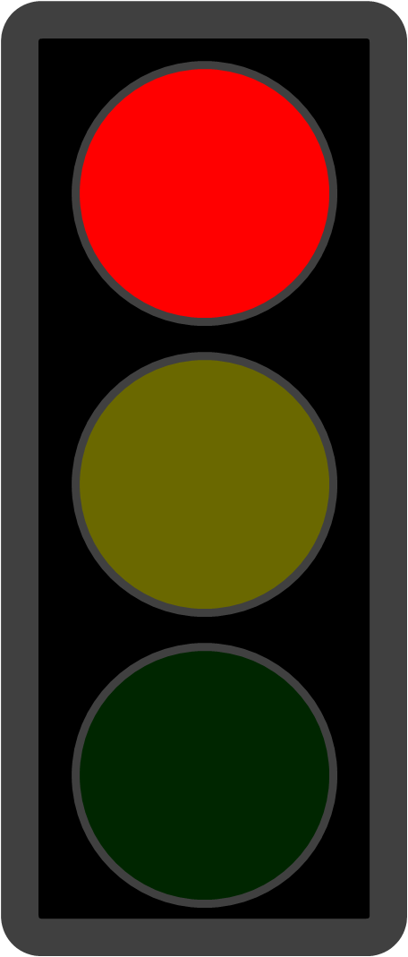
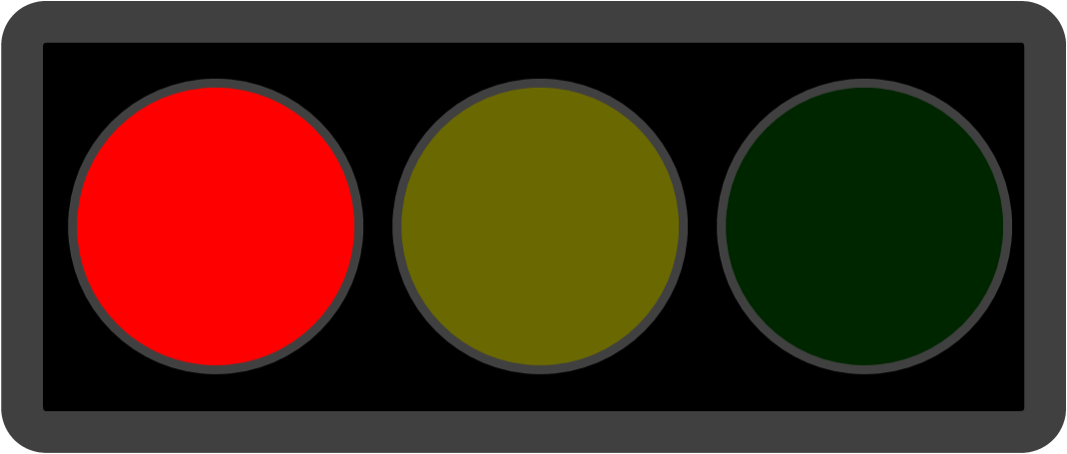
What is the meaning of…
Solid Red?
Stop is required
Flashing Red?
Stop, proceed when clear
Red Arrow?
Stop is required
Right turn permitted when clear

Slide 15
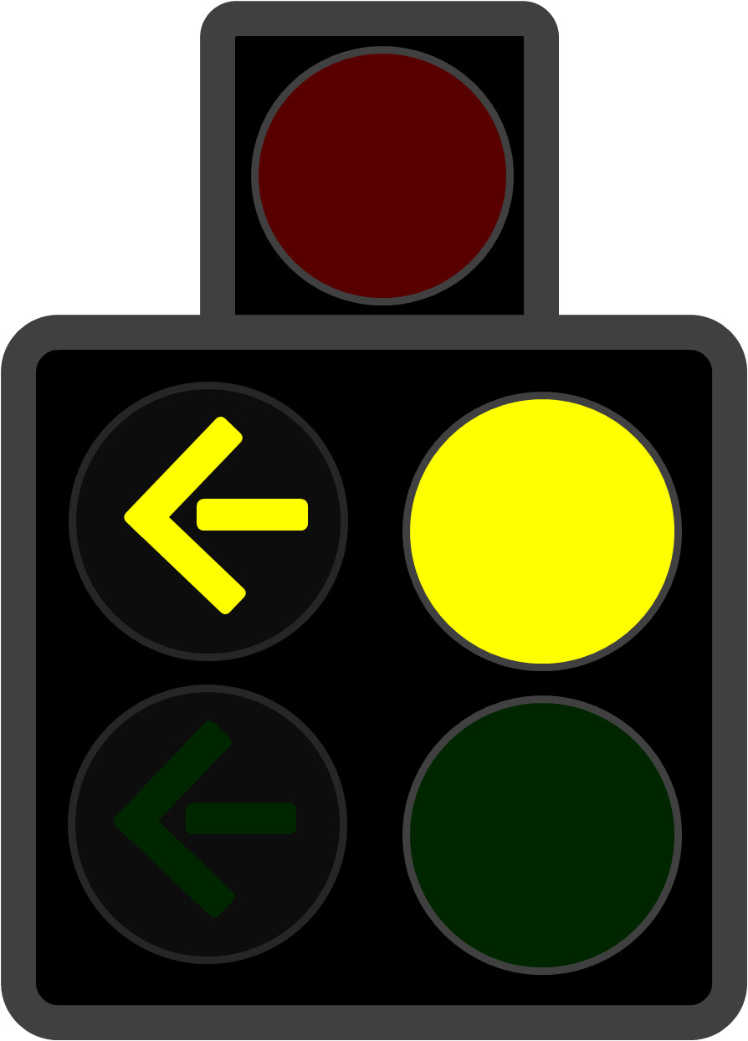
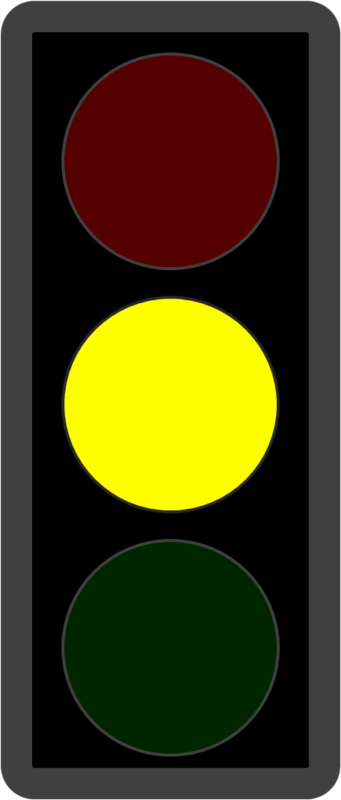
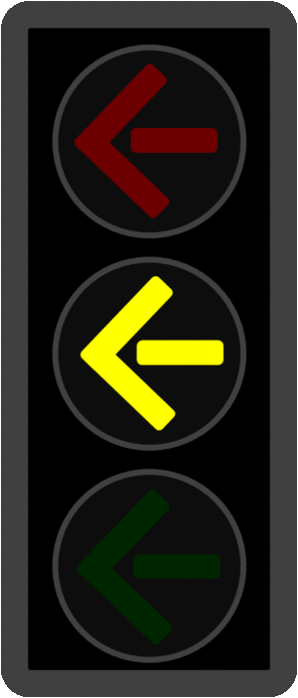
What is the meaning of…
Solid Yellow?
Warns a red will follow
Flashing Yellow?
Caution
Flashing Yellow Arrow?
Unprotected turn
Always Yield to oncoming traffic and pedestrians before turning left
Notes:
Emphasis on UNPROTECTED turns needed

Slide 16
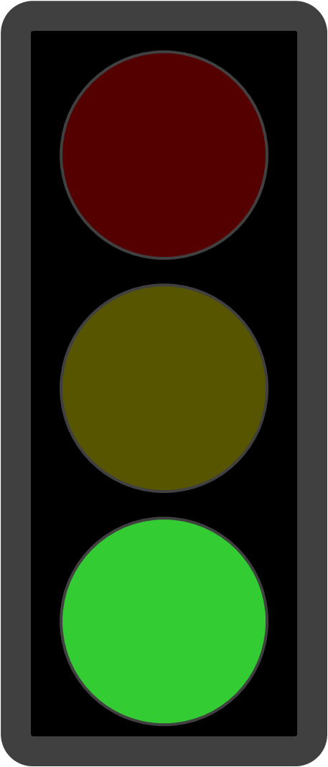
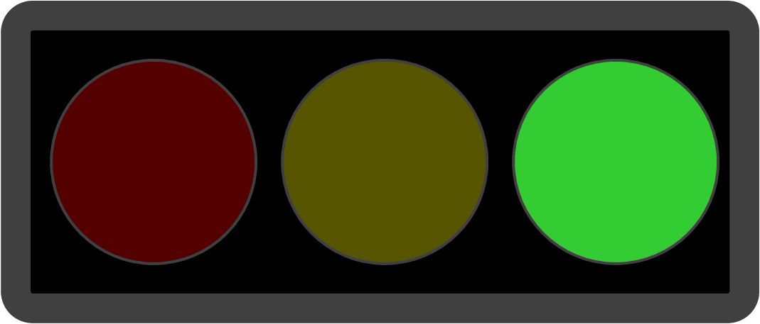
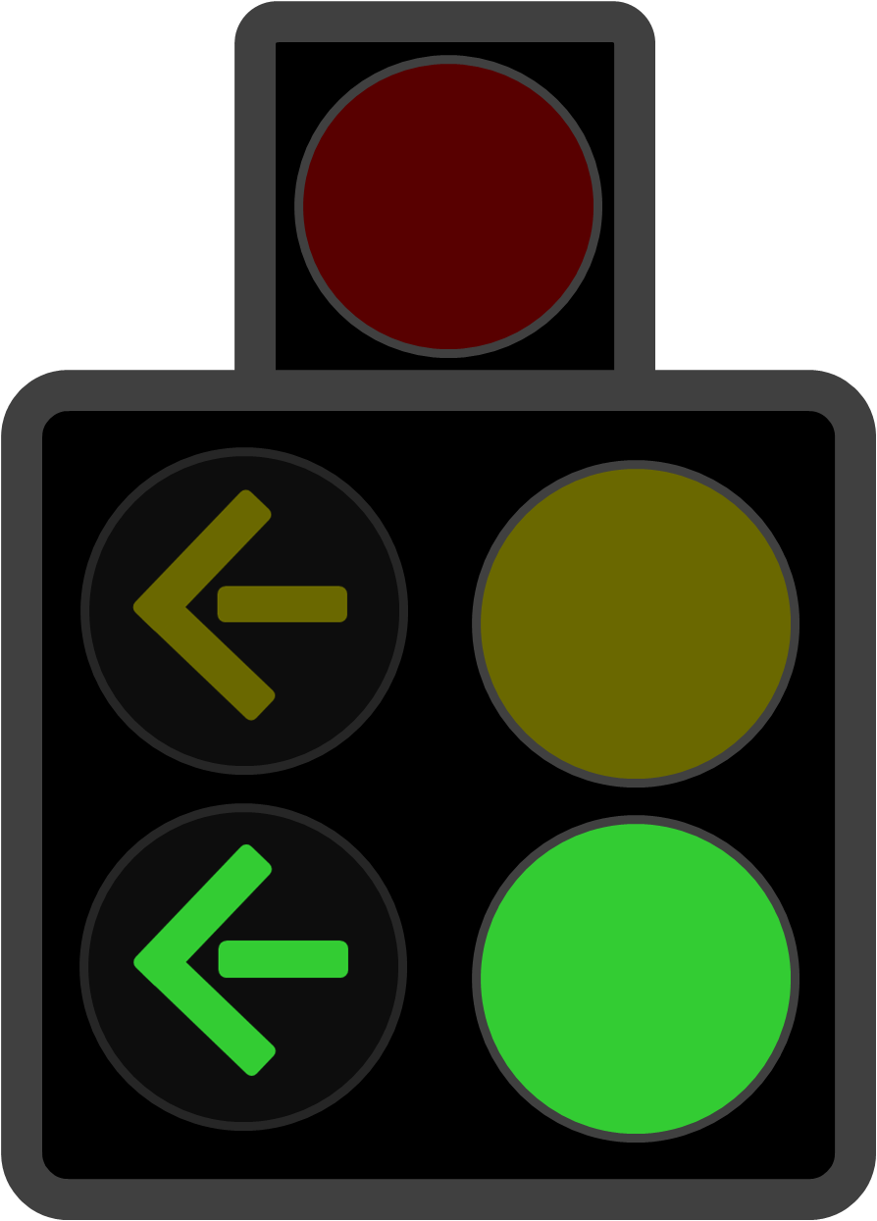
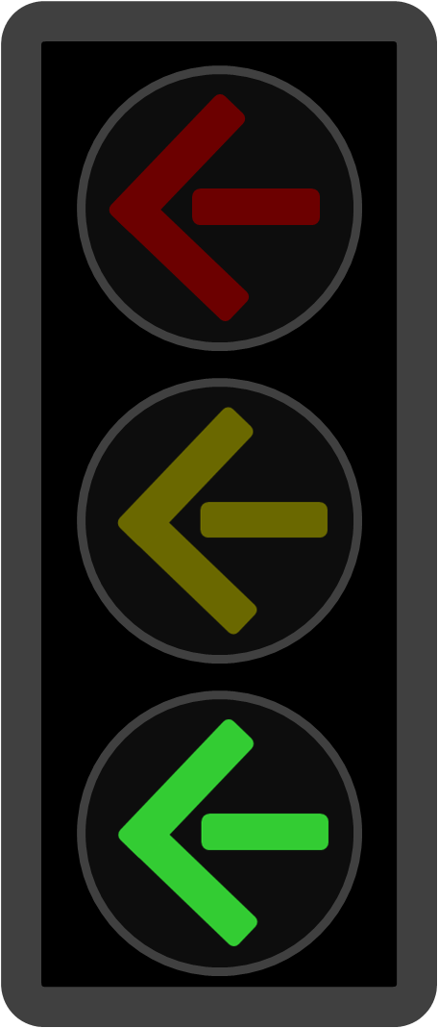
What is the meaning of…
Solid Green?
Proceed when clear
Unprotected turn
Always Yield to oncoming traffic and pedestrians before turning left
Green Arrows?
Protected turn
Proceed when clear
Notes:
Emphasis on UNPROTECTED turns needed

Slide 17
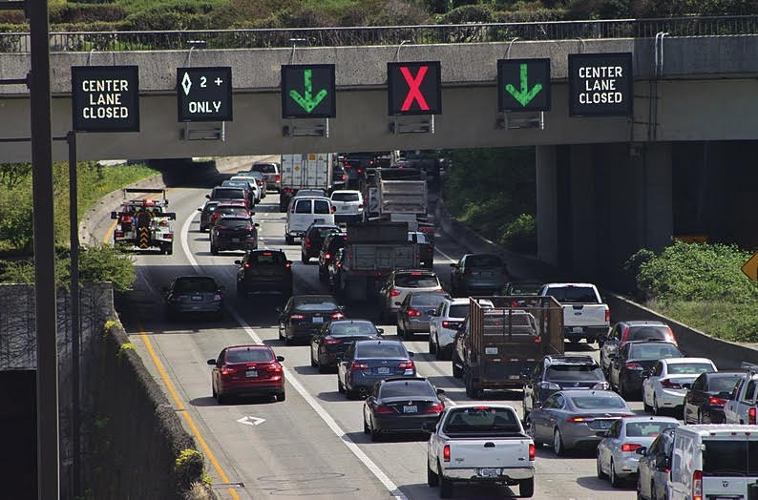
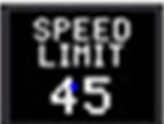
Smarter Highway System
Notes:
Lane use signals and speed limits – all regulatory
Ramp Metering
Road Sensors
Traffic Light
Stop Here on Red
Proceed on Green

Slide 18
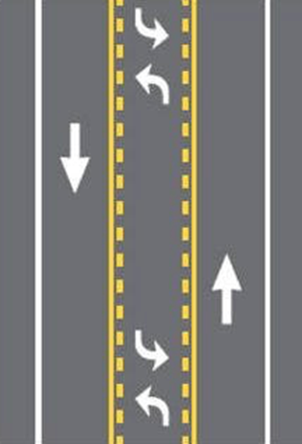
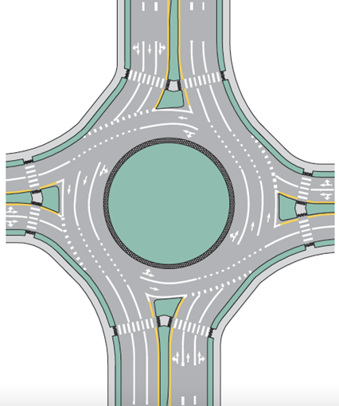
Pavement Markings
Regulate traffic and movement
Warn of potential dangers or road conditions
Guide and provide
information

Slide 19
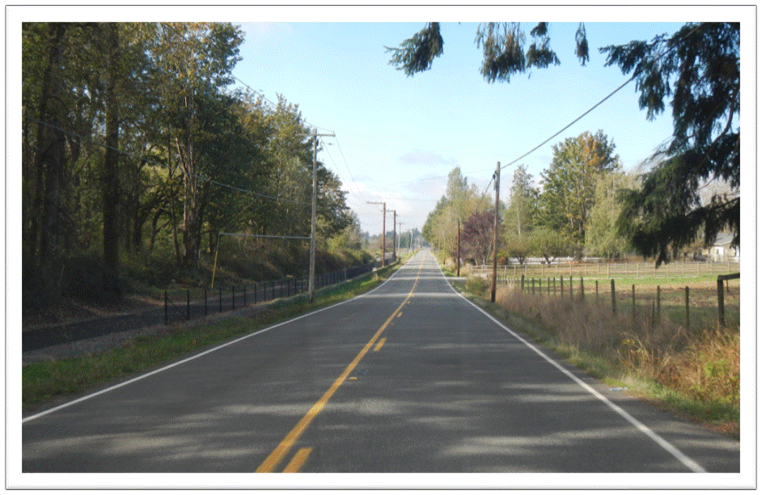
Identify the pavement markings and their meaning
Notes:
2 lane road on-coming cannot pass, fog lines

Slide 20
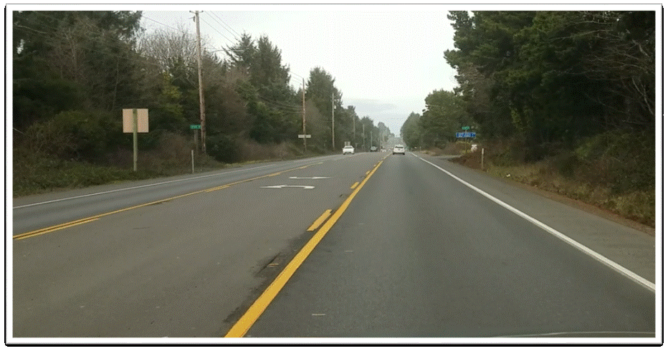
Identify the pavement markings and their meaning
Notes:
Shared turn lane
Fog line
Break in line indicates intersection

Slide 21
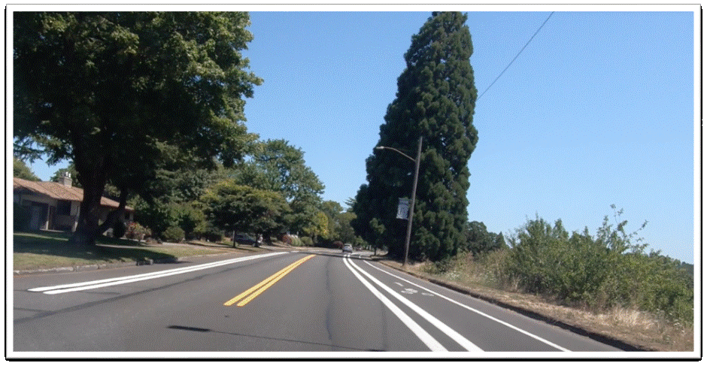
Identify the pavement markings and their meaning
Notes:
Double yellow lines indicate no passing. Turning is permitted. Double white lines indicate a lane barrier between a regular use and a preferential use lane, such as a bike lane. You should not change lanes over these pavement markings; wait until a single broken white line appears. Bike lane

Slide 22
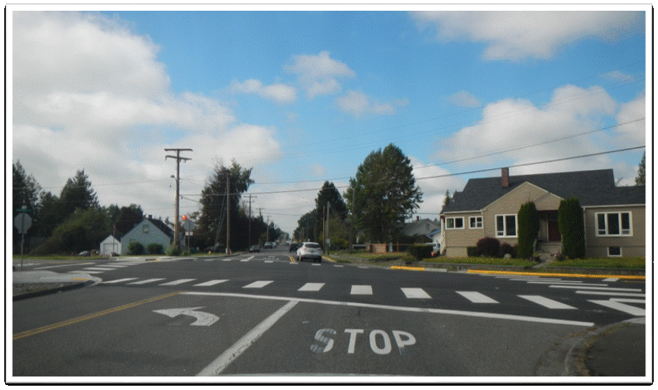
Identify the pavement markings and their meaning
Notes:
Painted STOP means the same as a physical stop sign. Left turn pocket, stop bar (line) and continental crosswalk markings. Continental crosswalk markings are visible from a significantly greater distance away. Yellow curb indicates no parking

Slide 23
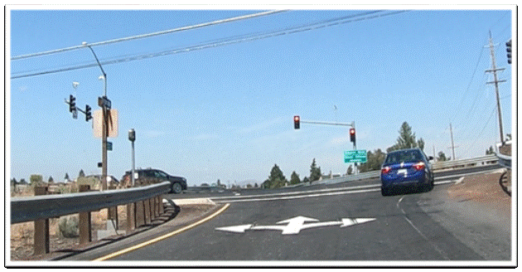
Identify the pavement markings and their meaning
Notes:
Directional arrow indicating what is allowed in this lane

Slide 24
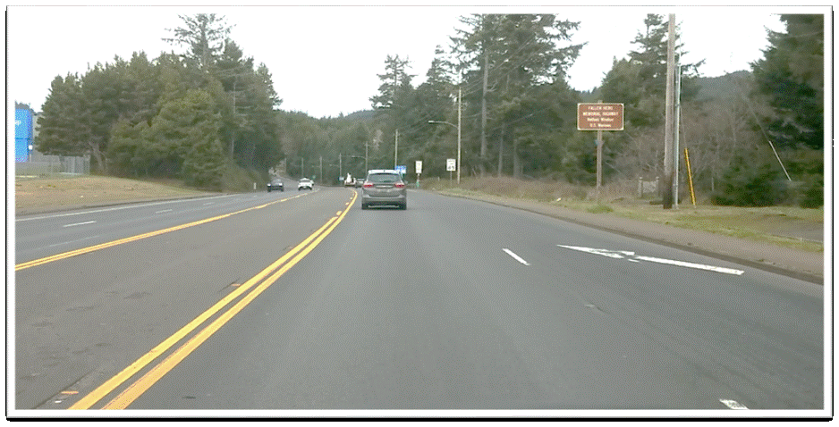
Identify the pavement markings and their meaning
Notes:
Lane ending, merge left, painted median turns into shared turn lane

Slide 25
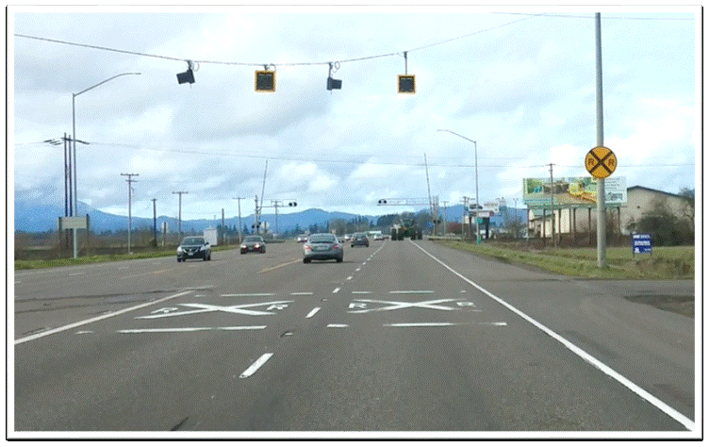
Identify the pavement markings and their meaning
Notes:
Railroad advanced warning pavement markings, fog line, shared turn lane

Slide 26
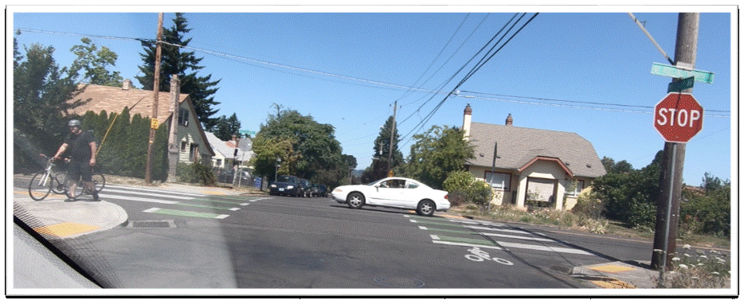
Identify the pavement markings and their meaning
Notes:
Green supplemental buffered bike lane at intersection. Green colored paint is used to highlight space used for cycling in high conflict areas

Slide 27
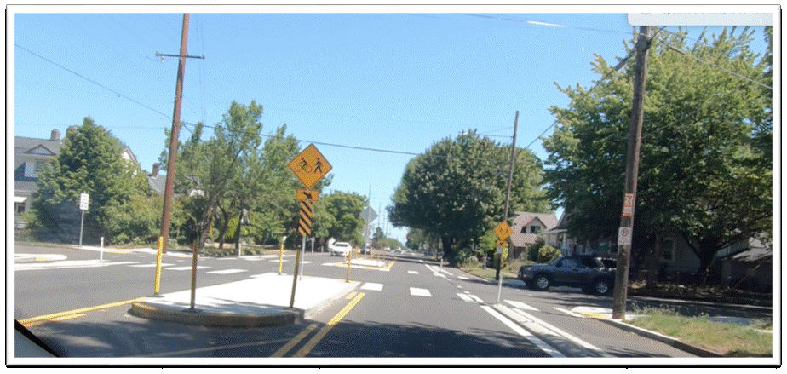
Identify the pavement markings and their meaning
Notes:
Painted median turns to a physical median. Physical median to the left and right, bike lane, and continental crosswalk,

Slide 28
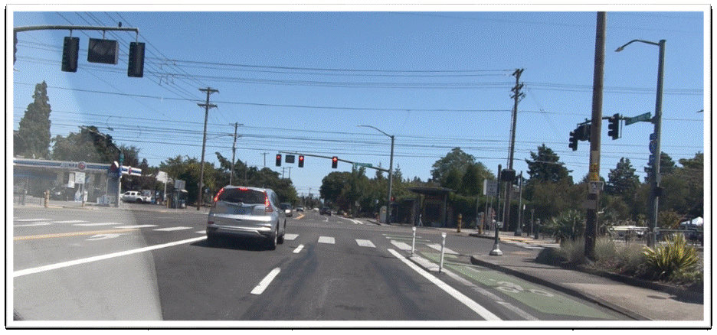
Identify the pavement markings and their meaning
Notes:
Left turn pocket, continental crosswalk, double white line to the right, bike lane, green bike box and green supplemental buffered bike lane

Slide 29
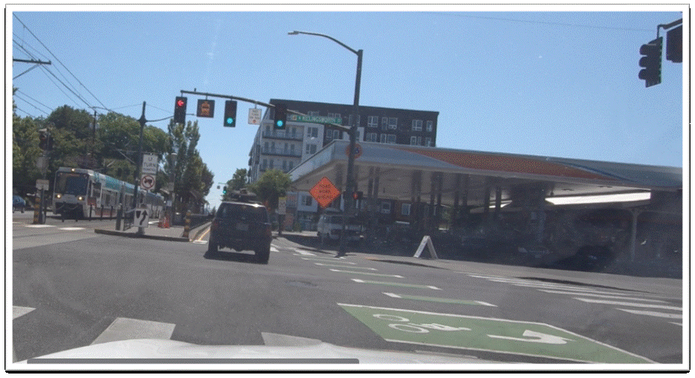
Identify the pavement markings and their meaning
Notes:
Continental crosswalk, green bike box and green supplemental buffered bike lane

Slide 30
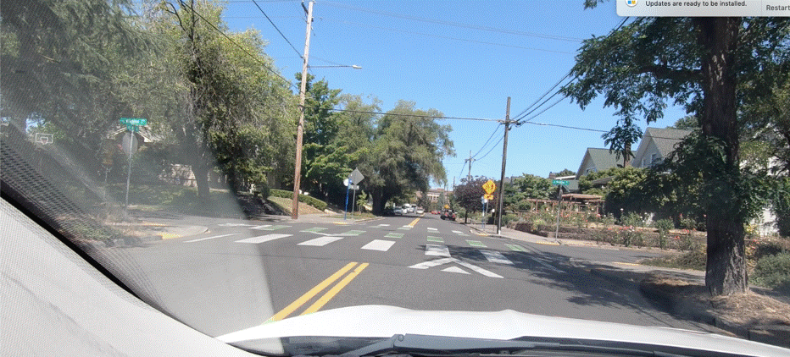
Identify the pavement markings and their meaning
Notes:
Double yellow line (separates traffic traveling in opposite directions/no passing), speed hump (traffic calming device marked with chevrons), continental crosswalk and green supplemental buffered bike lane

Slide 31
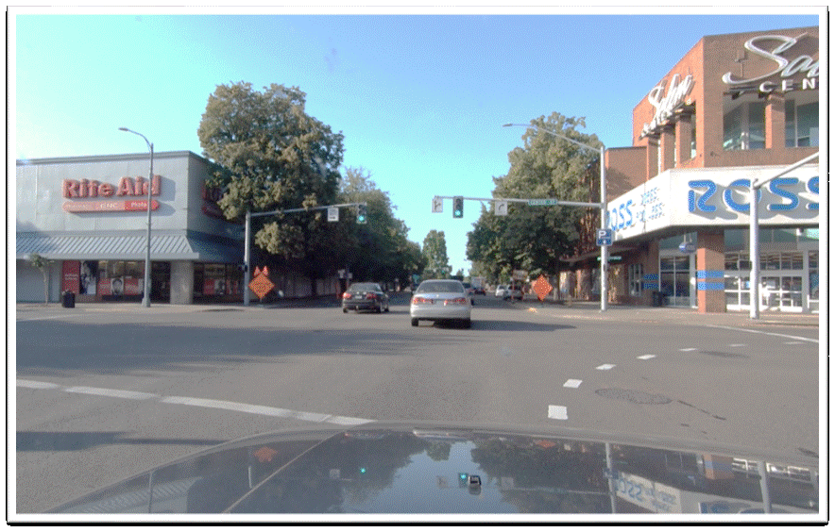
Identify the pavement markings and their meaning
Notes:
Crosswalk, dashed white line extensions

Slide 32
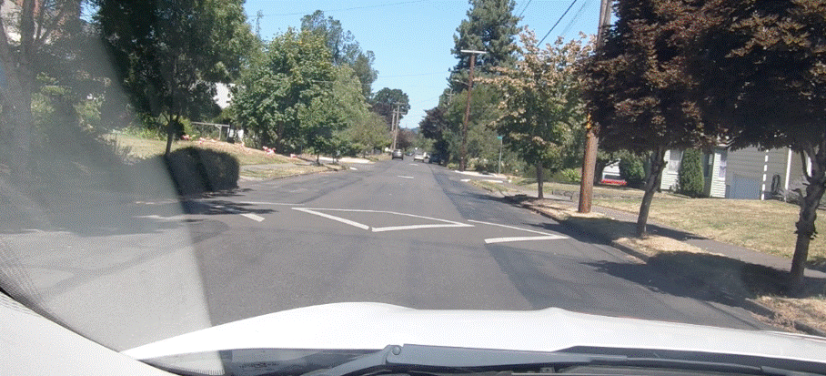
Identify the pavement markings and their meaning
Notes:
Speed hump with large chevron pavement markings

Slide 33
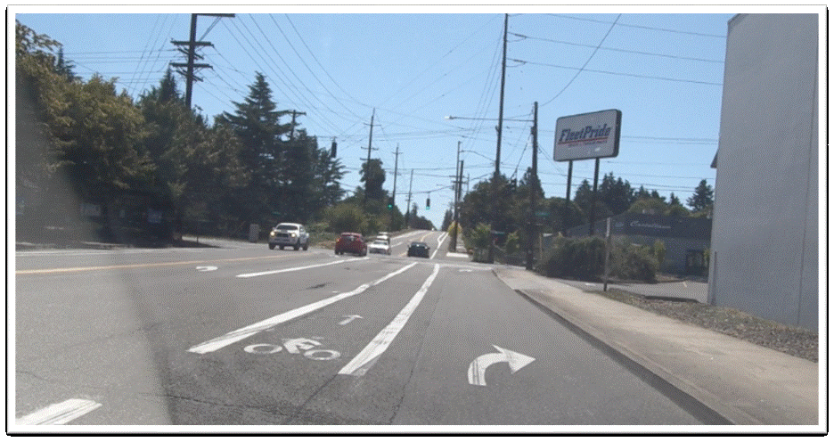
Identify the pavement markings and their meaning
Notes:
Bike lane with opening for access to right turn pocket

Slide 34
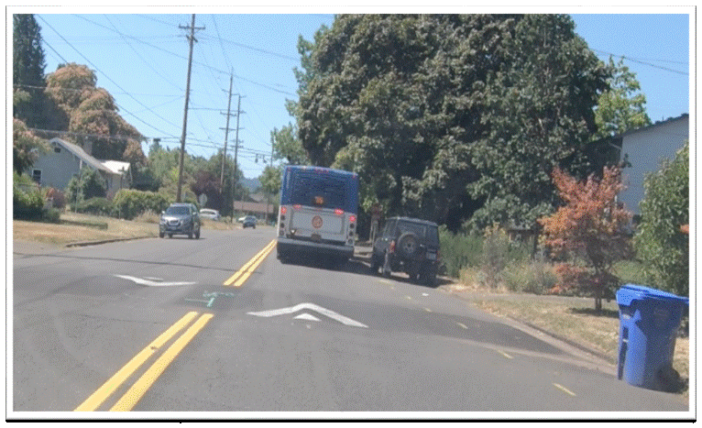
Identify the pavement markings and their meaning
Notes:
Speed hump with chevron pavement markings

Slide 35
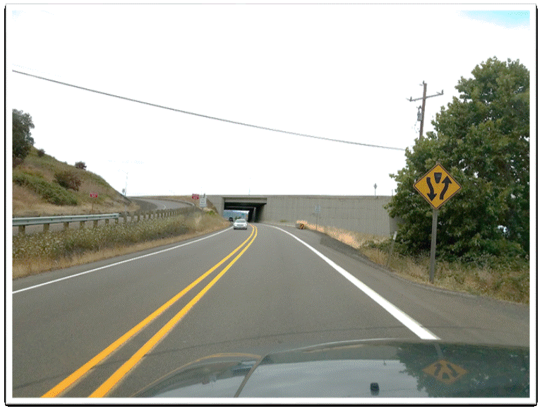
Identify the pavement markings and their meaning
Notes:
Double yellow (no passing), fog line

Slide 36
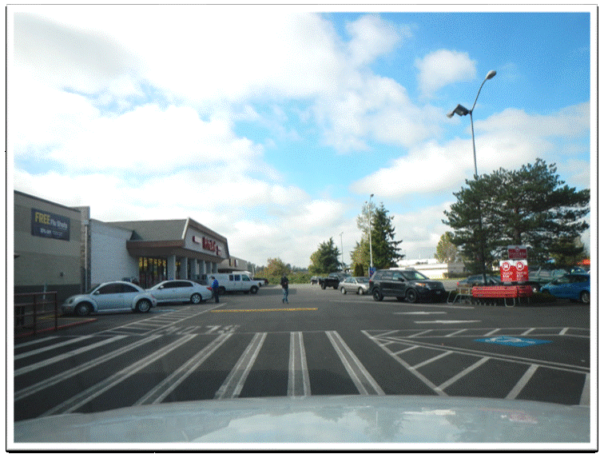
Identify the pavement markings and their meaning
Notes:
Crosswalk in parking lot, handicap parking space, yellow speed bump

Slide 37
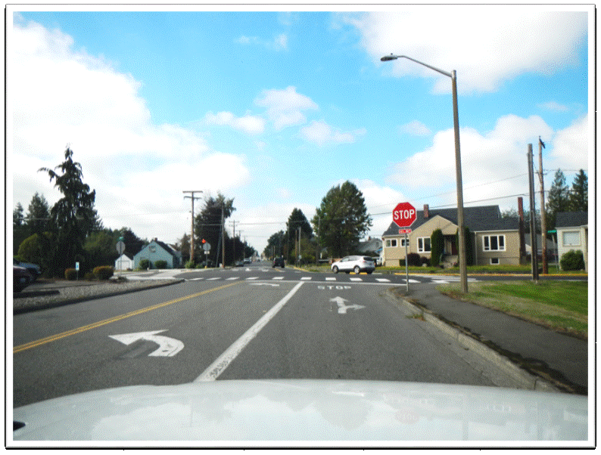
Identify the pavement markings and their meaning
Notes:
Double yellow line, left turn pocket, straight/left turn lane, painted STOP on roadway, stop bar (line), crosswalk

Slide 38
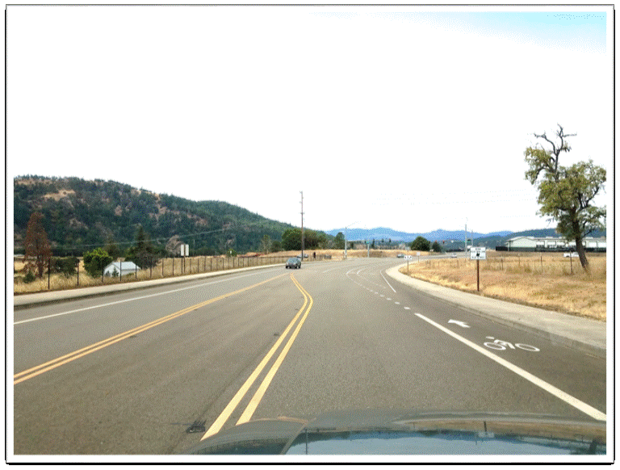
Identify the pavement markings and their meaning
Notes:
Painted median (traversable), bike lane opening up for vehicle crossover to right turn lane, left turn lane

Slide 39
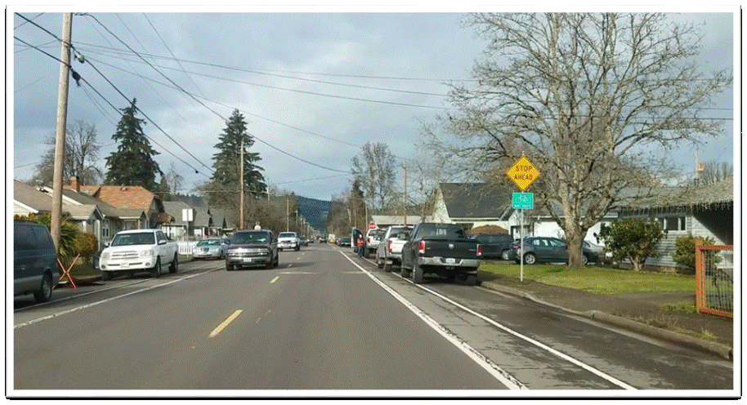
Identify the pavement markings and their meaning
Notes:
Parking lane to the right of marked bike lane, dashed yellow lane indicates traffic flows in opposite directions (passing permitted)

Slide 40
Identify the pavement markings and their meaning
Notes:
Shared lane marking, speed hump

Slide 41
Identify the pavement markings and their meaning
Notes:
Gore point (no crossing)

Slide 42
Identify the pavement markings and their meaning
Notes:
Shared turn lane, school crossing zone, bike lane

Slide 43
Identify the pavement markings and their meaning
Notes:
Shared turn lane, bike lane turns to the right into dashed lines indicating crossing permitted by vehicles

Slide 44
Identify the pavement markings and their meaning
Notes:
Bike lane proceeds up onto curb and changes to a painted bike box

Slide 45
Identify the pavement markings and their meaning
Notes:
Painted median (do not drive across median), speed hump, bike lane, yellow curb indicating no parking

Slide 46
Identify the pavement markings and their meaning
Notes:
Red painted curb indicating No Parking – Fire Lane

