Slide 1
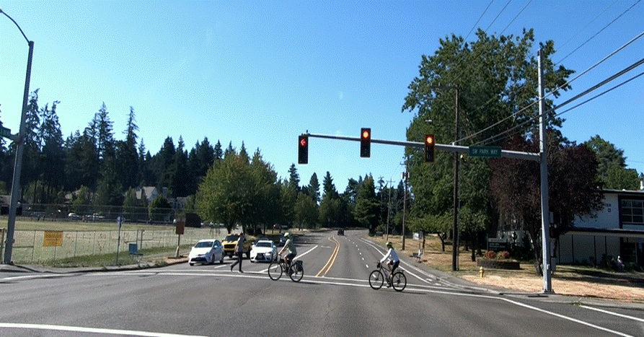
Restrictions and SIM
Notes:
Vision and Path Restrictions can be caused by many things.
They can be categorized into Environment, Vehicles and other Roadway Users, including pedestrians.
Environmental:
Weather Conditions-Curves-Hillcrests-Intersections-Buildings-Fences
Trees-Bushes-Signs-Traffic controls: Red Lights, Stop/Yield Signs-Intersections
Narrowing Lanes-Surface Conditions-Rain-Ice-Snow-Water-Loose Gravel -Sand –Leaves-Oil
Other Vehicles:
Parked Vehicles-Trucks-Busses-Stopped, Slow-moving Vehicles-Turning vehicles
Vehicles Entering the Roadway-Less than Four Seconds following distance
Other Users:
Pedestrians-Animals-Bikes-Motor Cycles

Slide 2
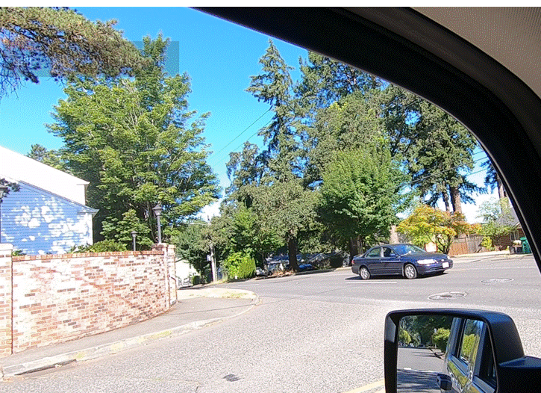
Vision Restrictions Defined
Any condition that blocks your view is a vision restriction. They always limit your ability to gather information about the condition of your intended path.
Notes:
Brick wall on the left

Slide 3
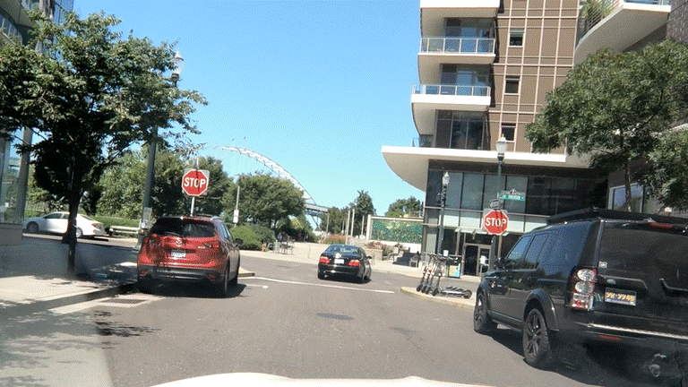
Path Restrictions Defined
Path restrictions temporarily or permanently prevent you from occupying space.
Notes:
Cars-stop sign-intersection

Slide 4
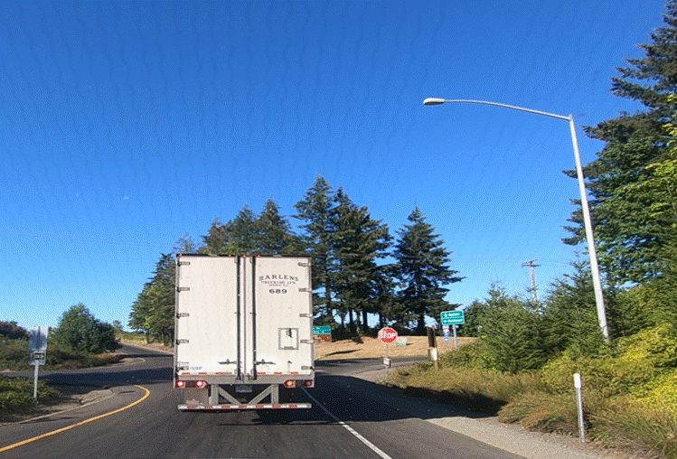
Vision and Path Restrictions
Some things can block both your vision and path.
Notes:
Trucks
Other examples that can block both are parked vehicles, hills, curves, and more

Slide 5
Vehicle Space Location Map

Slide 6
Vision or Path Restrictions
Your Turn
Notes:
Have students identify the restrictions and if they are blocking their path or vision

Slide 7
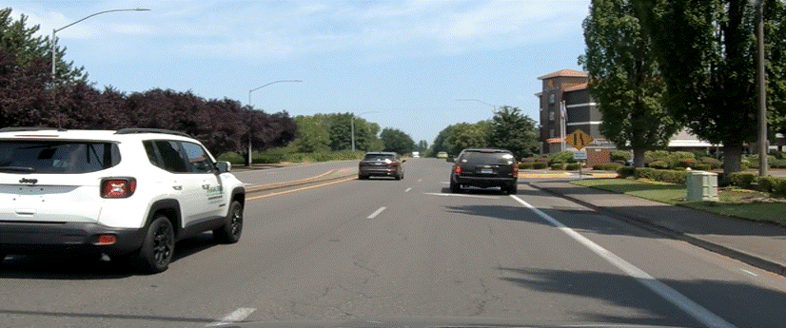
Notes:
Path restriction-lane ends and cars

Slide 8
Notes:
Path-intersection/railroad crossing
Vision-Bus

Slide 9
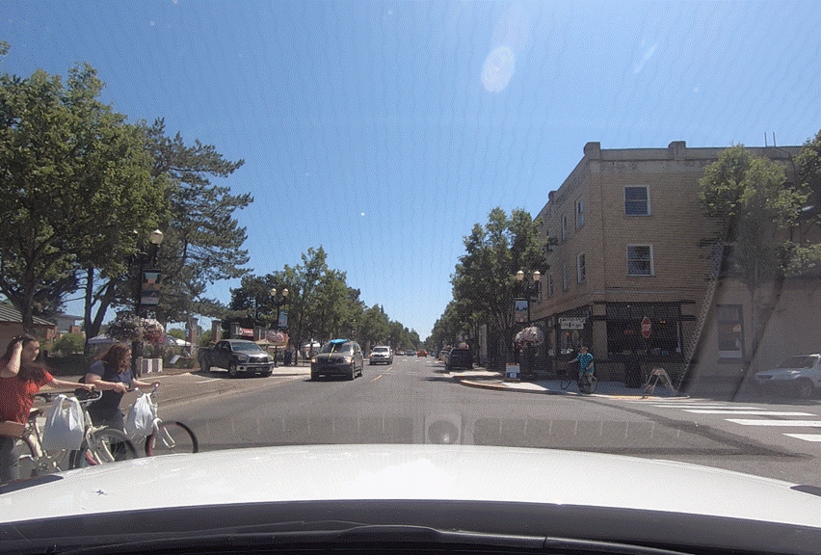
Notes:
Path restrictions- pedestrians and bicyclists

Slide 10
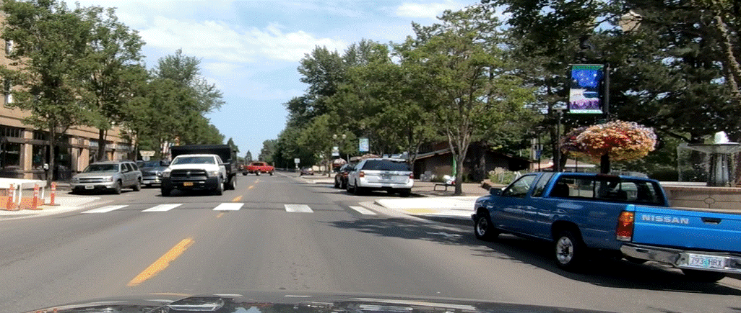
Notes:
Path-crosswalk
Vision-truck on left and right

Slide 11
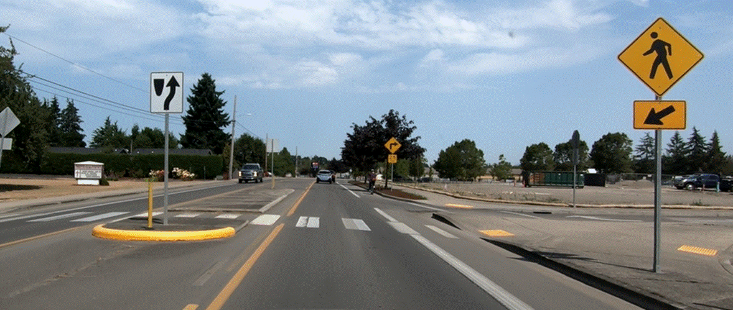
Notes:
Path-crosswalk

Slide 12
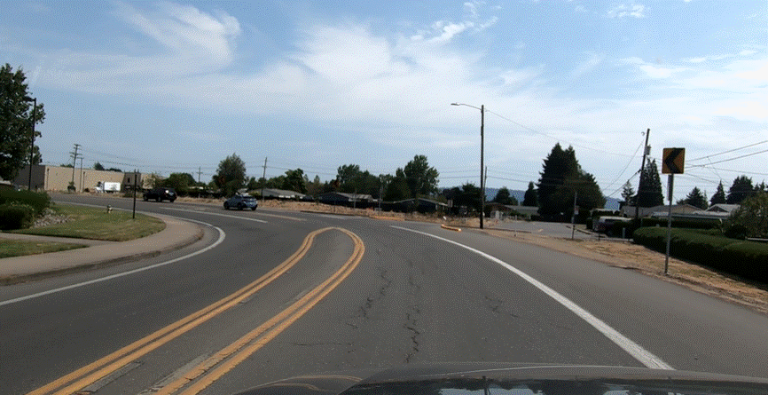
Notes:
Path and Vision-curve

Slide 13
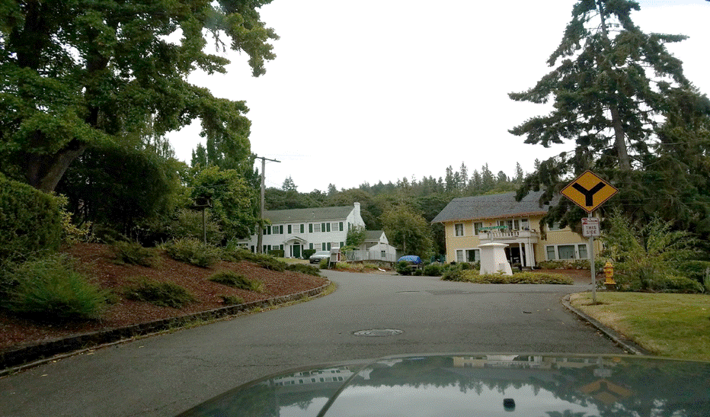
Notes:
Vision-intersection design and divider
Path-intersection and divider

Slide 14
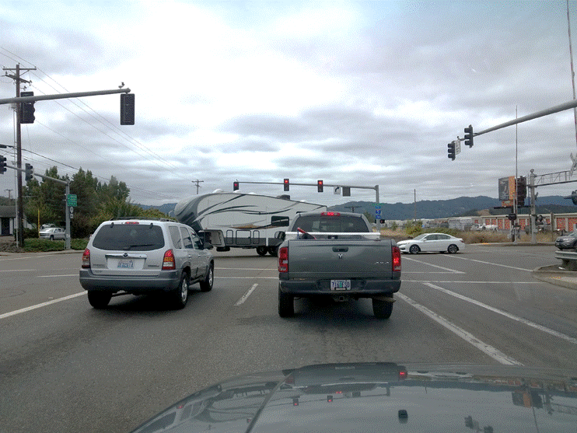
Notes:
Path-red light-stopped traffic
Vision-trailer in intersection

Slide 15
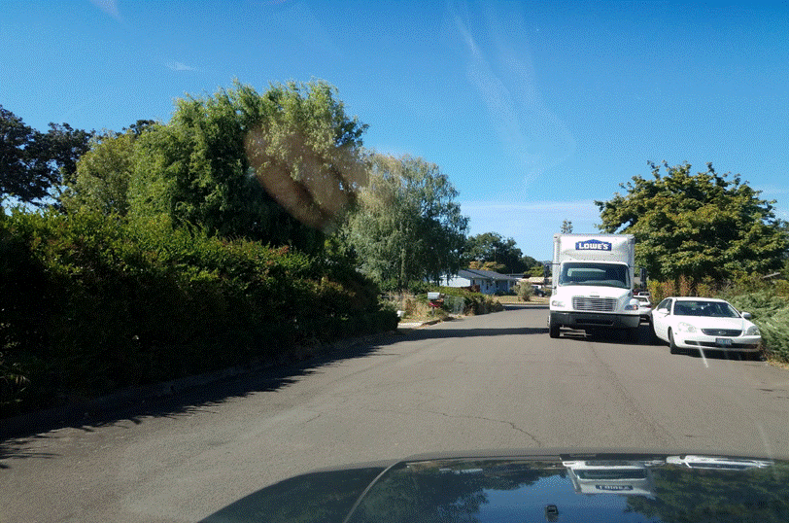
Notes:
Path and Vision-truck on right

Slide 16
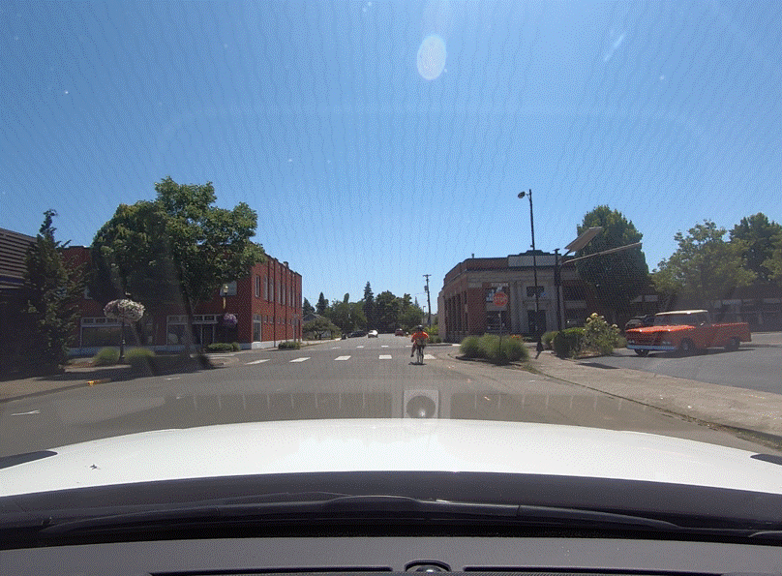
Notes:
Path-bicyclists and stop sign
vision- trees and bushes

Slide 17
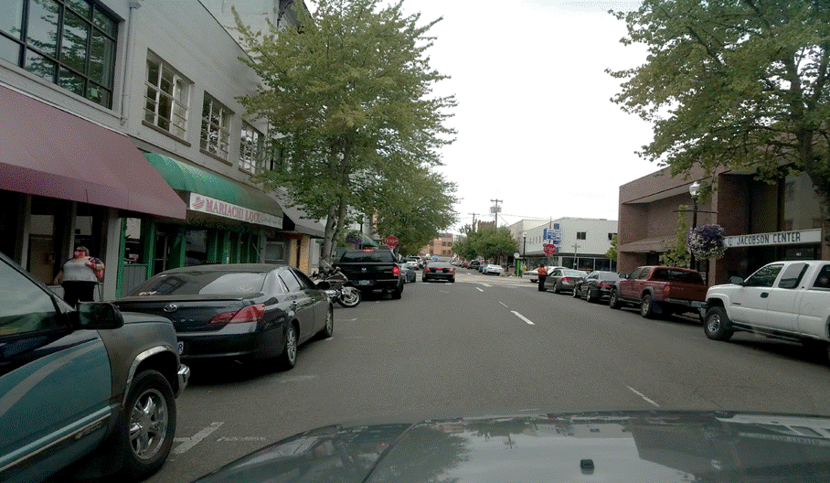
Notes:
Path-stop sign-pedestrian on right, and black truck sticking out
Vision-parked cars

Slide 18
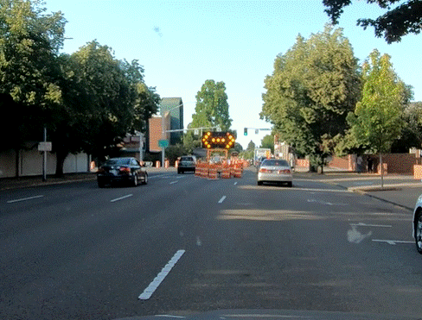
Notes:
Path-closed lane-barrels
Vision-parked cars-sign-trees

Slide 19
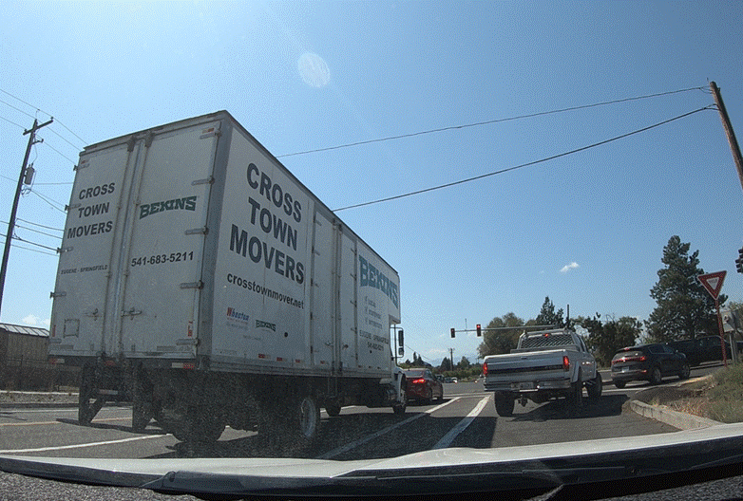
Notes:
Path-stopped traffic-yield sign
Vision-truck on left

Slide 20
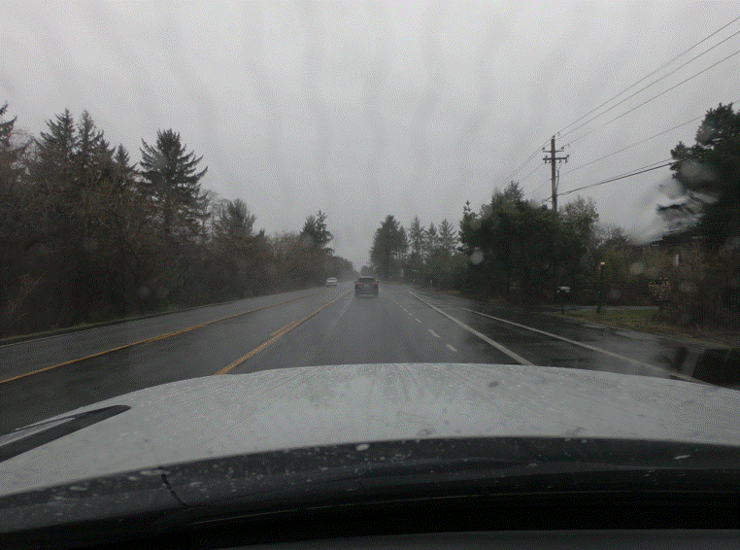
Notes:
Vision- rain
Path- car

Slide 21
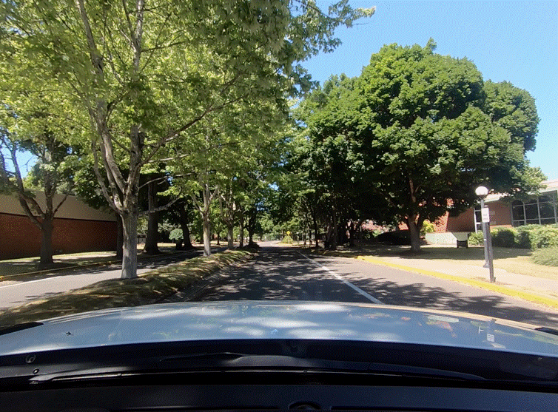
Notes:
Path- slight curve in road, center median
Vision- trees

Slide 22
Search, Identify and Manage (SIM)
“SIM” is the process used to gather information and respond to vision and/or path restrictions.
Search- to the Target Area for any restrictions
Identify- the solutions needed to manage restrictions and start to apply them
Manage- your space by reevaluating and adjusting your solutions before reaching the point of no return
Notes:
Search-for restrictions
Identify- does it affect my sight or path
Manage-adjust speed and/or position

Slide 23
Introduction to Using the SIM Process
Link to video
Notes:
This is an Intro to SIM. Interactive video gives students an opportunity to tell you what they are seeing and how they would respond. Full SIM application comes in Chapter 4
Lane positions are covered in Chapter 2. When discussing responding, address moving to the left or right vs lane position, until later.

