Slide 1
Yielding Worksheet

Slide 2
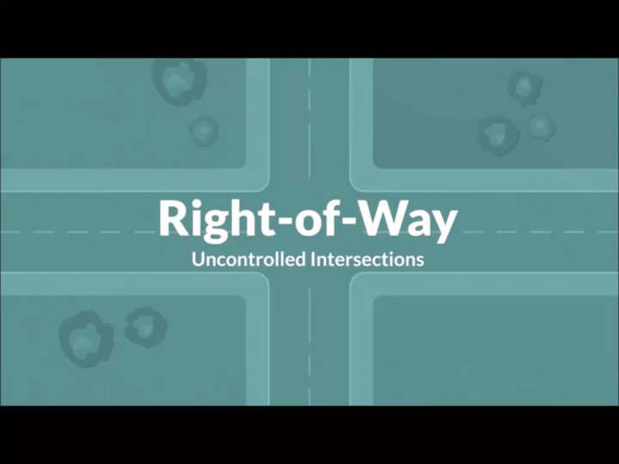
#1- Uncontrolled
Video

Slide 3
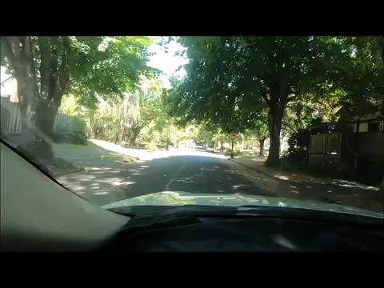
#2- Two-Way stop
Video

Slide 4
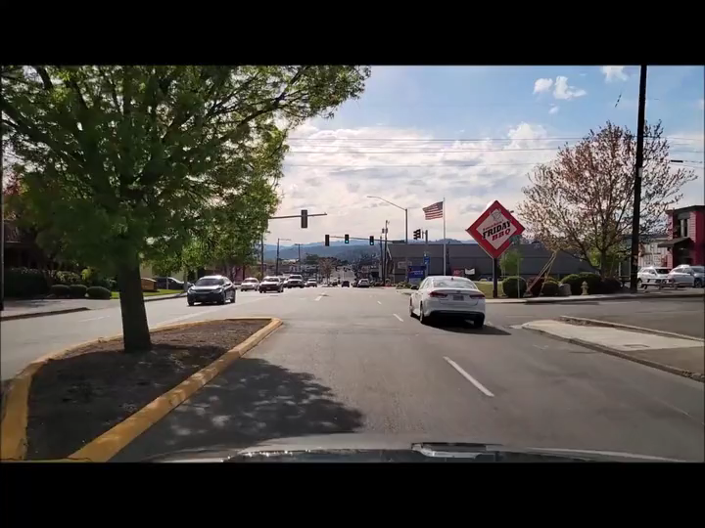
#3- Flashing Left Turn Arrow
Video

Slide 5
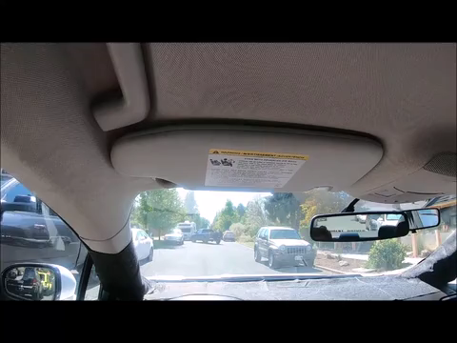
#4- Backing
Video

Slide 6
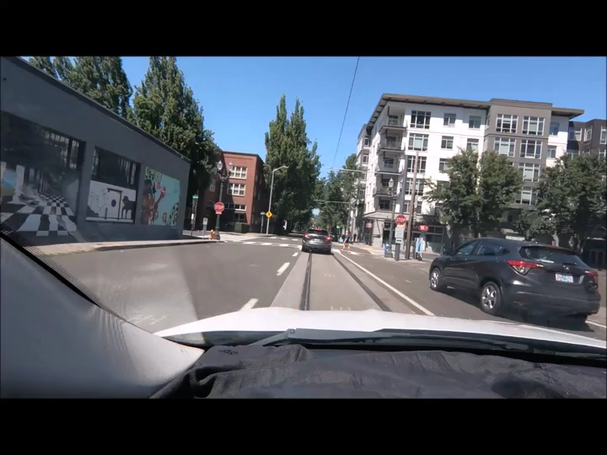
#5- Four-Way stop
Video

Slide 7
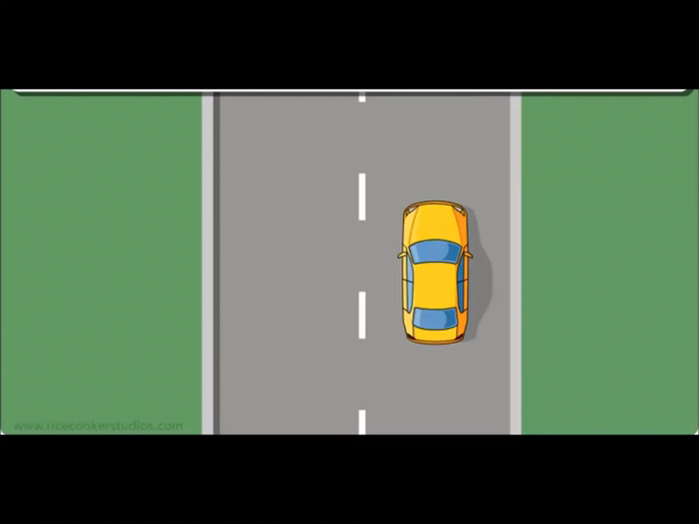
#6- Uncontrolled T-Intersection
Video

Slide 8
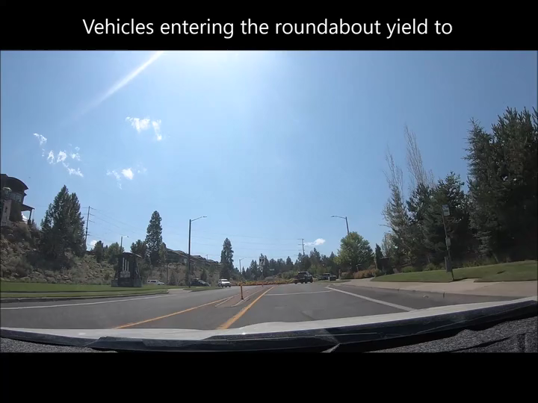
#7- Roundabout
Video

Slide 9
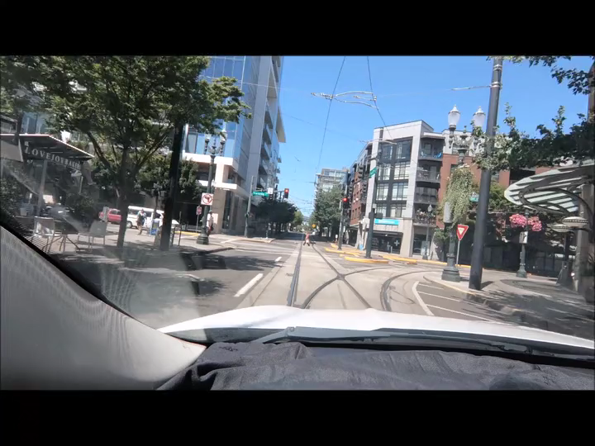
#8- Yield
Video

