Slide 1
Tracking
Through Turns and Curves
Notes:
Instructor preparation notes

Slide 2
Accurate Tracking Through Turns and Curves
Vision leads your vehicle
Look to the target area
Monitor tracking with your fringe vision

Slide 3
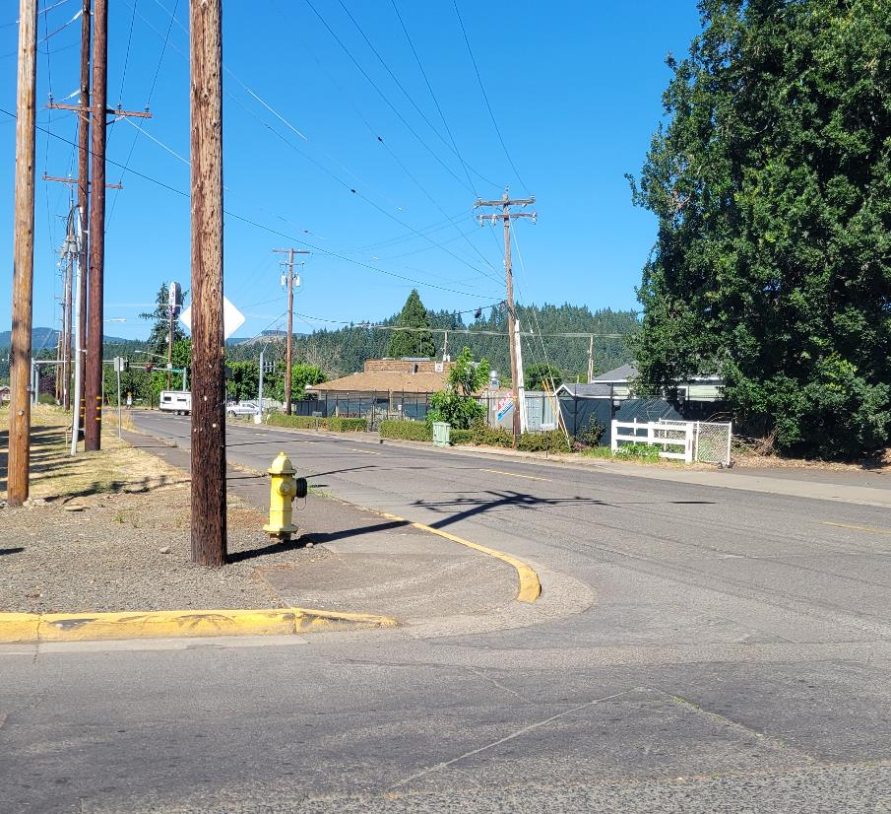
You have searched the intersection and intend to turn left
Where should your central vision be focused before and during the turn?
What should you see with your fringe vision?
Notes:
Central vision will be focused on the target area – signal and trees.
See position on roadway, reference points, lines and obstacles with fringe vision

Slide 4
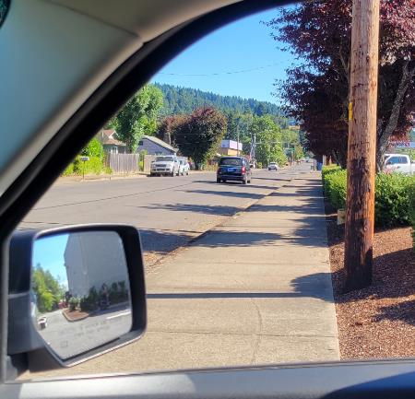
You have searched the intersection and intend to turn right
Where should your central vision be focused before and during the turn?
What should you see with your fringe vision?
Notes:
Central vision will be focused on the target area – end of roadway
See position on roadway, reference points, edge of roadway and obstacles with fringe vision

Slide 5
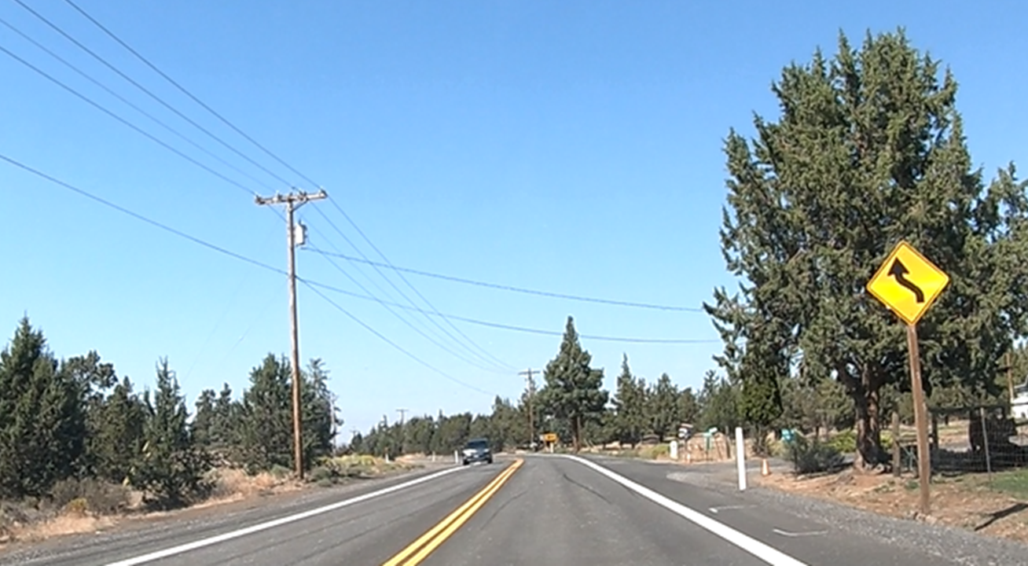
Tracking Through Curves
Where should your central vision be focused on approach to the curve?
What should you see with your fringe vision?
Notes:
See the target with your central vision
See reference points, lines and traffic with your fringe vision

Slide 6
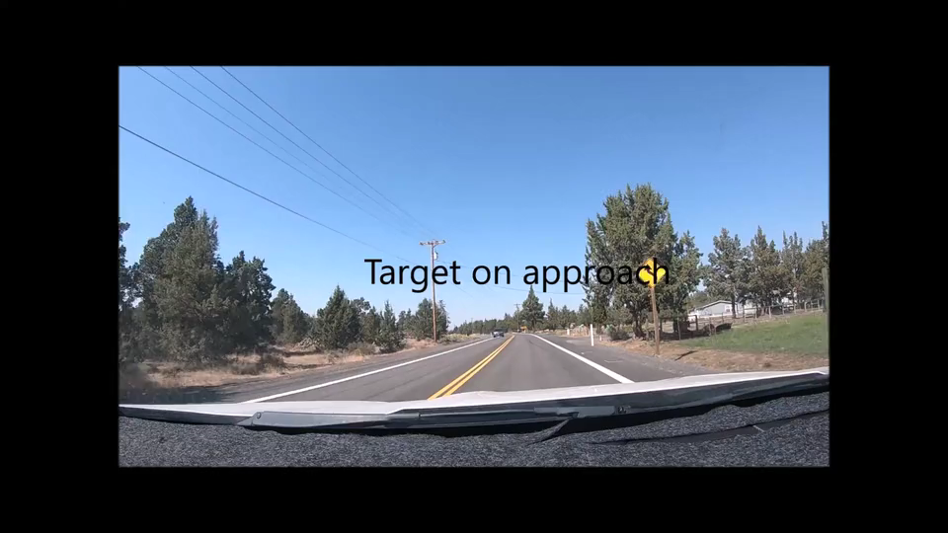
Tracking Through Curves- Let’s Practice!
Video

