Slide 1
Managing Space- SIM
Notes:
Instructor preparation notes

Slide 2
Target Area (Search)
Searching Areas
Search - to the Target Area for any restrictions
Identify – the solutions needed to manage restrictions and start to apply them
Manage – your space by reevaluating and adjusting your solutions before reaching the point of no return
15 Second (Identify)
4 Second (Manage)
Notes:
Three searching areas. Target area – search as far ahead as you can see to gather information. 15 Second Area – Identify and start to apply solutions to problems found in target area, for instance lane position, speed, communication. 4 Second Area – Manage by reevaluating the solutions and adjusting if needed.

Slide 3
SIM
Open /Closed?
Check other areas
Apply speed control options and lane position
Manage by reevaluating and adjusting
Notes:
Talk students through the process of identifying open/closed areas

Slide 4
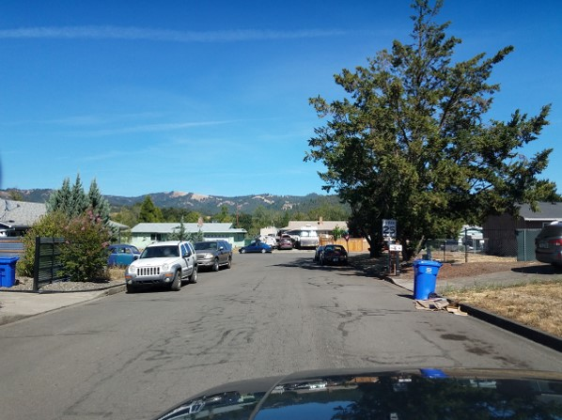
Notes:
Search-T intersection, yield sign and parked cars
Identify- search rear, apply brake, Lane position 2 prepare to yield.
Manage- did anything change before I am 2 seconds away

Slide 5
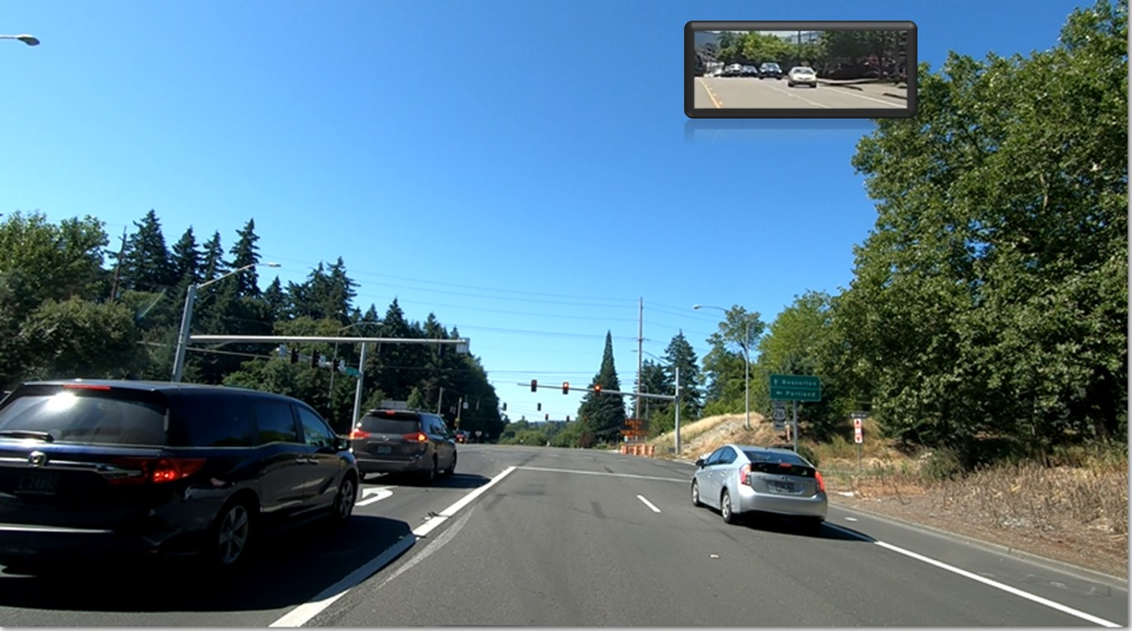
Closed front, left and right front.
Check where else at this moment?
Notes:
Rear- closed, cannot see 15 seconds away

Slide 6
What areas are closed?
Notes:
Target
15 second-all
4 second- right

Slide 7
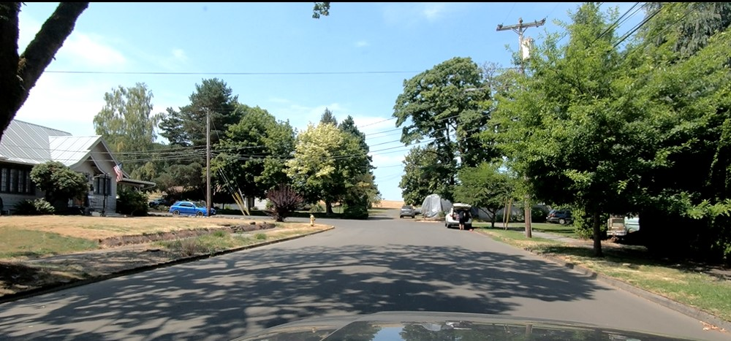
What areas are open?
What areas are closed?
Notes:
Front, left front, right front

Slide 8
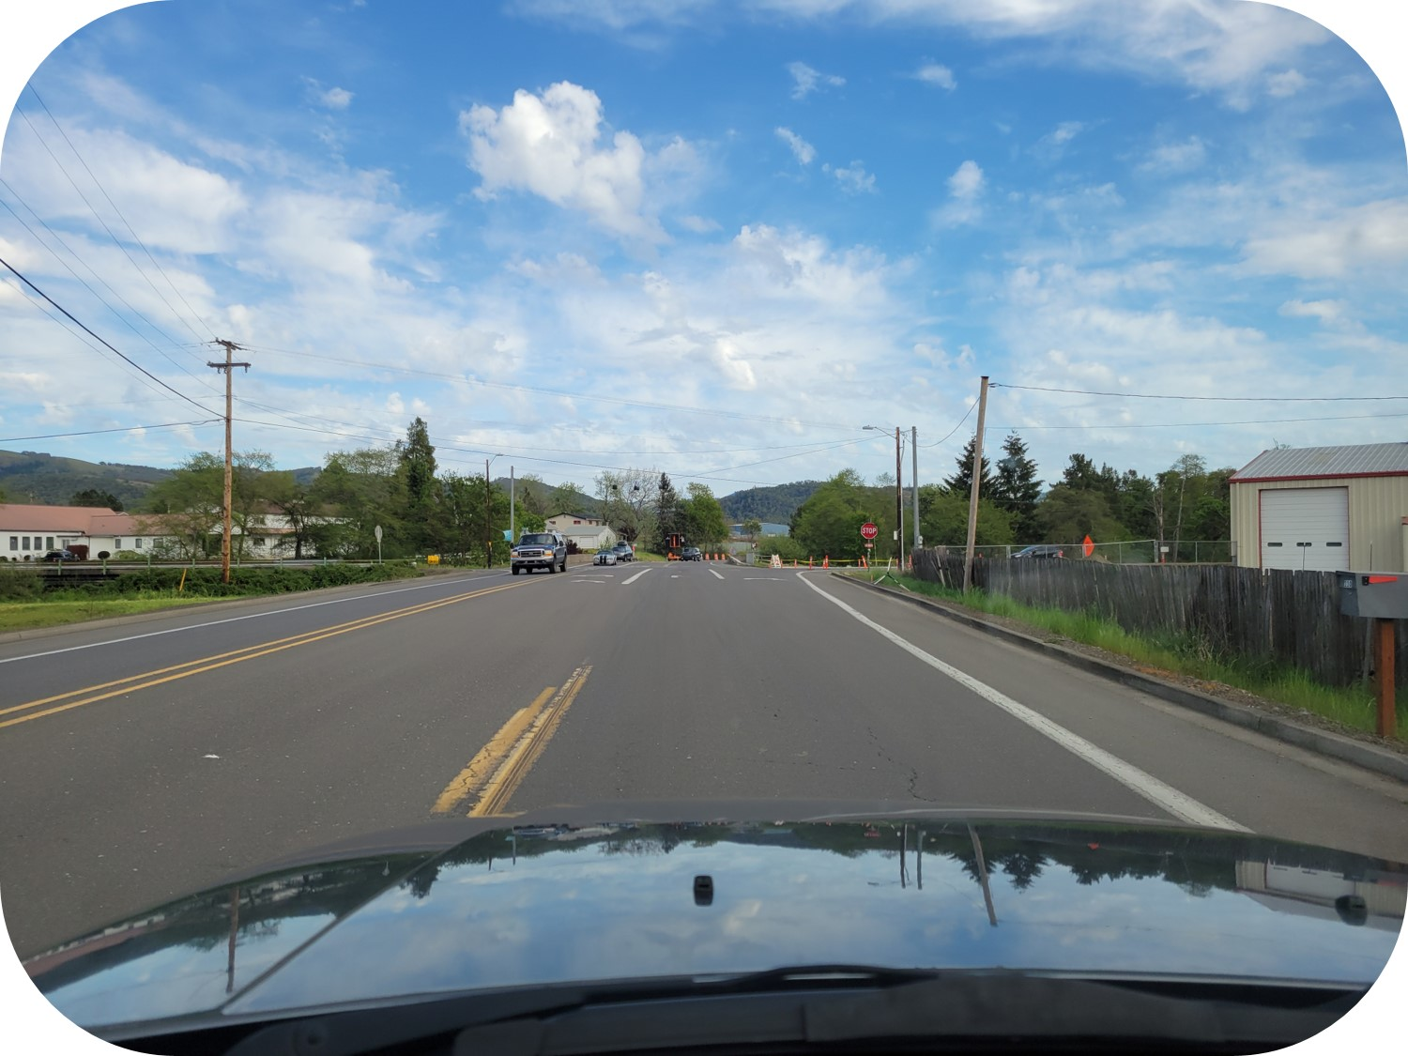
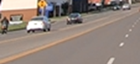
Where else should you check?
Notes:
Rear

Slide 9
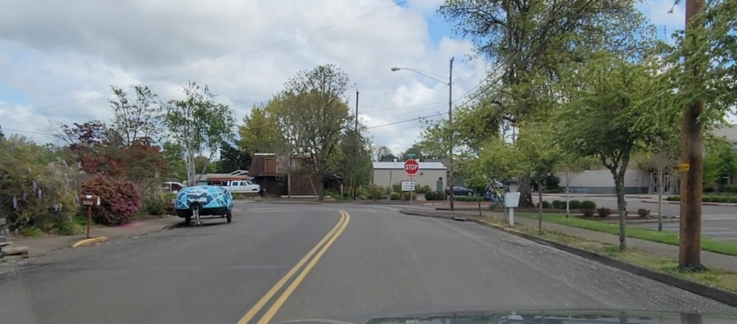
Closed front. What other areas should you check and what are the conditions?
Notes:
Rear-closed-cannot see 15 seconds away

Slide 10
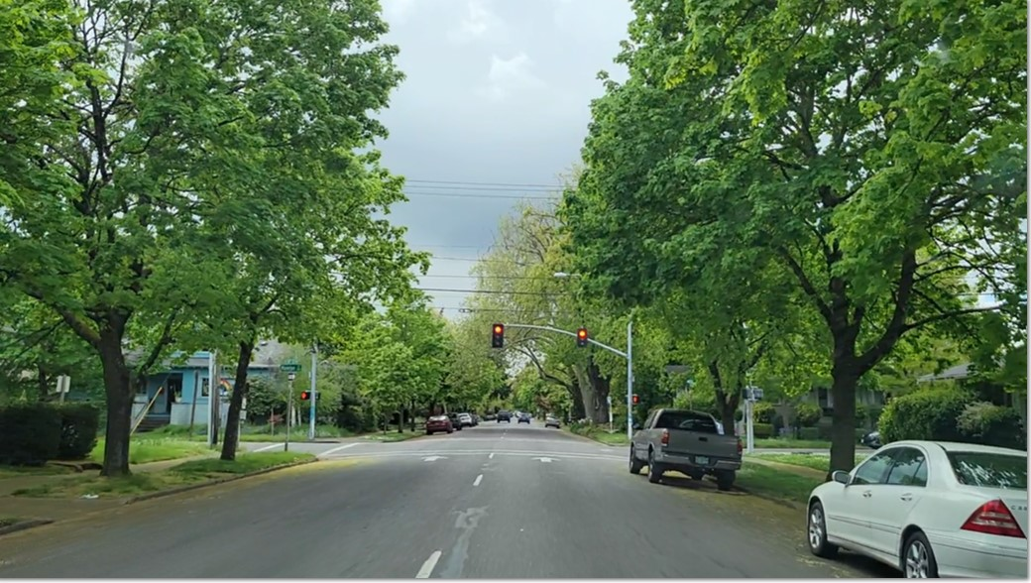
What other areas should you check and what are their conditions?
What areas are closed? What areas are open?
Notes:
Closed: Right front-front-target area
Open: left front and Rear

Slide 11
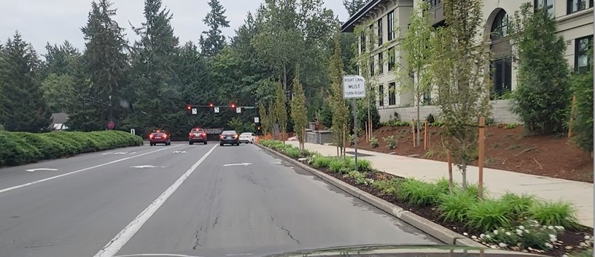
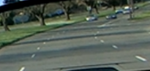
What other areas should you check and what are their conditions?
Notes:
Rear- open

Slide 12
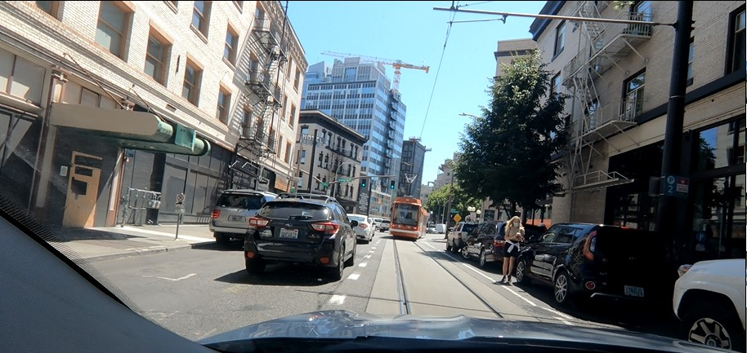
Closed front, left and right front.
Check where?
Other area conditions?
Best lane position?
Best speed control option?
Notes:
Rear-
Lane position 1
Reduce speed-cover or apply brake

Slide 13
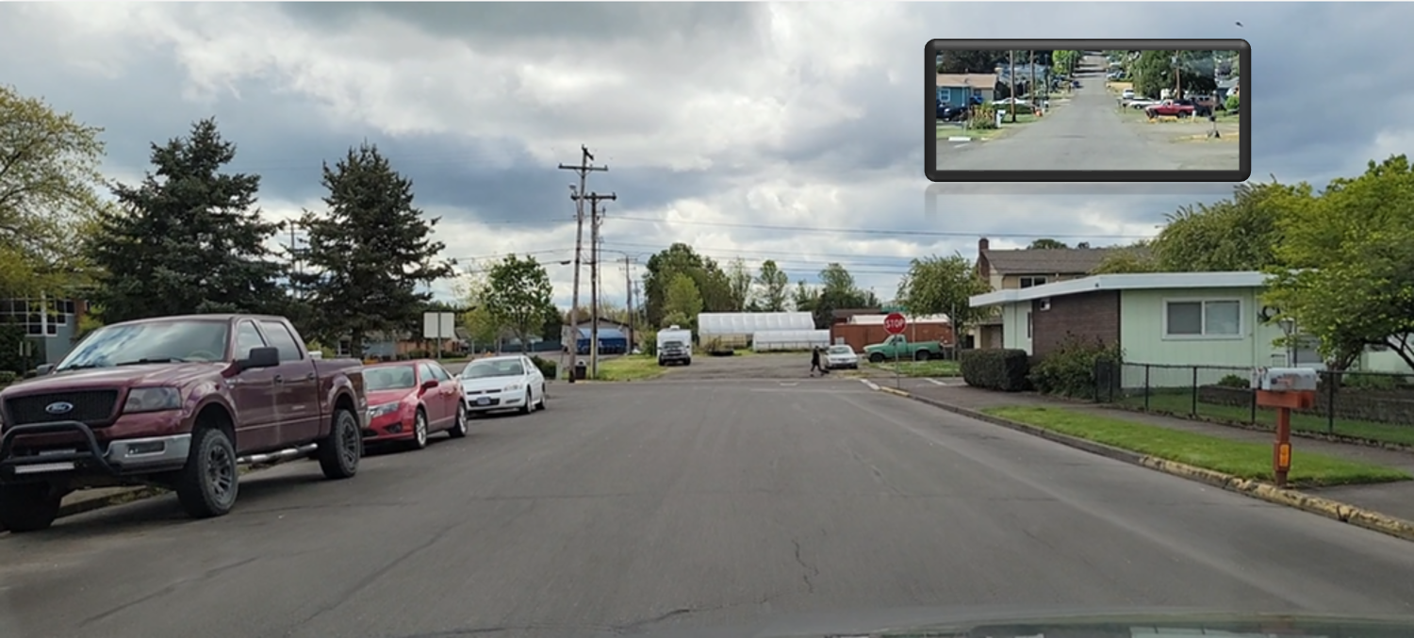
This sign prompts you to check where?
Notes:
Rear=open

Slide 14
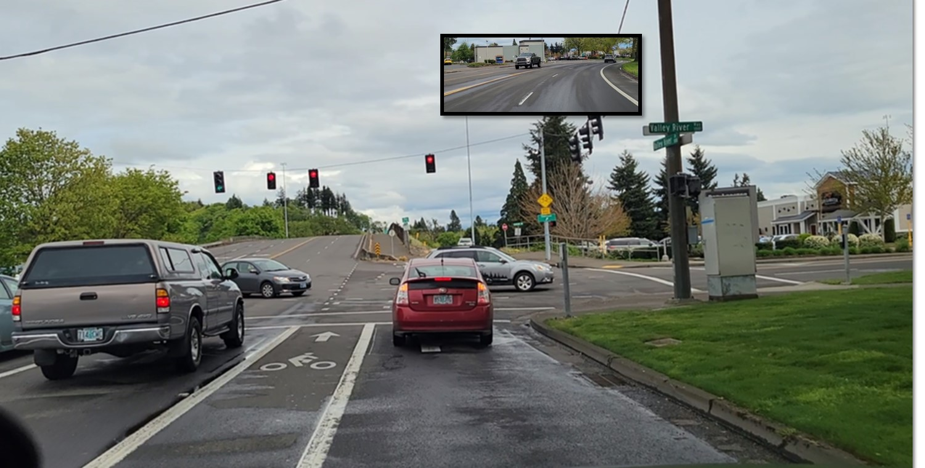
Check where? Condition?
Speed control? Lane position?
Notes:
Rear-open
Apply brake
Lane position-side position 3

Slide 15
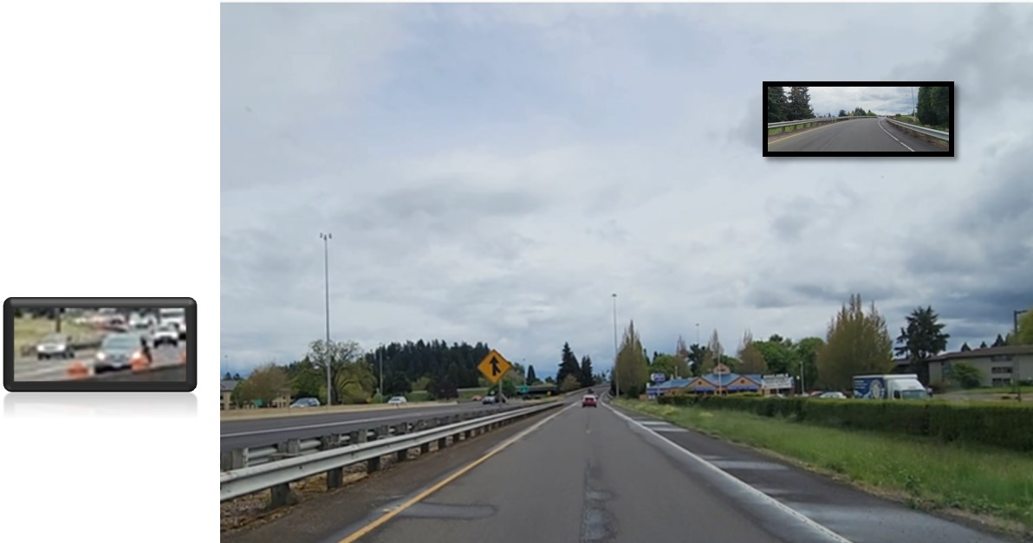
This sign prompts you to search which other areas?
Notes:
Rear, Left front and left rear

Slide 16
Your Turn
Identify open and closed areas
Name the other areas to check and their condition
Determine the best speed control and lane position needed

Slide 17
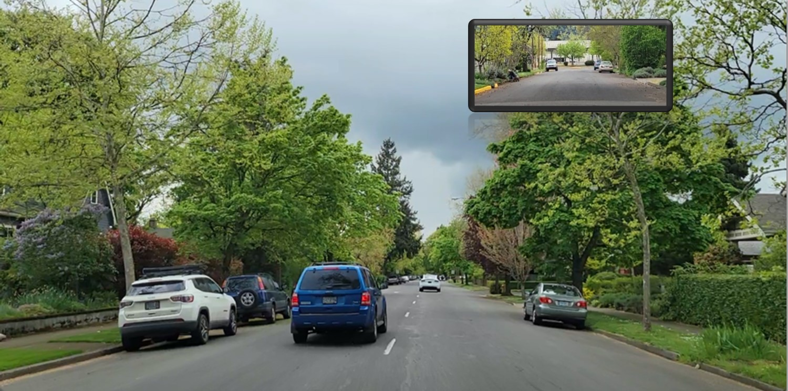
Notes:
Open: Front, rear
Closed: Left Front, Right Front, Target

Slide 18
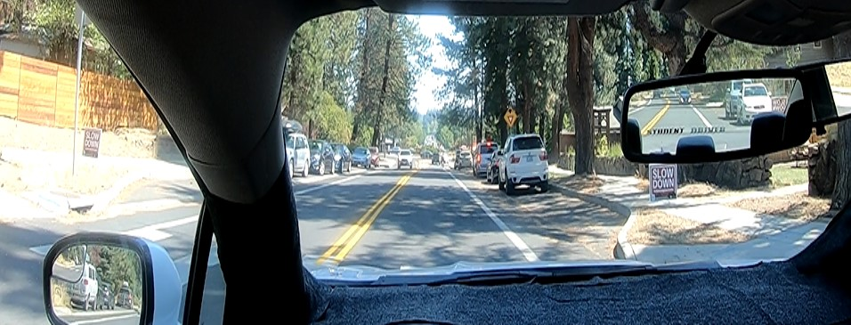
Notes:
Open: Front, Rear, Left Rear,
Closed: Left Front, Right Front, Target

Slide 19
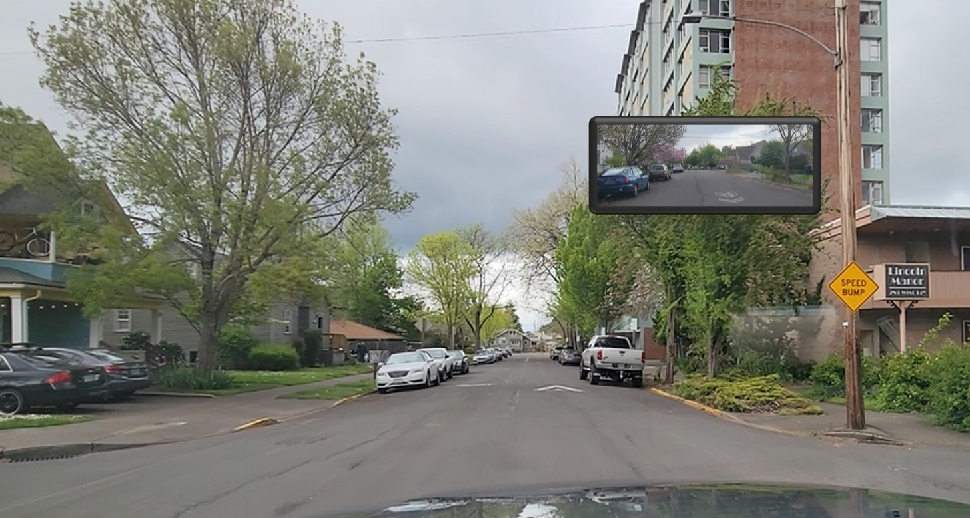
Notes:
Open: Front, Left Front, Rear
Closed: Target, Right Front

Slide 20
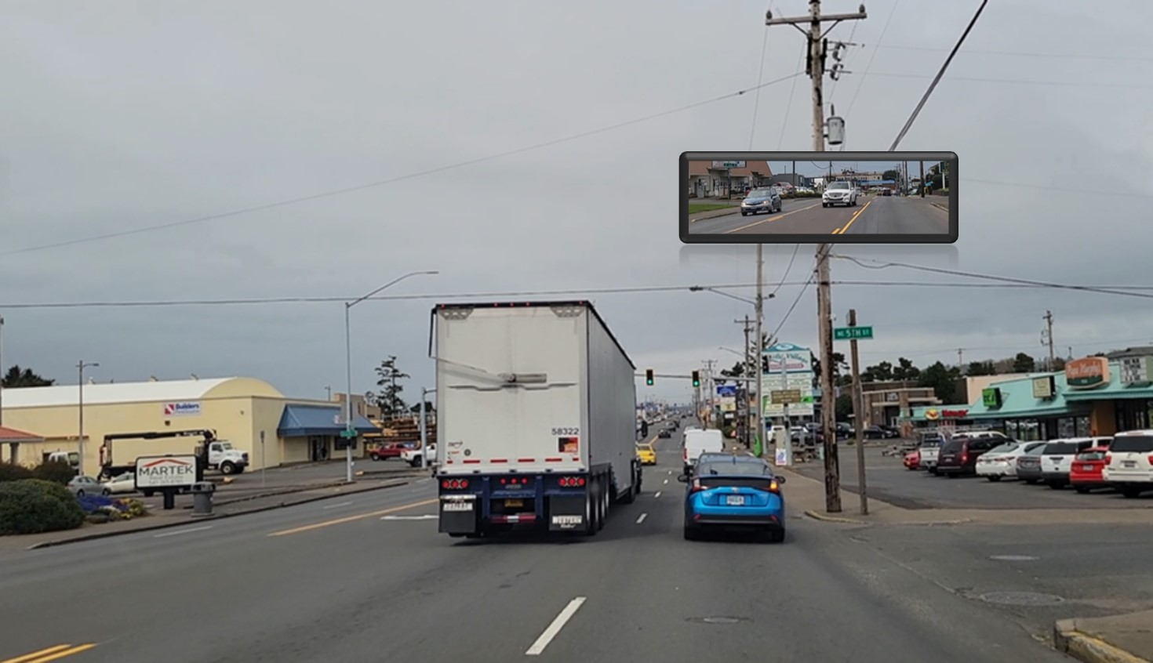
Notes:
Open: Rear
Closed: Target, Front, Left Front, Right Front, Left Rear

Slide 21
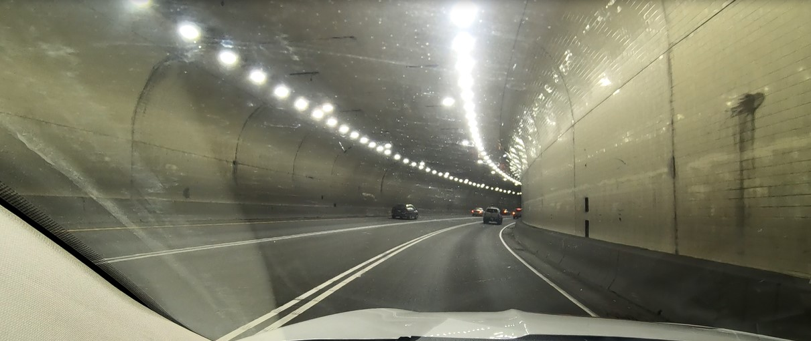
Notes:
Open: Left Front
Closed: Target, Front, Right Front

Slide 22
Notes:
Left front and left rear

Slide 23
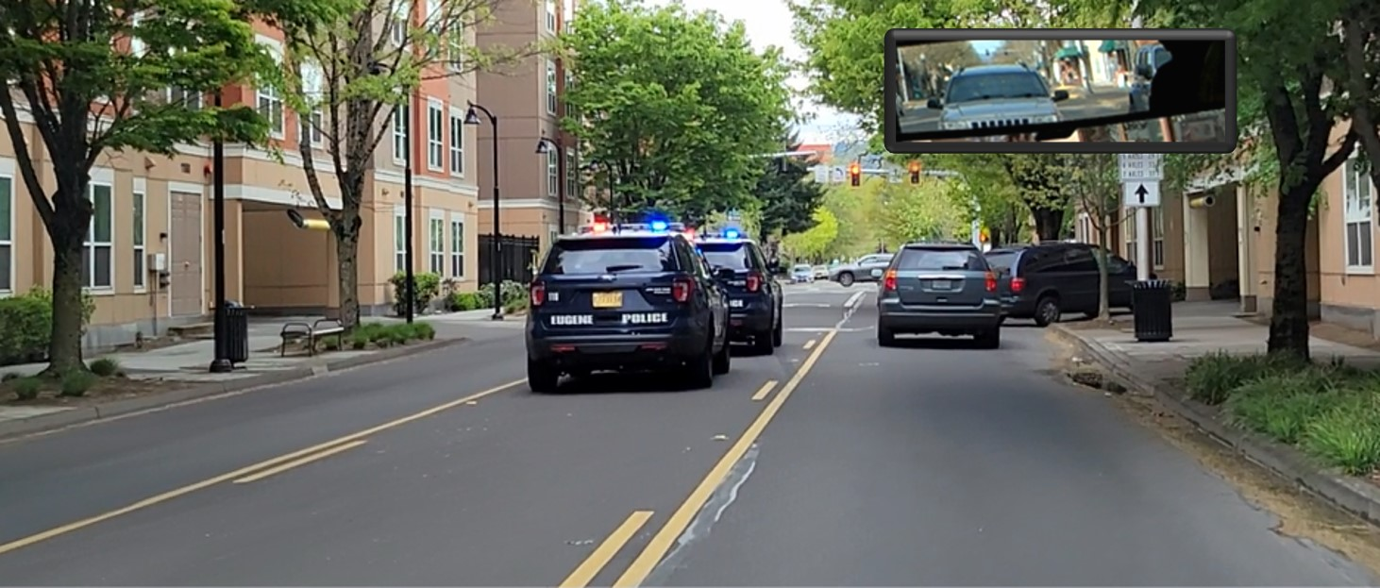
Closed Front, Left Front and Right Front. Where should you check?
Notes:
Rear

Slide 24
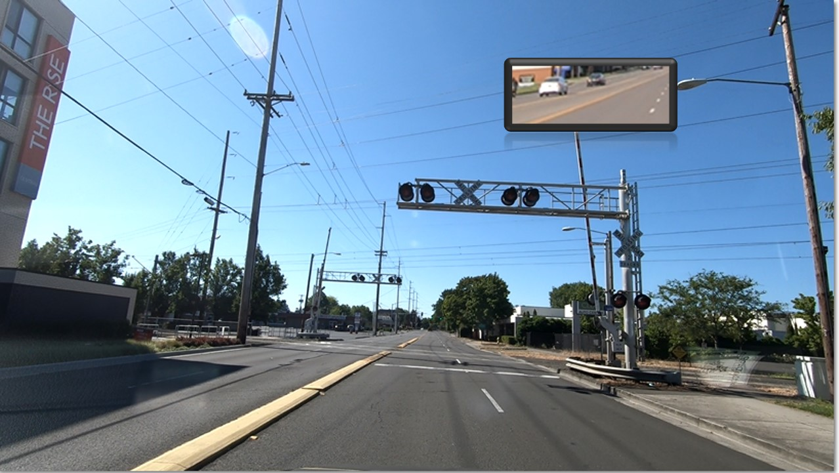
Closed front and left front. Where should you check?
Notes:
Rear and right rear

Slide 25
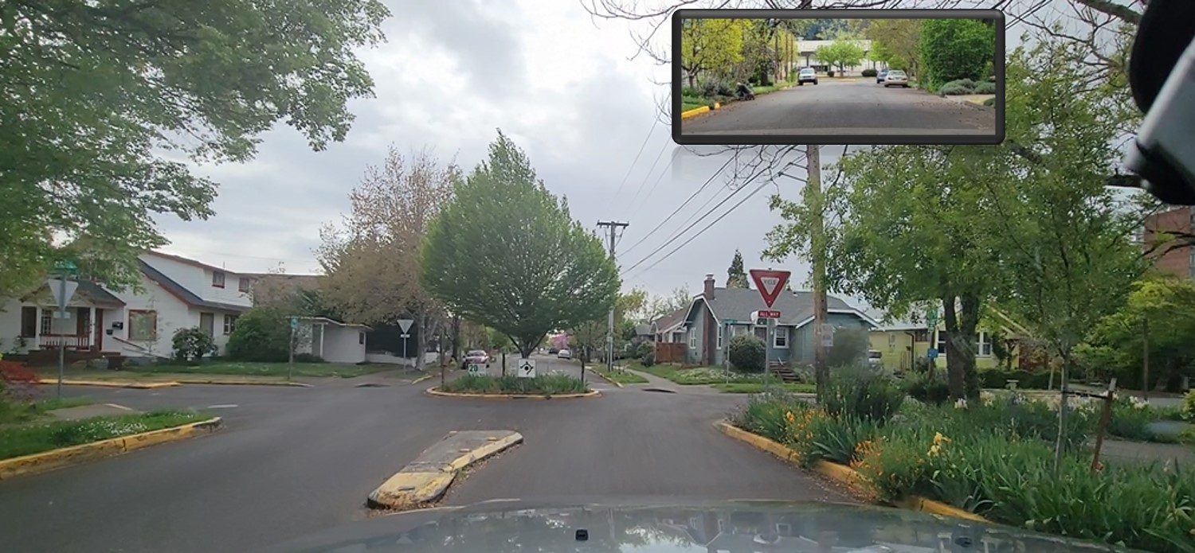
This sign prompts you to check where?
Notes:
Rear-open

Slide 26
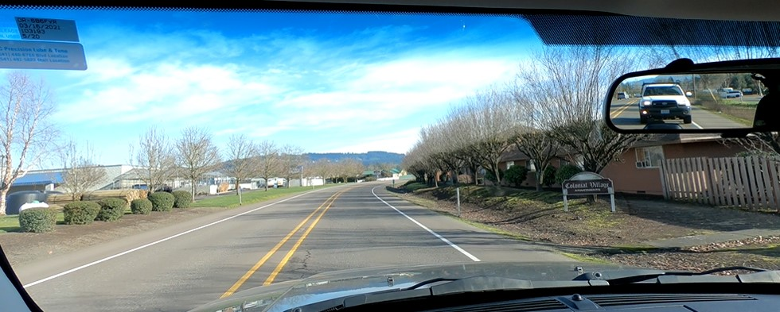
Closed rear and right front. Where should you check?
Notes:
Front, left front

Slide 27
Closed right front and left front. Where should you check?
Notes:
Rear, left rear, right rear

Slide 28
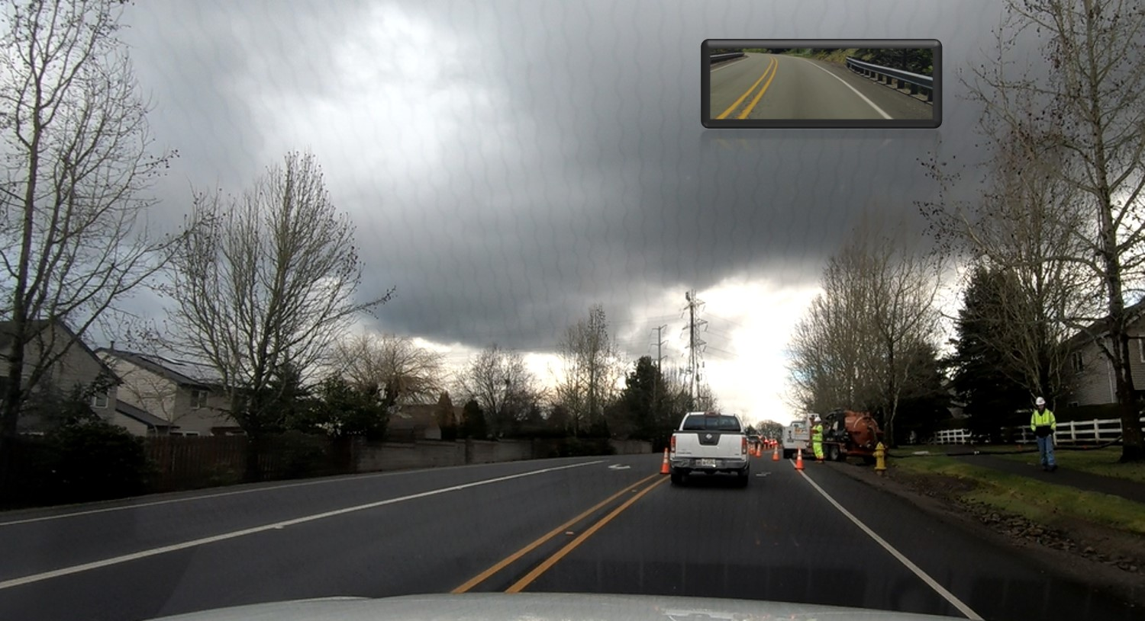
What areas are closed? What areas should you check?
Notes:
Closed: Front, right front, rear
Open: Left front, left rear

Slide 29
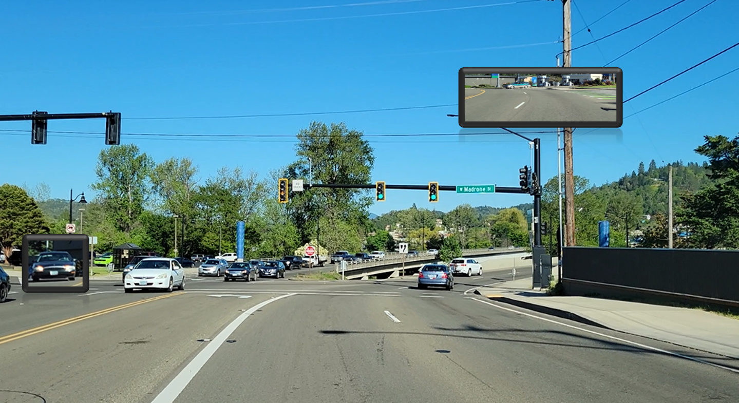
What areas are open? What areas are closed?
Notes:
Open: Rear, Left front, Right front
Closed: Front (curve)

Slide 30
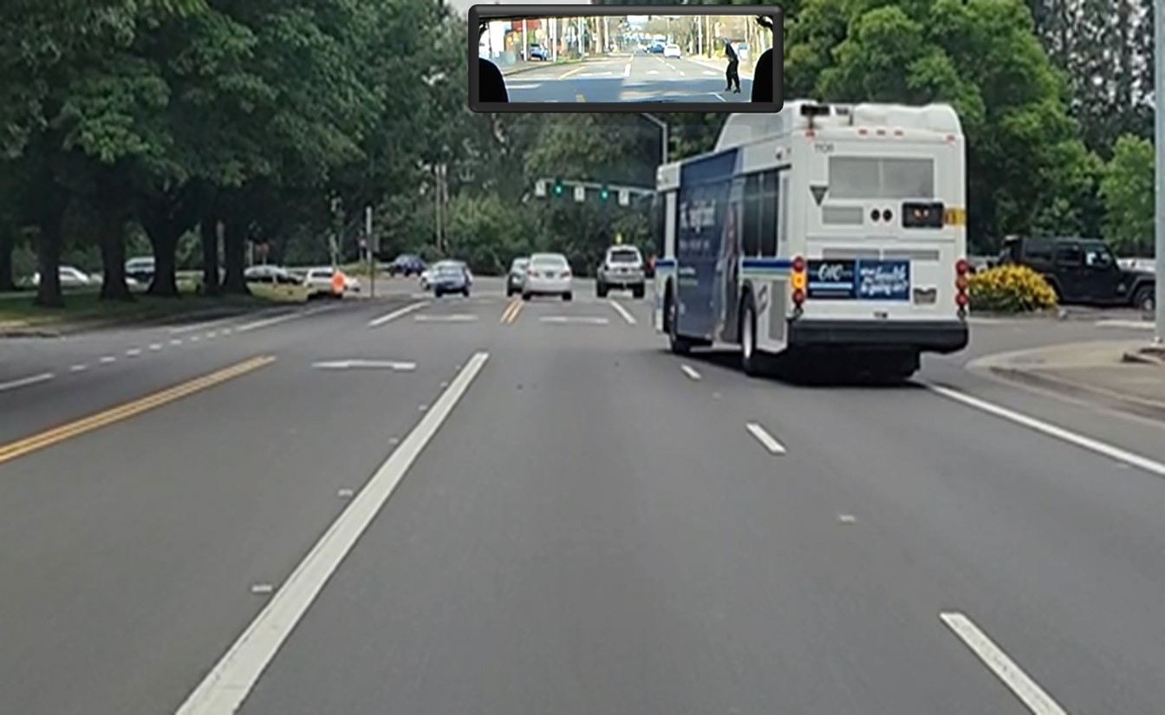
Front open or closed? Where should you check?
Notes:
Front closed due to the bus changing lanes. Notice the pedestrian in the rear zone.

Slide 31
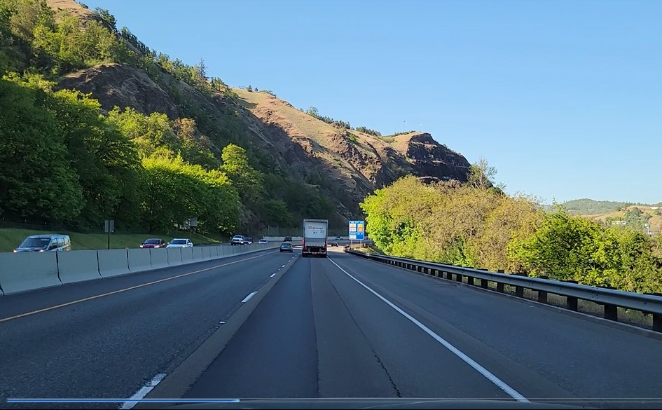
Front closed. What other areas should you check?
Notes:
Rear

