Slide 1
Dangers of Backing

Slide 2
Backing is High Risk
Video Link
Notes:
Use videos to discuss dangers of backing
Statistics – Backing and Back Over Accidents
According to the National Highway Safety Traffic Administration (NHTSA), there are at least 500,000 backing crashes of some type every year in the U.S. Of those half-million crashes, 15,000 include some type of injury and approximately 210 deaths – mostly children aged five and under (31% of all fatalities) and elderly people aged 70 and over (26%).1 Up to two children every week are killed in the U.S. by back over incidents.2 Sadly, most of these events (70%) occur with a parent or family member behind the wheel.2 Besides children and elderly people, some back over accidents also involve pets.

Slide 3
Backing is High Risk- Motorcycle
Video Link

Slide 4
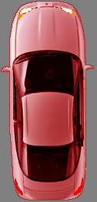
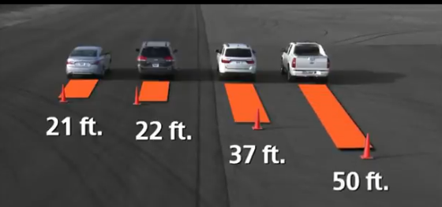
Backing Increases Risk
Your view is reduced (blind areas are huge)
Your view is blocked by the vehicle
Others are not always aware of backup lights
When you can, Drive Forward
Notes:
Remind students of the blind areas around the vehicle.
No standard distance. The rear is the largest.

Slide 5
Backing safely
Check around the vehicle by walking around before backing (if possible)
Check 360 degrees before backing
Back slowly
Look back, glance forward and utilize mirrors and backup cameras.
Do not rely on mirrors and backup cameras-they are a tool

Slide 6
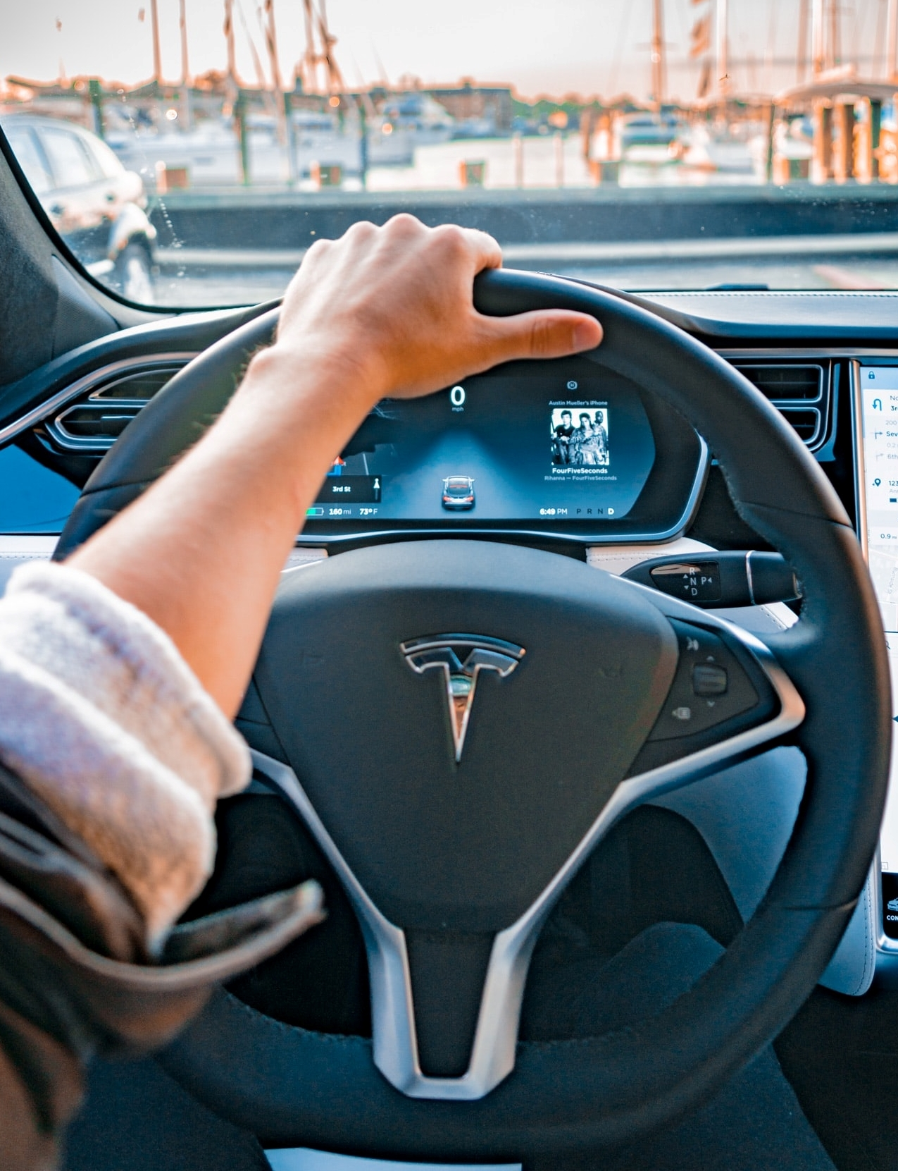
Backing Straight
Right foot on brake
Shift to reverse
Search 360
Left hand at 12 o’clock position
Right hand on back of passenger seat
Target to the rear
Back slowly

