Slide 1
Turning Around
Changing Your Direction

Slide 2
Options
Go Around The Block
Parking Lot
Right Side
Left Side
U-Turn
Y-Turn - 3 Point Turn
Notes:
Evaluate the Risks
Least amount of risk
Some Risk – Many LOS-POT blockages in parking lots
Reduced Risk - Backing in, pulling out forward
High Risk - Backing into traffic
High Risk - Crossing all traffic lanes
Maximum Risk - Crossing traffic lanes & backing into traffic

Slide 3
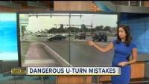
U-Turns
Video
Notes:
Note: At the end of the video, the instructor will say to check the “rear zone”. Remind students we use “rear space” or simply “check the rear”
Video: ABC Action News- https://www.youtube.com/watch?v=od1WuIv6Aco

Slide 4
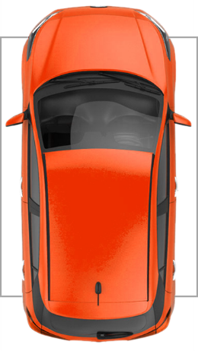
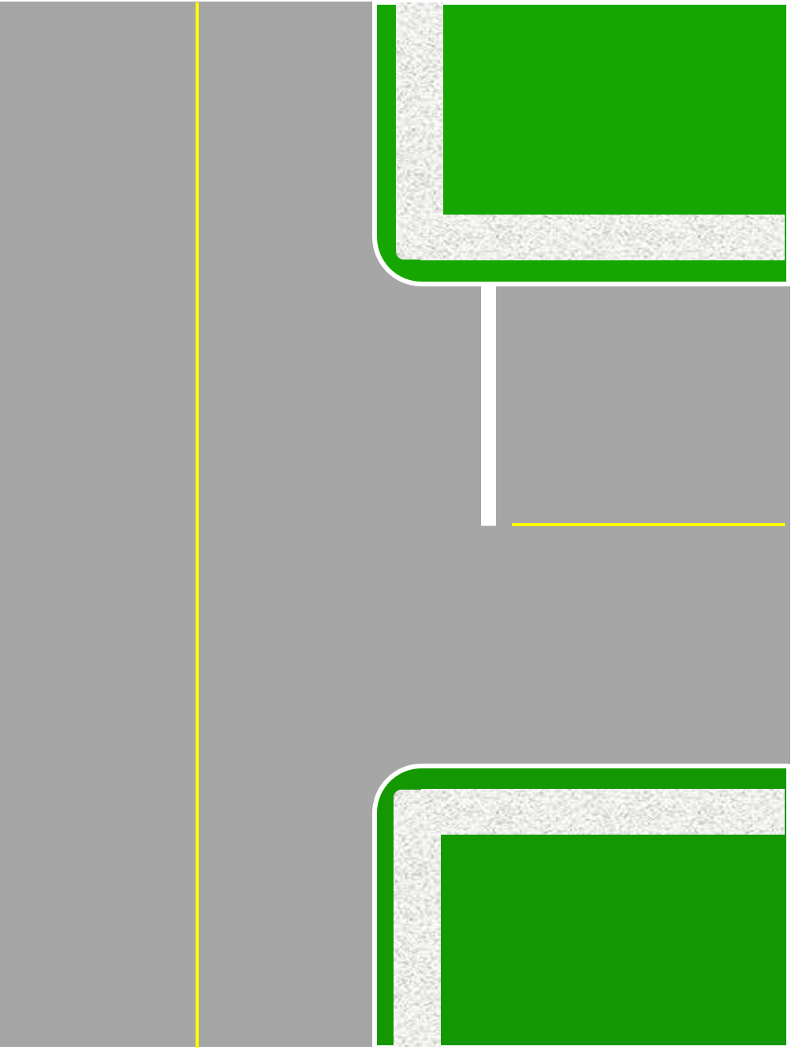
Right Side Turnaround
1
2
Select location, MSMOG and exit traffic.
Shift to reverse, 360° search, back to pivot point, turn wheel and check front swing.
Back to safety stop, shift to drive
Signal and turn left.
3
4
4
1
Notes:
To decrease risk, it is best to back the shortest distance. Back only far enough to get the front of the car even with the curb line, which is the forward safety stop position.

Slide 5
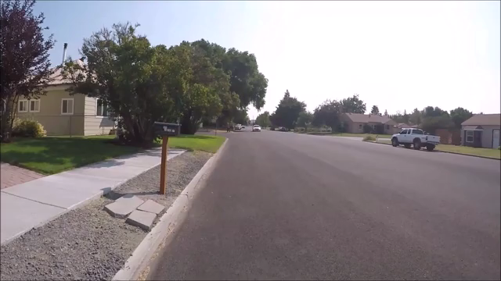
Right Side Turnaround
Video

Slide 6

Left Side Turnaround
1. Select location, turn left and MSMOG to exit traffic.
2. Shift to reverse,
360° search, yield to pedestrians, target rear and back slowly.
1
2
1

Slide 7
Left Side Turnaround
2
1. Back to the pivot point. Search and yield to traffic and begin turn.
2. Stay close to the curb and complete the turn in the least amount of space
3.MSMOG and re-enter traffic.
1
3

Slide 8
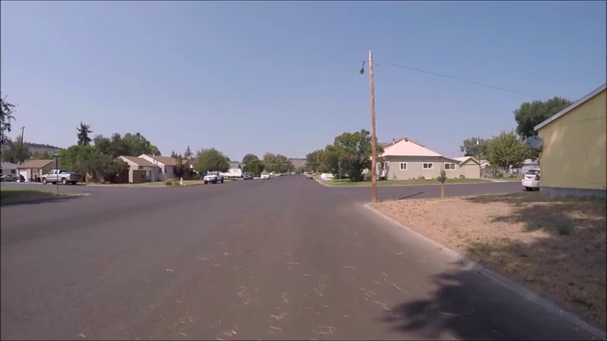
Left Side Turnaround
Video

Slide 9

Illegal U-Turns
At traffic-light controlled intersections unless a sign permits it
On a highway, in city limits, mid-block
On a highway where you cannot be seen by another driver approaching from any direction for a distance of:
  500 feet within city limits
  1000 feet outside city limits
Anywhere a sign prohibits

Slide 10
Modified U-Turn:
U-Turn rules apply!
3
Search 500’ – 1000’
and MSMOG to curb
2. Turn left, stop at front limit, shift to reverse, search 360° degrees
3. Target right rear, turn wheel and, back far enough to clear edge of roadway, stop and shift to drive.
4. Continue forward.
2
1
4
1

Slide 11

3- Point Turnaround
Video

