Slide 1
Back-In Angle and Perpendicular Parking

Slide 2
What are the benefits of backing into parking spaces?
Can enter and exit easier
Takes less time to park and exit
Can see better when leaving
Prevents backing out into traffic
Better control and lowers risk

Slide 3
Back-In Angle Parking

Slide 4
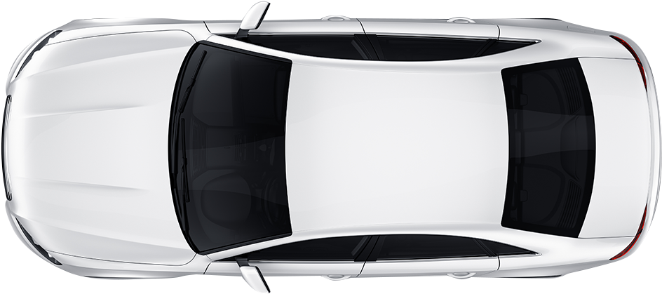
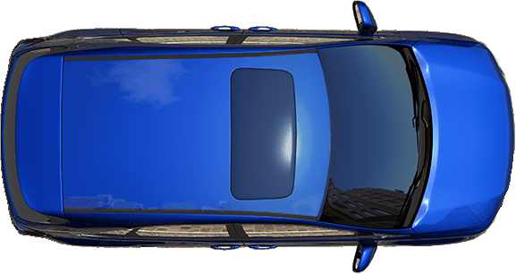
Approach
Check front and rear
Signal right
Side Position 3
(3 feet) from the
parking space.
Reference Point- middle of the right half of the hood

Slide 5
Reference for 3 feet

Slide 6
Approach
Pull past the space and stop
Before backing
Shift to reverse
Check 360°

Slide 7
Backing In
Target and back slowly
Turn the wheel when the pivot point aligns with the space

Slide 8
Complete park
Straighten car and tires
Stop at Rear Position
Reference Point: 1 foot behind door post or middle of rear passenger window

Slide 10
To Exit the Parking Space
Shift to drive
Check traffic
Signal
Pull out when clear

Slide 11
Back-In Perpendicular Parking

Slide 12
Approach
Check front and rear
Signal right
Side Position 3
(3 feet) from the
parking space.
Reference Point- middle of the right half of the hood

Slide 13
Approach
Pull forward until your body is aligned in the center of the space
Select 45° Target – over outside edge of the driver’s side mirror

Slide 14
Start Park
Turn wheel fully left, creep forward until on target
Turn the wheel fully to the right
Do 360° search
Reverse and back slowly until vehicle is perpendicular with the space

Slide 15
Backing In
Turn the wheel fully to the right
Do 360° search
Reverse and back slowly until vehicle is perpendicular with the space

Slide 16
Backing In
Continue backing until your car is on target
Stop and straighten the wheel

Slide 17
Backing In
Continue backing and stop at Rear Position
Secure car

Slide 18
Exiting the space
Shift to drive
Check traffic
Signal
Pull out when clear

