Slide 1
Angle Parking

Slide 2
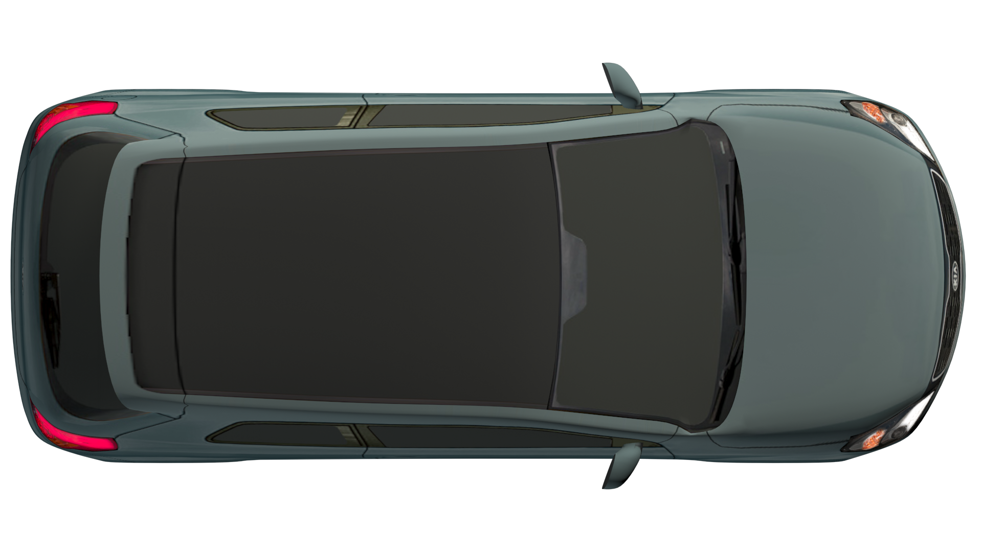
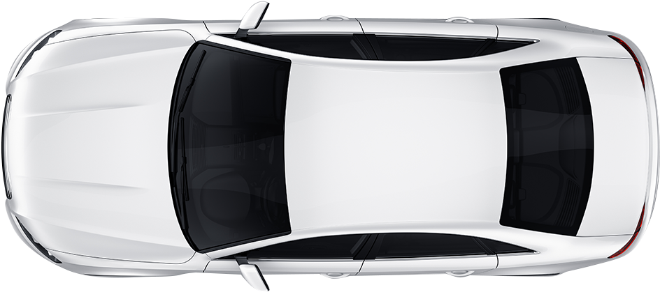
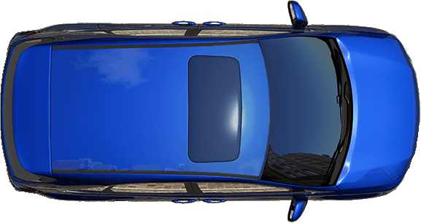
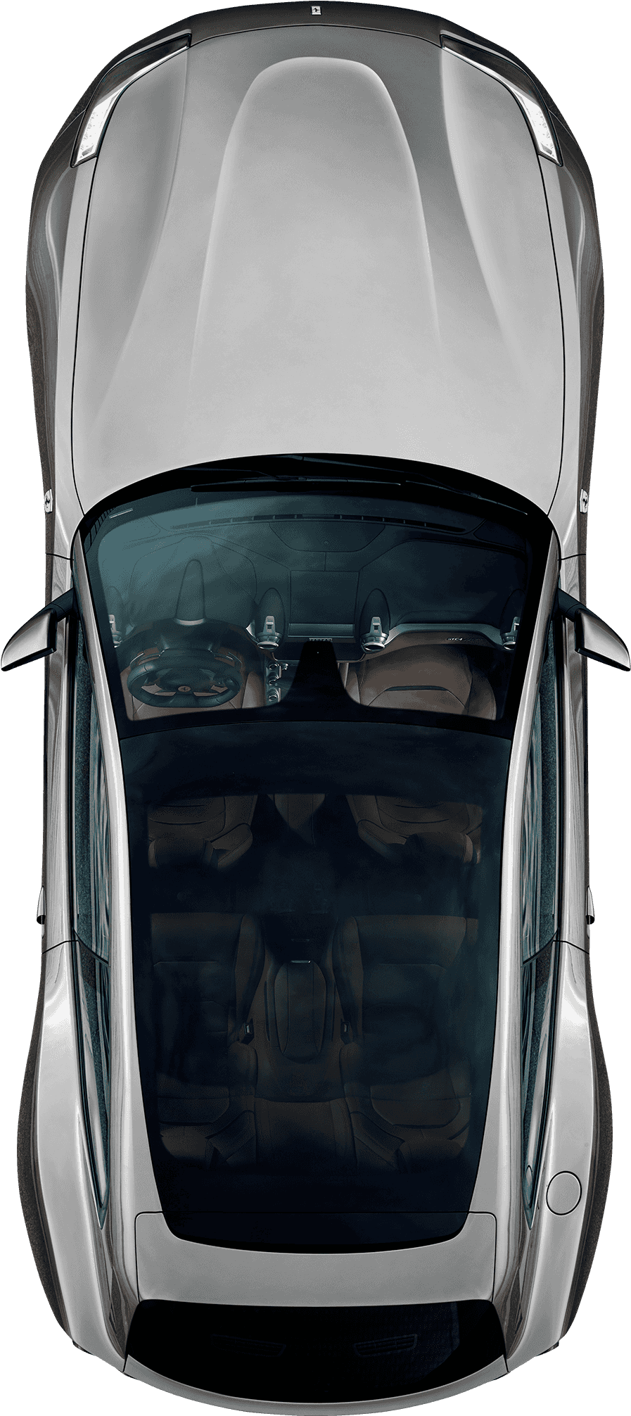
Two Way Traffic Pattern

Slide 3
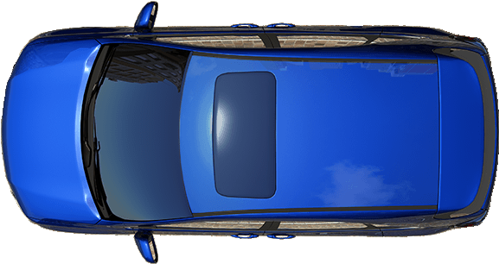
One Way Traffic Pattern

Slide 4
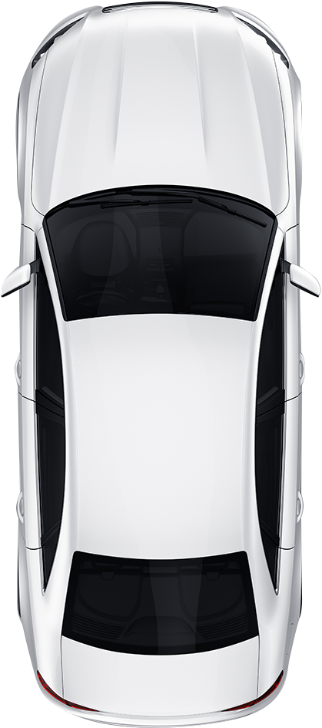
Approach
Check front & rear
Signal right
Side Position 6 (6-8 feet) feet from the parking space
Reference point- right edge of hood

Slide 5
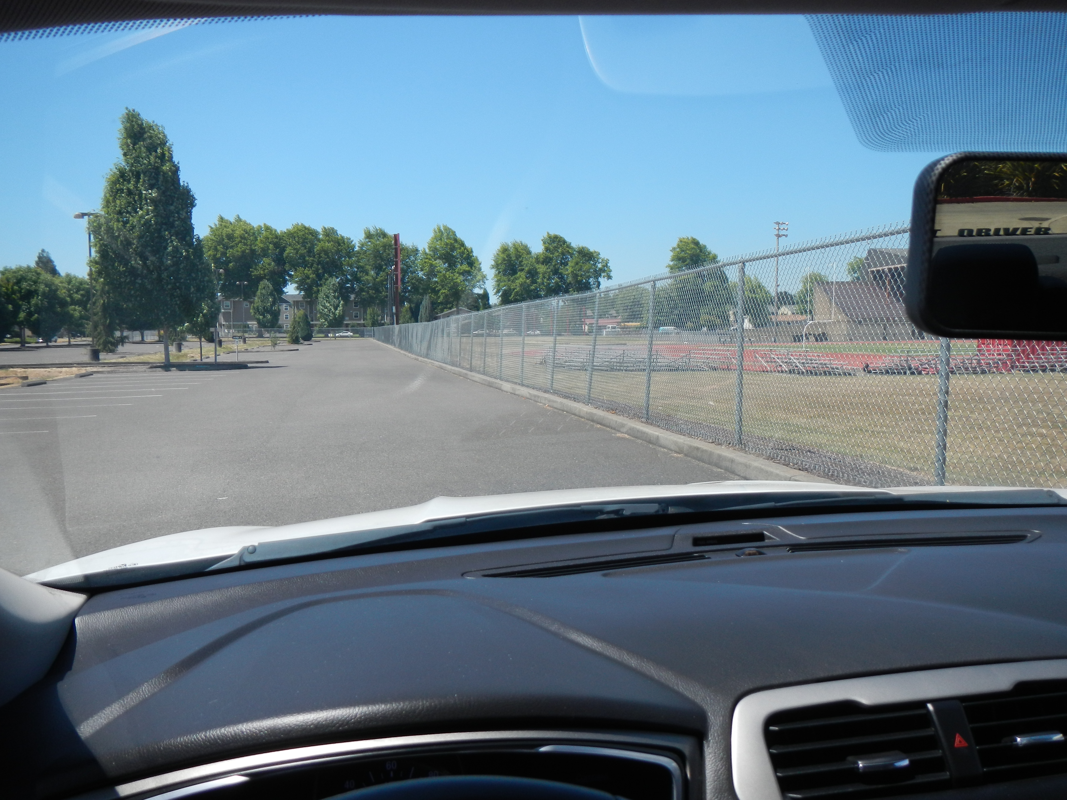
Reference 6 – 8 Feet Away

Slide 6
Begin Turn
When you can see the center of the parking space without your vision cutting across the line, slowly enter the space.
Creep – Target the center of the space -Turn Wheel

Slide 7
Complete Park
Straighten car and tires
Stop at Forward Position
When parked to the right as illustrated, the curb will appear forward of the left corner post
When parked to the left, the curb will appear forward of the right corner post
Secure the car

Slide 8
To Exit the Parking Space
Shift to reverse
Check Traffic (360)
Back Slowly
Check All Corners

Slide 9
To Exit the Parking Space
Begin to turn the wheel when the rear pivot point aligns with the bumper of the vehicle on the right and the side mirror aligns with the bumper of the vehicle on the left

Slide 10
To Exit the Parking Space
Continue backing until you clear the vehicles
Stop, straighten the tires and shift to drive

Slide 11
Perpendicular Parking

Slide 12
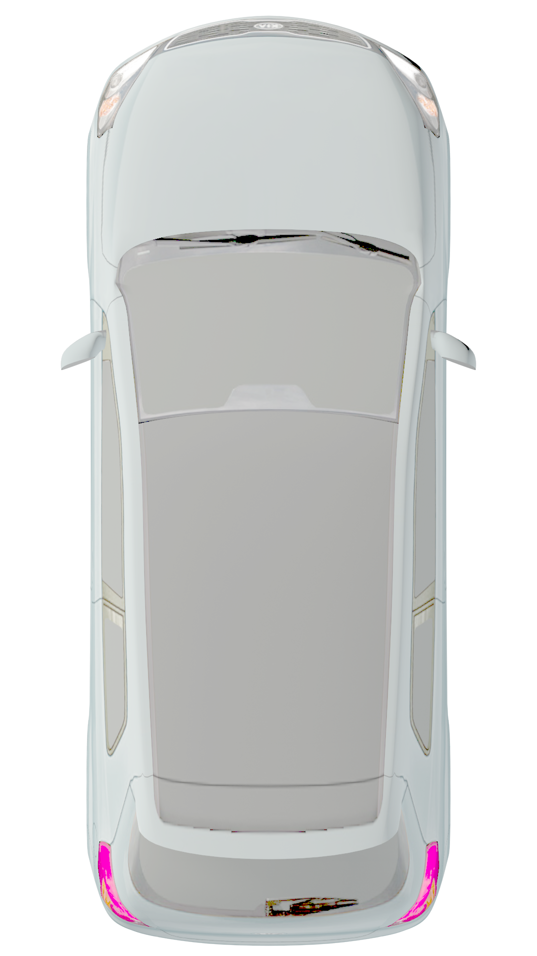
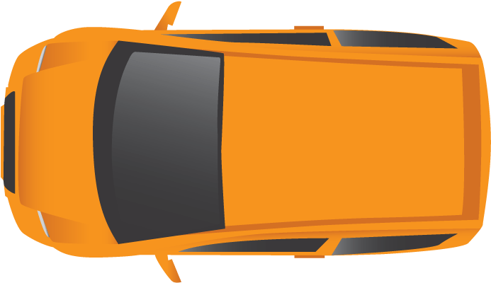
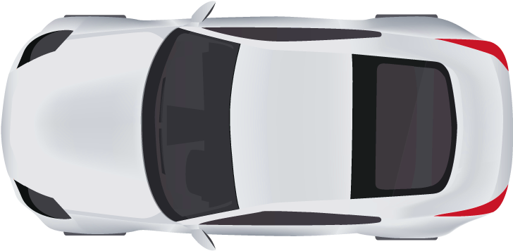
Two Way Traffic Pattern

Slide 13
One Way Traffic Pattern

Slide 14
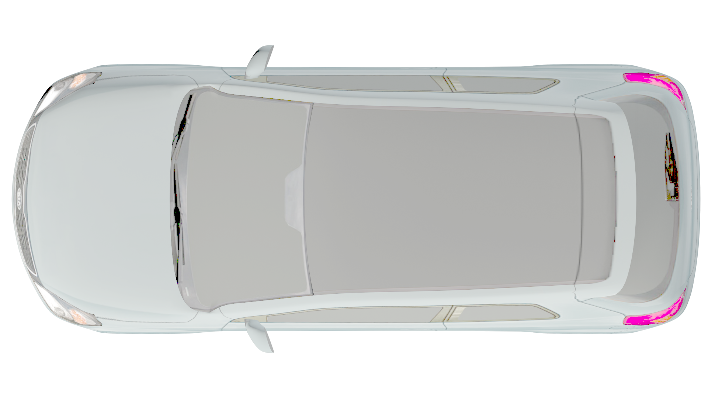
Approach
Check front and rear
Signal right
Side Position 6
(6-8 feet) from the
parking space.
Reference point-
right edge of hood

Slide 15
Begin Turn
When you can see the center of the parking space without your vision cutting across the line, slowly enter the space
Target the center of the space -Turn Wheel

Slide 16
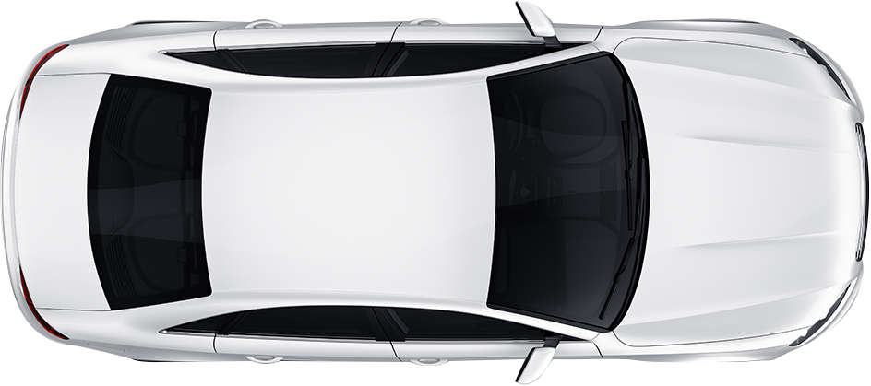
Complete Park
Straighten car and tires
Stop at the Forward Position- Side mirrors or corner post aligned with the curb
Secure the car

Slide 17
To Exit the Parking Space
Shift to reverse
Check Traffic (360°)
Back Slowly
Check All Corners
Begin to turn the wheel when side mirror aligns with the rear bumper of the vehicle to your left.

Slide 18
To Exit the Parking Space
Continue backing until you clear the surrounding vehicles
Stop, straighten the tires and shift to drive.

