Slide 1
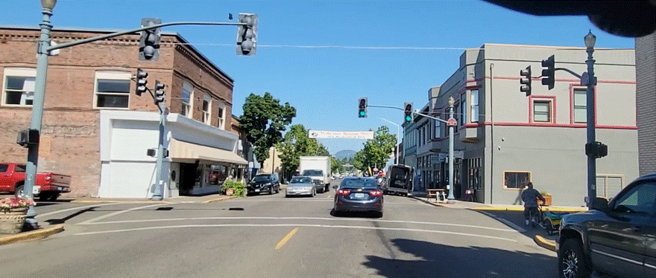
Intersections

Slide 2
What is an Intersection?
The place where two or more roads meet
Can be any shape
Usually controlled
Traffic signs and/or signals present on one or more sides
Sometimes uncontrolled
No traffic signs or signals present on any side

Slide 3
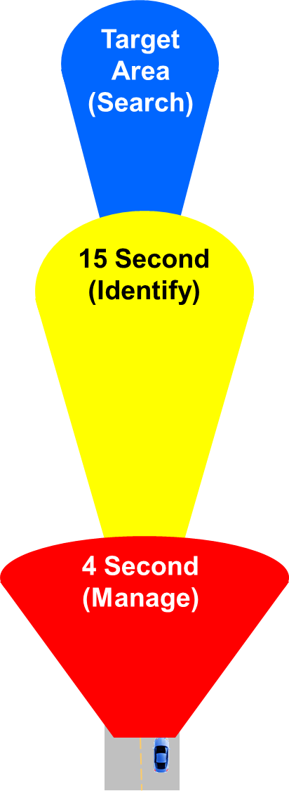
Remember SIM
Search to find Intersections in the Target Area
Identify the solutions needed and start to apply them by the 15-Second Area
- Speed, position, and communication
Manage by reevaluating in the 4 Second Area
- Reevaluate with 45º or 90º searches
- Be prepared to adjust speed, position, and communication before you occupy that space

Slide 5
Intersection Clues
What are clues that you are approaching an intersection?
Notes:
To be able to search and control an intersection. Identify the intersection in the target area.
Have students name clues that help identify an intersection- crosswalks, cross traffic, broken lines, street signs

Slide 6
Which intersections did you have?
Video link

Slide 7
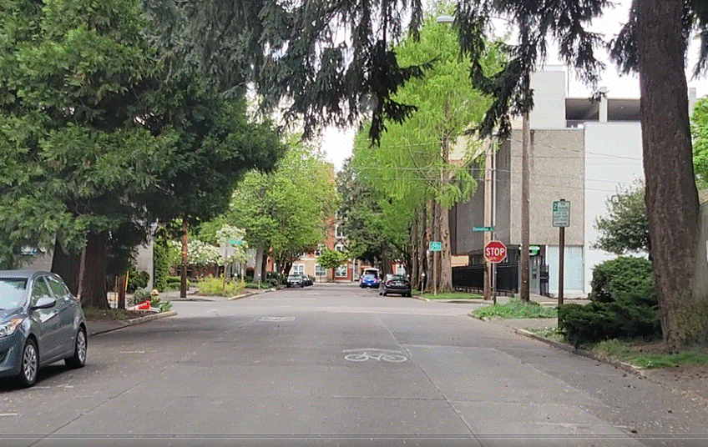
Where are the intersections?
What are the clues?
Notes:
Stop sign
End of the road

Slide 8
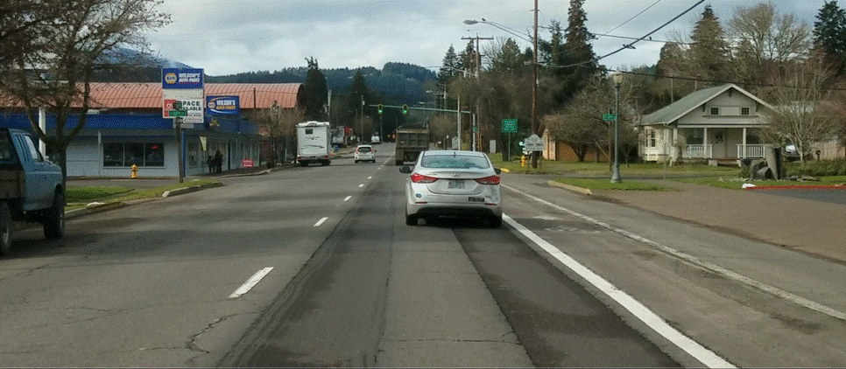
Where are the intersections?
What are the clues?
Notes:
Signal
Break in the sidewalk
Signs

Slide 9
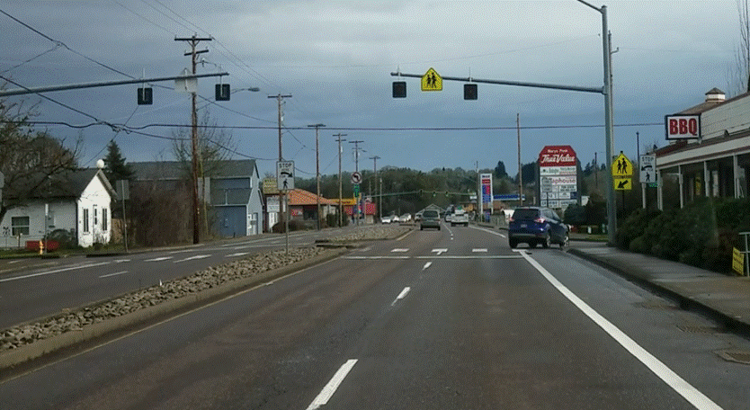
Where are the intersections?
What are the clues?
Notes:
Crosswalk
Break in the divider

Slide 10
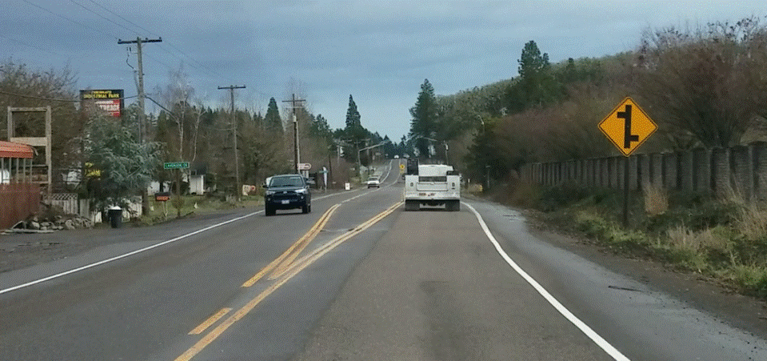
Where are the intersections?
What are the clues?
Notes:
Signs
Turn lane

Slide 11
Controlled or Uncontrolled?
- Controlled Intersections have lights and/or signs to assign yielding requirements.
- Uncontrolled Intersections have no lights or signs. Yielding rules apply to assign yielding responsibilities.

Slide 12
Controlled or Uncontrolled?
Uncontrolled
Notes:
uncontrolled

Slide 13
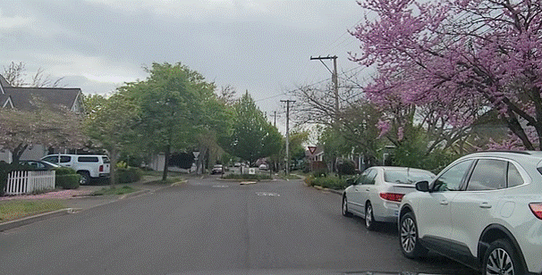
Controlled or Uncontrolled?
Controlled
Controlled- Yield sign
Notes:
Controlled-yield sign

Slide 14
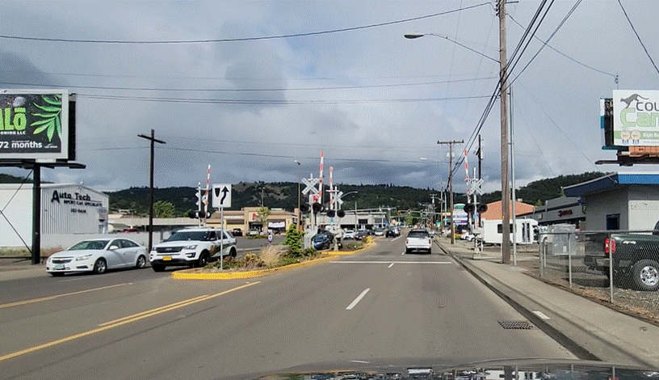
Controlled or Uncontrolled?
Controlled-Crossbucks, lights and crossing arms
Who yields? Best actions to take?
Notes:
Controlled
Vehicles yield to trains
Cover brake and search 45 left front right

Slide 15
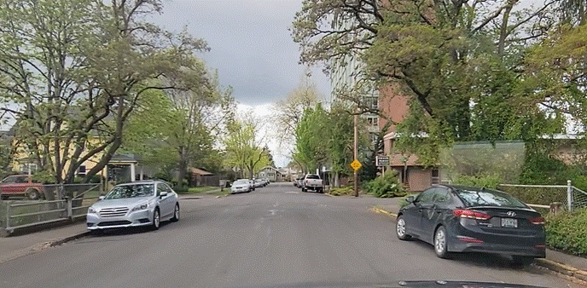
Controlled or Uncontrolled?
Controlled
Notes:
Controlled- Stop sign on right

Slide 16
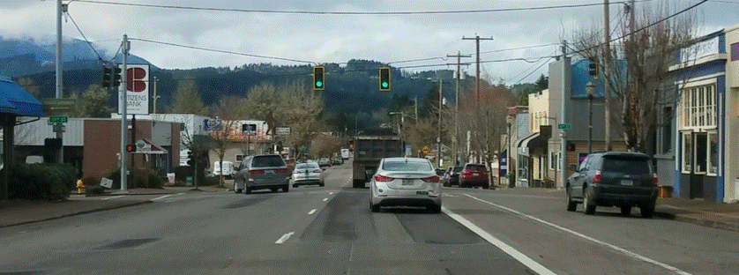
Controlled or Uncontrolled?
Controlled-Signal
Controlled
What is the point of no return?
Notes:
Controlled-signal

Slide 17
Controlled or Uncontrolled?
Uncontrolled
Notes:
Uncontrolled

