Slide 1
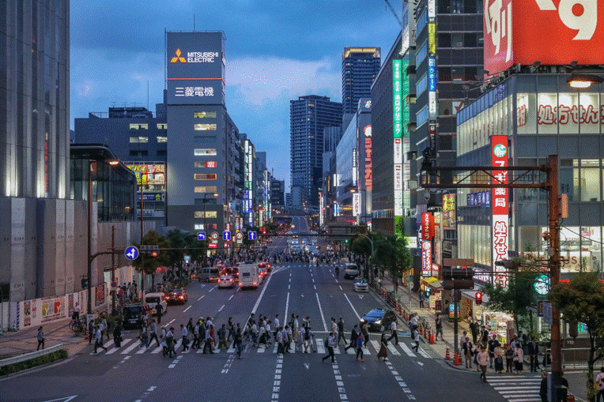
Pedestrians

Slide 2
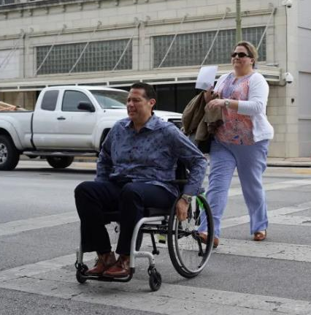
What is a pedestrian?
A pedestrian is any person on foot or using a wheelchair
Notes:
They may be using a skateboard*, roller/in-line skate* etc. Regardless of how they get around, they are all vulnerable and we share the responsibility with them to ensure their safety.

Slide 3
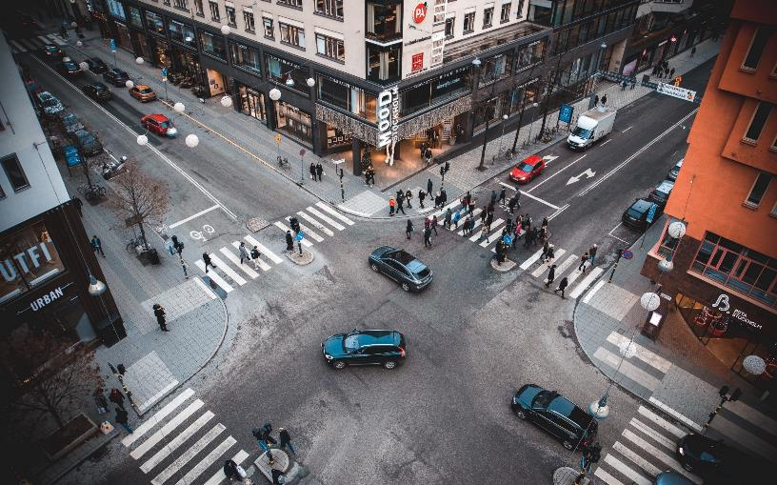
Why are they at risk?
Lack of protection and the inability to withstand forces when hit
Notes:
Pedestrians are one of our most vulnerable road users due to the lack of protection and the inability to withstand forces when hit.

Slide 4
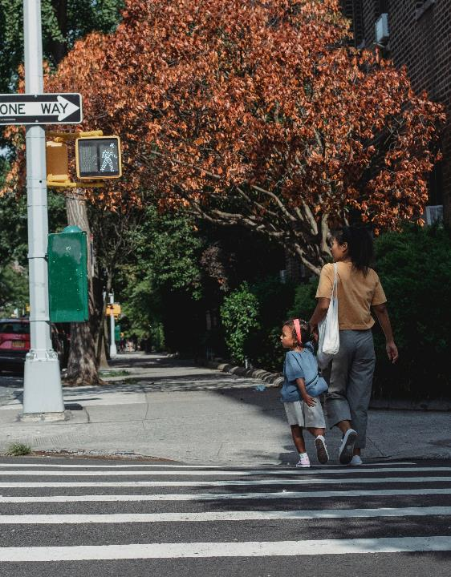
2020
- A pedestrian was killed every 81 minutes
- 6,516 pedestrians killed in traffic crashes
Notes:
According to NHTSA data, in 2019 most pedestrian traffic deaths occurred in urban settings (82%), on the open road (73%) versus intersections (26%), and during dark lighting conditions (80%). The largest number of pedestrian deaths occur on Saturdays (1,042), and the majority of these deaths happen during dark lighting conditions (853)
https://injuryfacts.nsc.org/motor-vehicle/road-users/pedestrians/

Slide 5
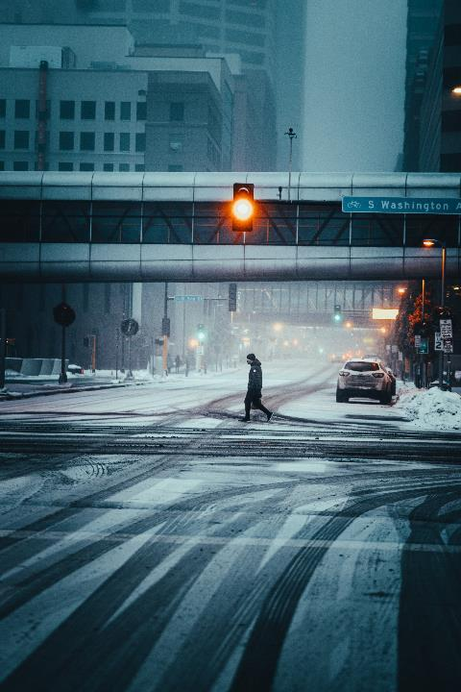
Where are they occurring?
- Most pedestrian traffic deaths occurred in urban settings (82%)
- On the open road (73%) versus intersections (26%)
- During dark lighting conditions (80%)
- The largest number of pedestrian deaths occur on Saturdays (1,042), and most of these deaths happen during dark lighting conditions (853)
Notes:
According to NHTSA data, in 2019 most pedestrian traffic deaths occurred in urban settings (82%), on the open road (73%) versus intersections (26%), and during dark lighting conditions (80%). The largest number of pedestrian deaths occur on Saturdays (1,042), and the majority of these deaths happen during dark lighting conditions (853)

Slide 6
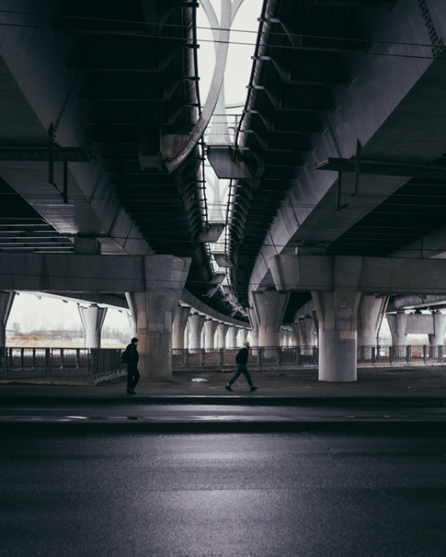
Including these places
- Driveways
- Parking lots
- Private Property
Notes:
The National Center for Health Statistics (NCHS) estimates 7,668 pedestrians died in traffic or non-traffic incidents in 2019. Non-traffic incidents occur on non-traffic ways such as driveways, parking lots, or other private property. The latest data from the National Highway Traffic Safety Administration (NHTSA) estimates that in 2019 6,205 pedestrians died in traffic crashes occurring on public roads.

Slide 7
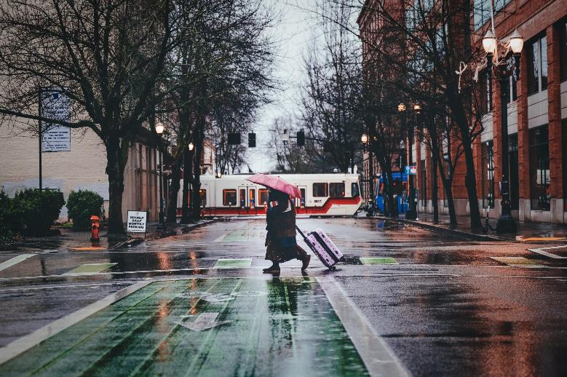
Pedestrians are hard to see

Slide 8
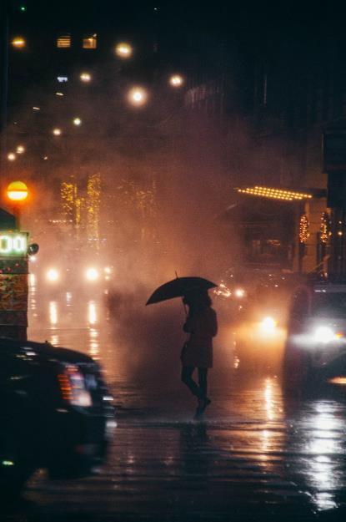
Pedestrians are hard to see

Slide 9
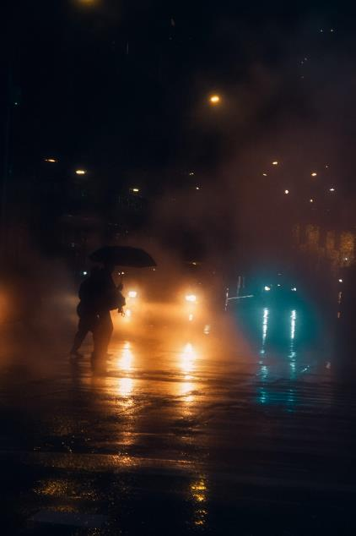
Pedestrians are hard to see
Video Link

Slide 10
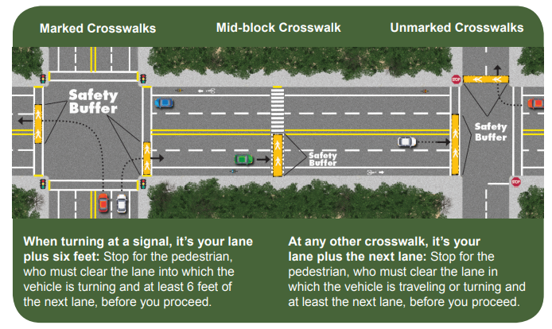
What is a Crosswalk?
Notes:
At any crosswalk – marked or unmarked – until people walking have cleared your lane, plus the lane next to you.
When turning at a traffic signal, until people crossing have cleared the lane you are turning into and at least six feet of the next lane.
In school zones, as directed by crossing guards.
For people who are blind (using a white cane or a guide dog), until they are completely across the roadway.

Slide 11
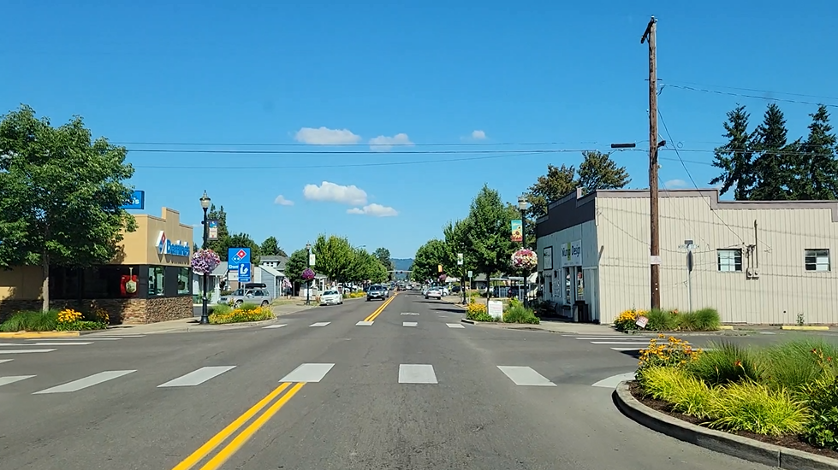

Slide 12
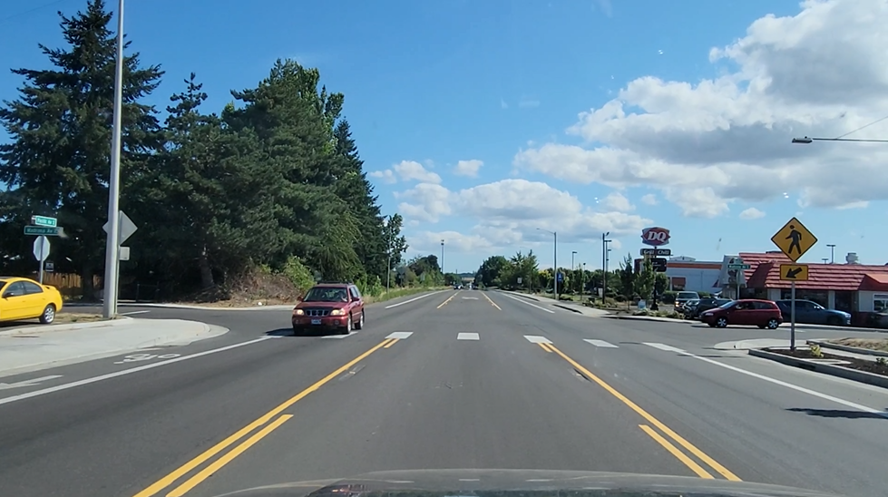

Slide 13
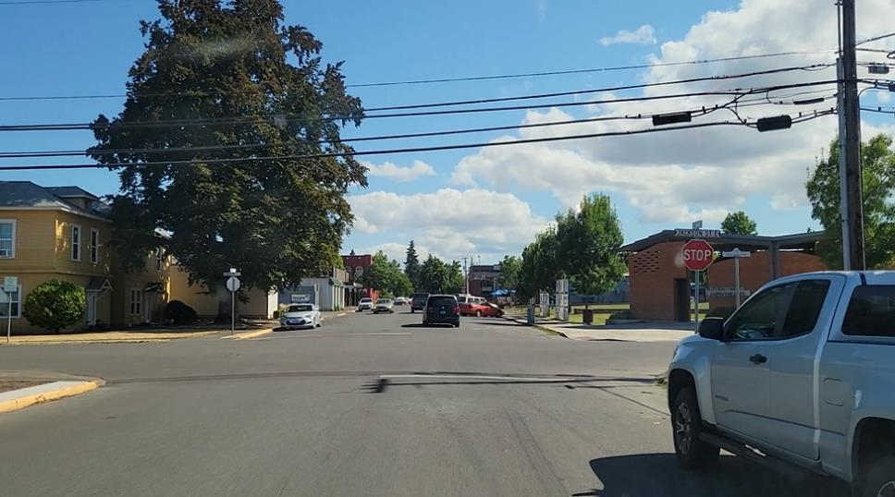

Slide 14
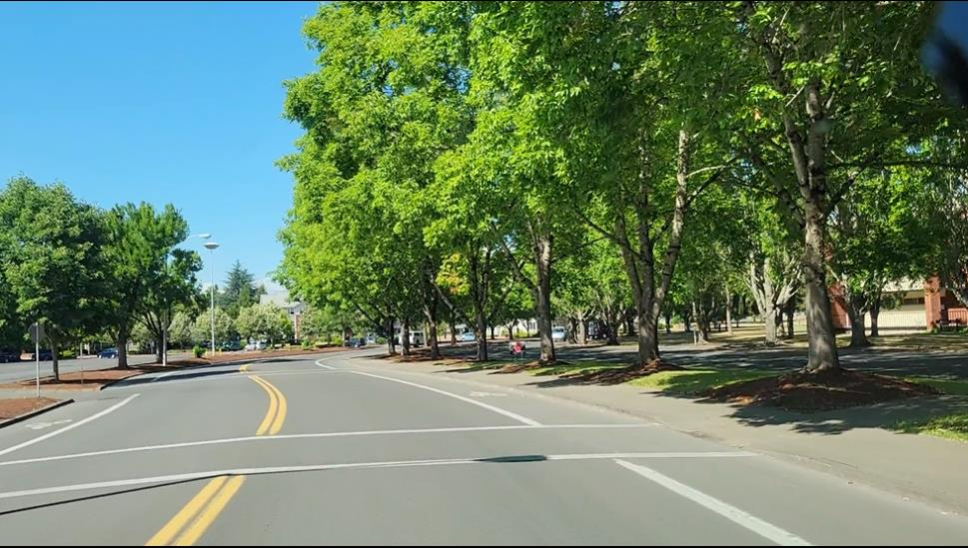

Slide 15
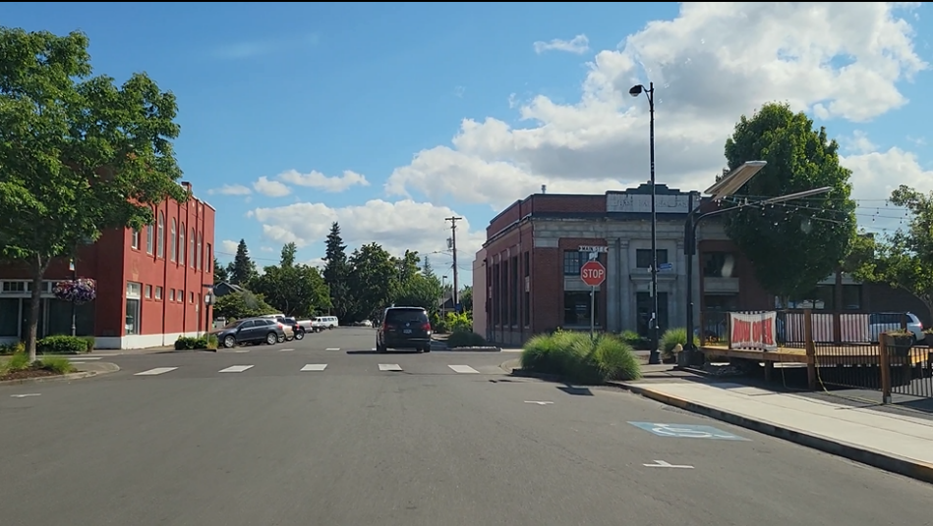

Slide 16
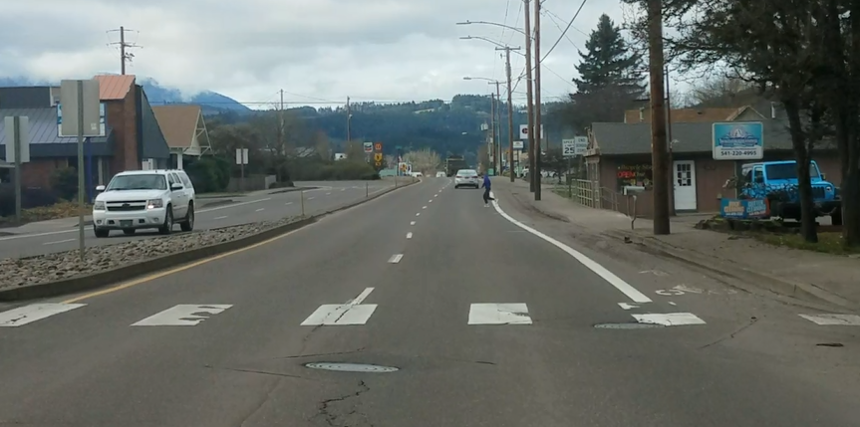

Slide 17
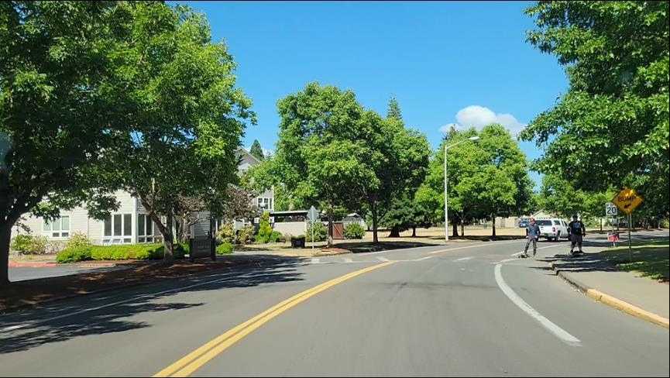
Interacting with Pedestrians

Slide 18
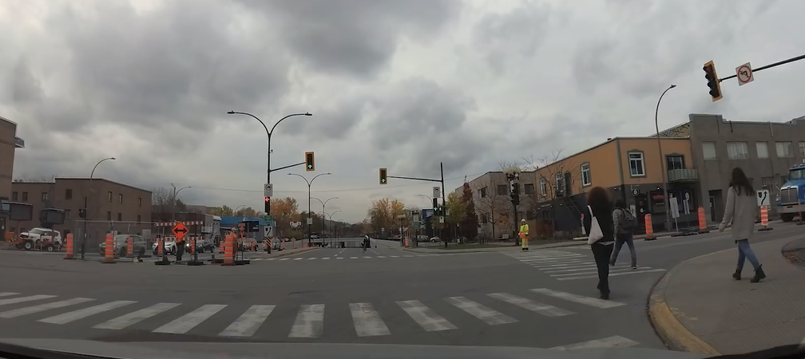
Turning Right

Slide 19
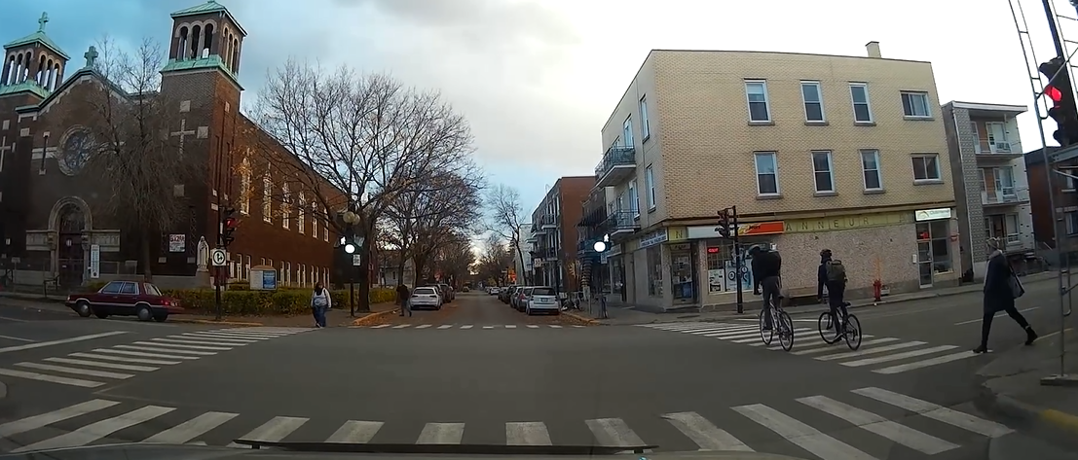
Turning Left

Slide 20
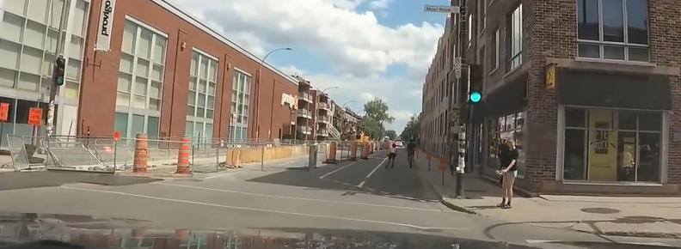

Slide 21
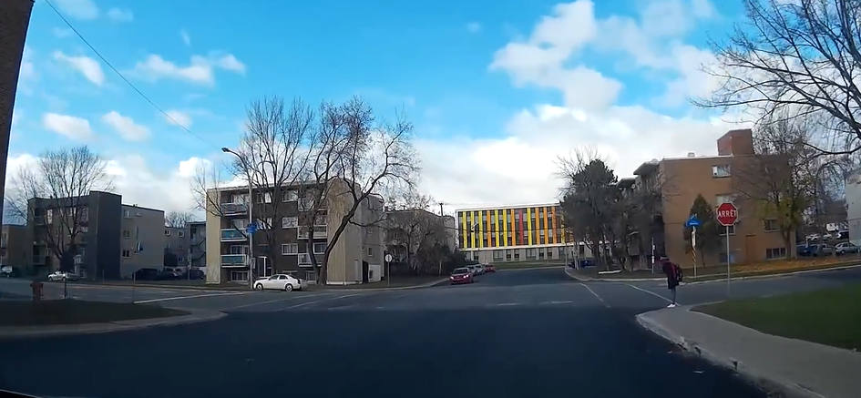

Slide 22
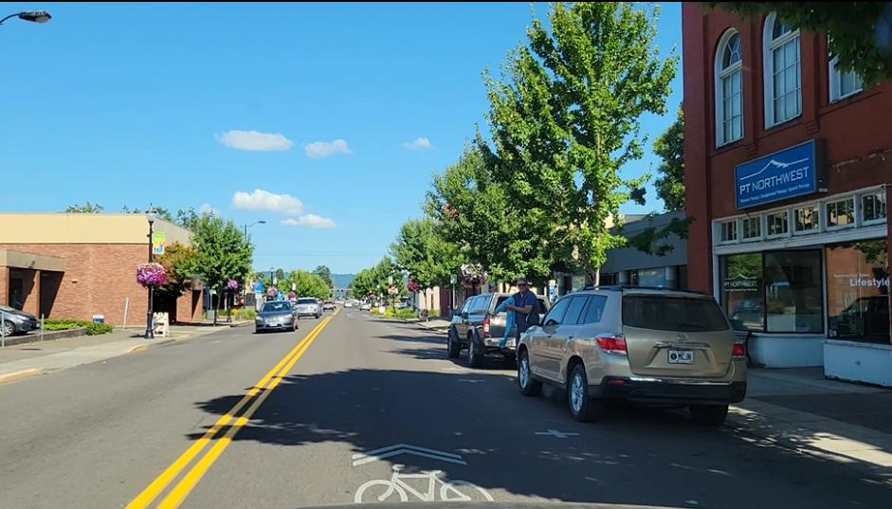

Slide 23
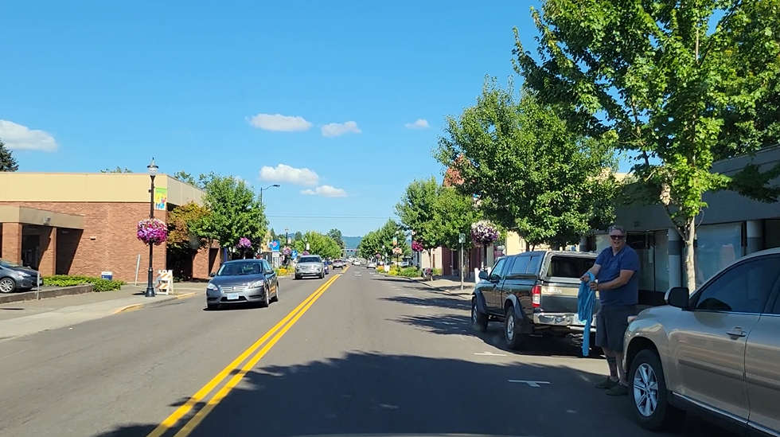

Slide 24
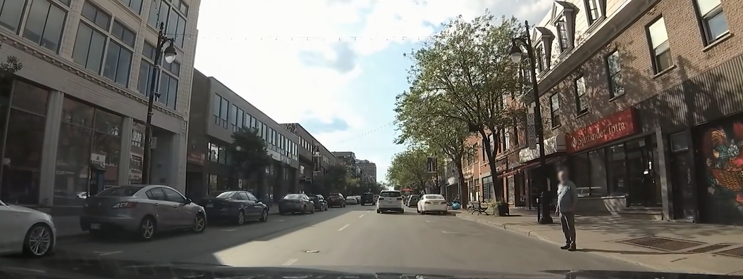

Slide 25
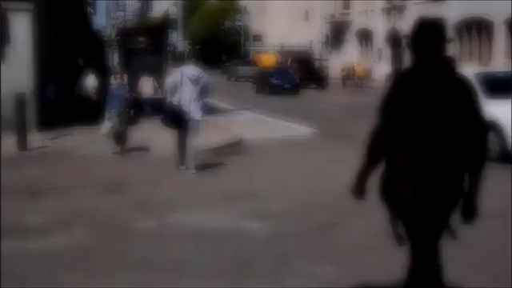
When do I stop?
Video Link
Notes:
By law, a pedestrian is in a crosswalk when any part of the pedestrian moves into the roadway, at a crosswalk, with the intent to proceed.
That includes not only the pedestrian’s body, but also a wheelchair, cane, crutch, bicycle or any other extension of the person.

Slide 26
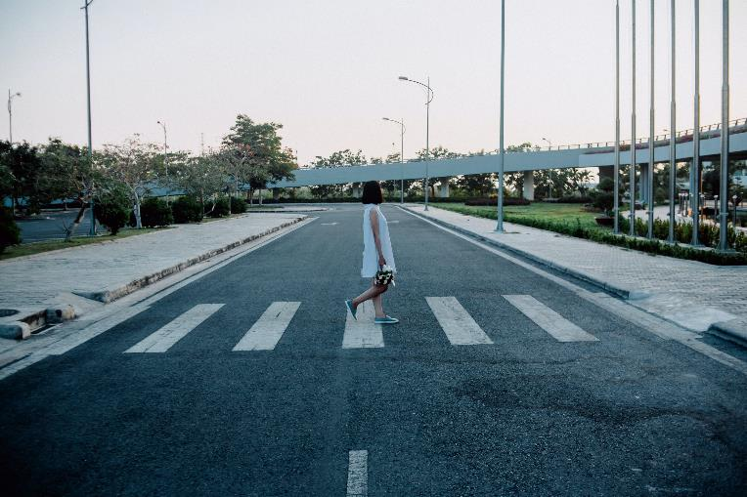
Search effectively
Notes:
Even when searching effectively they can still be hard to see

