Slide 1
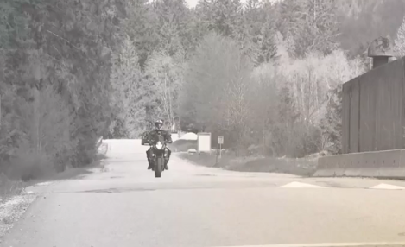
Motorcycles

Slide 2
Motorcycles Are Hard To See
Video Link
When a crash occurs between a motorcycle and another vehicle.
The driver often says “I did not see the motorcycle”

Slide 3
Video
Notes:
Reproduced with permission from the State of Wisconsin

Slide 4
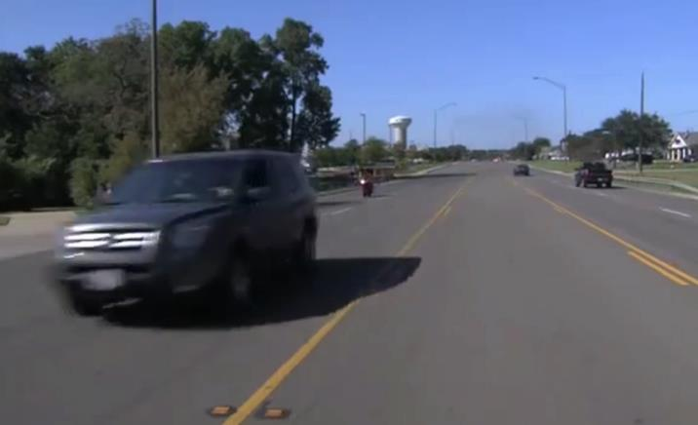
Collisions are more likely to occur when:
The other vehicle is turning left.
A motorcyclist is riding in blind spots.
Conditions of the roadway reduce traction.
A motorcyclist is forced to take an unexpected action.
Larger vehicles block motorcyclists from the driver’s view.

Slide 5
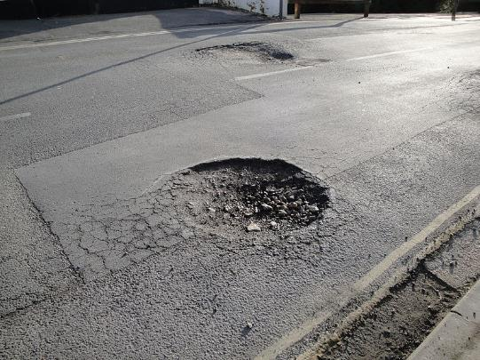
Roads conditions affect motorcycles more than vehicles
Potholes
Wet pavement
Objects on the road
Animals
Gravel
Edge breaks – when two traffic lanes are different heights
Expansion joints – connects two sections of road together
Open bridge joints – holds sections of a bridge together
Slick surfaces – leaves, trolley tracks, crosswalk lines, painted surfaces
Standing water
Debris
Notes:
Source-https://www.frayneaccidentinjurylaw.com/blog/common-motorcycle-accidents/

Slide 6
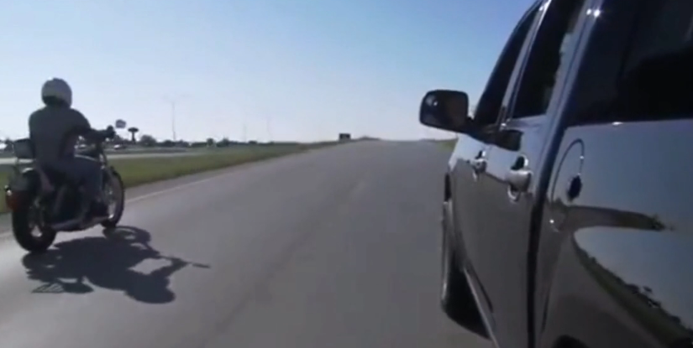
Safety Around Motorcycles
Video Link

Slide 7
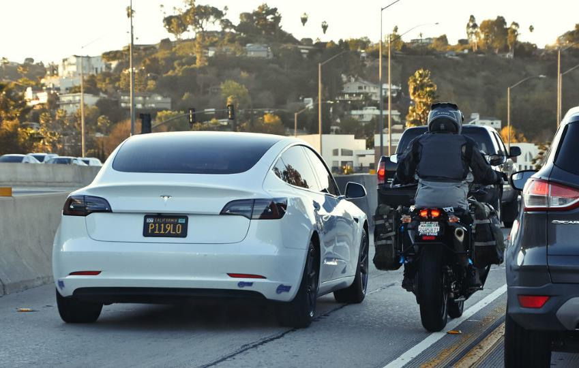
Lane splitting
Not allowed in Oregon and most other states.
Watch for motorcycles that do this, especially in slow or stopped traffic on multi lane roads.
Notes:
Lane splitting is when motorcyclists drive between slow or stopped traffic.

Slide 8
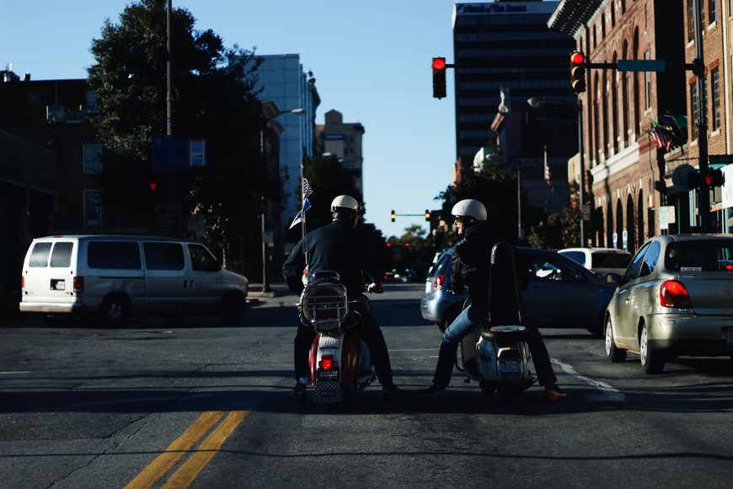
Red Light Law
Notes:
Oregon's Red Light Law
After coming to a stop, if a traffic light controlled by a vehicle sensor fails to detect the motorcycle after waiting one full cycle of the light, the rider may proceed with caution, yielding to other vehicles.

Slide 9
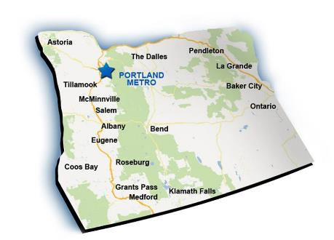
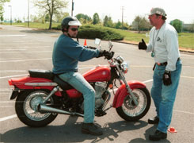
Team Oregon Motorcycle Riding Course
You must have a valid driver’s license and motorcycle endorsement, or motorcycle instruction permit to ride a motorcycle in Oregon.
State law requires that all new riders take an approved training course to earn a motorcycle endorsement.
http://team-oregon.org//

