Slide 1
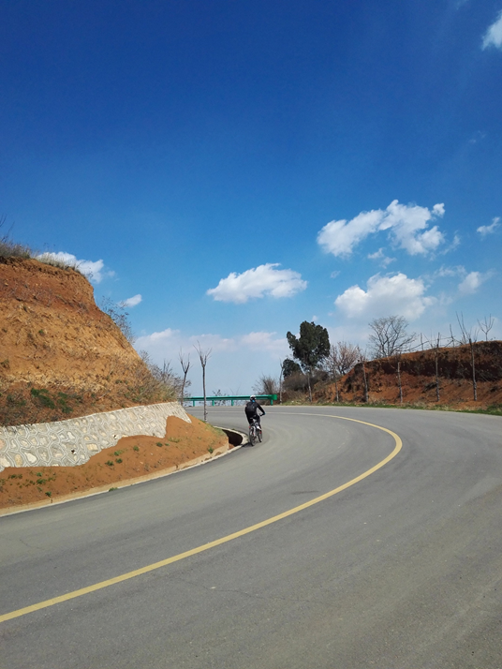
Curves and Hills

Slide 2
Every curve is a path restriction
Notes:
See curves as a closed space

Slide 3
Your vision is blocked

Slide 4
Why are curves high risk?
Speed
Visibility
Road design
(radius/slope)
Road conditions

Slide 5
Why are curves high risk?
Tire condition
Vehicle- type, weight, height and load
Oncoming traffic
Laws of physics
(inertia/momentum)
Driver expectations

Slide 6
Momentum, Balance and Traction
Video Link

Slide 7
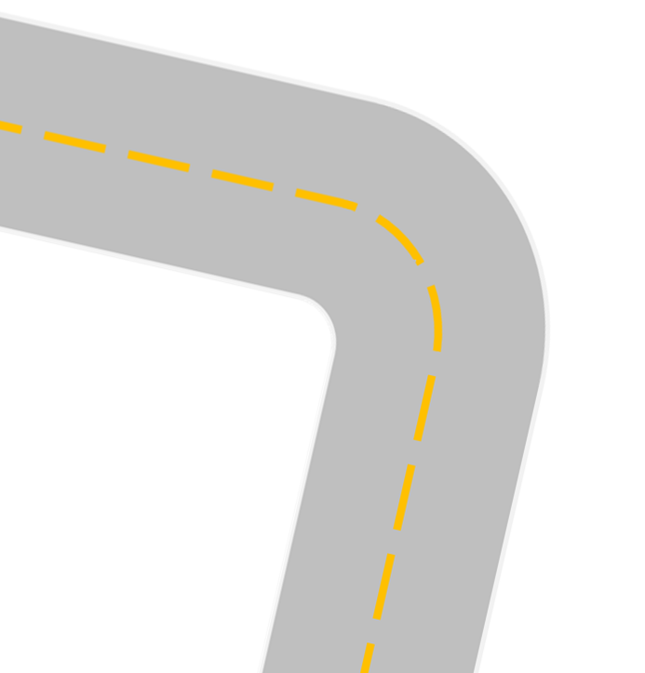
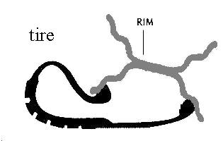
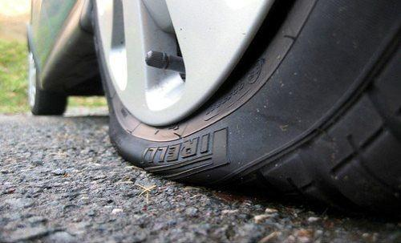
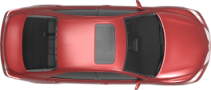
Actual Path
Inertia - Momentum
Excessive speed and steering into the turn affects vehicle balance - roll force deforms right front tire and causes changes in tire pressure and traction!
Desired Path
Tire with
low pressure
Tire patch changes and rim may touch or dig into the road surface.

Slide 8
Camber
Positive Camber or Bank: The outside edge of lane is higher than the inside edge of lane.
What will happen to the car as you travel the curve to the right?
Negative Camber or Bank: The outside edge of lane is lower than the inside edge of lane.
What will happen to the car as you travel the curve to the right? Why should you drive more slowly on this curve?
Notes:
Positive Camber- Weight will go towards the direction of the curve, making it easier to navigate the curve.
Negative Camber- Weight will go towards the opposite direction of the curve, making it harder to navigate the curve.

Slide 9
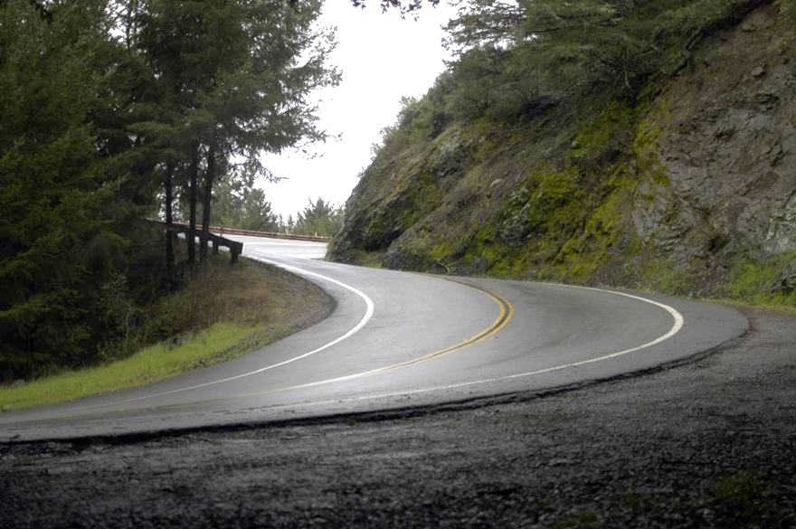
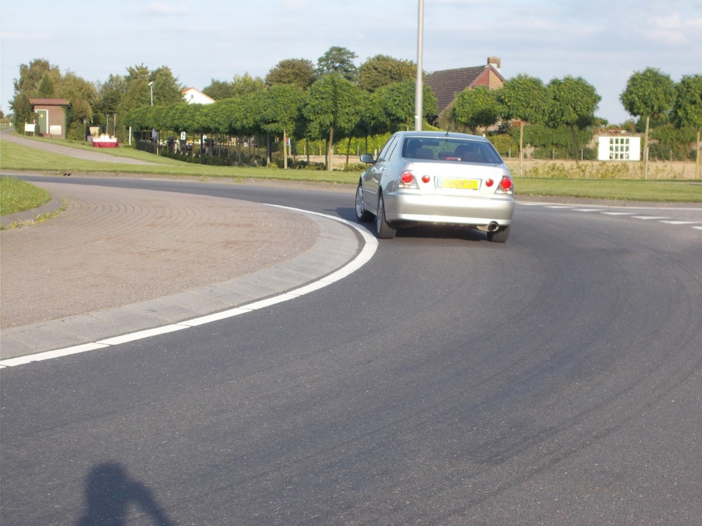
Camber
Positive Camber
Negative Camber

Slide 10
Risks from vehicle
Length
Height
Width
Weight
Velocity
Type of Tires
Condition of Tread
Center of Gravity
Tire Inflation
Load Distribution
And More!

Slide 11
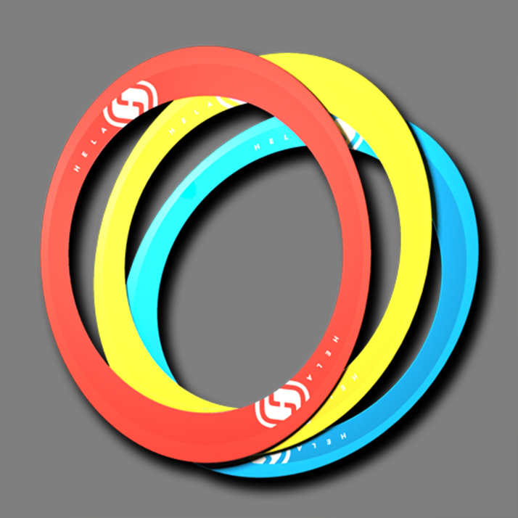
Activity
Notes:
Steering wheel activity- See 7.1- Curves and Hills Activity Directions

Slide 12
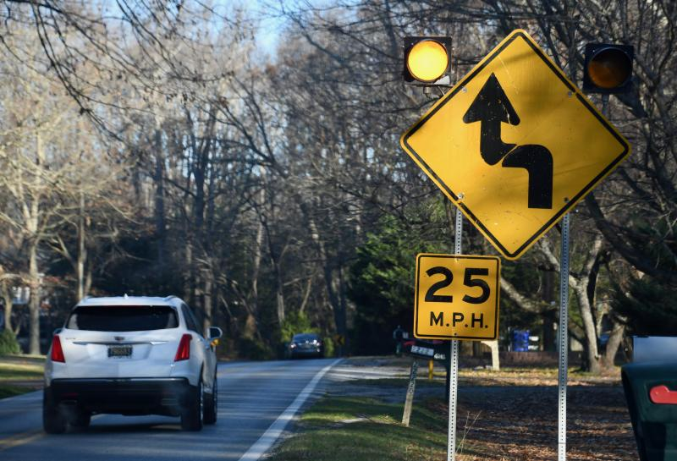
How to Manage Curves Safely
Check the rear
Follow speed signs
Reduce speed before entering the curve
Vision Use
Notes:
Follow the posted speed signs
Remind to target on approach-look through the curve and target on exit

Slide 13
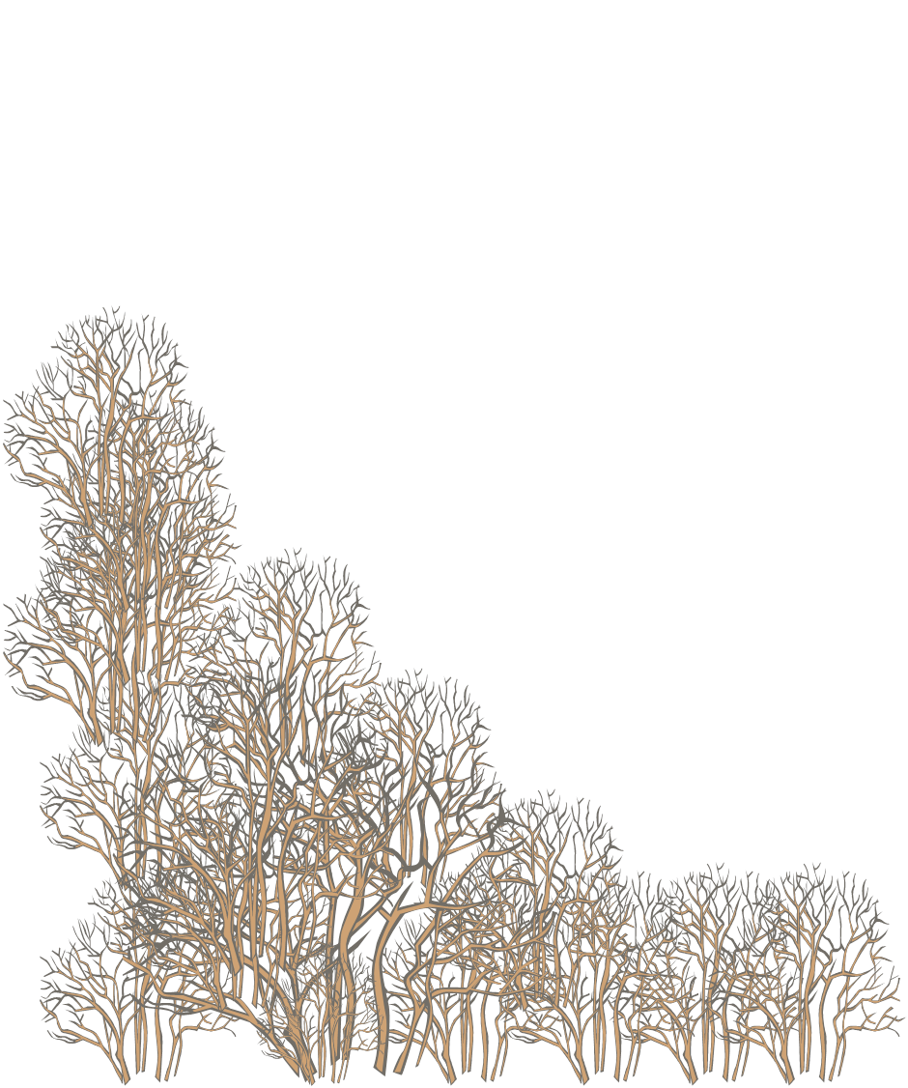
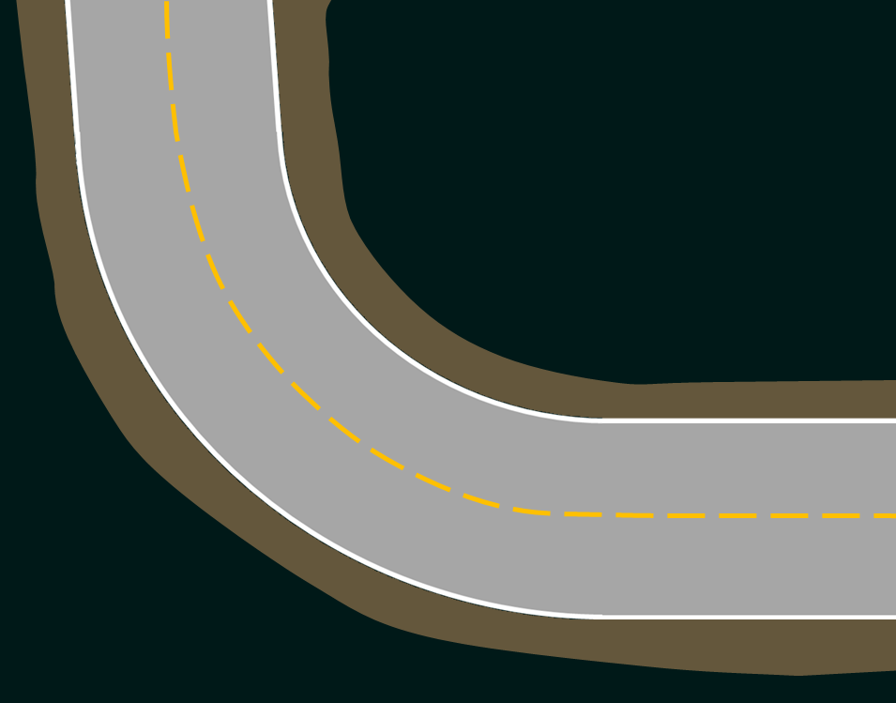
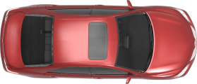
1
Right Curve
2
Notes:
If no oncoming traffic move to LP 2 to see through the curve
With oncoming traffic stay in LP1

Slide 14
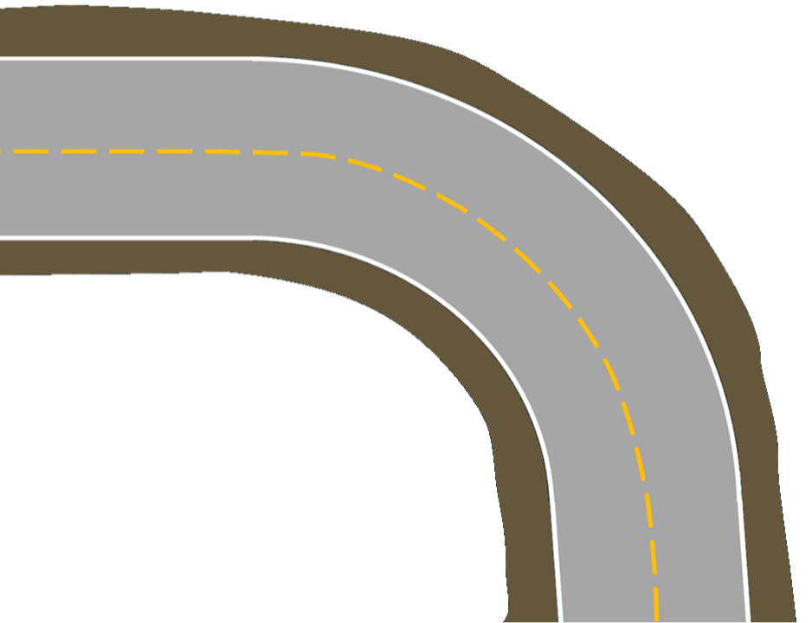
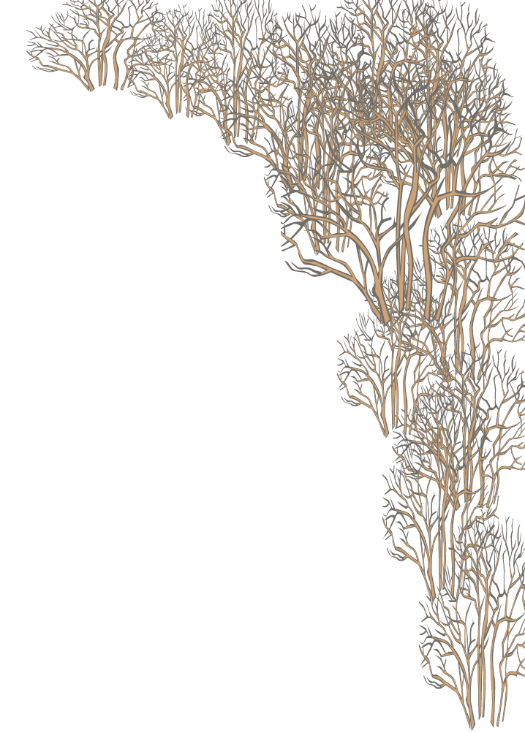
1
1
Left Curve
3
Notes:
If no oncoming traffic move to LP 3 to see through the curve
With oncoming traffic stay in LP1

Slide 15
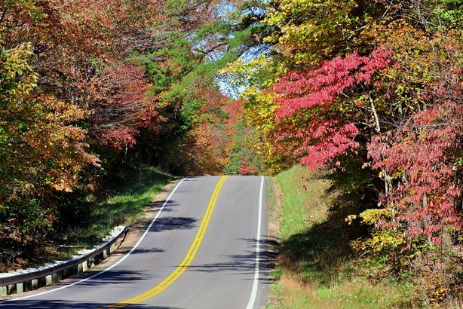
Approaching Hills
Sight
Oncoming traffic
Speed control up and down
Look over hillcrest
Lane position 1

