Slide 1
Skids
Causes, Detection and Correction
Video

Slide 2
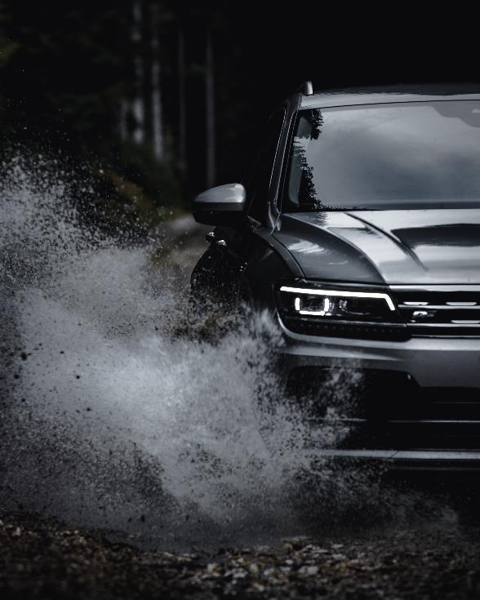
3 Types of Skids
Loss of Traction to:
Front Wheels
Rear Wheels
All Wheels

Slide 3
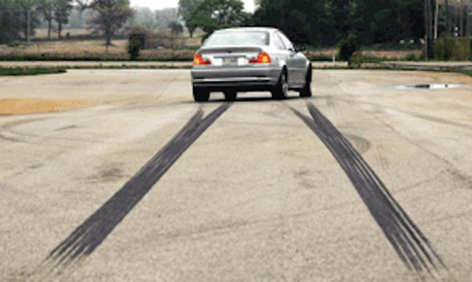
Front Wheel Skid: Steering Loss
Causes
Brakes applied to the point of wheel lock-up
- ABS provides some steering but stopping distance increases
Excessive speed to negotiate a turn or a curve
Corrections
Look and steer to the target
Off the brake - regain traction

Slide 4
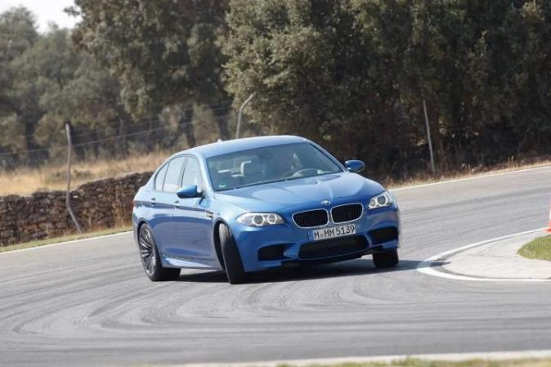
Rear Wheel Skid: Off-Target Yaw
Causes
Hard acceleration or braking changes pitch forces and traction adhesion
Excessive speed when approaching a curve
Corrections
Look and steer to the target
Off brake and gas

Slide 5
All Wheel Skid
Video
Causes:
Excessive speed while going into a curve causes a change in the roll force
Excessive speed and a slick surface

Slide 6
How to Drive Out of a Skid
When in a skid, take your foot off the brake or accelerator
Look and steer in the direction you want your car to go
Be careful not to oversteer
If you are on ice and skidding in a straight line, shift to neutral or step on the clutch
Slow down and be careful when you brake, change lanes or make turns
Leave plenty of space between you and the vehicle ahead

Slide 7
Detection and Correction
Video Link

