Slide 1
Reference Points, Blind Areas and Transition Points

Slide 2
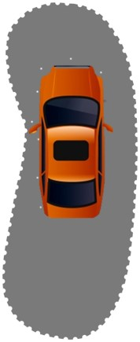
Blind Areas
Even properly adjusted mirrors do not allow you to see the ground around your vehicle. The areas that are not visible in the mirrors are called blind areas.

Slide 3
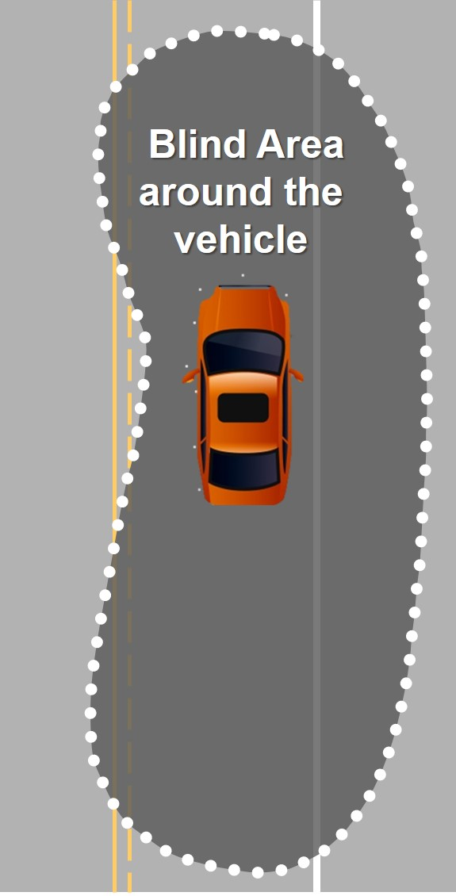
The body of the car blocks your view of the surrounding roadway
You cannot see the actual position of the car
Notes:
Like the shape of a kidney bean

Slide 4
Line of Vision Blind Area
Blind areas create an optical illusion that makes the vehicle seem larger than it really is.
Reference Points help you place your vehicle in the correct position.

Slide 5
Standard Blind Areas
One car length to the front
Two + car lengths to the rear
Notes:
Newer cars are going to be than 2 car lengths. With the middle brake light and the center seat in the back having head restraints, longer it creates more line-of-sight blockages

Slide 6
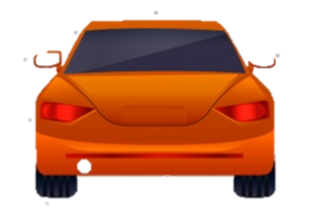
Standard Blind Areas
Left side - half a car width
Right side - two car widths

Slide 7
Standard Blind Areas
One car length to the front
Two car lengths to the rear
Half a car width to the left
Two car widths to the right
Discover the size of the blind area around your car.
Notes:
This assignment may be an in class activity or homework

Slide 8
Reference Points

Slide 9
Notes:
For Left Side Position- Answer on next slide

Slide 12
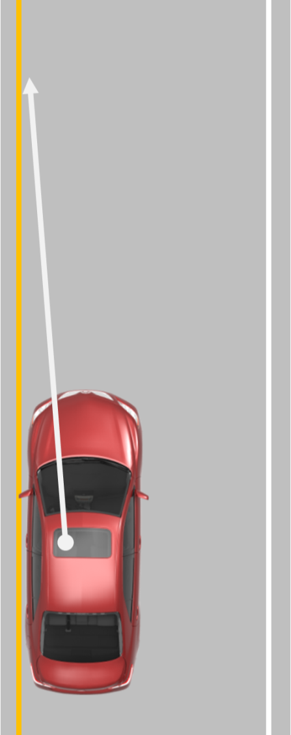
Left Side Position
Standard Reference Point:
1 foot in from the left front corner of hood
Used for…
Lane Position 2
Side position for approaching left turns (no oncoming traffic)
Parking on the left

Slide 13
Notes:
For Right Side Position- Answer on next slide

Slide 16
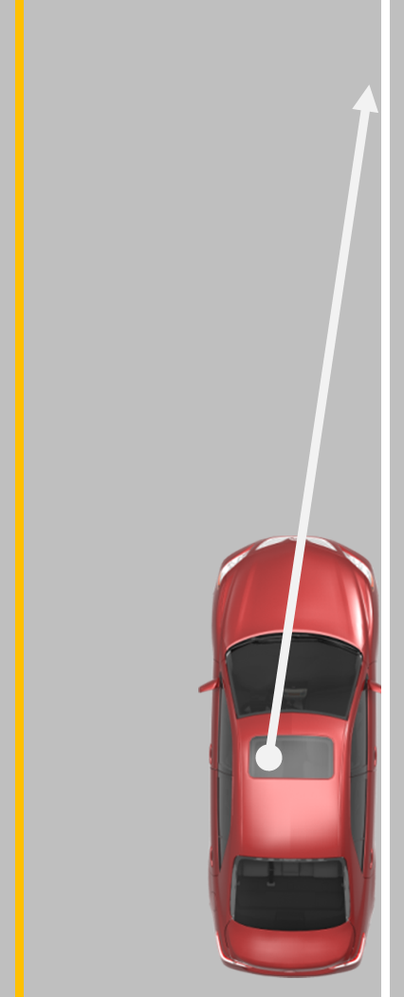
Right Side Position
Standard Reference Point:
The center of the hood
Used for…
Lane Position 3
Parking on the right

Slide 17
Notes:
For Side Position 3- Answer on next slide

Slide 20
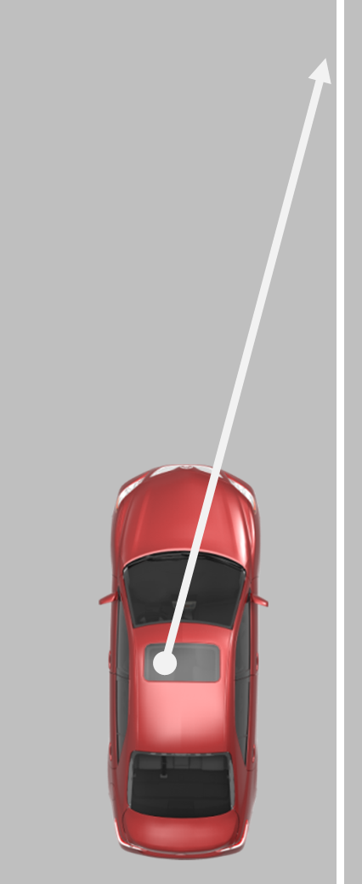
Side Position 3
Standard Reference Point:
Middle of the right half of the hood
Used for…
Approaching a right turn when a bike lane is not present.
Back-in parking
Parallel parking

Slide 21
Notes:
For Side Position 6- Answer on next slide

Slide 22
Notes:
This reference point will be used for forward angle and perpendicular parking

Slide 24
Side Position 6
Standard Reference Point:
Right edge of the hood
Used for…
Approaching angle and perpendicular parking

Slide 25
Notes:
For Forward Position- Answer on next slide

Slide 28
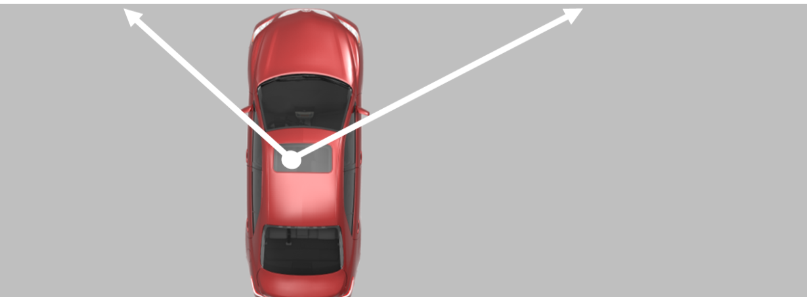
Forward position
Standard Reference Point:
Side mirror or corner post
Used for…
Used for stopping before crosswalks and stop lines; safety stops to get a clear line of sight without entering a traffic lane; and beginning sharp right turns

Slide 29
Notes:
View looking over driver’s right shoulder out the right rear side passenger window, behind the passenger seat. For Rear position- answer on next slide

Slide 31
Rear Position: Standard Reference Point:
1 foot behind the corner post or the middle of the rear passenger window
Notes:
View looking over driver’s left shoulder out the left rear side passenger window, behind the driver’s seat

Slide 32
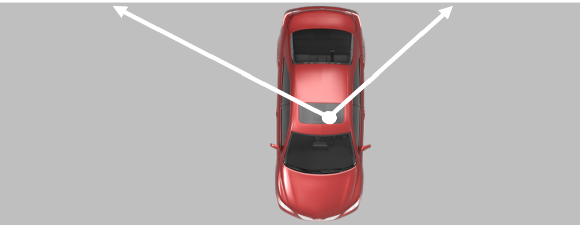
Rear position
Standard Reference Point:
1 foot behind the corner post or middle of rear passenger window
Used for…
Rear stop position

Slide 33
Standard Reference Points
Left Side Position – 1 foot in from the left front corner of hood
Right Side Position - The center of the hood
Side Position 3 - Middle of the right-half of the hood
Side Position 6 - Right edge of the hood
Forward Position - Side mirrors or corner post
Rear Position – 1 foot behind the corner post or the middle of the rear passenger window
Notes:
Remember these reference points are standard. They will move a little for some people. Style of car, eye dominance, height, and seating position are ways the reference points could slightly change

Slide 34
Eye Dominance Activity
Notes:
Rehearsal Activity:
Emphasize to Students: correct seating position, No raising of body, No closing an eye, No squinting. Conduct eye dominance activity to show how your eye dominance can affect what you see.

Slide 35
Transition Points
A Transition Point is a reference point used to change speed and or direction during turns

Slide 36
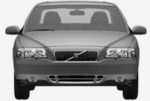
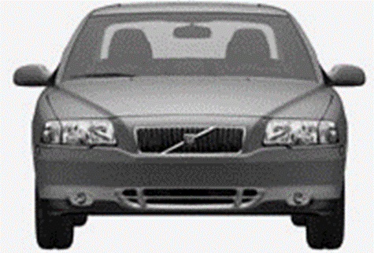
Transition Points
Left Turns
The Left Corner Post aligns with the target
Right Turns
Inside Rearview Mirror aligns with the target

Slide 37
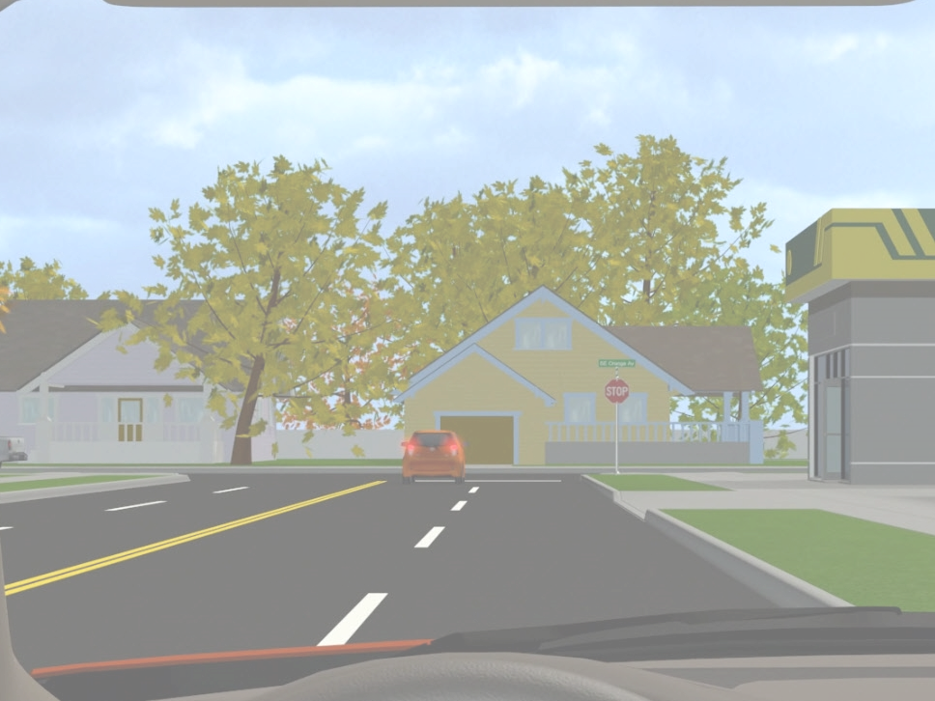
The Target helps you establish an accurate path.
The Target and the Transition Point together help you maintain that accurate path and keep your car balanced while turning (or driving through a curve).
Use them to know the precise time to make a change (transition) in steering, braking, and accelerating.

Slide 38
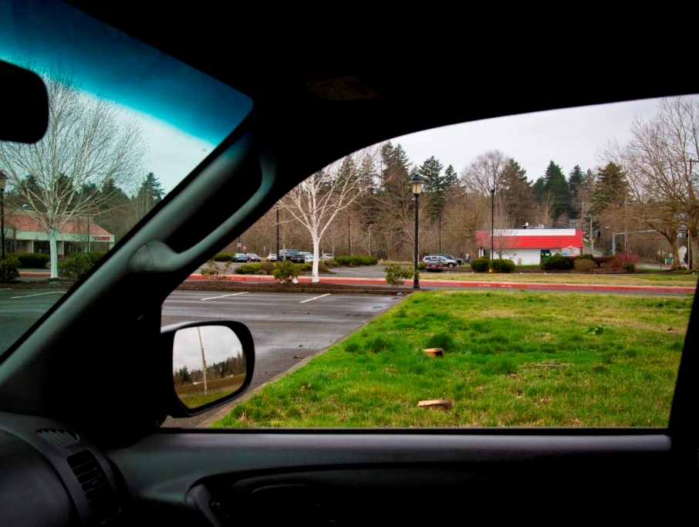
The tree is your target.
Turn your head to the target before turning the wheel.
Notes:
Use this slide to test student’s understanding of targets, transition points

Slide 39
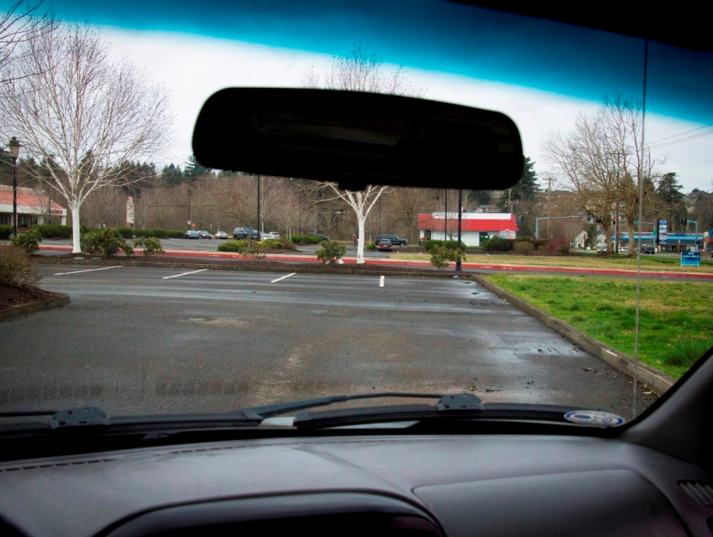
The target is in line with your inside mirror.
The car is at the transition point for making a right turn; this is the point to begin steering recovery actions.
Notes:
Use this slide to test student’s understanding of targets, transition points.

Slide 40
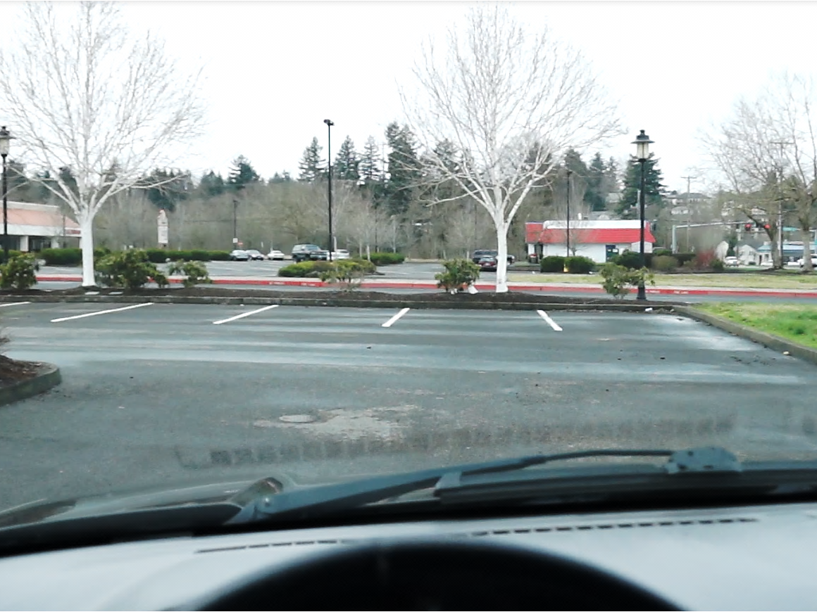
Is the car on or off target?
Is the turn complete?
Notes:
Use this slide to test student’s understanding of the on and off target concepts associated with completing a turn.

Slide 41
Off target. The turn is not complete.
Notes:
Use this slide to test student’s understanding of the on and off target concepts associated with completing a turn. Answer on next slide

Slide 42
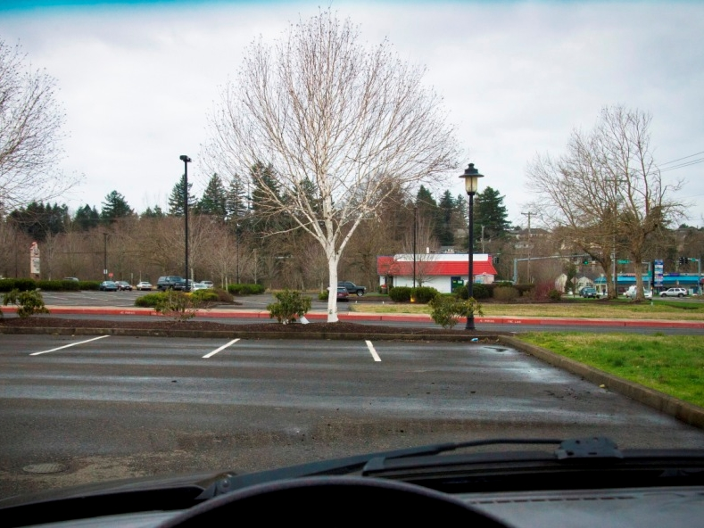
The vehicle is now
on target; the turn is
complete.

Slide 43
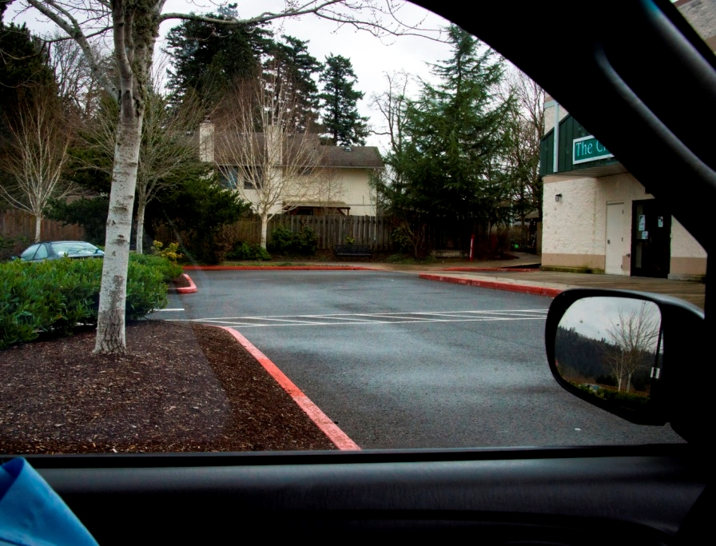
This tree is your target.
Which window are you aiming through?
Notes:
Use this slide to test student’s understanding of targets, transition points.

Slide 44
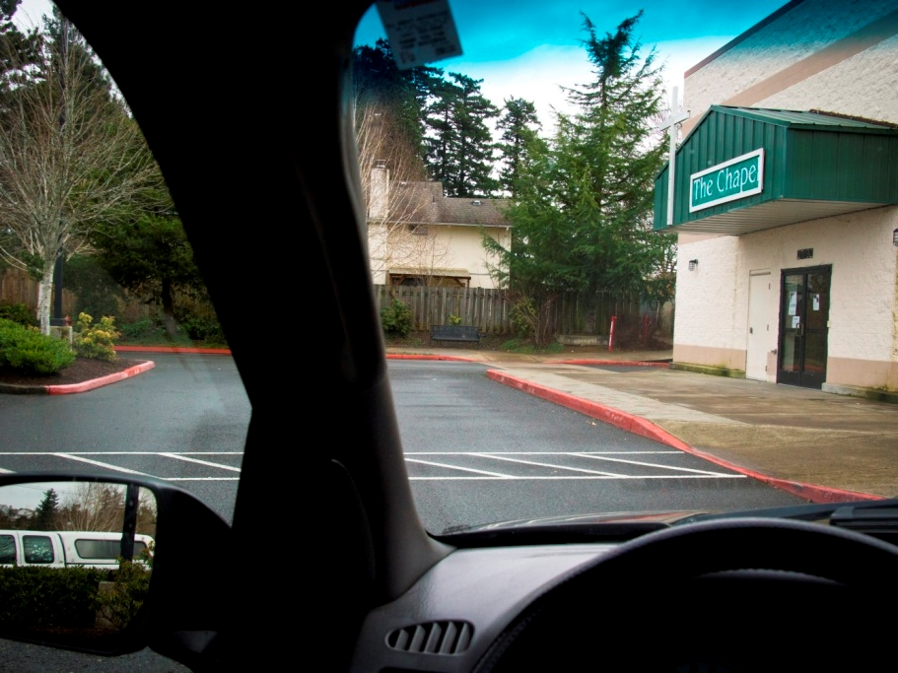
The left transition point is aligned with the target.
Notes:
Use this slide to test student’s understanding of targets, transition points.

Slide 45
What action should you take?
Notes:
Use this slide to test student’s understanding of targets, transition points.

Slide 46
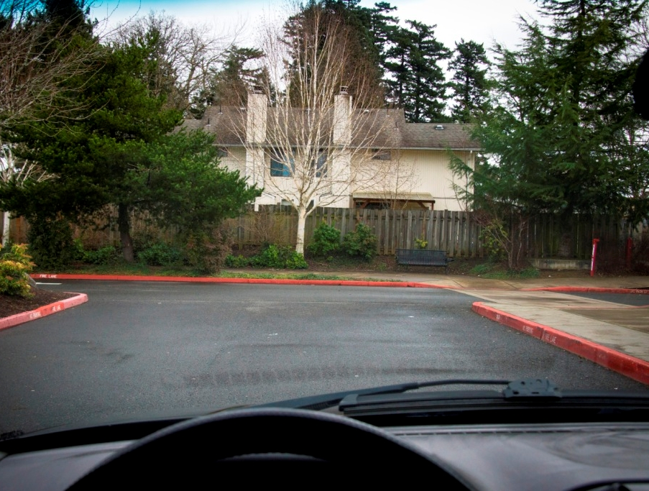
Is the car on or off target?
Off target
Notes:
Driver is off target because they failed to recover steering correctly

Slide 47
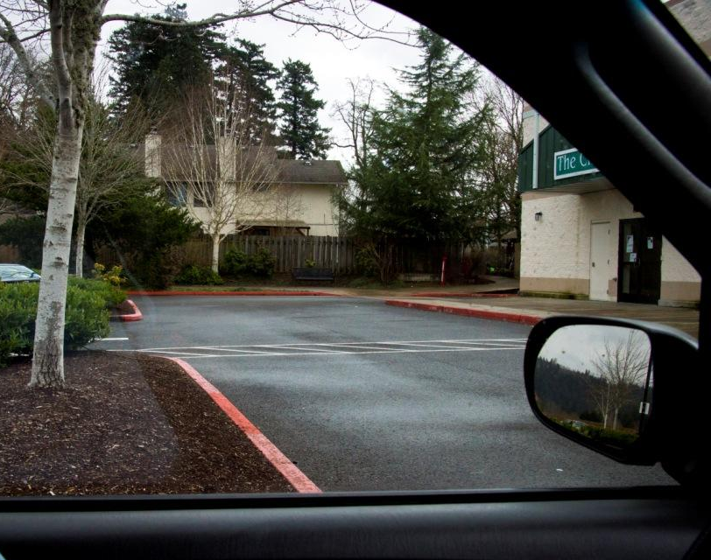
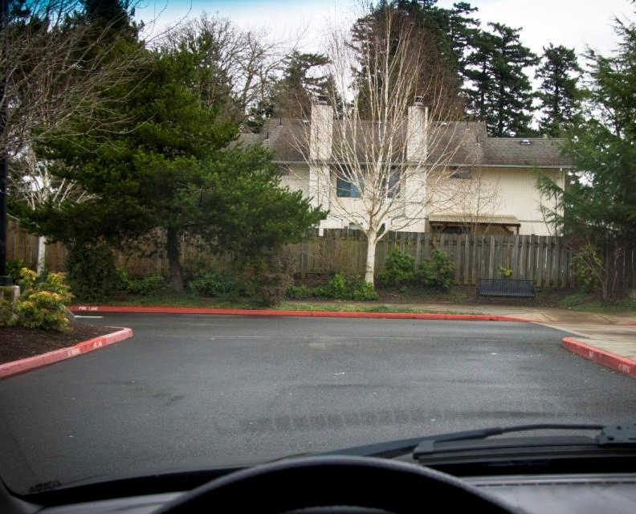
A.
B.
C.
Which photo shows the earliest stage of a turn being made? How can you tell?
Which photo shows the car on target? How can you tell?
Which photo shows the transition point for making a left turn? How can you tell?
Which photo shows the transition point for making a right turn? How can you tell?
D.
E.
Notes:
Use this slide to test student’s understanding of targets, transition points
Answers:
1. D
2. A
3. C
4. B

