Slide 1
On and Off Target
Vision and Steering Control

Slide 2
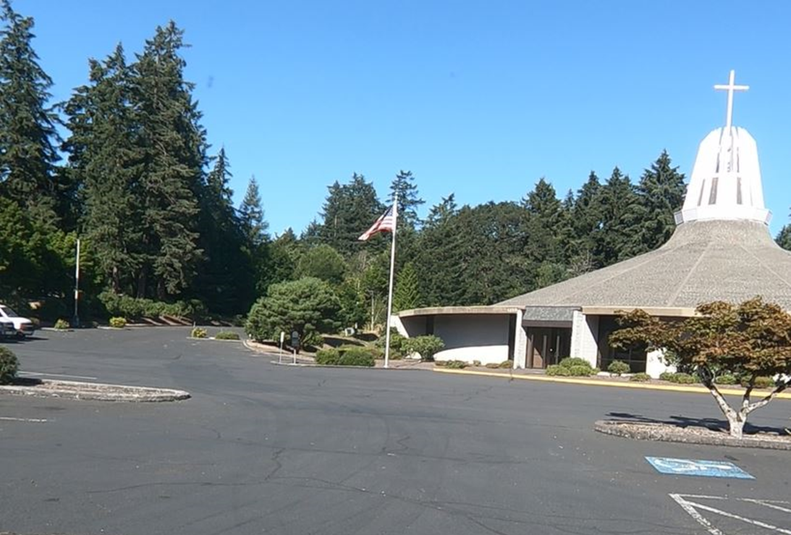
What is your target?

Slide 3
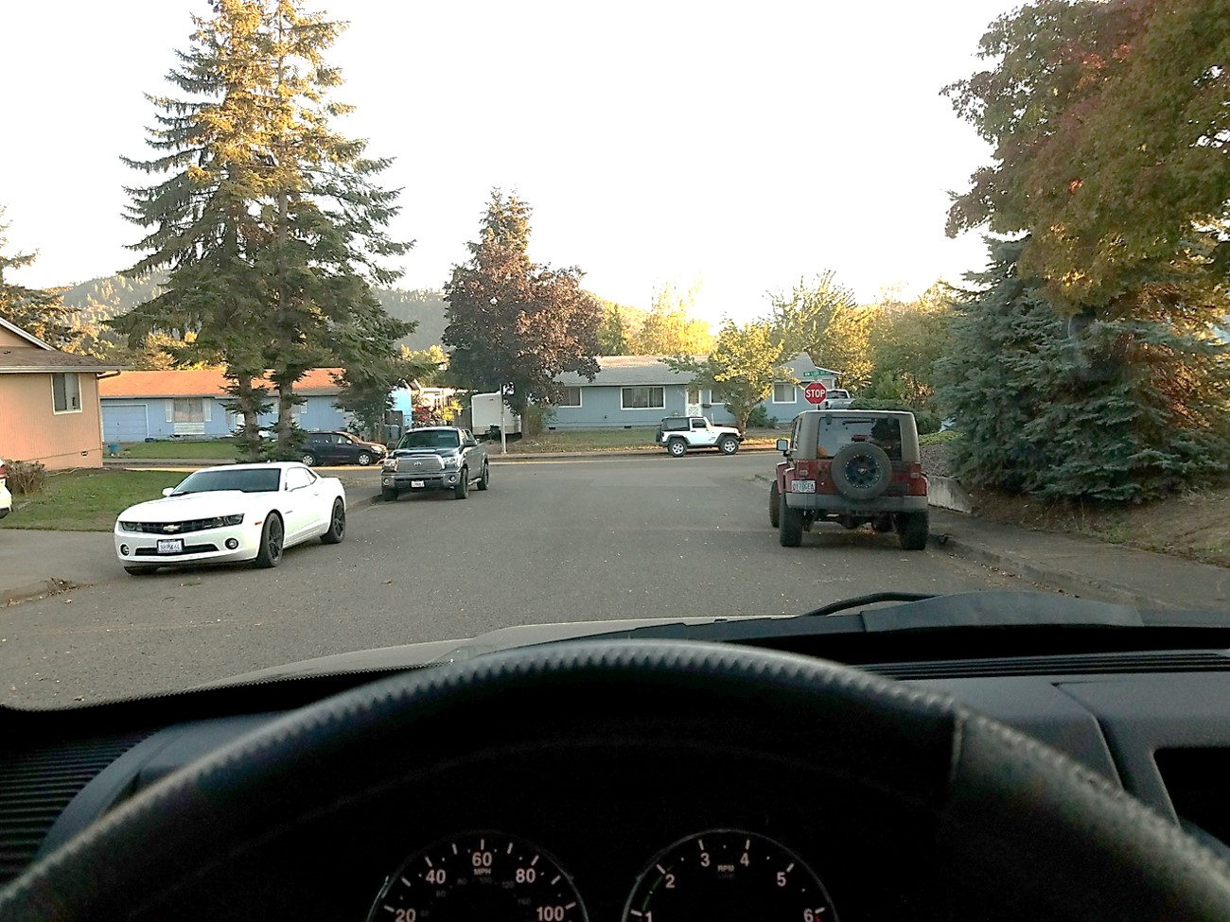
What is your target?

Slide 4
The left side of the window. The vehicle is on-target

Slide 5
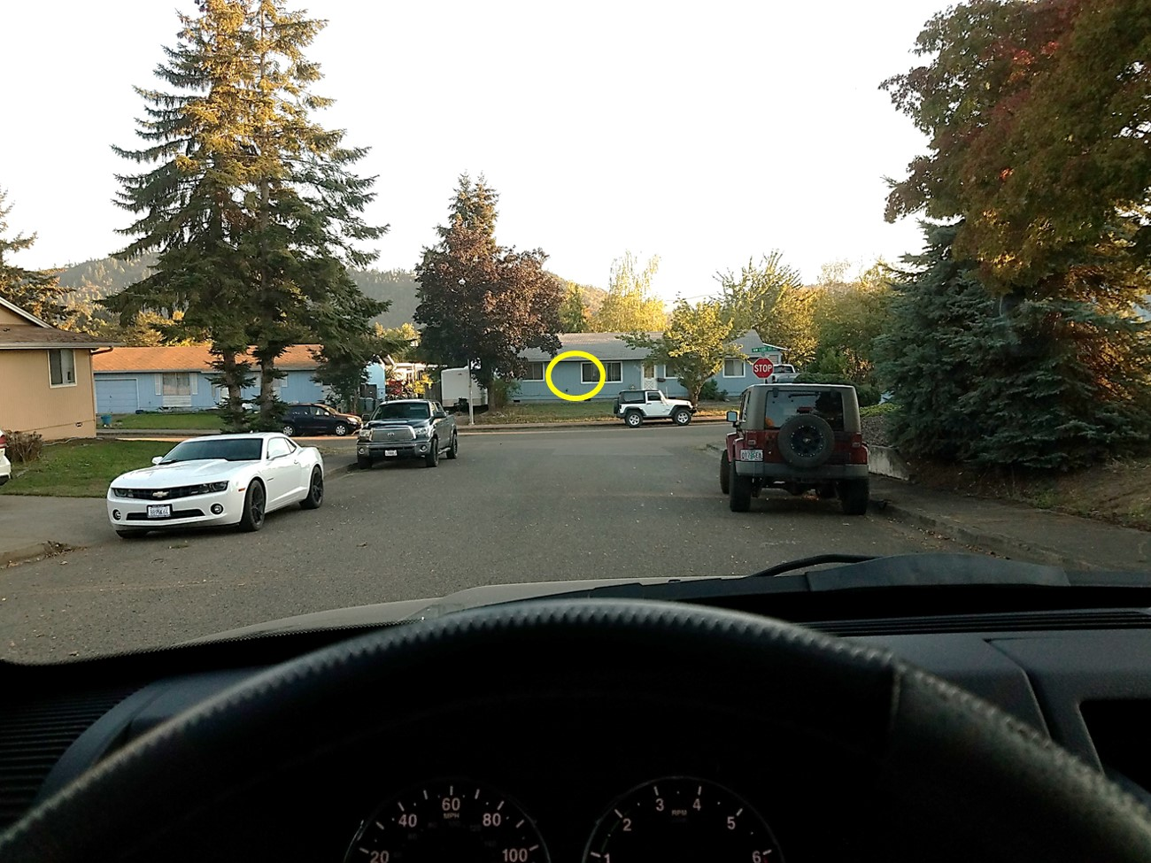
Your vision leads the vehicle. Look where you want the vehicle to go, then steer towards the target.

Slide 6
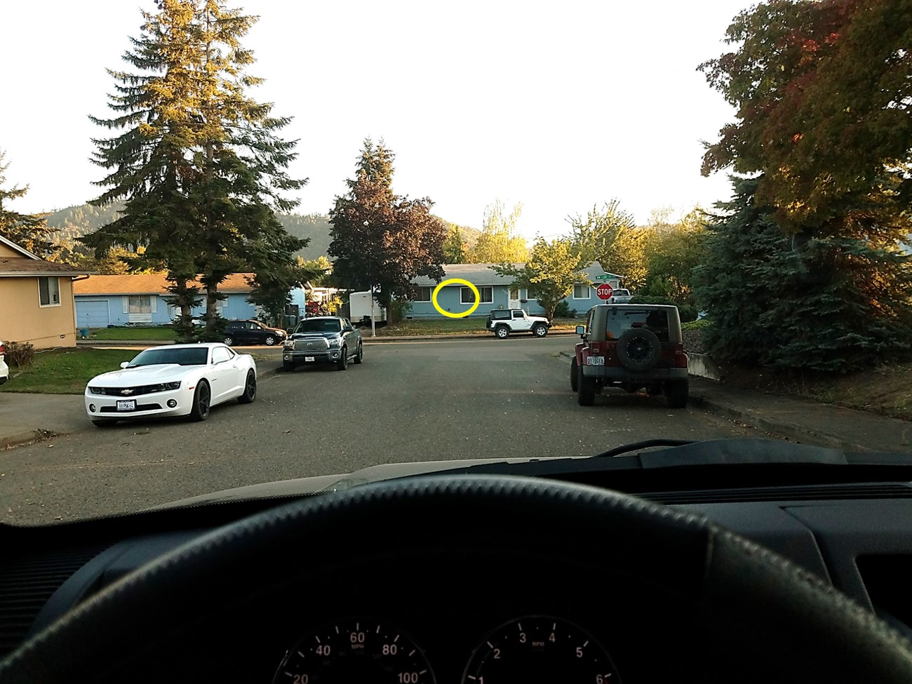
See the target with your central vision

Slide 7
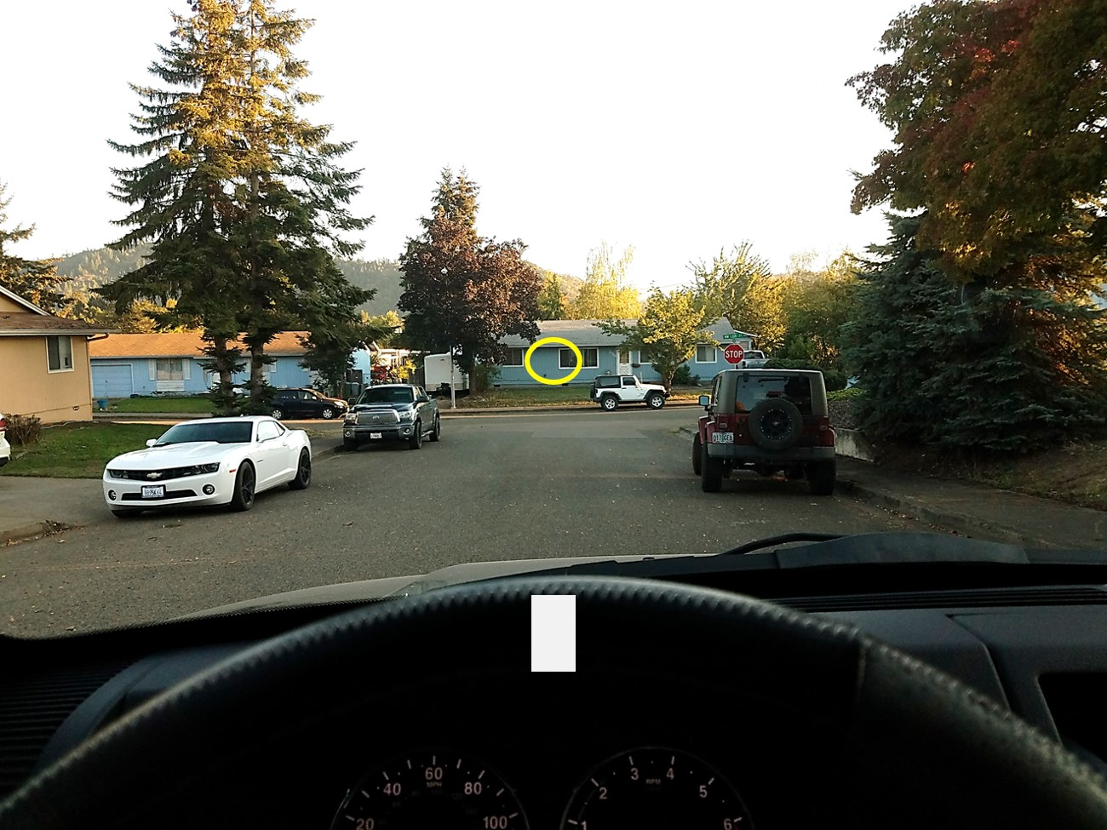
The top of the wheel aligns with the target

Slide 8
See the steering wheel with your fringe vision

Slide 9
What other elements can you see with your fringe vision?
Notes:
Other vehicles-stop sign-curb-road-houses

Slide 10
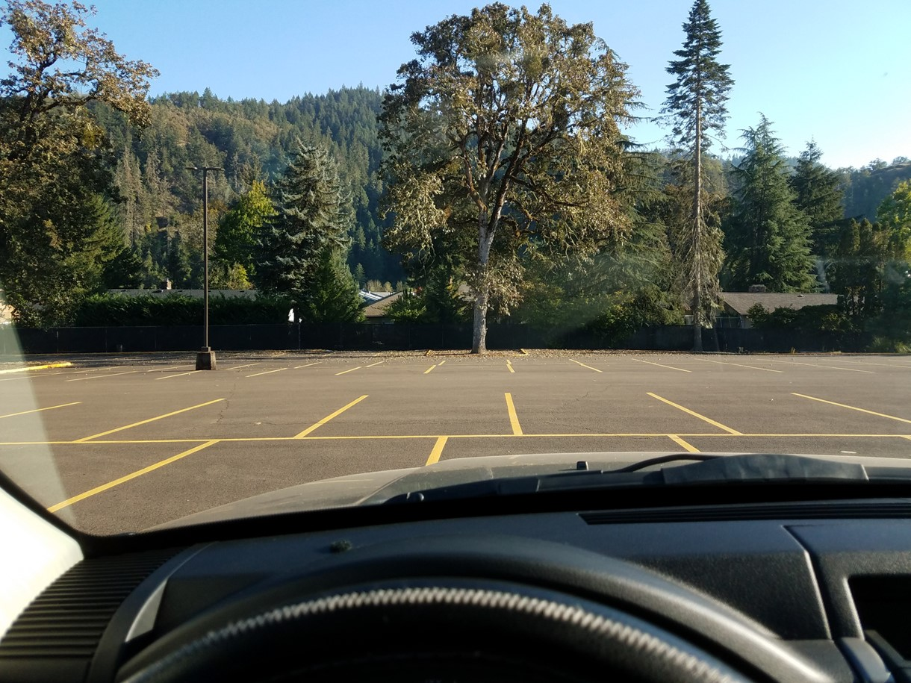
Is the vehicle on or off target?
Notes:
On target

Slide 11
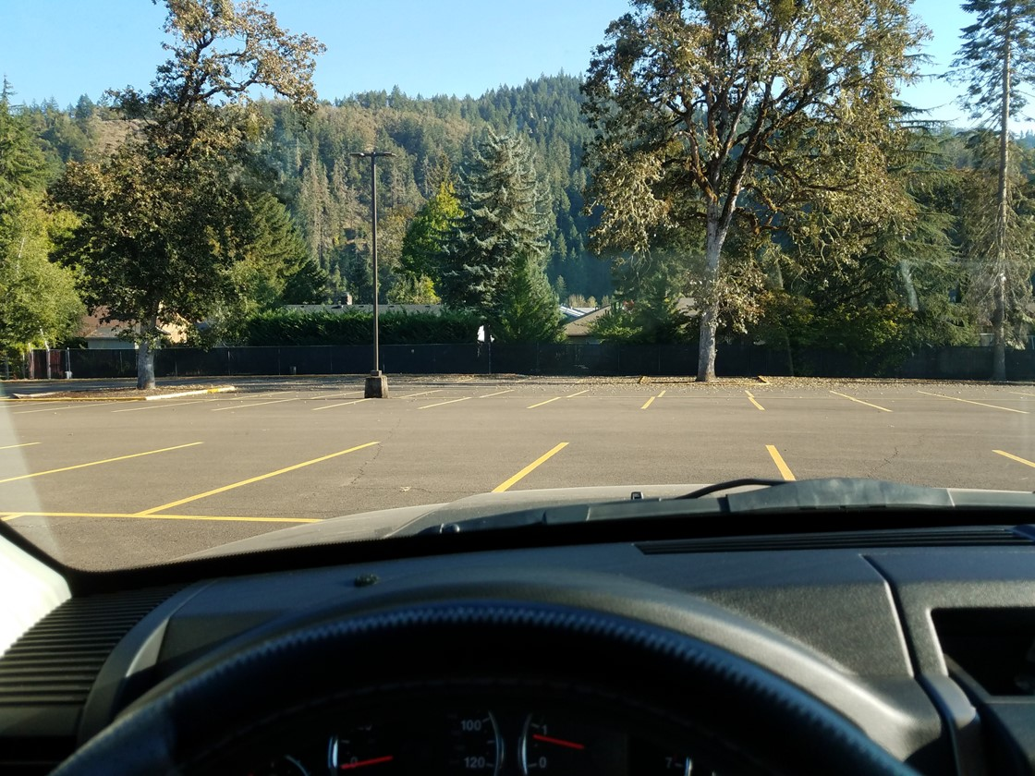
Where should you look and steer to get back on target?
Is the vehicle on or off target?
Notes:
Off target.
To the right, towards the target

Slide 12
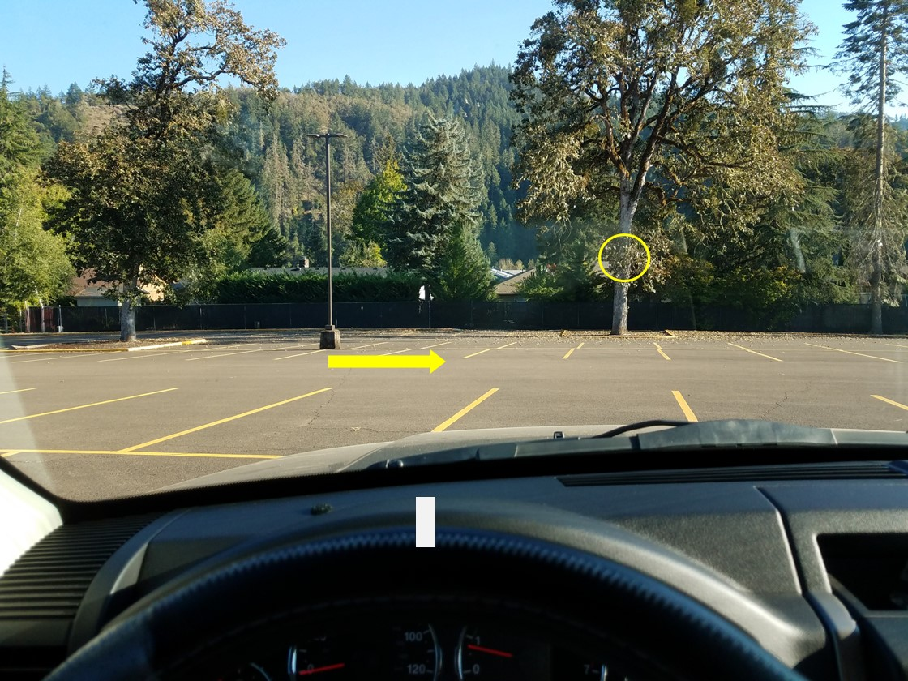
Look and steer to the right to get back on target
Notes:
Off target.
To the right, towards the target

Slide 13
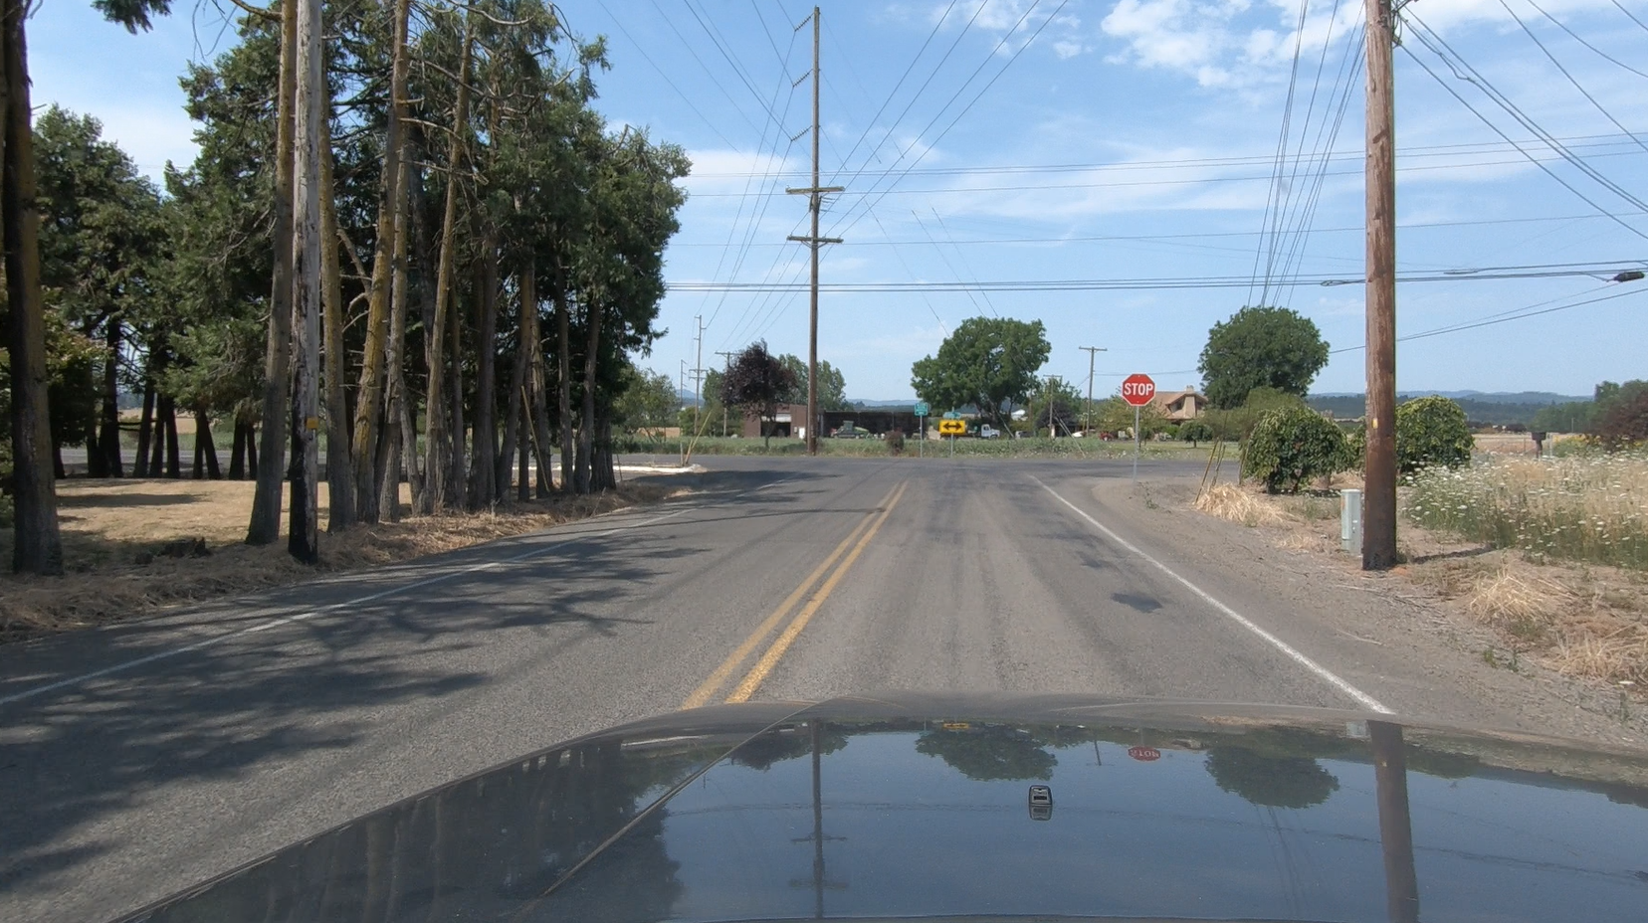
What is your target?

Slide 14
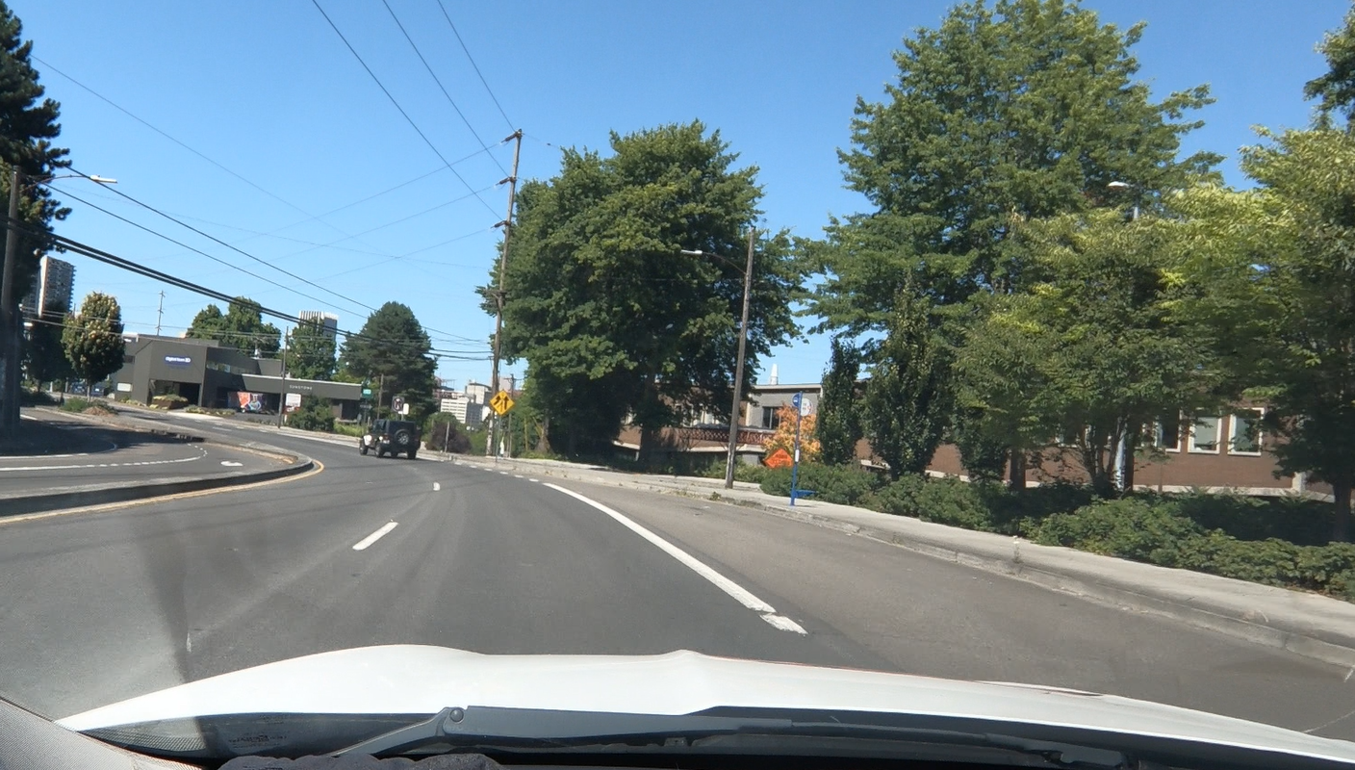
What is your target?

Slide 15
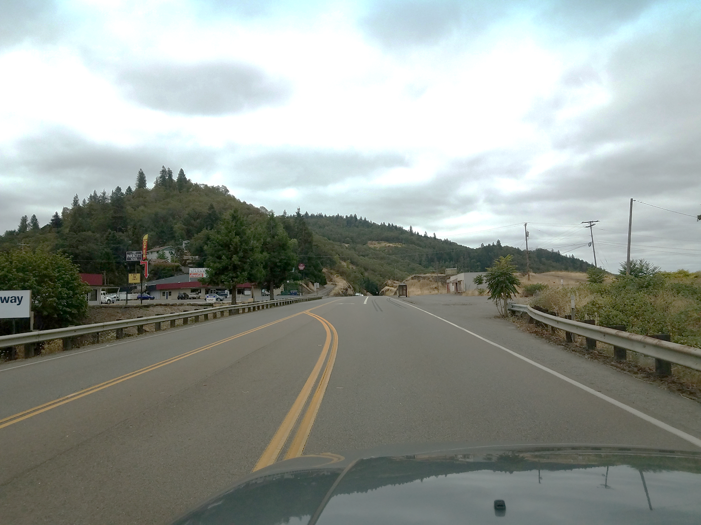
What is your target?

Slide 16
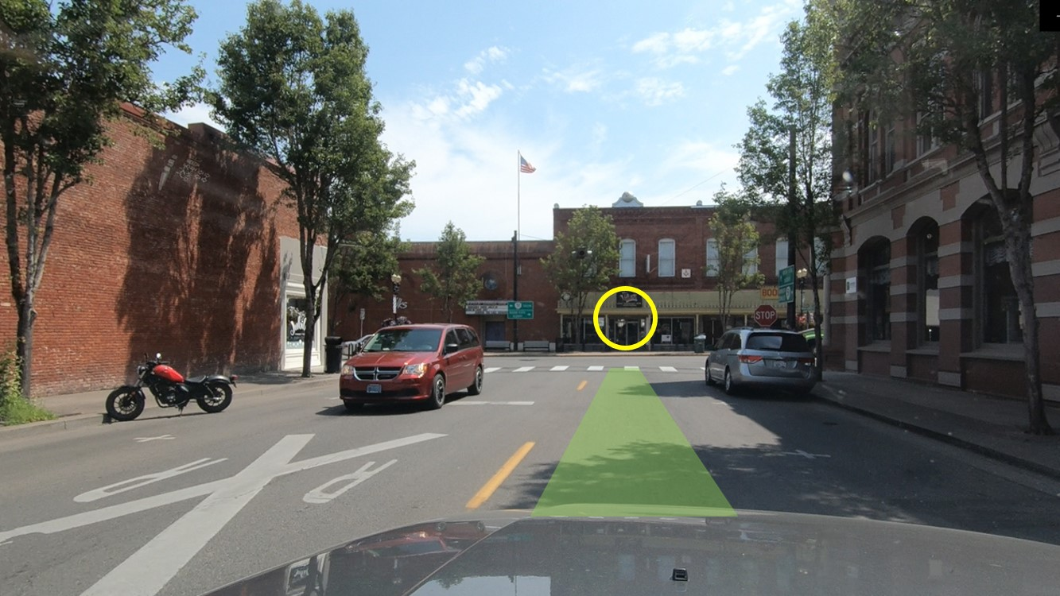
Remember, your vision leads the vehicle. Target with your central vision and see other elements with your fringe.

Slide 17
You are the Driver What is your target and what is your path?

Slide 18
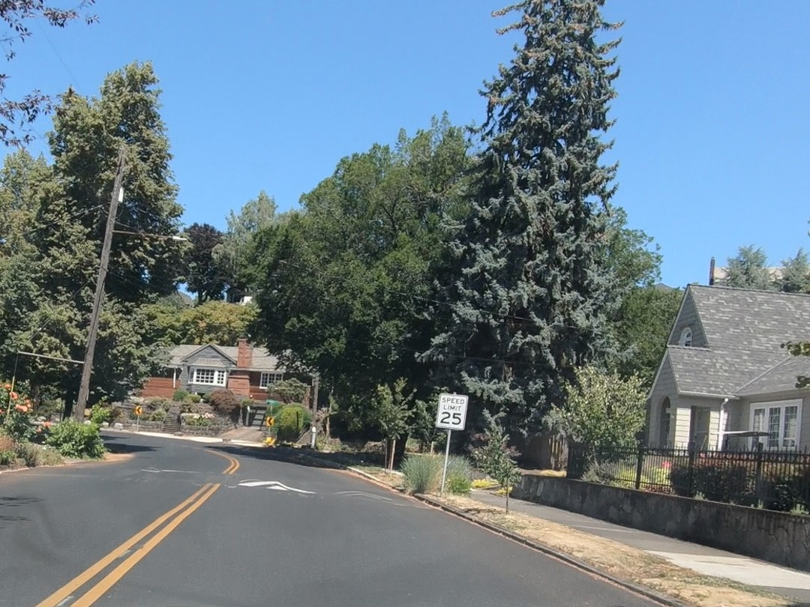
What is your target?

Slide 19
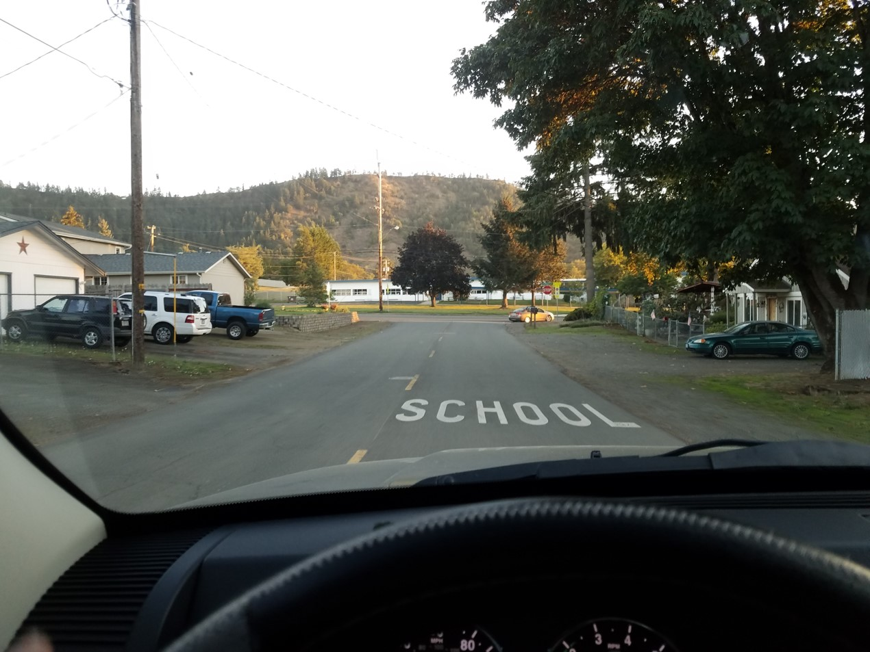
What is your target?

Slide 20
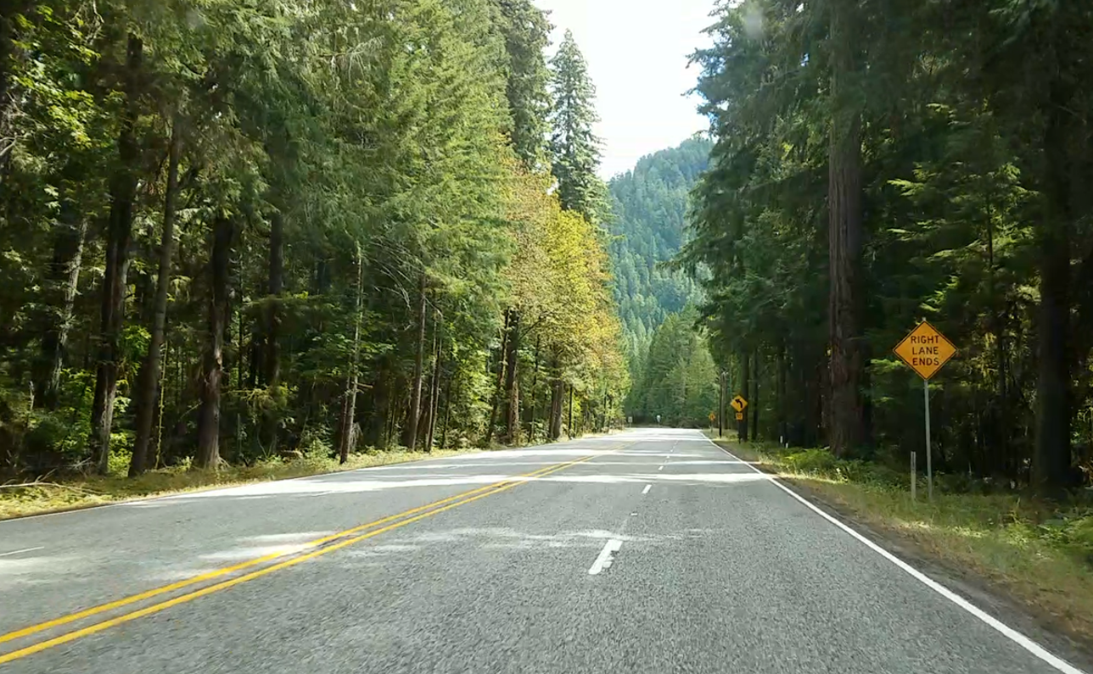
This is your path of travel
What is your target?

Slide 21
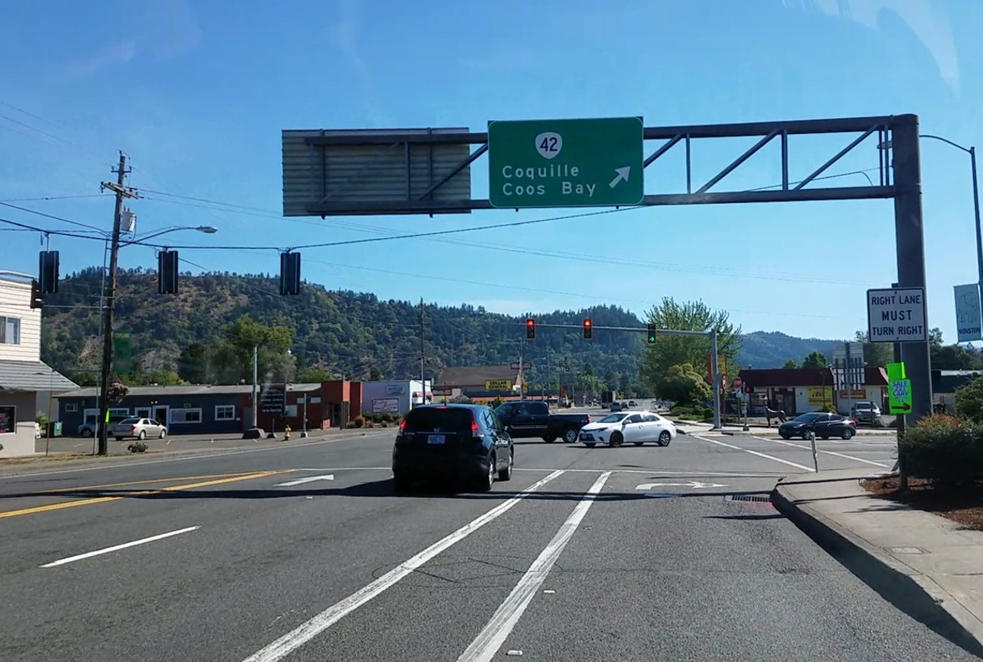
You intend to turn right. What is your target?

Slide 22
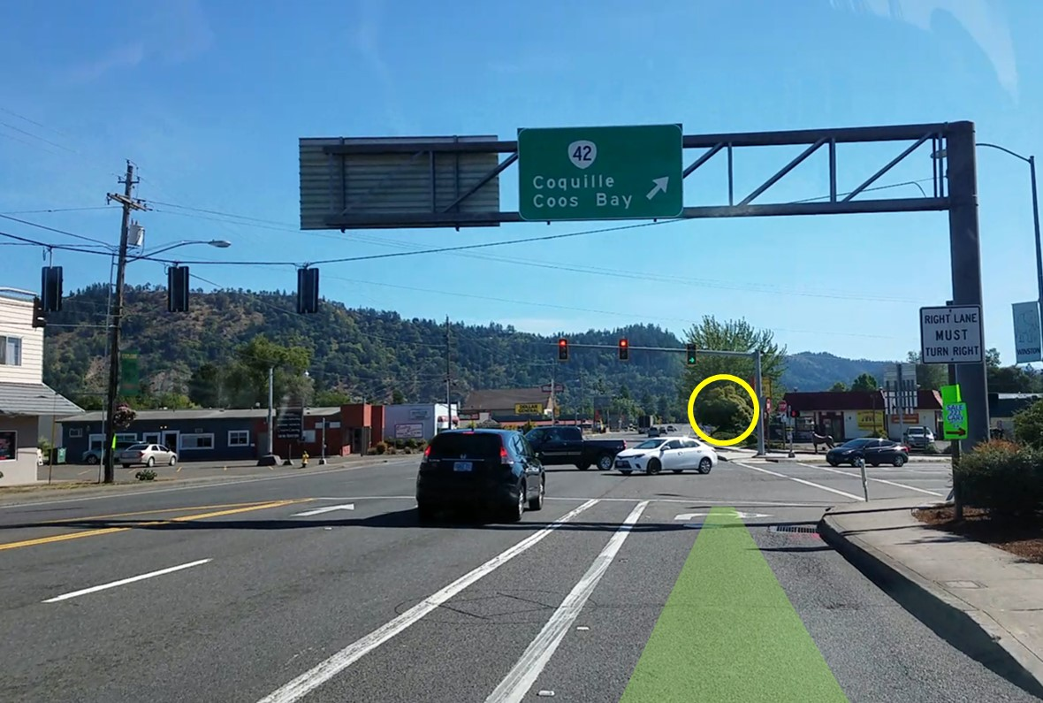
This is your path of travel

Slide 23
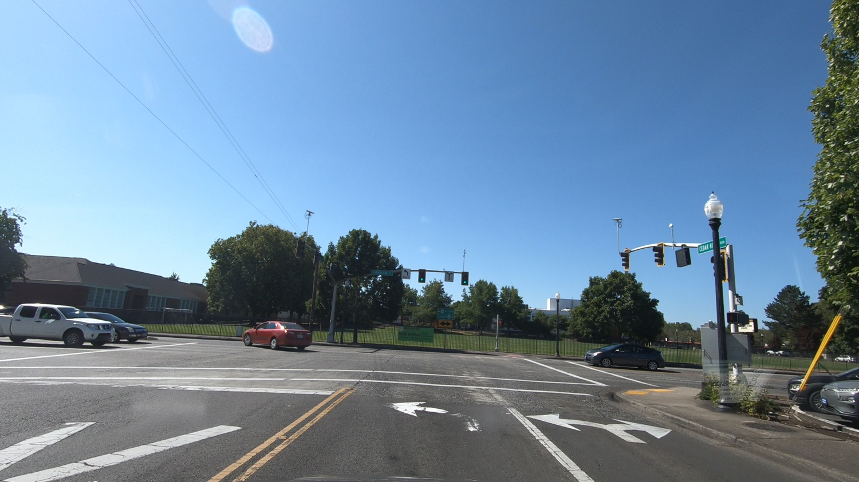
You intend to turn left. What is your target?

Slide 24
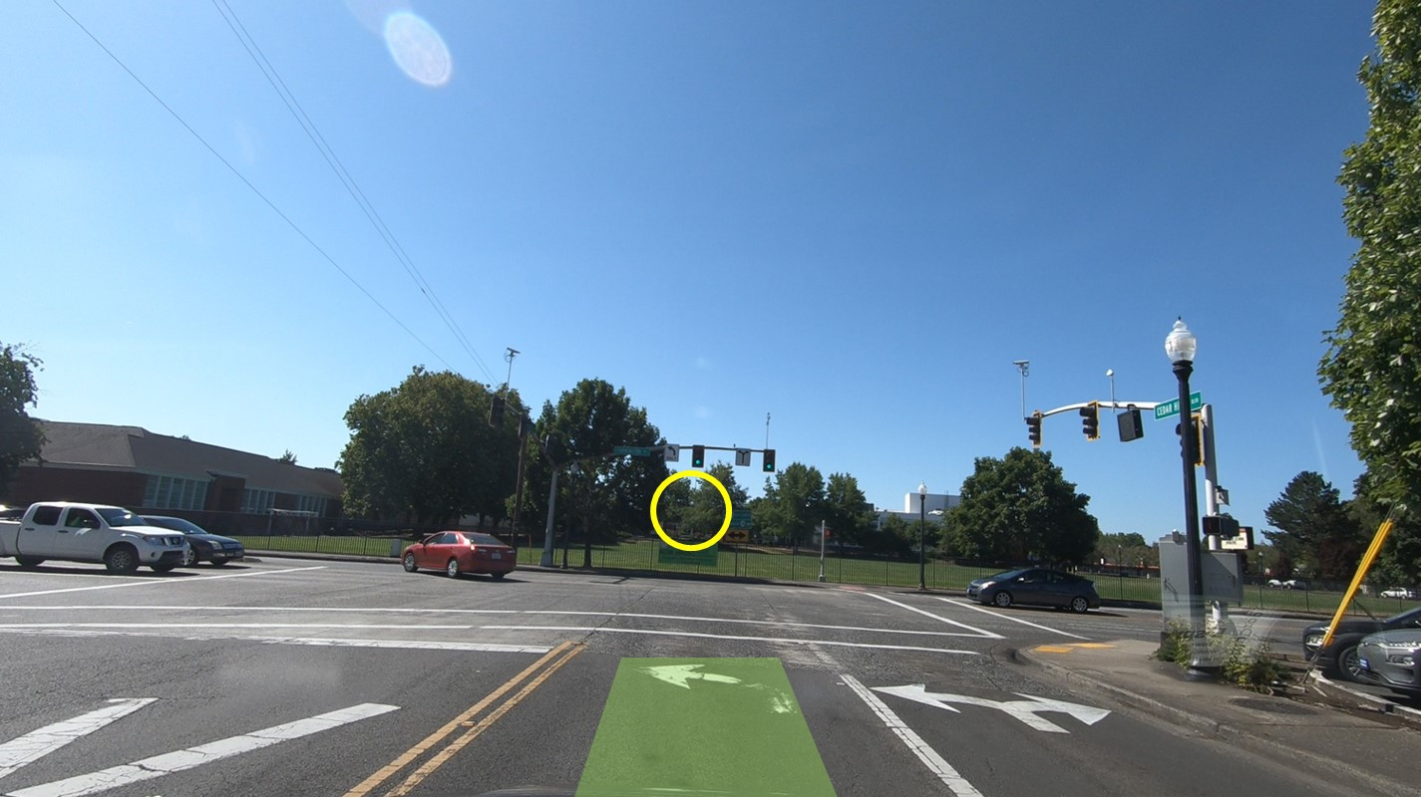
This is your path of travel

Slide 25
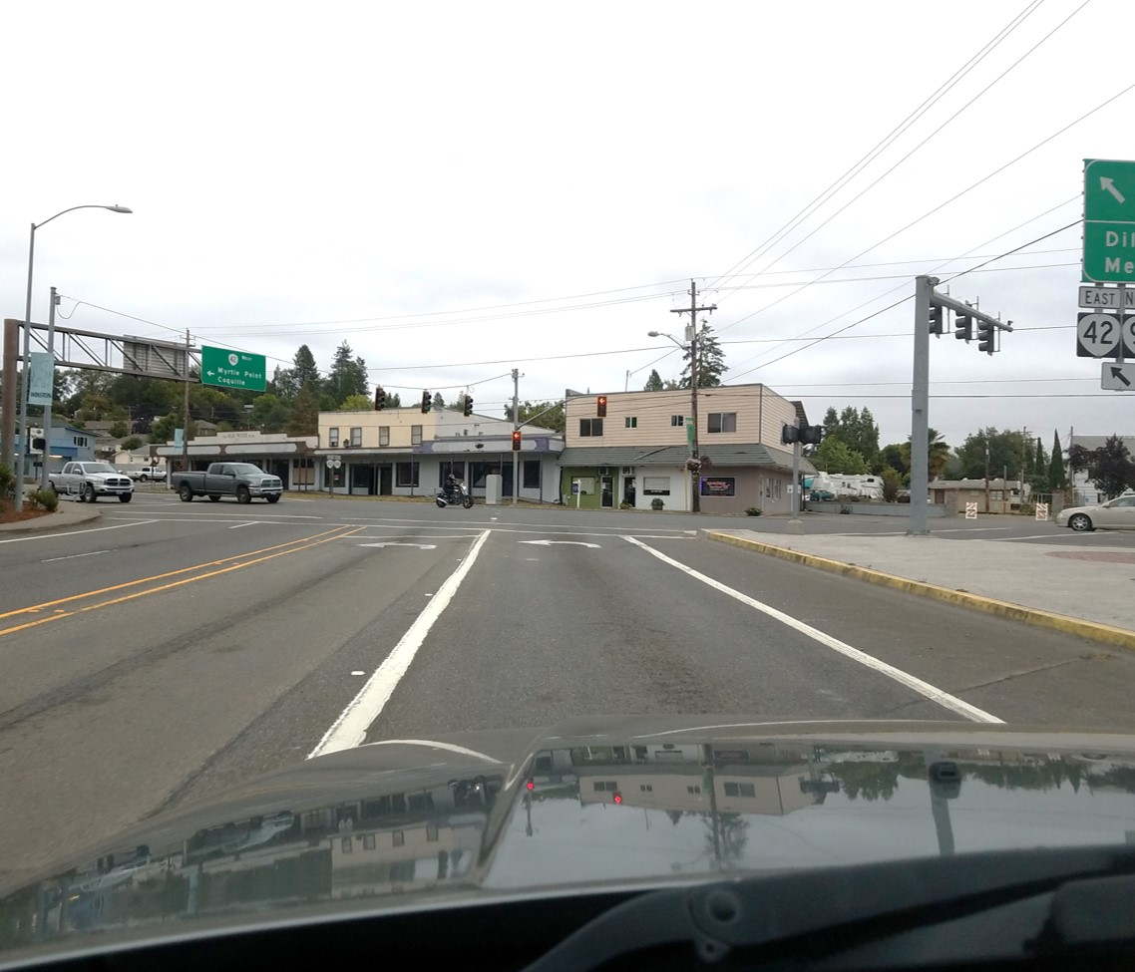
You intend to turn left. What is your target?

Slide 26
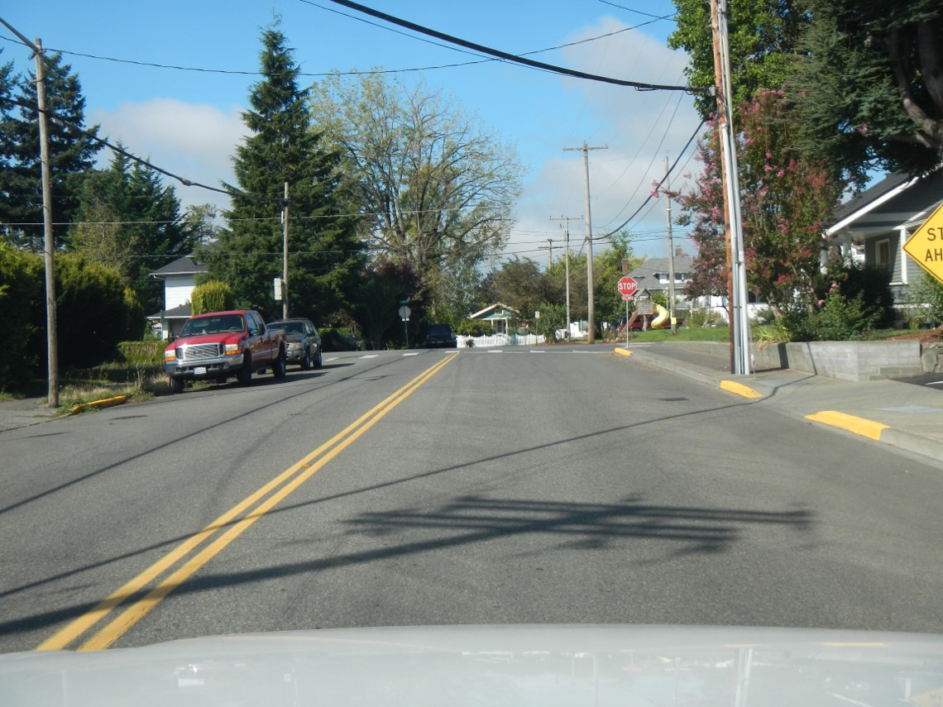
You intend to turn right. What is your target?

Slide 27
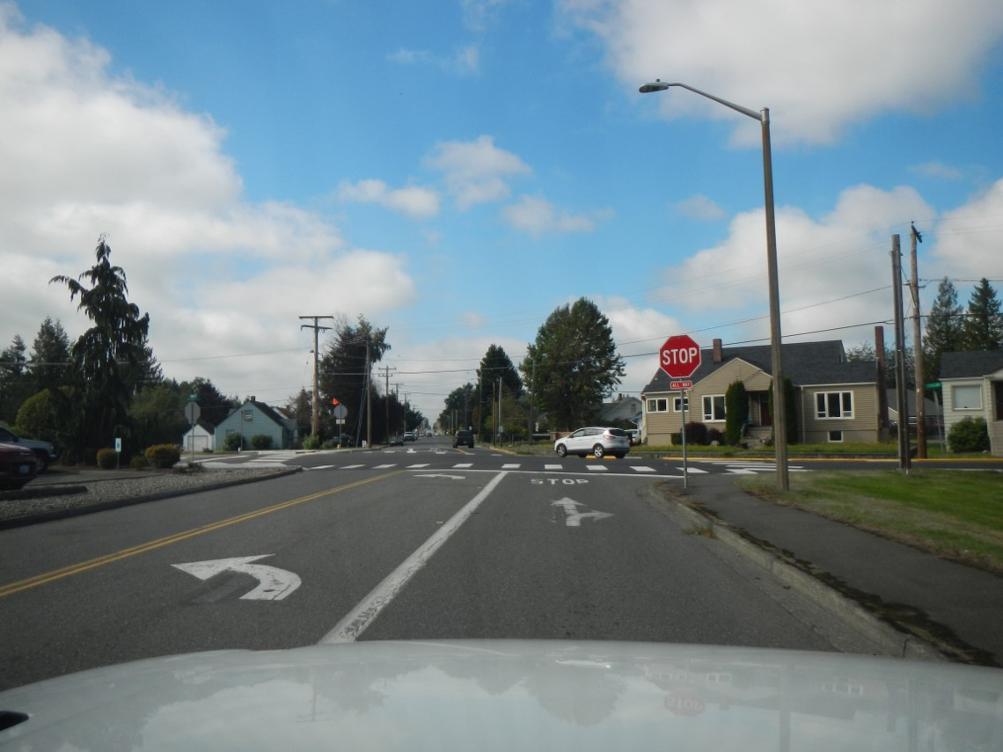
What is your target for continuing forward?

Slide 28
What is your target for turning right?

Slide 29
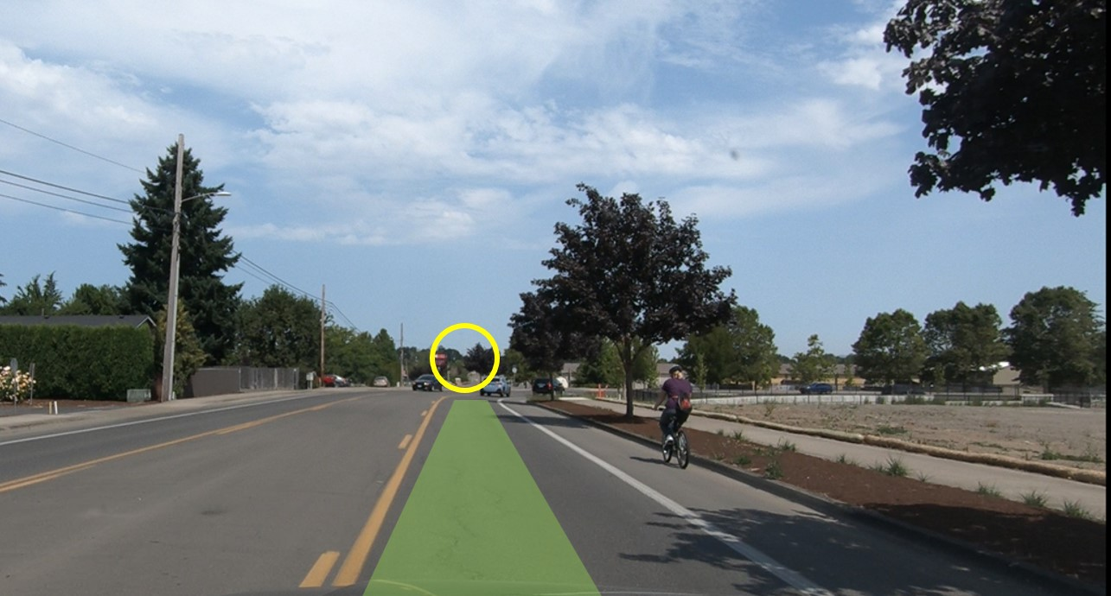
Remember, target with your central vision and see other elements with your fringe.

