Slide 1
Backing Turns and Pivot Point

Slide 2
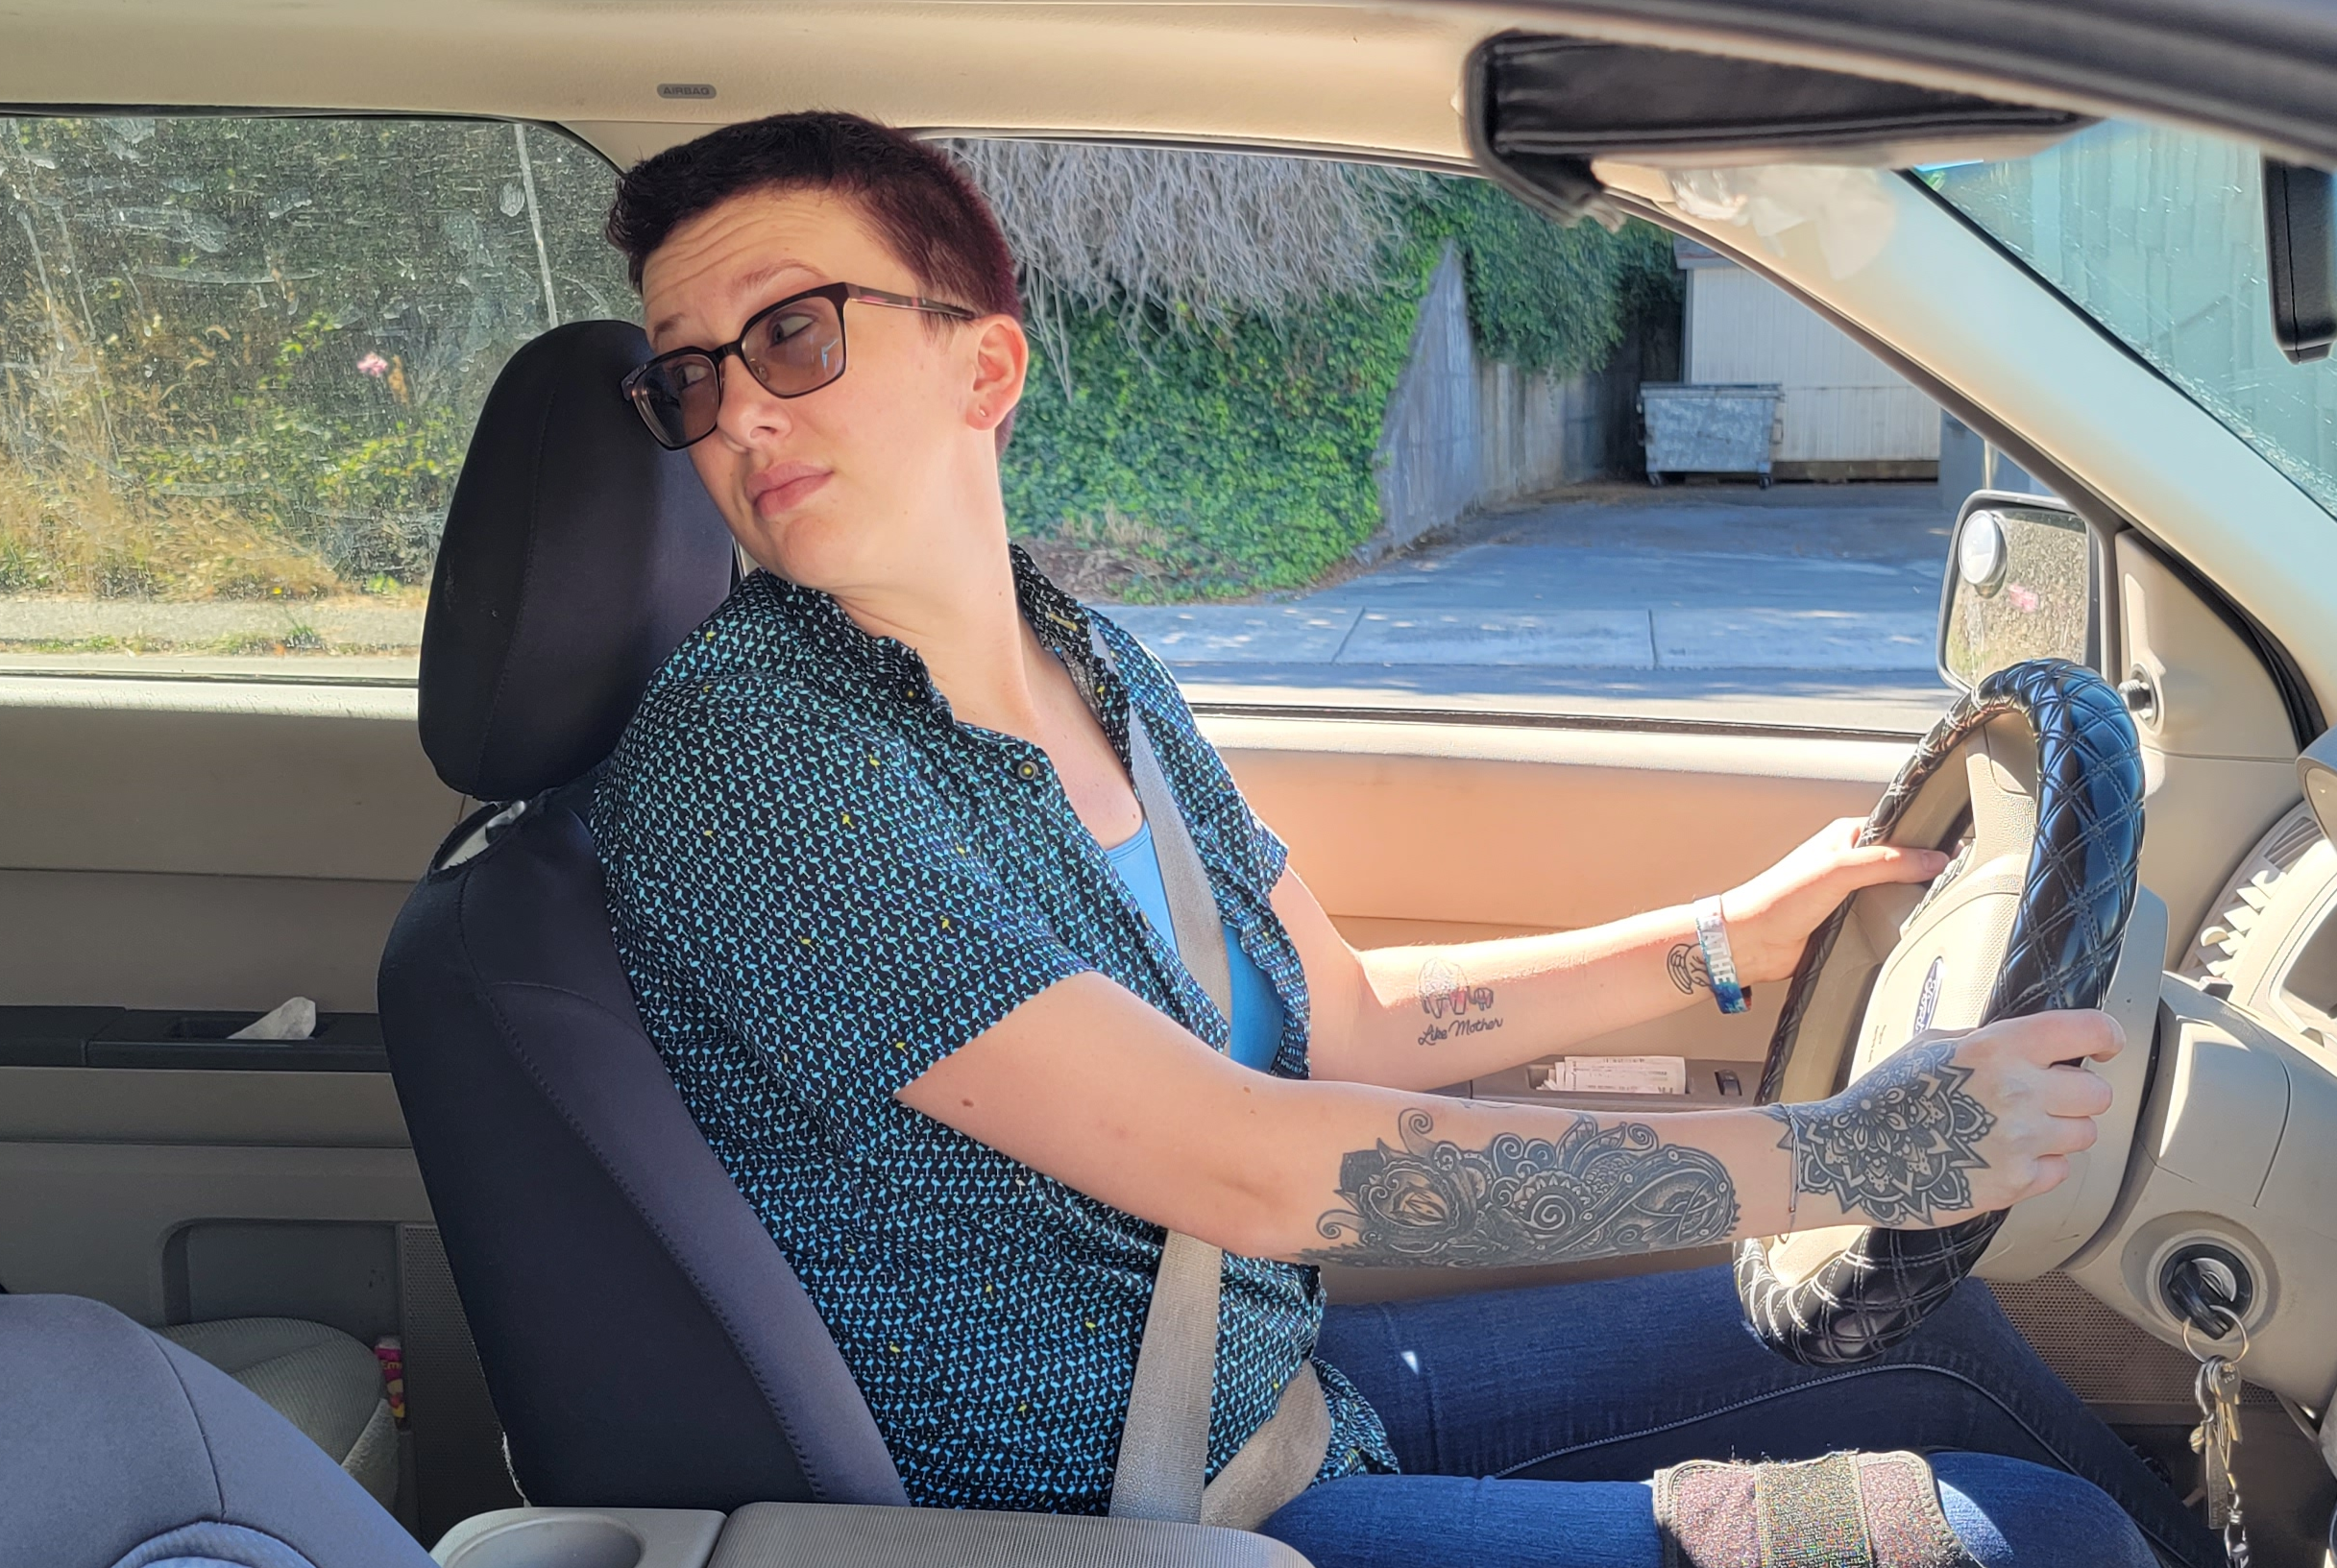
Backing Turns
Turn Head – Look to target area before turning the wheel.
Use two hands on the wheel.
Where is your target when backing to the left?
Where is your target when backing to the right?

Slide 3


Backing Turns
Turn the wheel in the direction you want the back of the car to move.
Check front swing to be certain that the front of the vehicle does not contact anything.

Slide 4

Pivot Point for Backing Turns
That point directly above the center of the rear tire

Slide 5
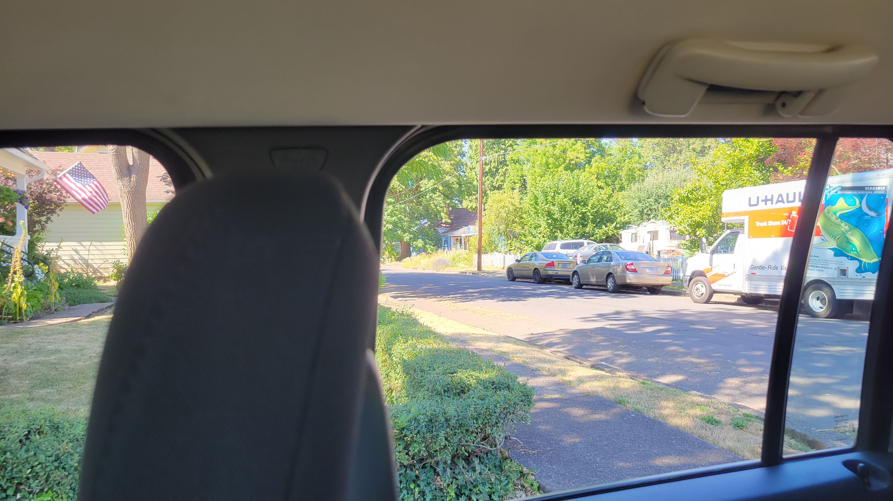
Pivot Point
When the nearest edge of your intended lane aligns with the pivot point, begin to turn the wheel
Notes:
Looking over the right shoulder across the rear corner post/blind spot the curb appears to align with pivot point – begin turning wheel to the right.

Slide 6

Reference Point = Pivot Point
rear corner post

Slide 7

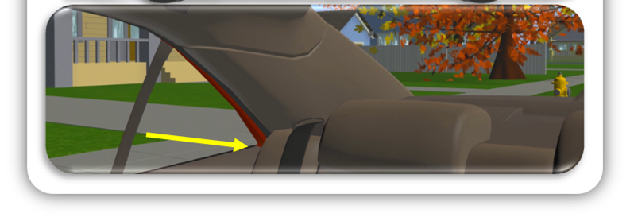
Reference Point = Pivot Point

